Slide 1
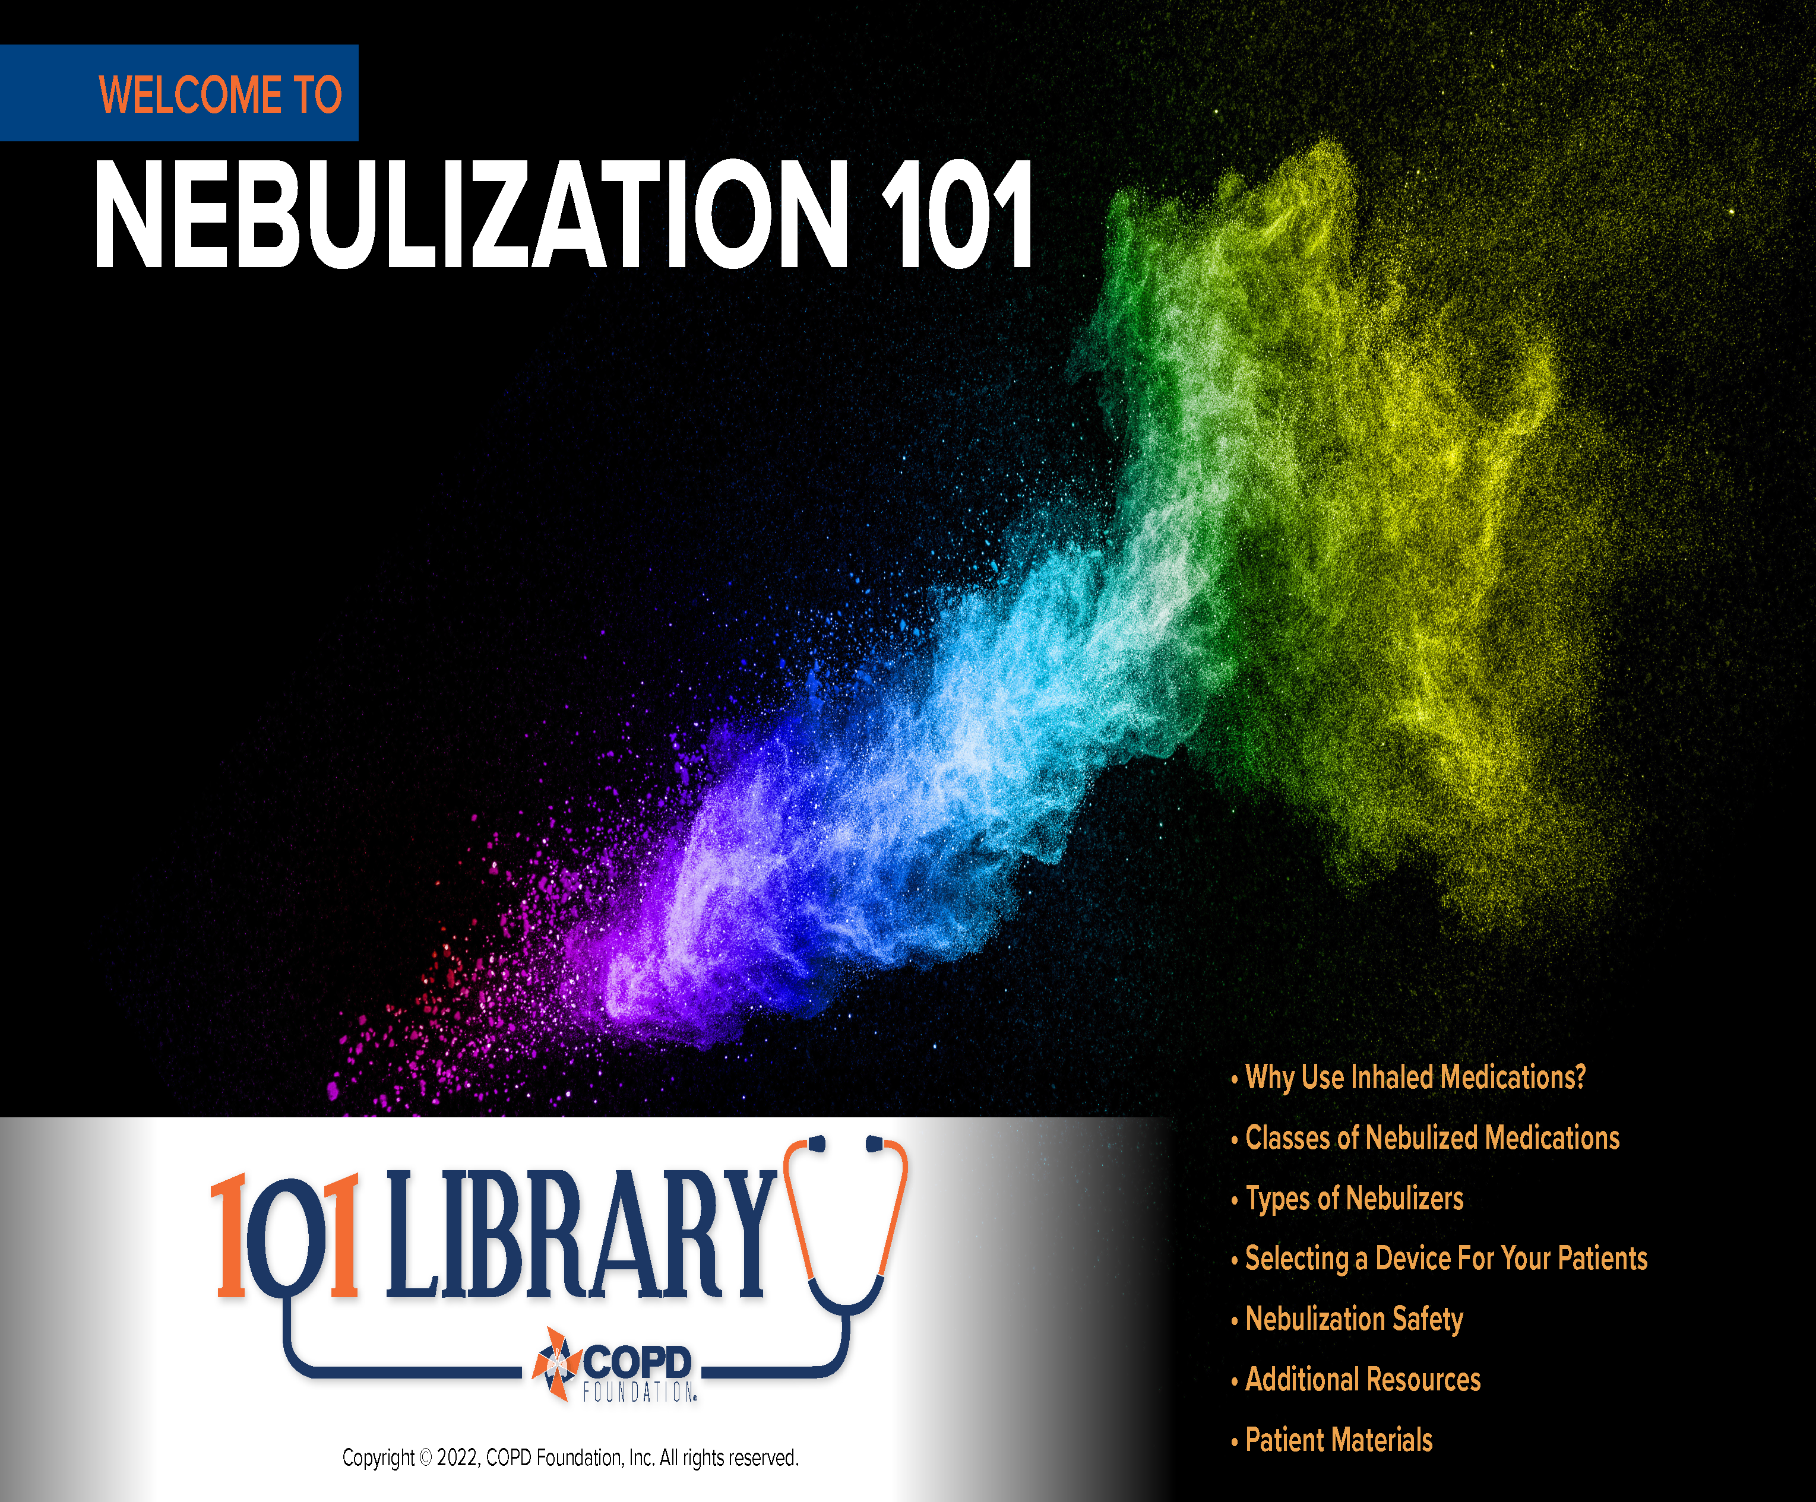
Notes:
Welcome! This presentation is intended to provide an overview of key points of the use of nebulized medications for COPD therapy. In addition, we have provided resources for supplemental learning as well as patient materials to facilitate communication and discussion (particularly among the newly-diagnosed).
We hope these materials are of benefit to you and your practice. Please contact us at info@copdfoundation.org with comments, questions, or concerns.
Copyright © 2022, COPD Foundation, Inc. All rights reserved.

Slide 2


Slide 3
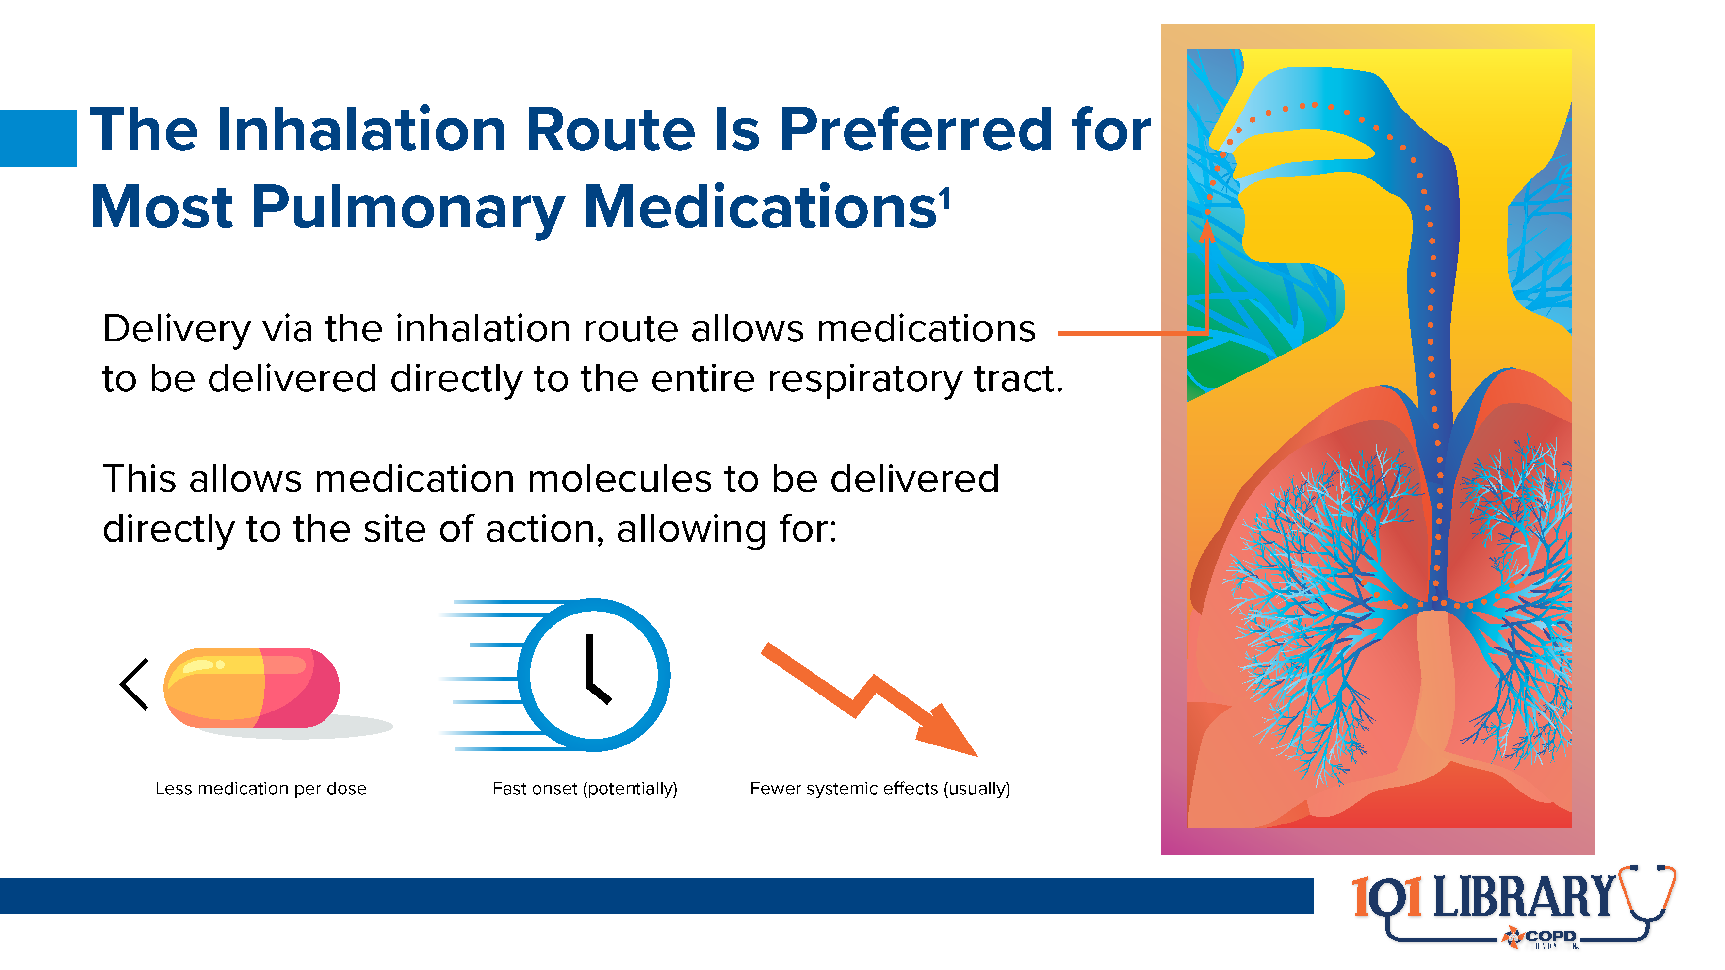
Notes:
Inhaled medications are generally considered front-line therapies in COPD and similar respiratory conditions. As these drugs can be delivered directly to the cells of the airways and lung parenchyma, their concentrations can be lower than other drugs that must survive digestion or enzymatic processes before reaching their target organ system. This direct delivery also enables faster onset of action. In addition, since most of the medication remains in the respiratory tract rather than entering the circulatory system, there is much lower risk of systemic effects.

Slide 4
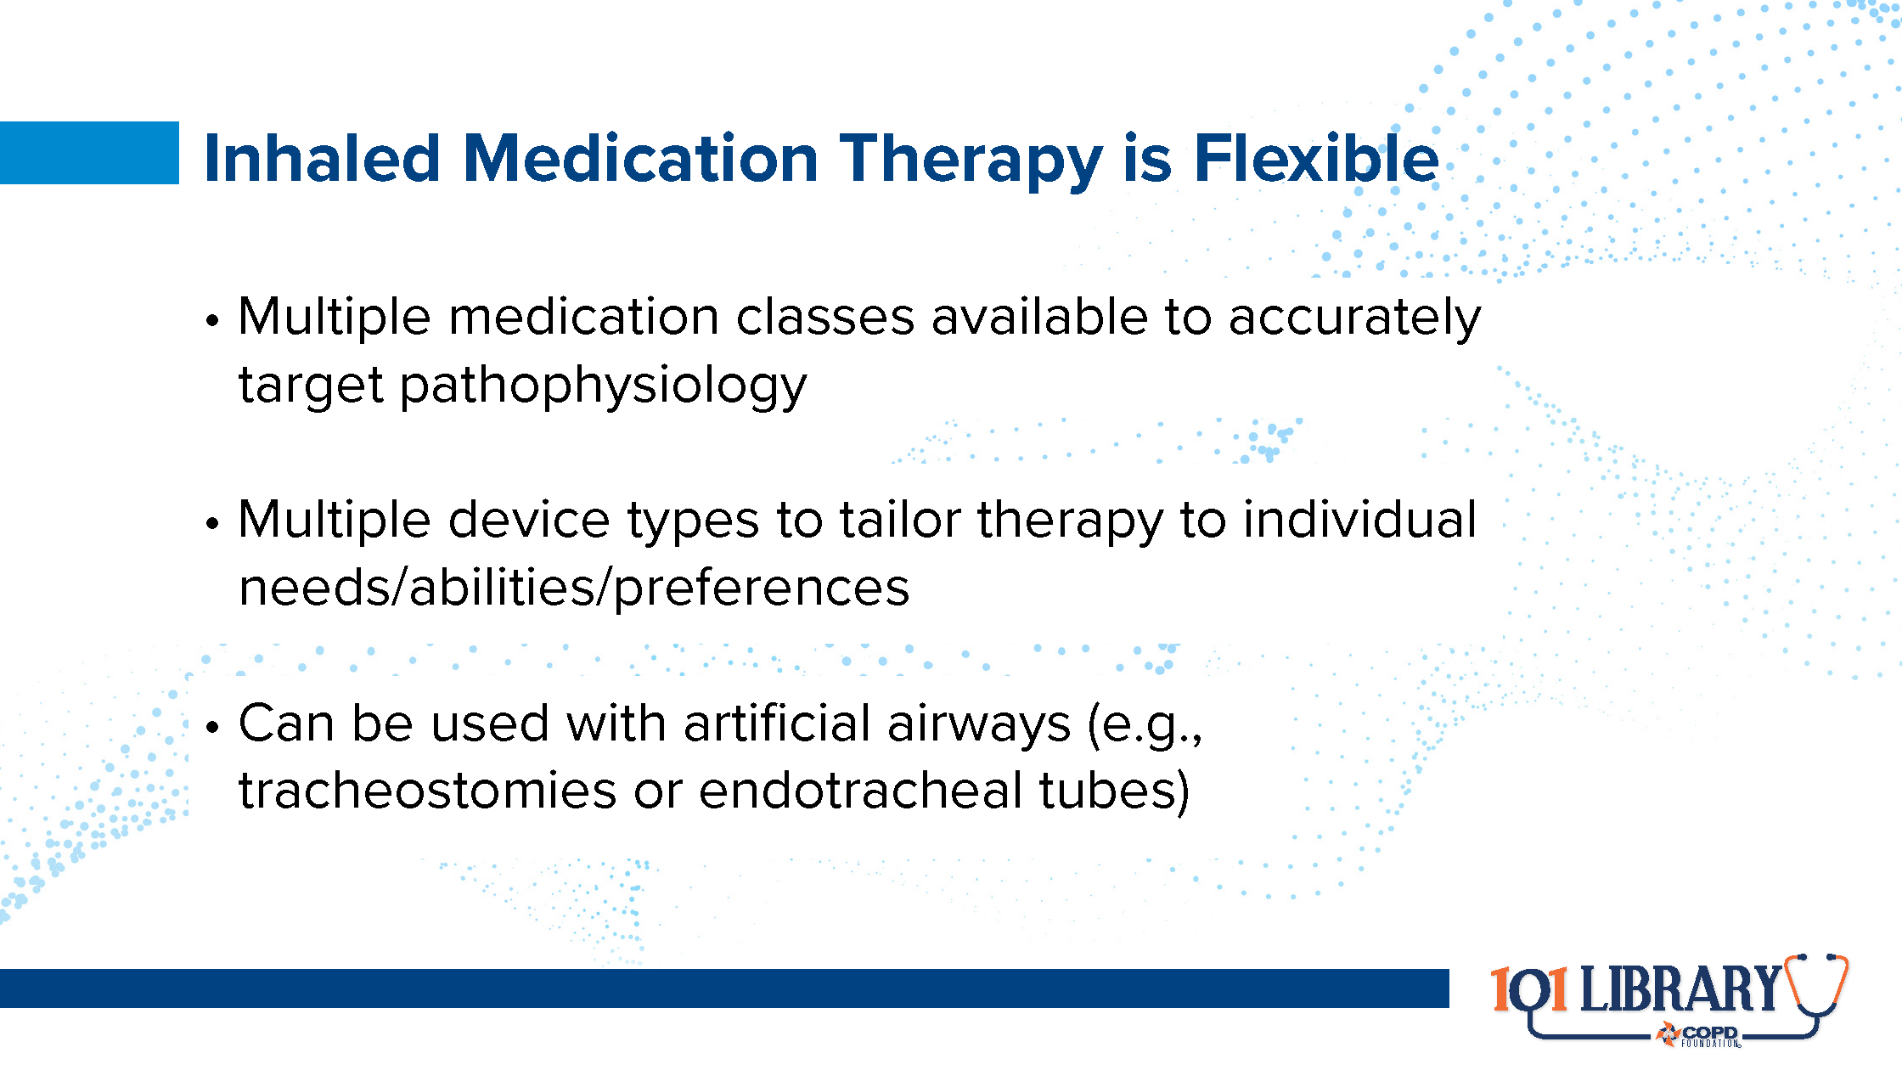
Notes:
There are multiple classes of medications available to address the complex pathophysiology of COPD and associated lung diseases. Some address airway caliber, some address inflammation, some modify mucus production. There are even inhaled antibiotics available. In addition, the inhalation route enables medication delivery via a variety of devices. The use of pressurized metered dose inhalers (pMDIs), dry powder inhalers (DPIs), soft mist inhalers (SMIs), and of course nebulizers allows therapy to be tailored to individual needs and preferences.
Finally, inhaled medications are generally compatible with artificial airways. This allows some continuity of therapy regardless of care venue or change in patient condition.

Slide 5
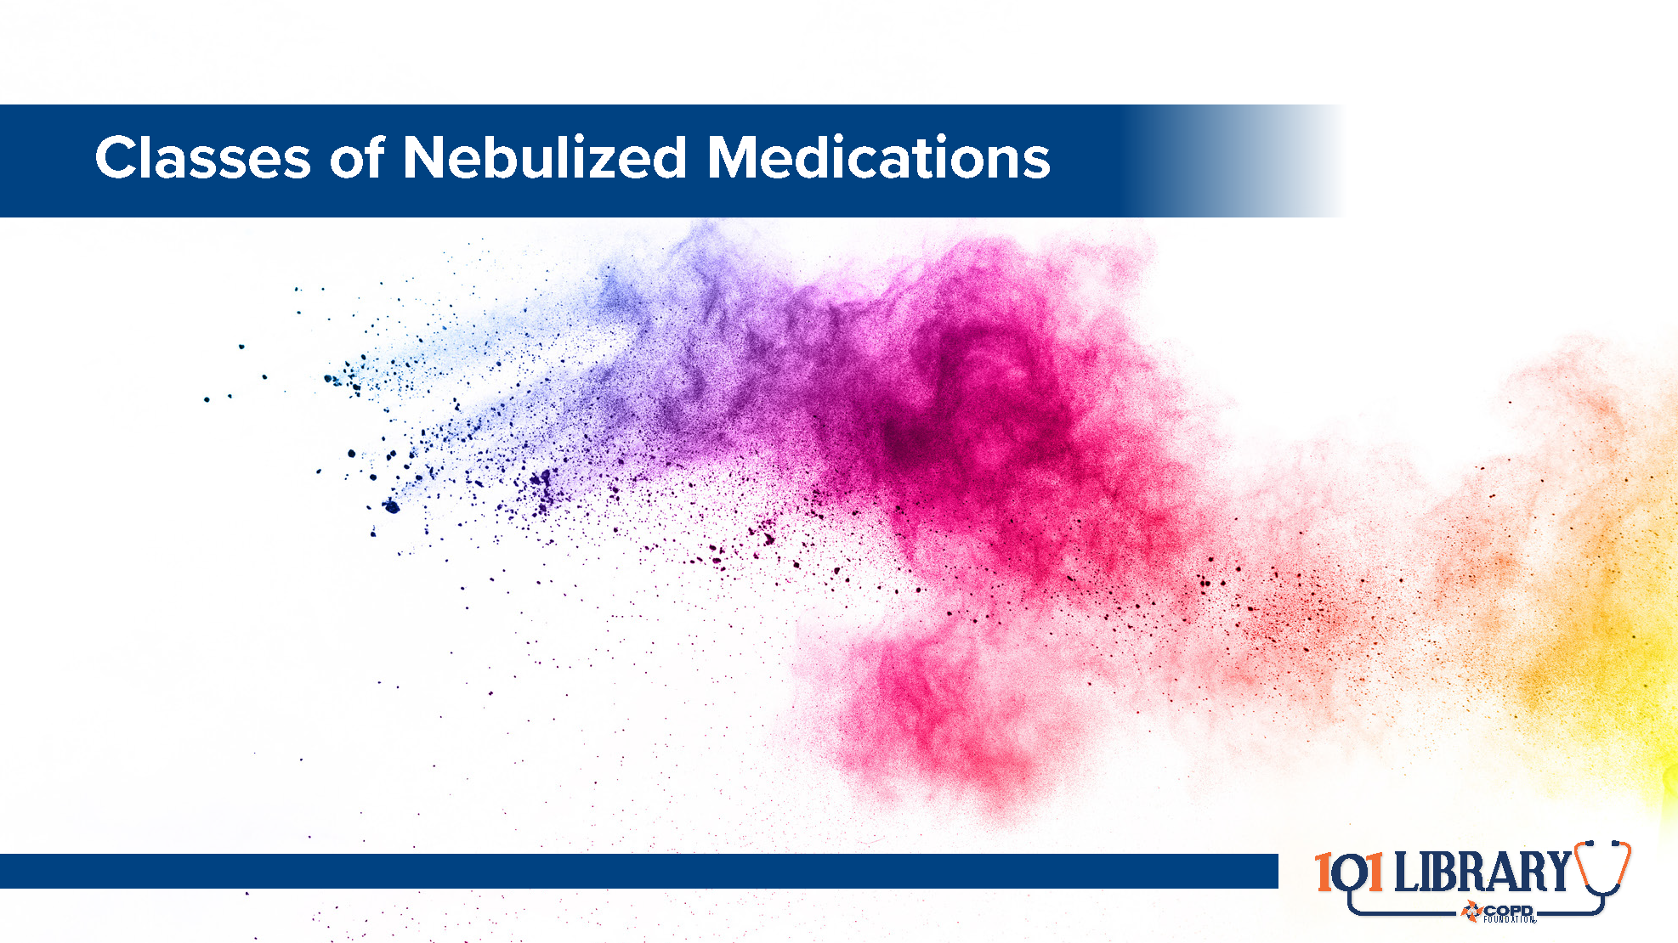

Slide 6
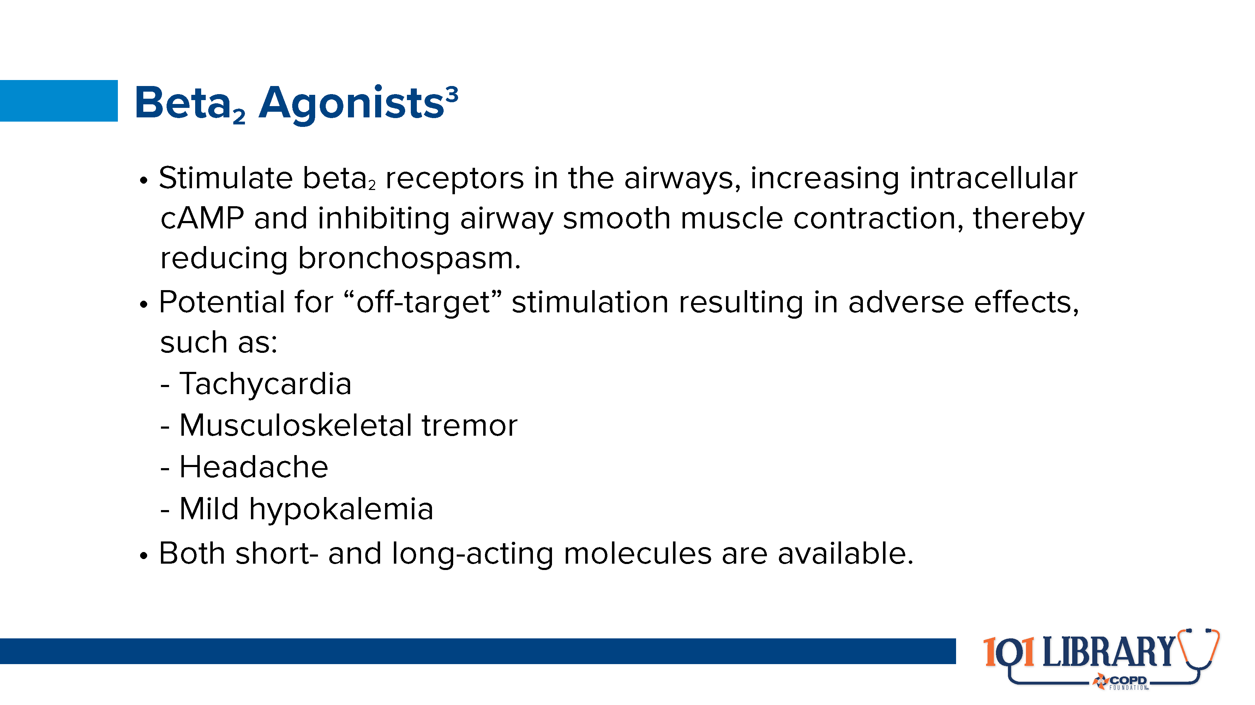
Notes:
Adrenergic medications have been a mainstay of pulmonary therapy since epinephrine was first obtained from the adrenal gland in the early 20th century. However, epinephrine and its earliest derivatives had very broad spectrum effects, leading to adverse effects across a variety of organ systems. Research in the second half of the century lead to the isolation of the alpha₁, alpha₂, beta₁, and beta₂ classes of adrenergic receptors, and allowed the development of more precisely-targeted molecules. The potential for non-airway receptor triggering does still exist, so clinicians must remain vigilant.
Modern beta₂ agonists are available in short-acting (sometimes called “rescue” or “reliever”) formulations for quick relief of intermittent symptoms, as well as long-acting (sometimes called “controller” or “maintenance”) varieties. This allows personalized tailoring of therapy plans to optimize symptom burden.

Slide 7
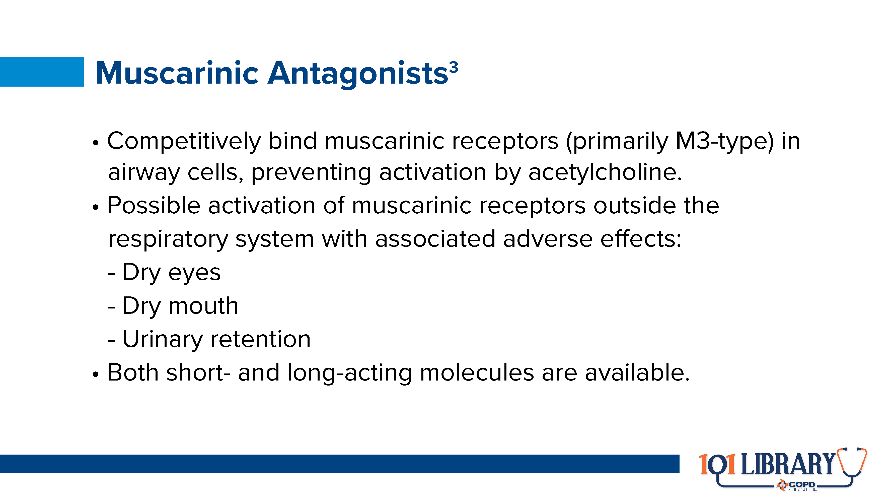
Notes:
Similar to the beta₂-agonist class, muscarinic antagonists have a long history of use. Judicious use of extracts from plants such as nightshade or datura has been relieving airway symptoms for centuries, although use declined somewhat with the rise of selective beta₂-agonists. Once again, research has led to an improved understanding of dosages and receptor-specific targeting, and the use of muscarinic antagonists is commonplace. Here again clinicians must be knowledgeable of potential adverse effects, as even modern muscarinic antagonists may have some spill-over to other systems.

Slide 8
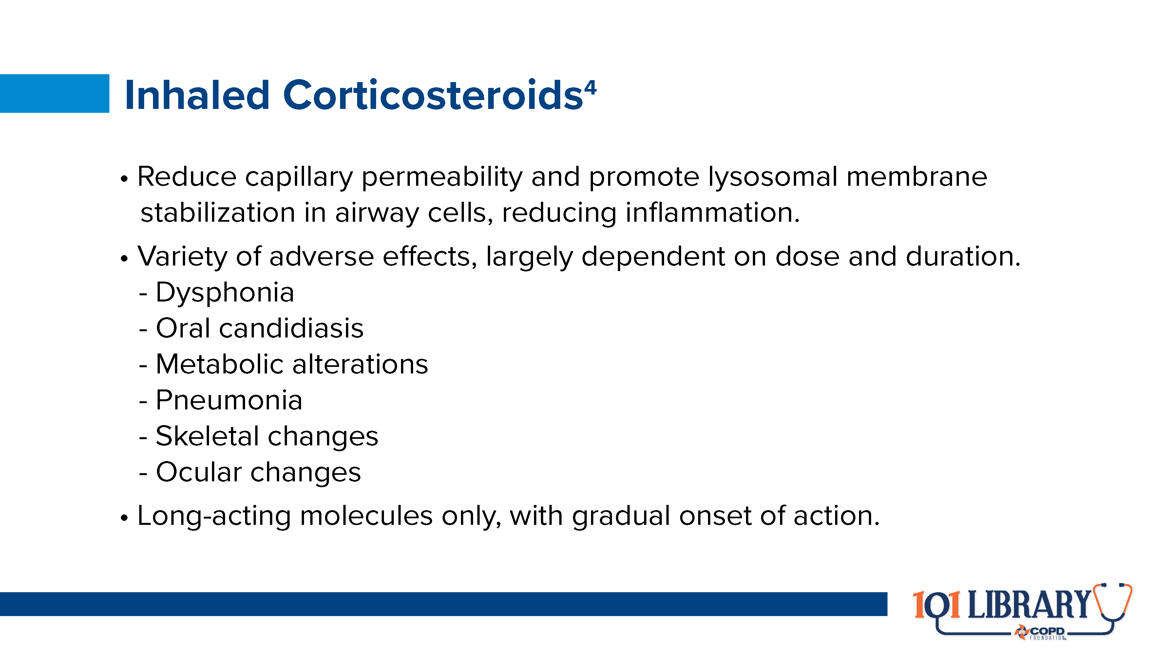
Notes:
After their development in the early part of the 20th century, inhaled corticosteroids rose to prominence through asthma therapy recommendations Their anti-inflammatory effects can be of benefit in several other respiratory pathologies (including some phenotypes of COPD), but they are often seen to have a more concerning risk profile. Inhaled corticosteroids can alter microbiomes in the upper and lower airways, potentially leading to colonization by Candida albicans (a condition commonly known as thrush) and associated oropharyngeal issues. Thus, the mouth should be rinsed after any use of these medications. Long-term use of inhaled corticosteroids has also been associated with some elevated risk of osteoporosis (and delayed growth in younger patients). Some inhaled corticosteroid molecules have also been associated with an increased risk of pneumonia in COPD.⁵

Slide 9
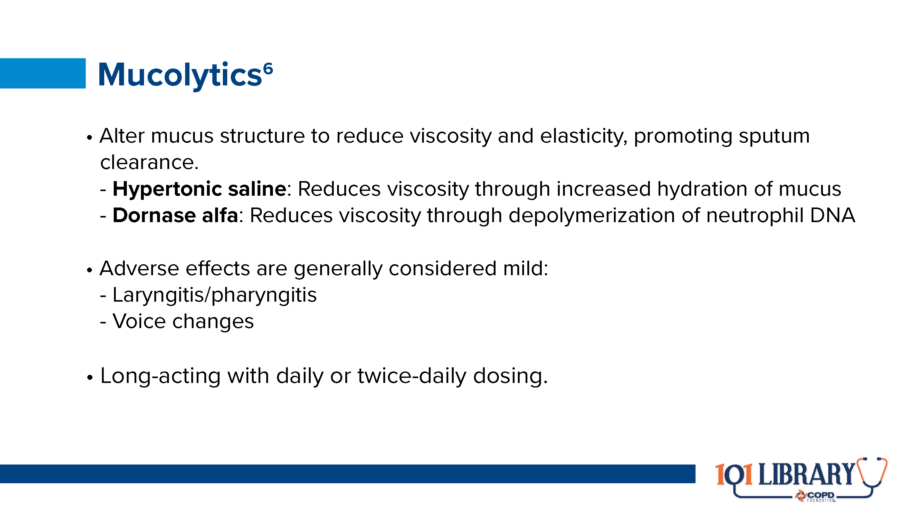
Notes:
Mucolytics are relative newcomers to the scene and are best known for use in conditions like cystic fibrosis. Their mechanisms of action may vary, but their consistent function is to improve cough and sputum clearance through the thinning of airway mucus. Other mucolytics are available in oral formulations for cases in which the nebulized options are insufficient.

Slide 10
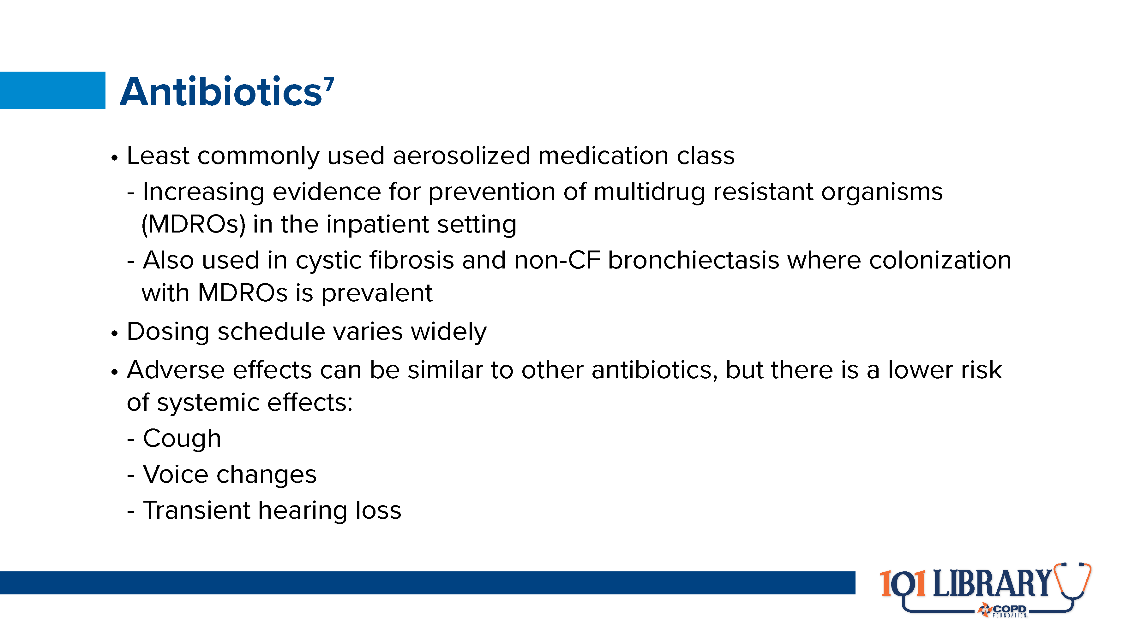
Notes:
Antibiotics are relatively uncommon in most chronic respiratory conditions, but they do have a role to play. Their biggest advantage is reduced risk of systemic adverse effects while addressing stubborn pathogens.

Slide 11


Slide 12
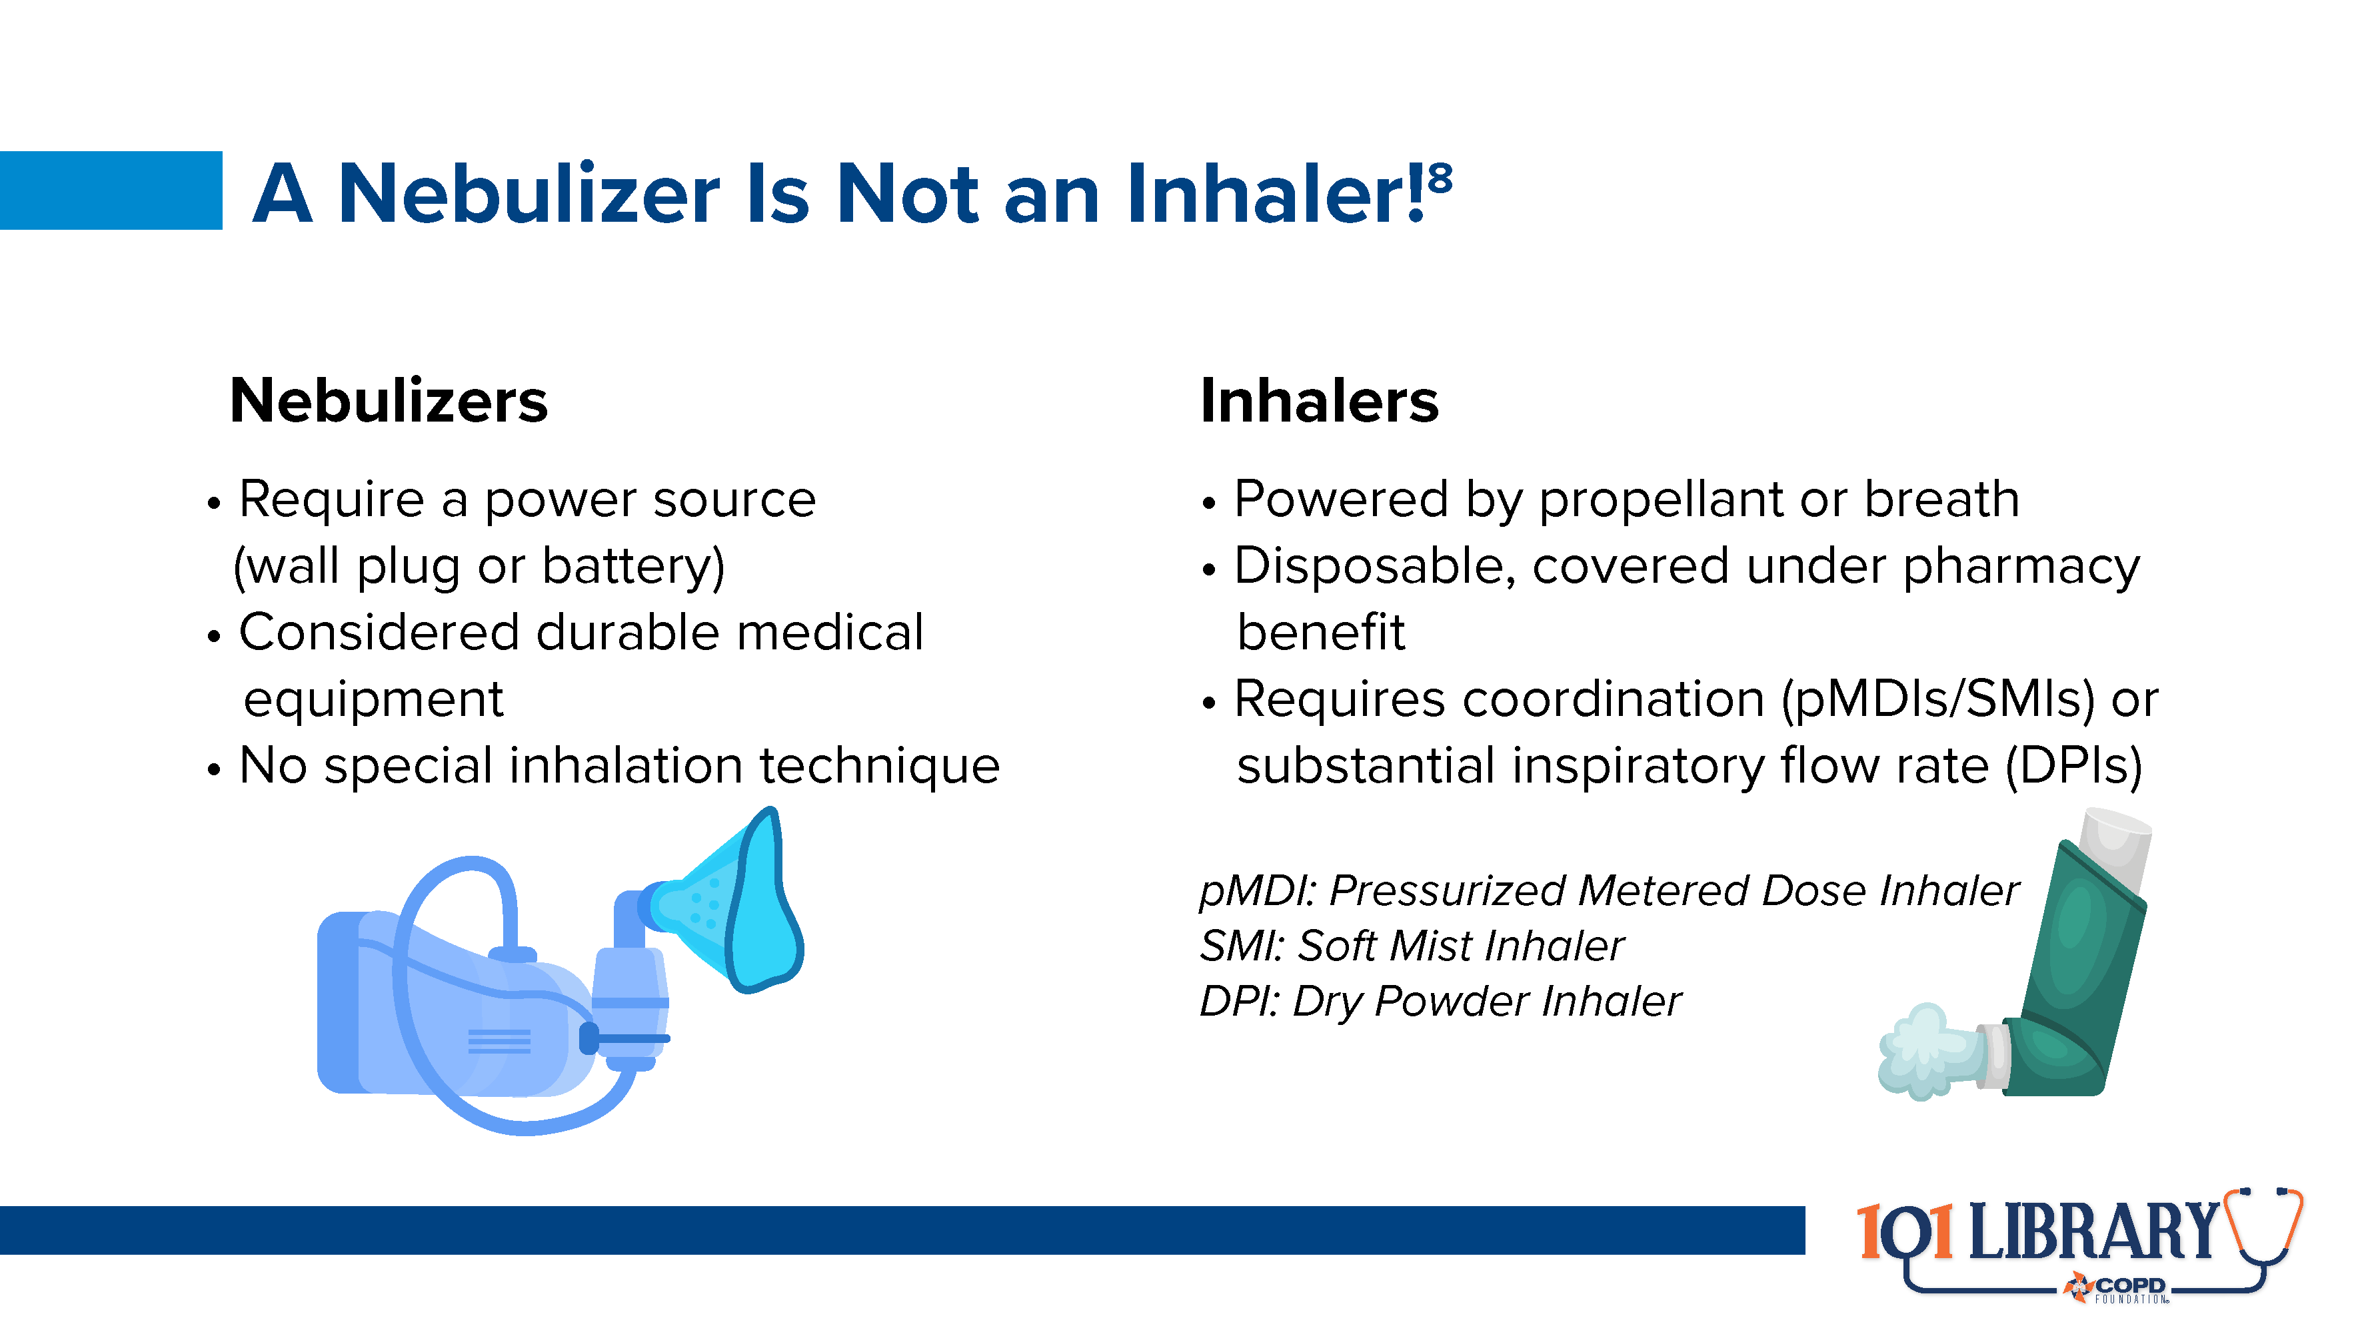
Notes:
This may seem obvious, but there is room for significant confusion when discussing these devices with patients. Because of the key differences between these classes of devices, it is important that any potential confusion (in thought or communication) be minimized. In addition, understanding the differences between inhalers and nebulizers allows both patients and clinicians to select therapies that best fit individual needs, abilities, and goals.

Slide 13
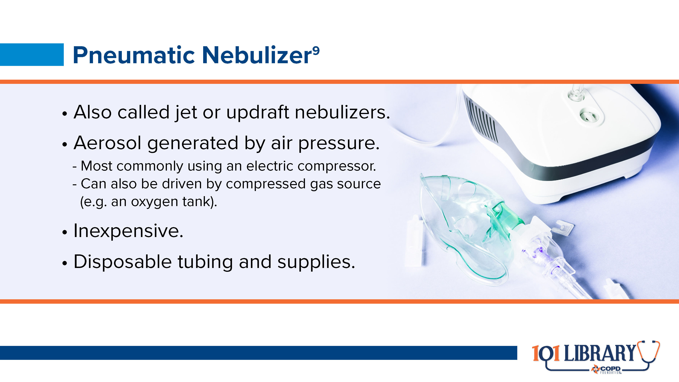

Slide 14
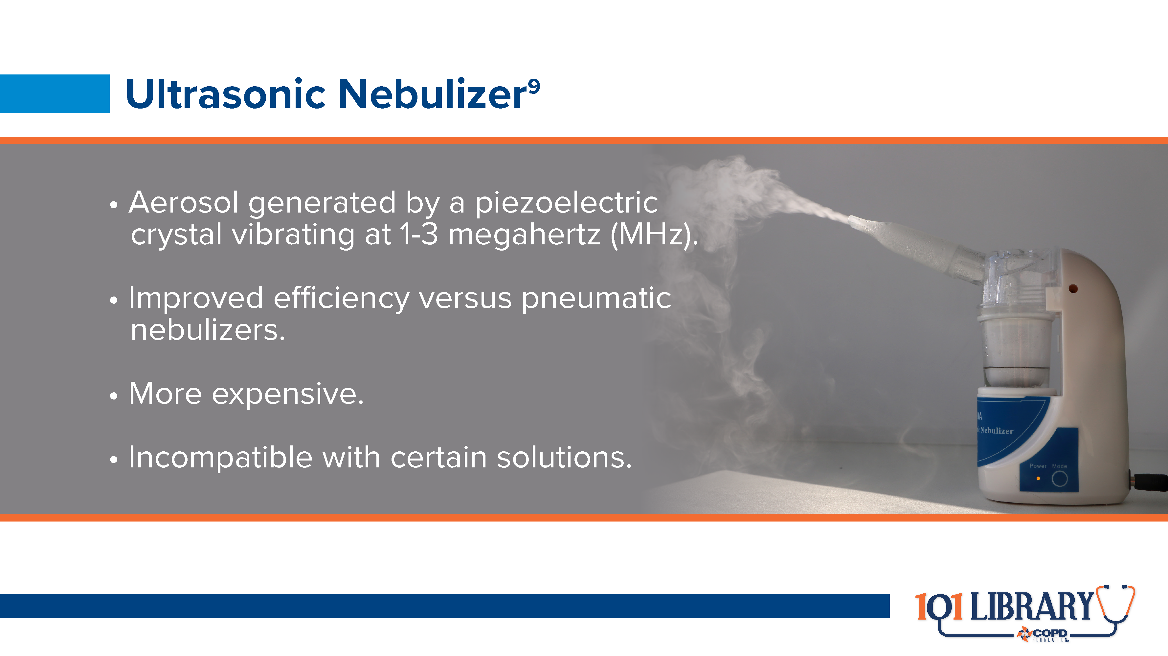

Slide 15
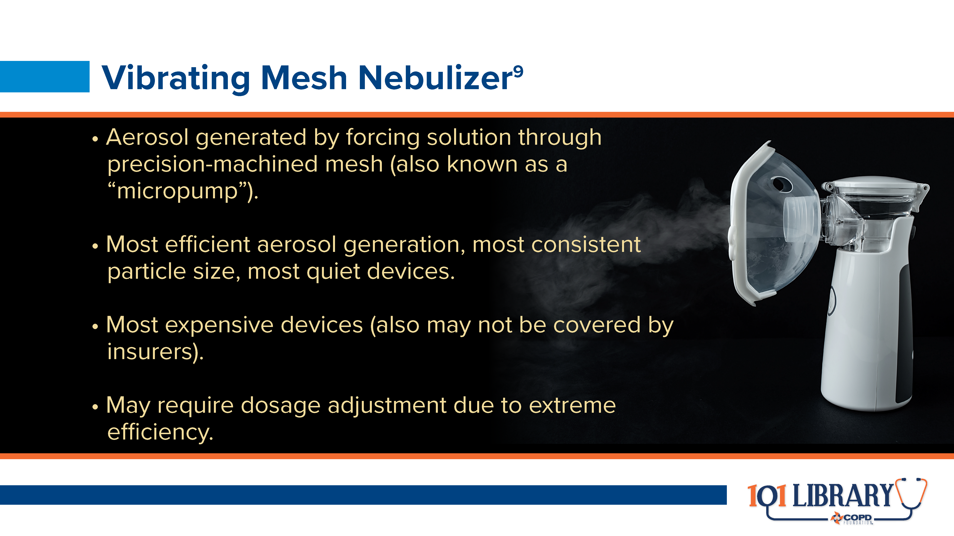

Slide 16


Slide 17
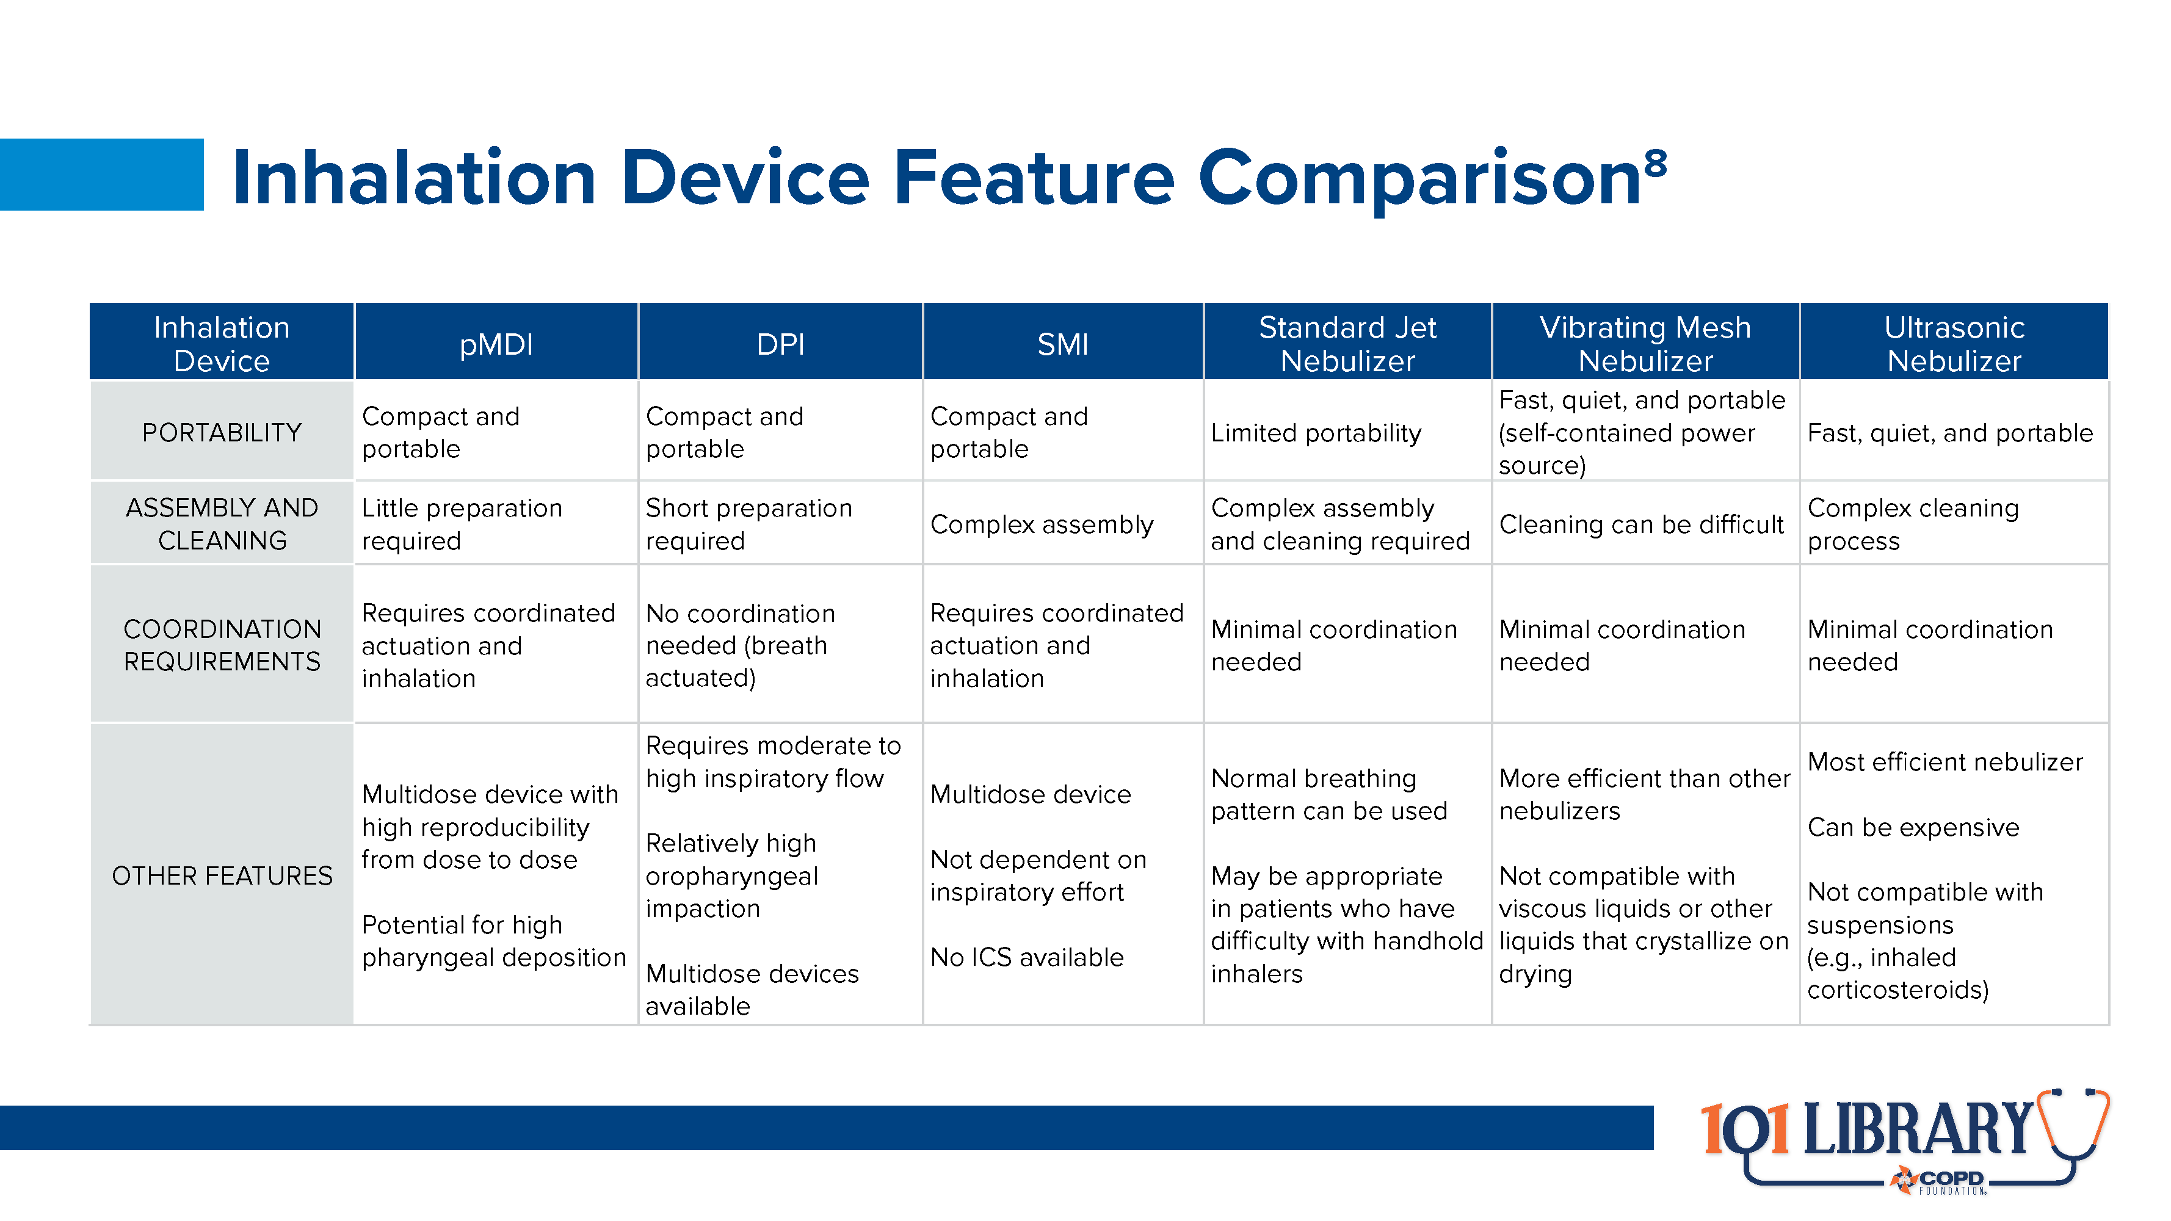
Notes:
There are a variety of other inhalation devices on the market as well. This chart provides a comparison of inhalers with the nebulizers discussed on previous slides.

Slide 18
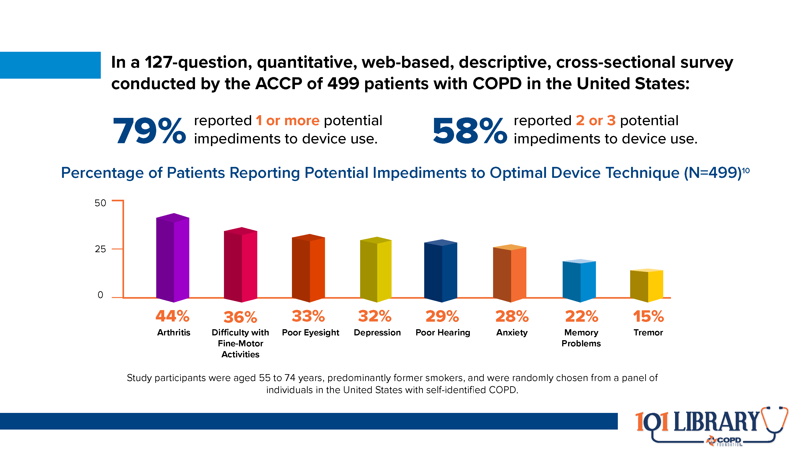
Notes:
In 2018, the American College of Chest Physicians (CHEST) published results from a survey asking people with COPD what other conditions they had that might impact their ability to use an inhalation device. The results indicate that a large proportion of this population has multiple potential barriers to proper use of inhalers, and that nebulizers may be a more appropriate choice for many. (cite Hanania 2018 paper in final draft)

Slide 19
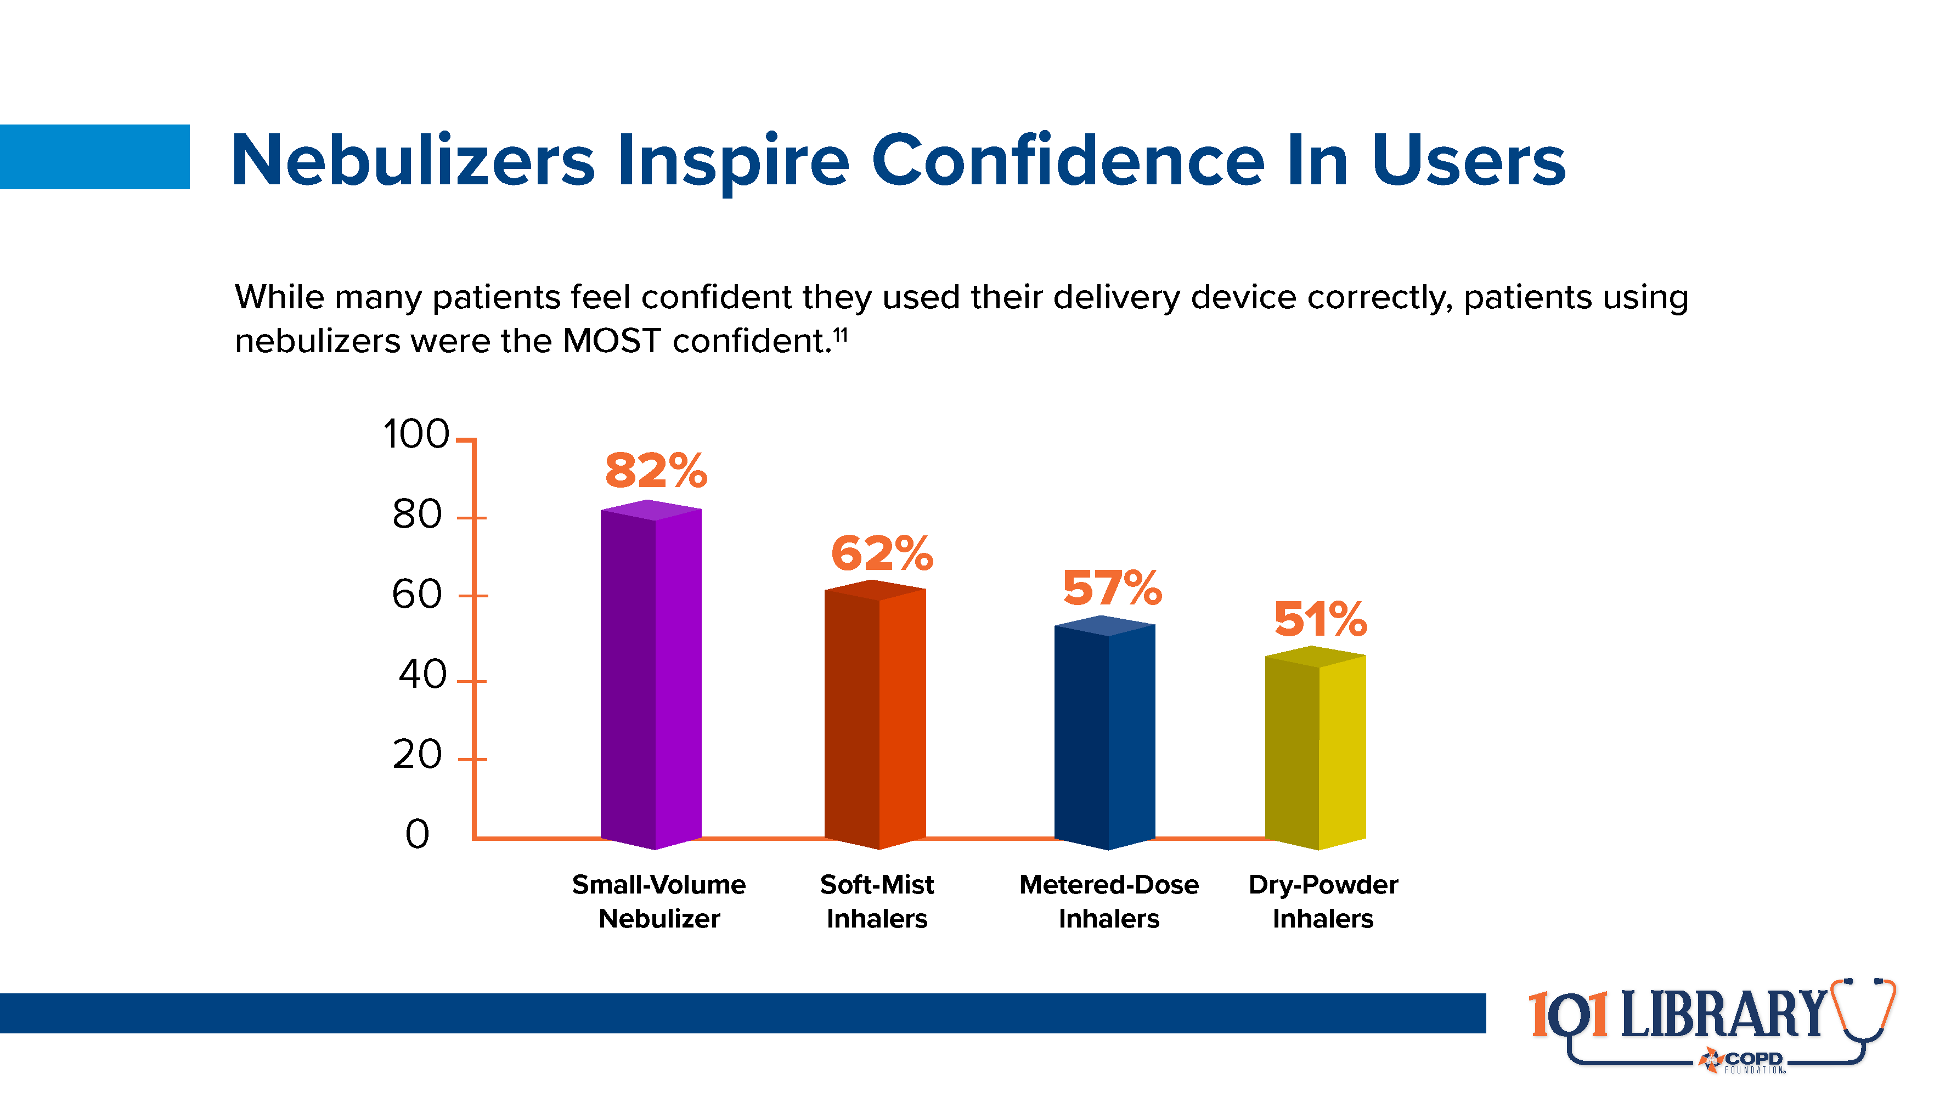
Notes:
Nebulizers provide a consistent, easy-to-use option for many people. Studies indicate that almost half of people in the US with COPD already own a nebulizer for use with other medications. When considering adding a particular inhaled medication, consider asking if the patient has a nebulizer and is comfortable with using it. (cite Hanania again)

Slide 20
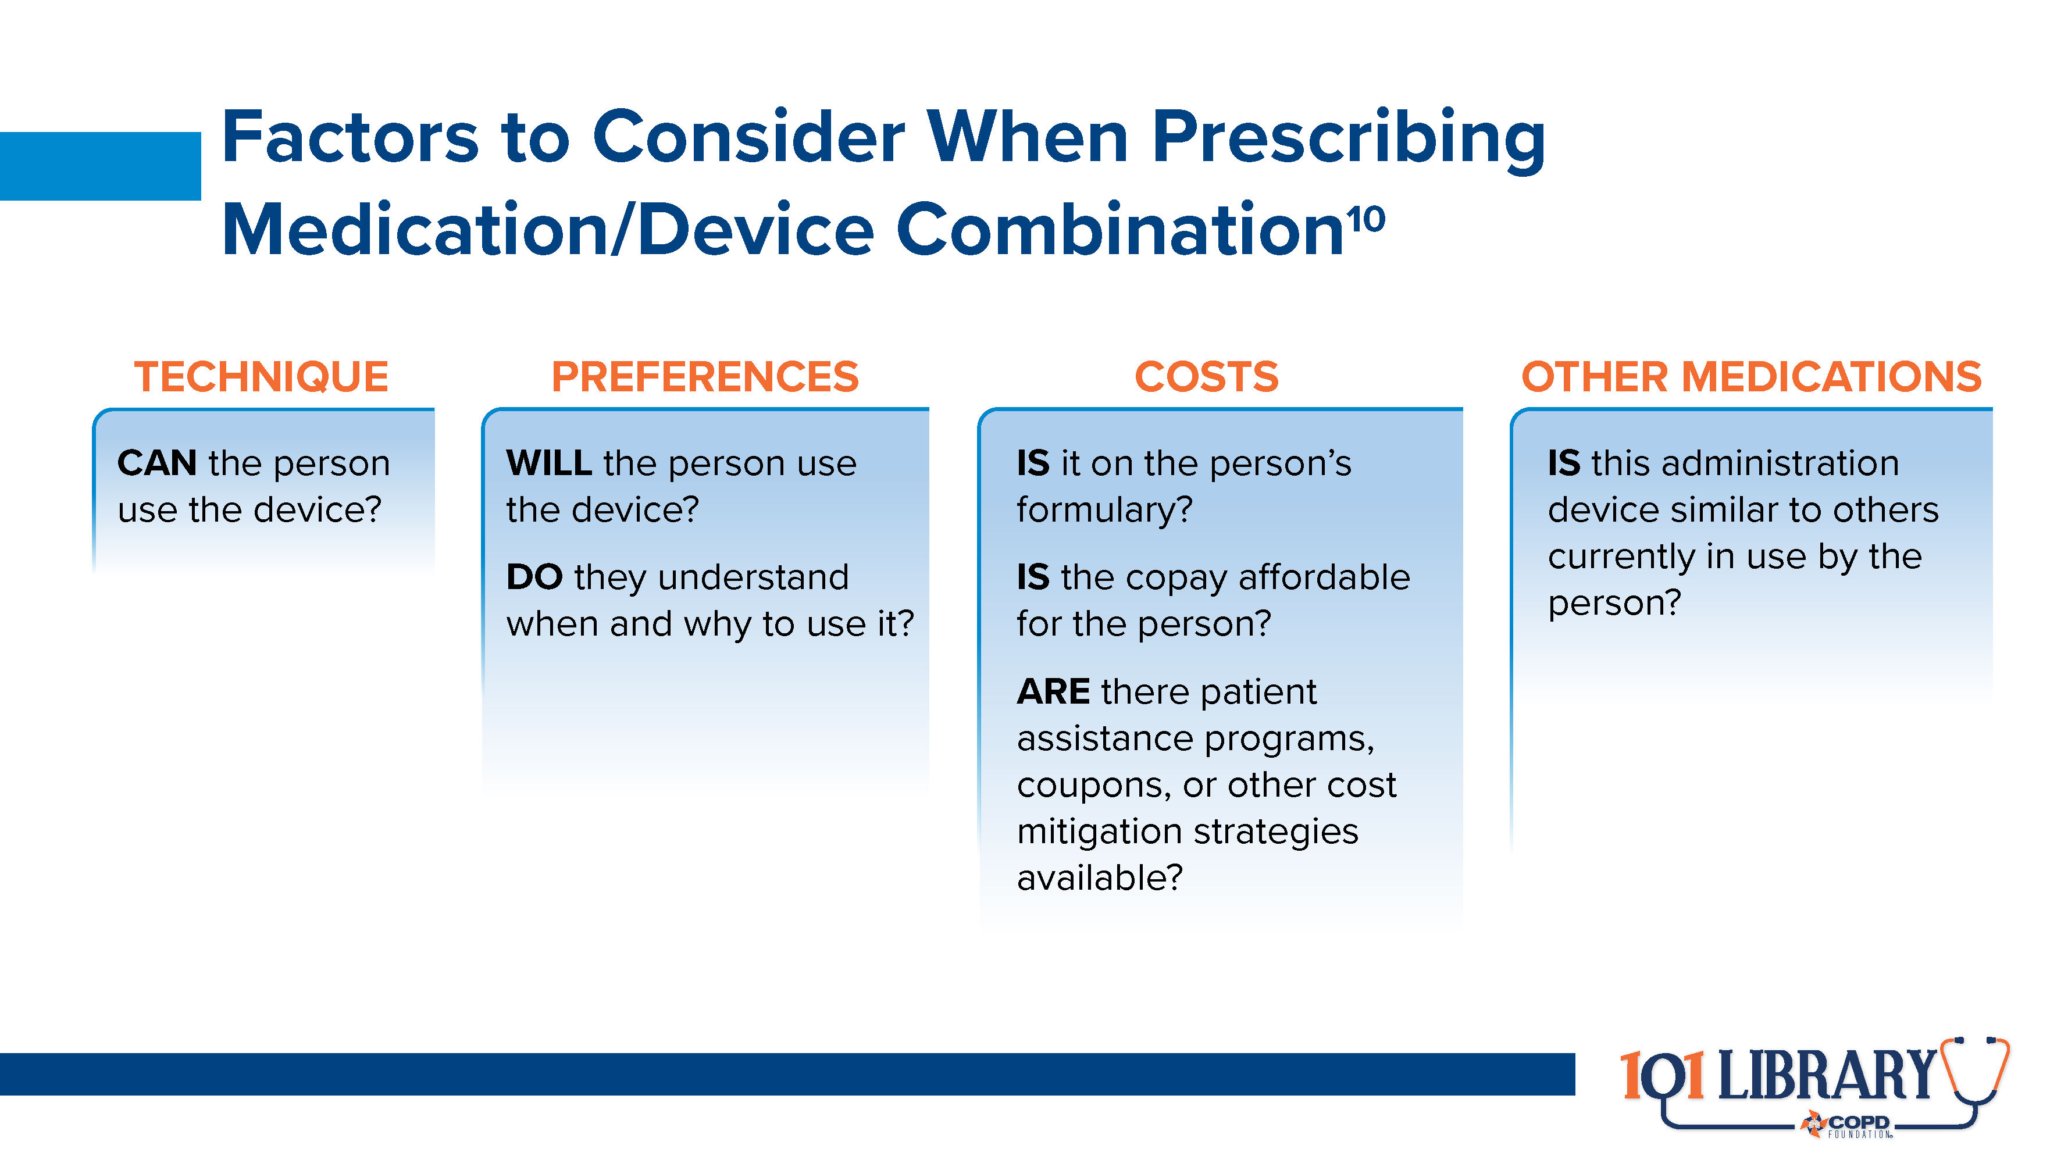
Notes:
Other factors, including convenience, clinical setting, and availability of a particular drug with a particular device may also be considerations. All of these must be considered in order to truly individualize care.

Slide 21


Slide 22
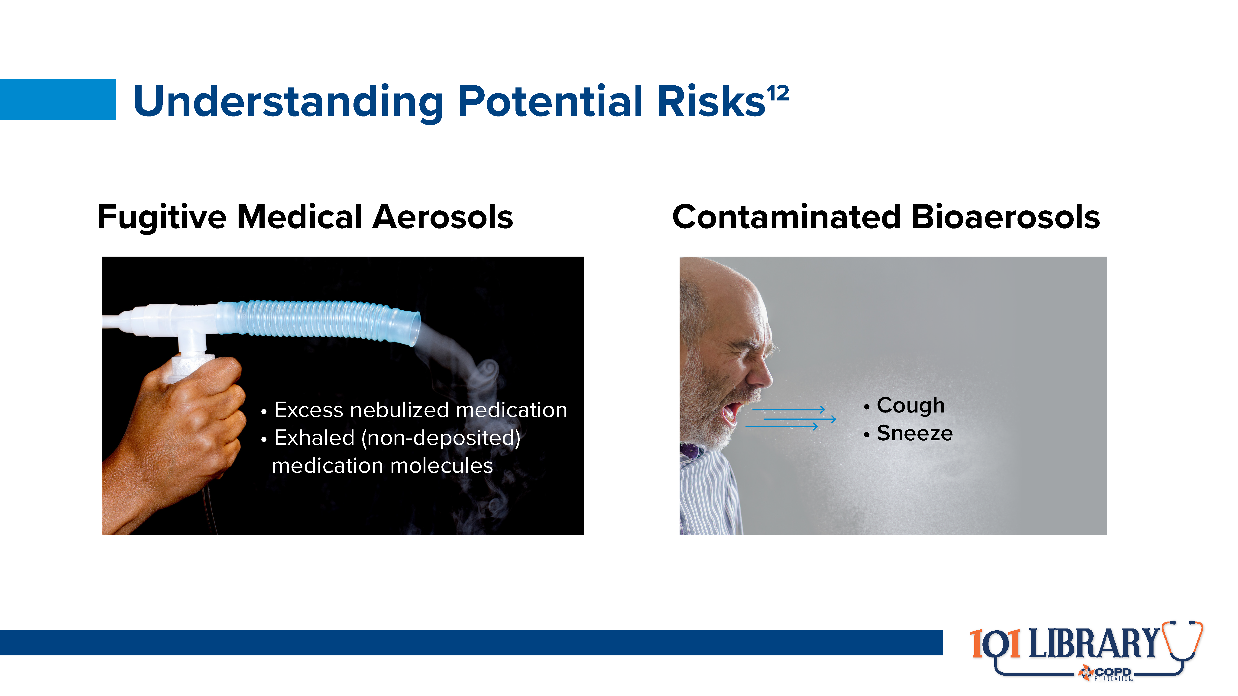
Notes:
For many years, clinicians administering aerosolized medications have questioned whether “secondhand” exposure posed any significant concerns. The COVID-19 pandemic highlighted these concerns, as well as the need to better understand other risks associated with aerosol exposure.
Potentially concerning aerosols can be grouped into fugitive medical aerosols (created by equipment with intent to deliver to the respiratory tract) or contaminated bioaerosols (created by the patient’s body and expelled). As both categories have different characteristics (including particle size and potential contaminant load), they may require different mitigation strategies.

Slide 23
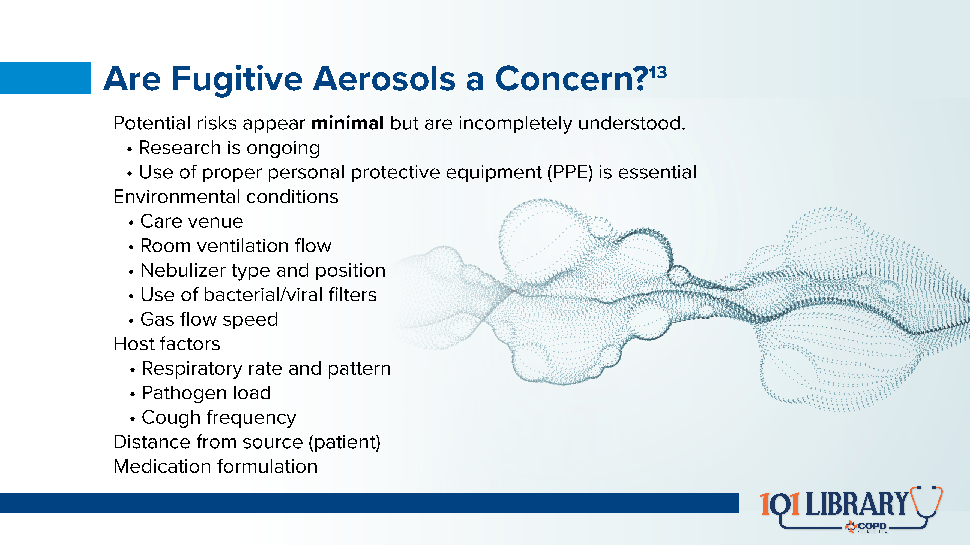
Notes:
This area of research is still evolving, and many questions remain. However, the overall risks of contamination and/or clinically significant dosing via secondhand exposures appear virtually nonexistent. Basic mitigation strategies (including the use of PPE) appear quite effective at reducing the risk even further.

Slide 24
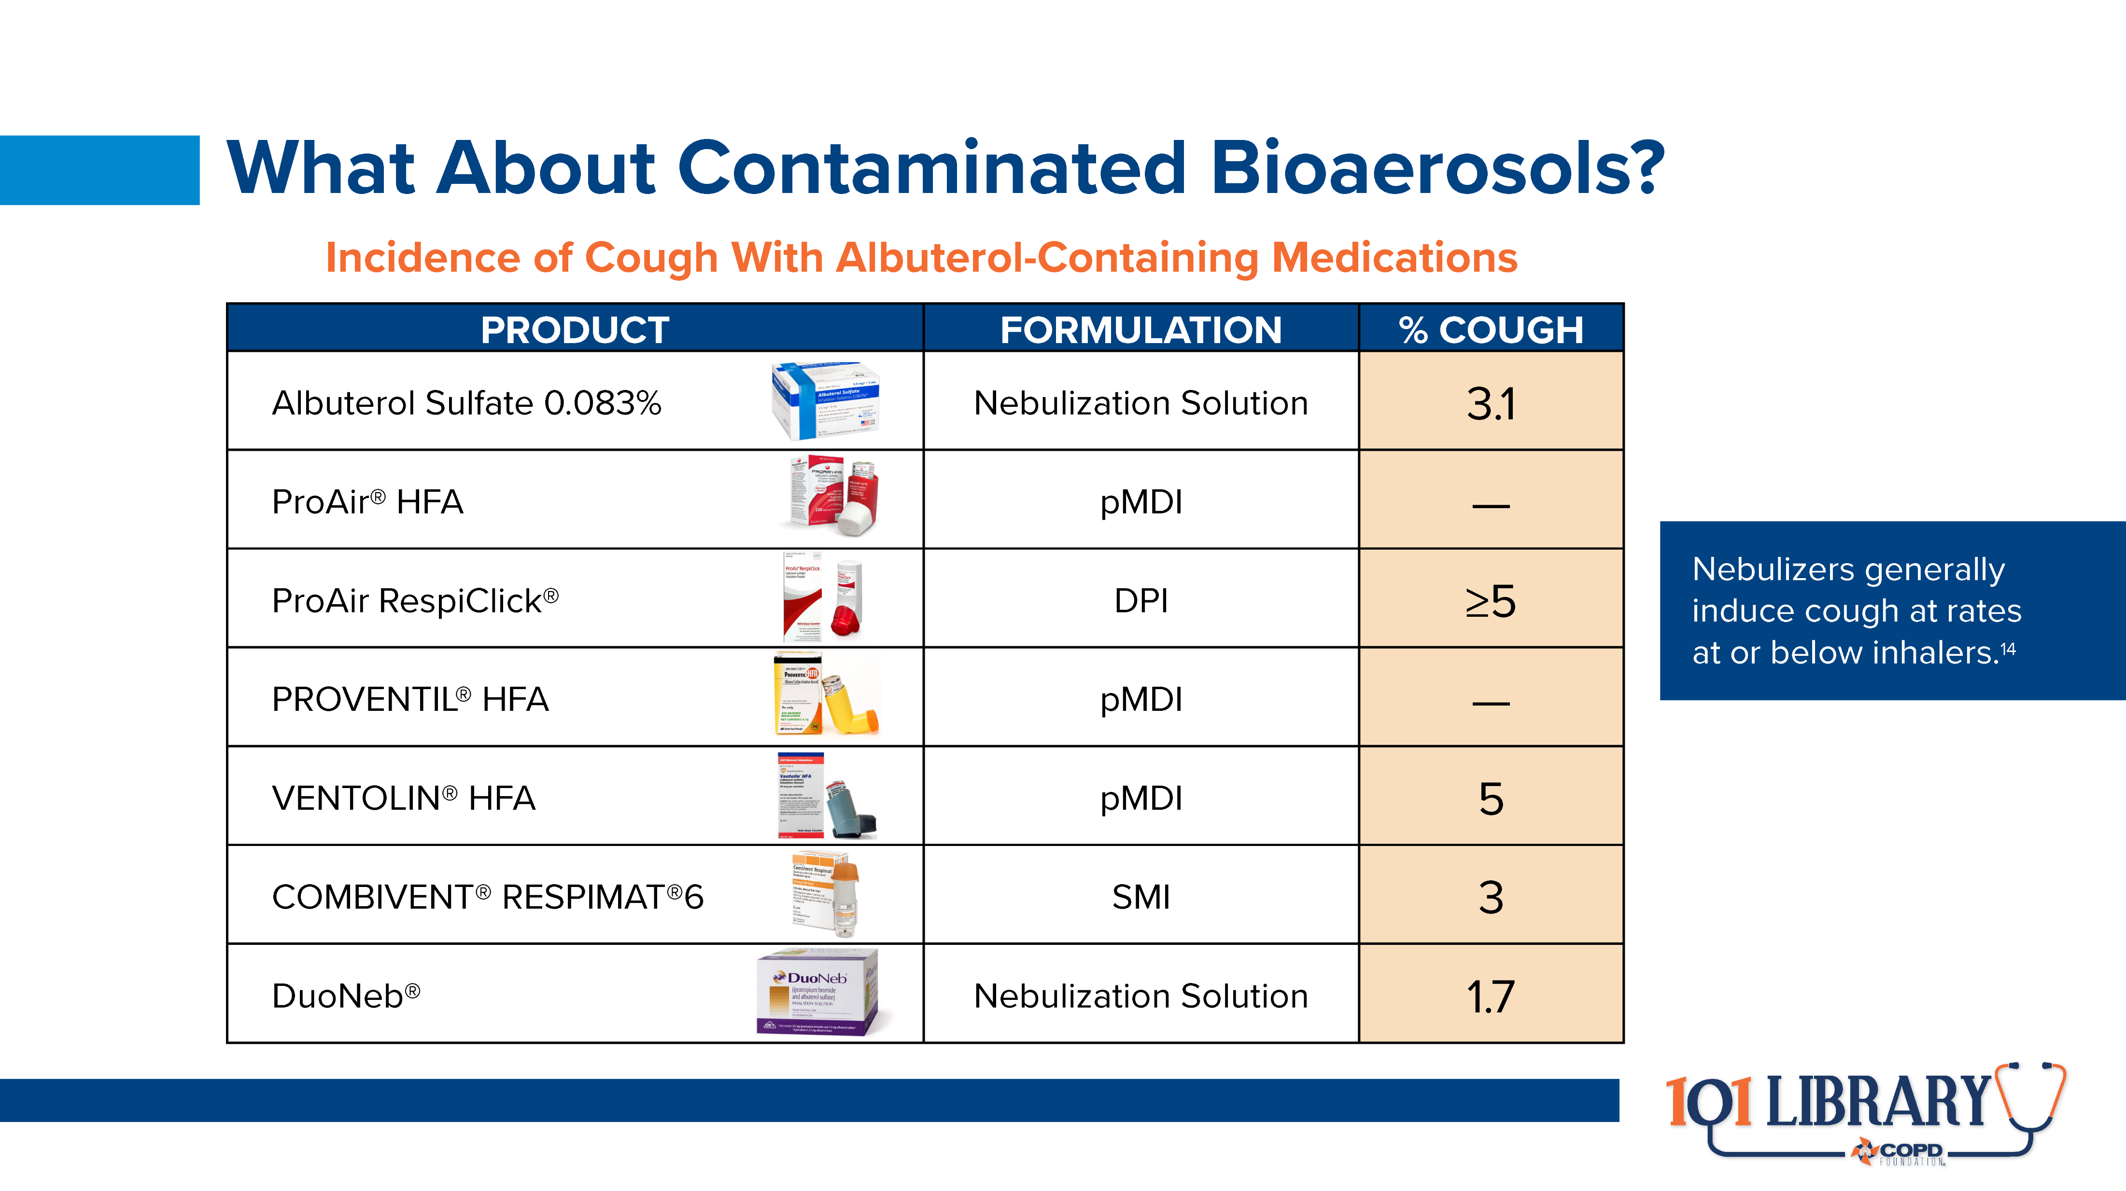
Notes:
The greatest risk for exposure to contaminated bioaerosols, a strong cough, is also relatively low. The risk of provoking a cough is, in many cases, even lower with nebulized medications than with other inhaled therapies. Again, the use of PPE remains of great benefit.

Slide 25
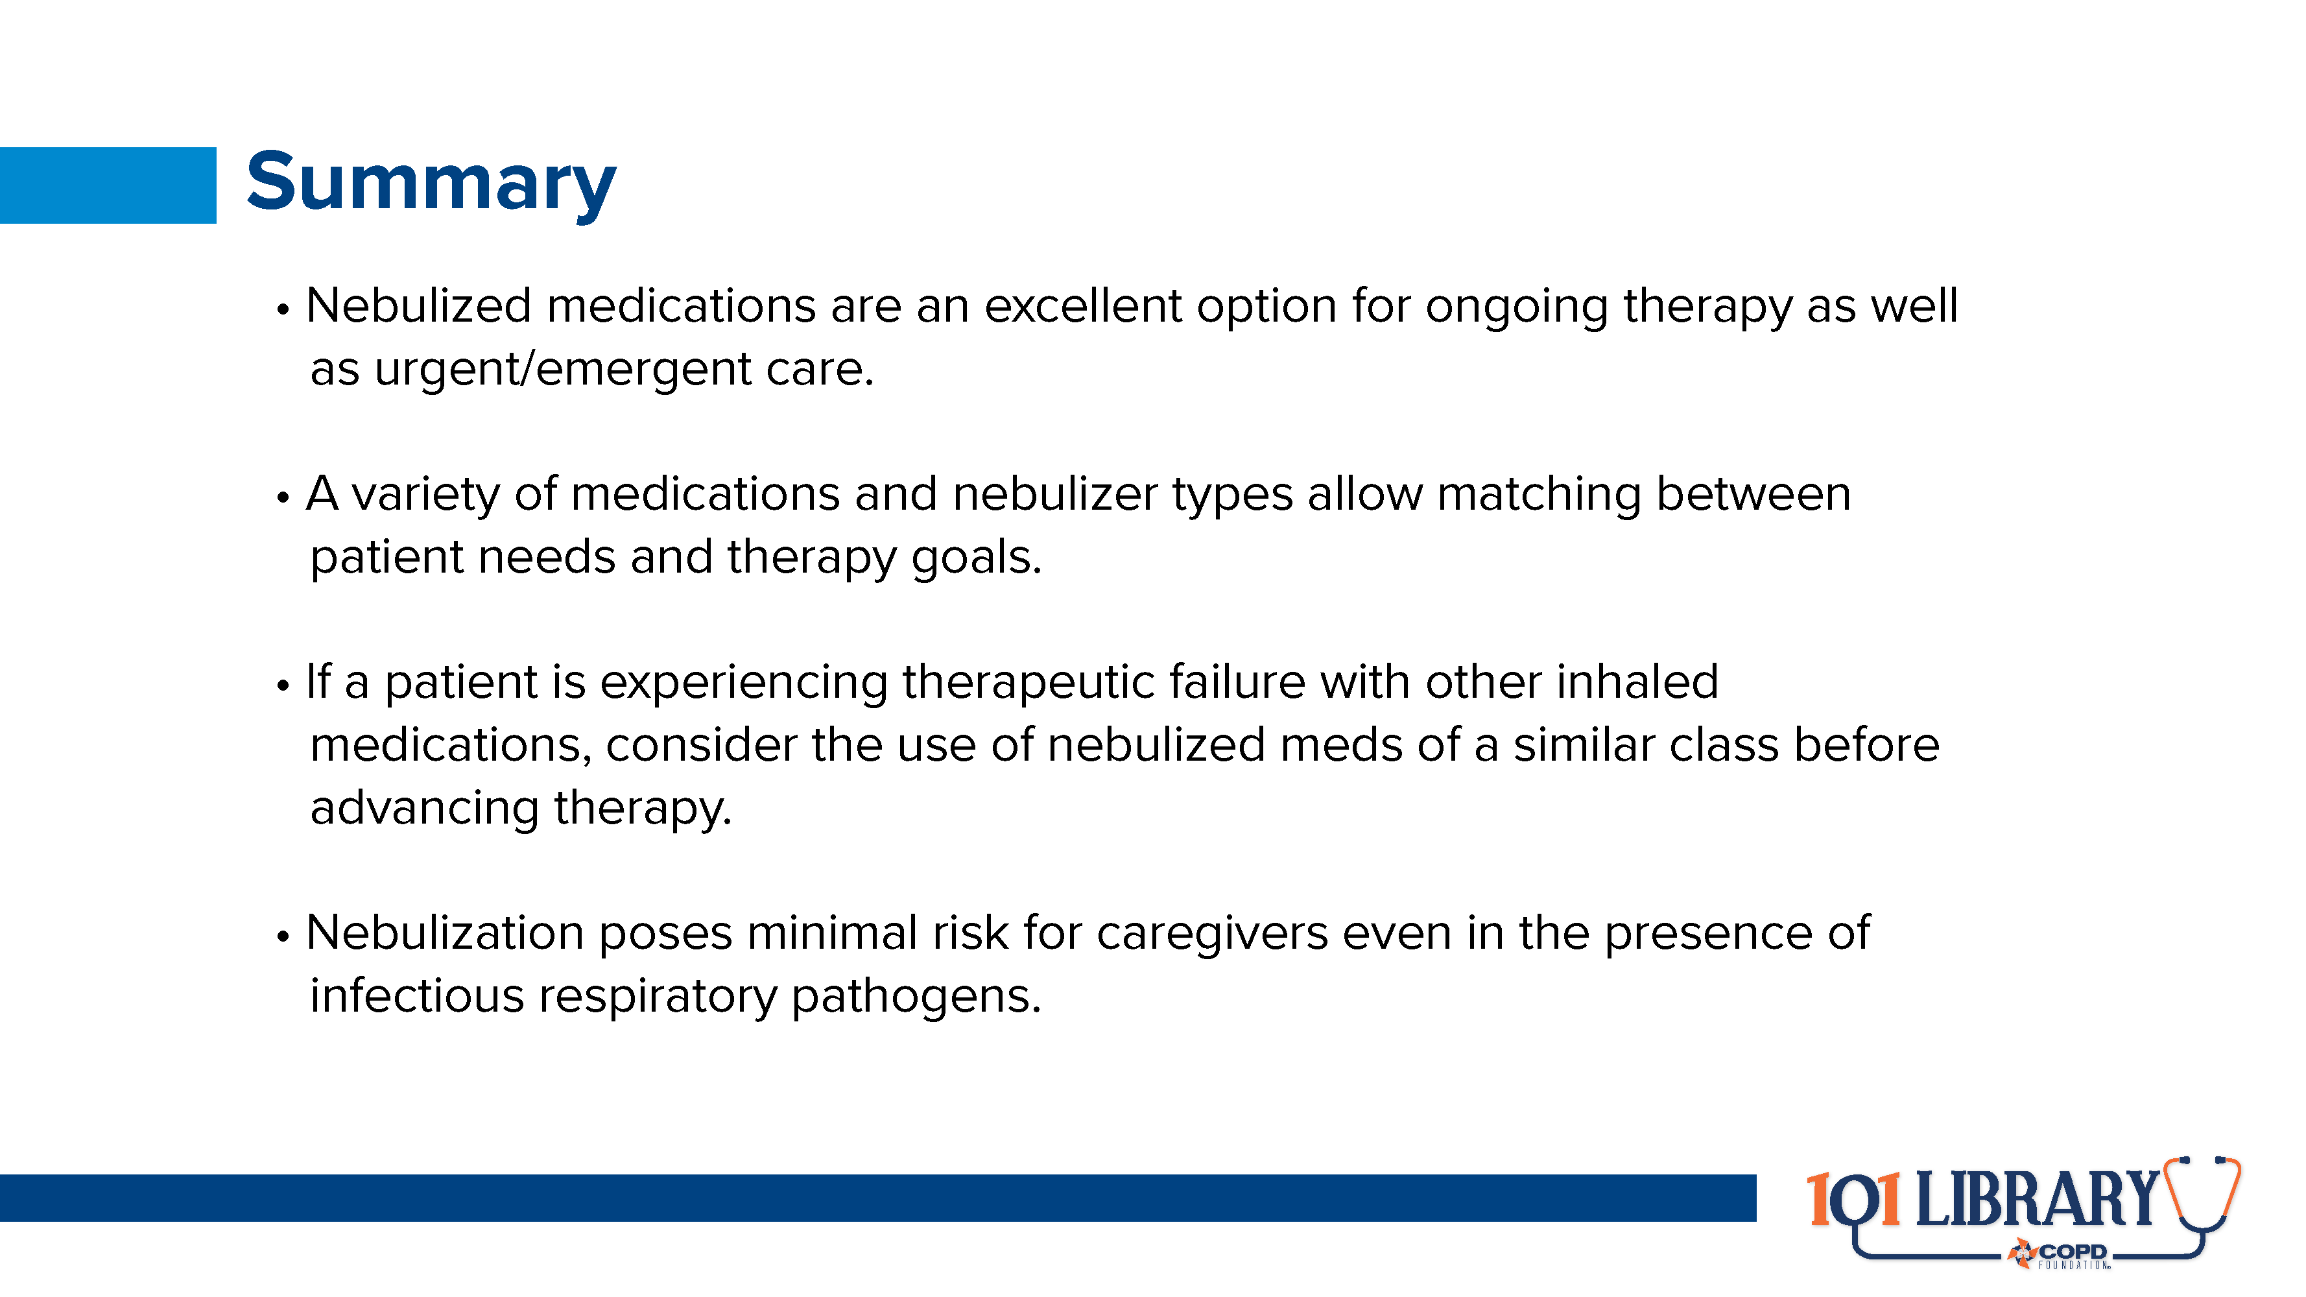

Slide 26


Slide 27
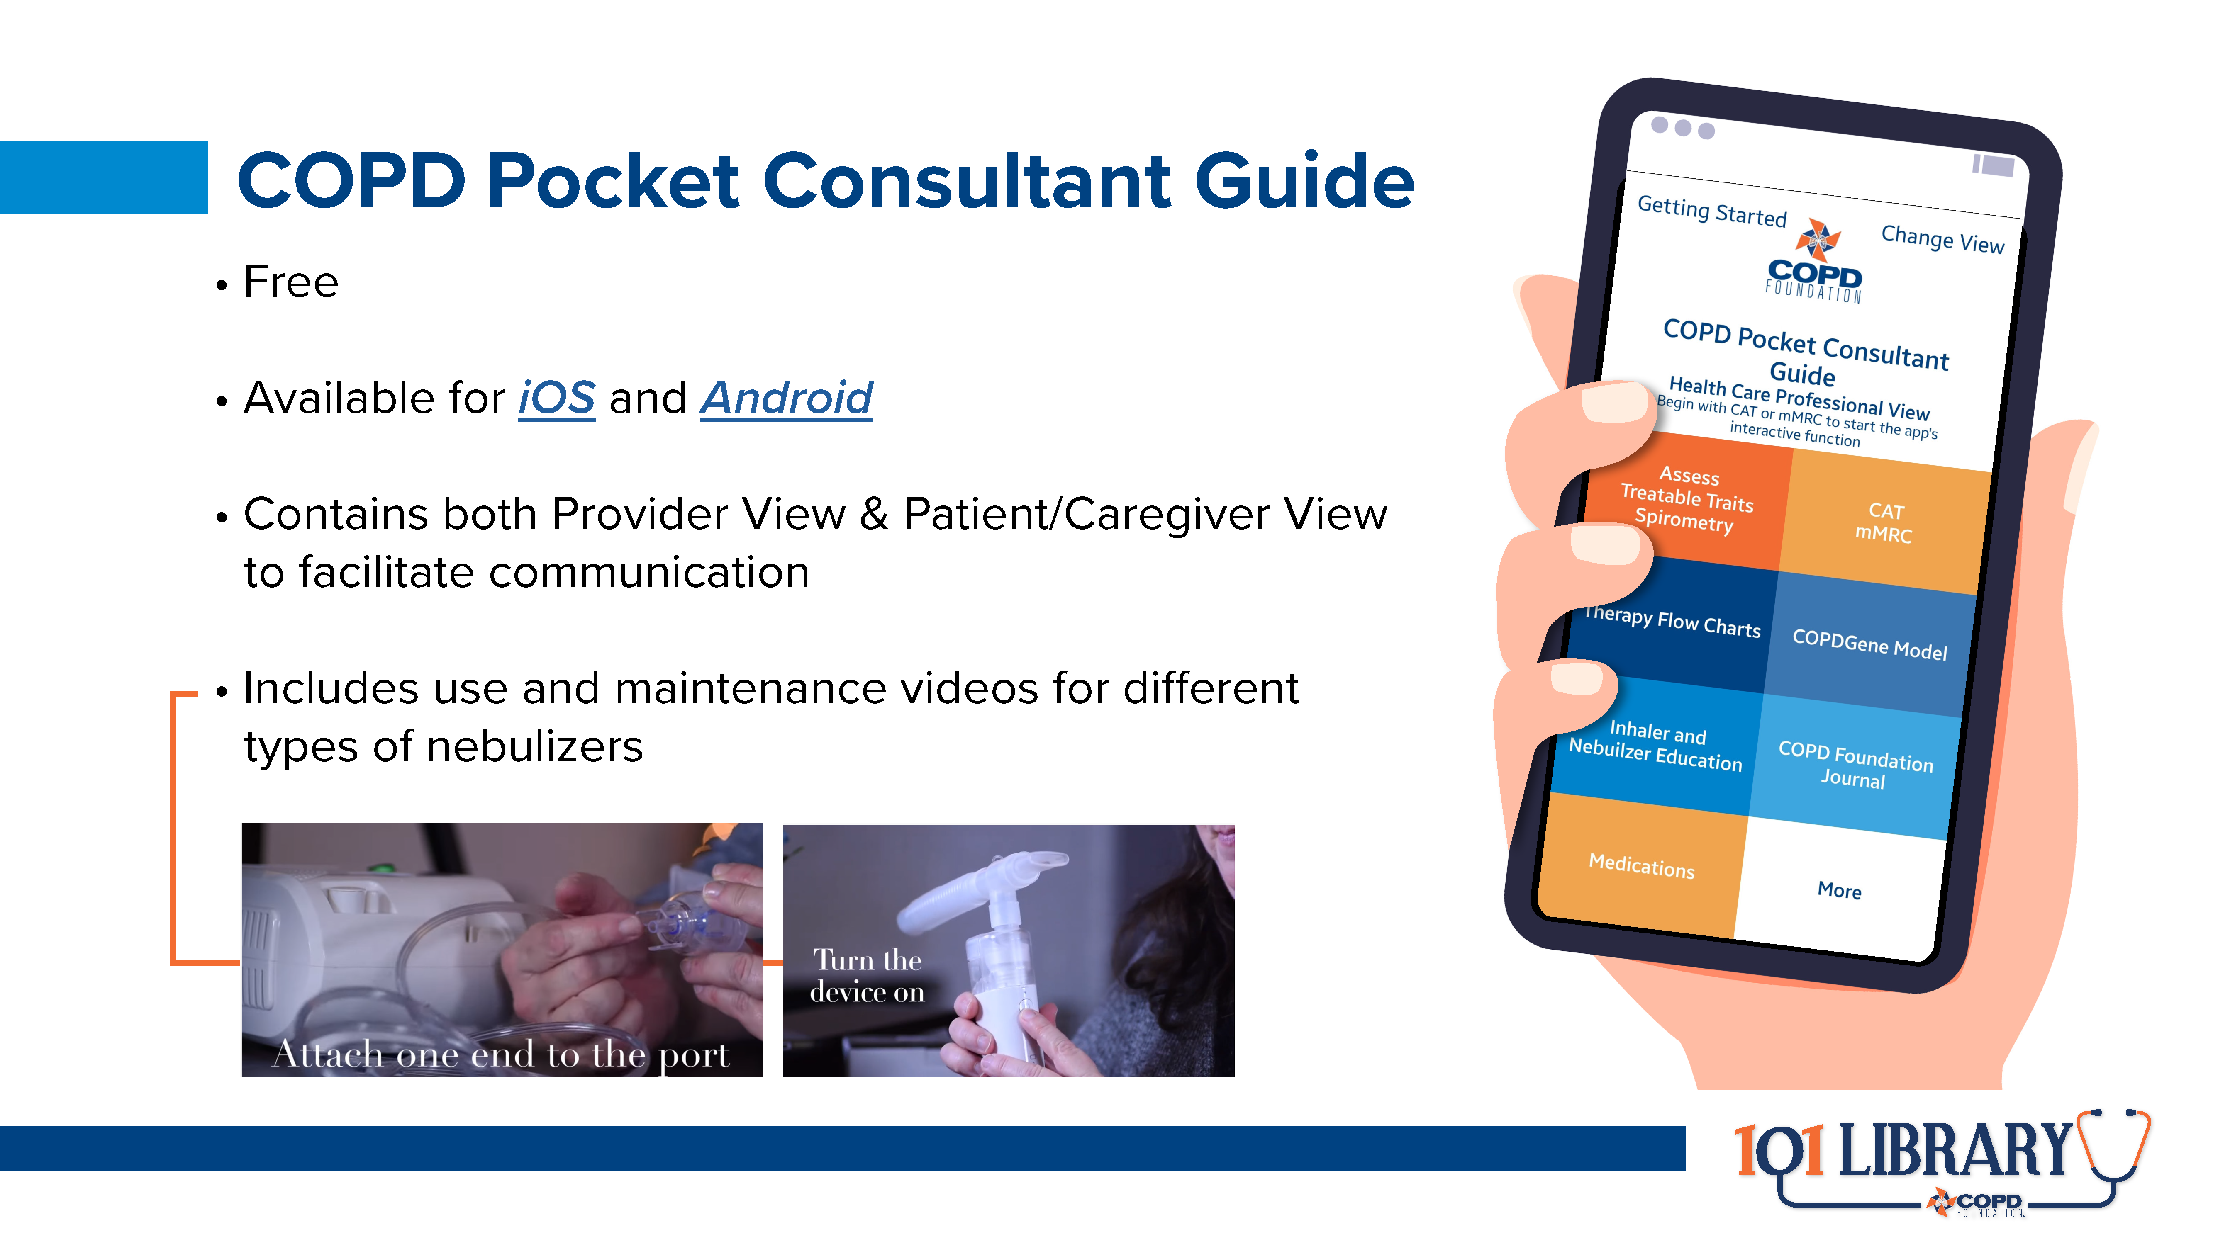

Slide 28
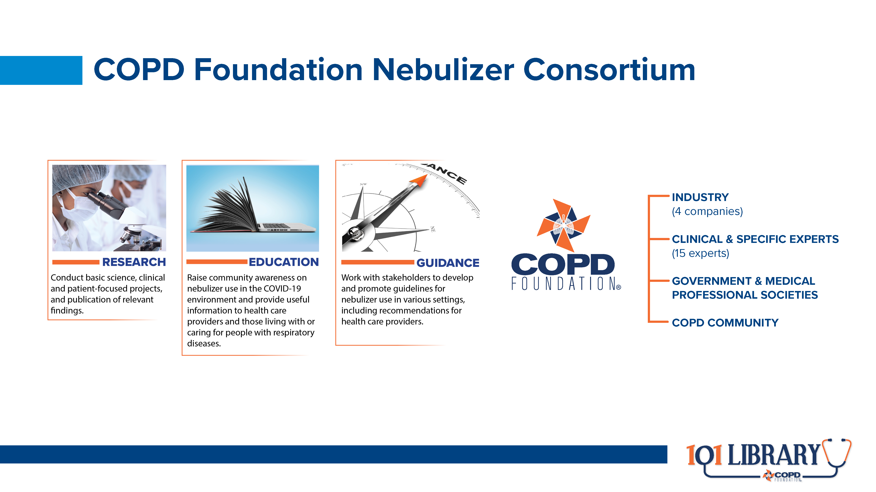

Slide 29
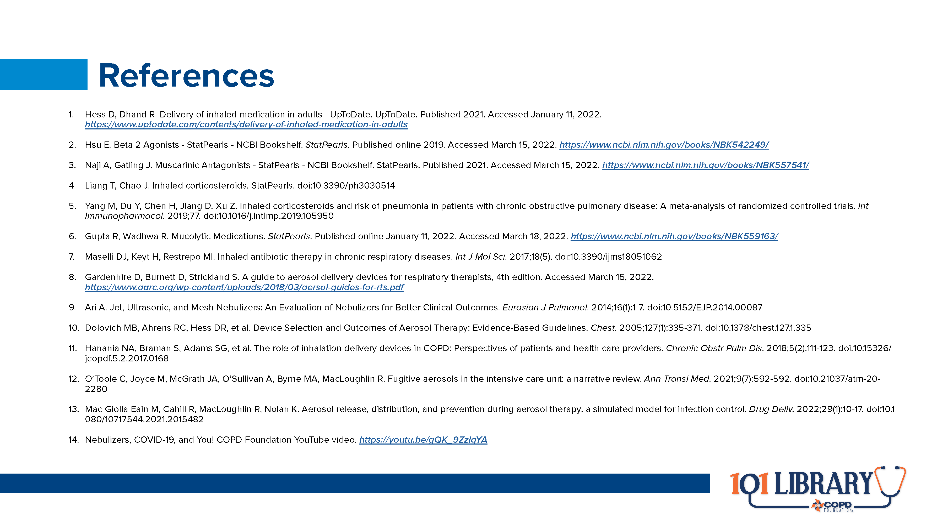

Slide 30


Slide 31
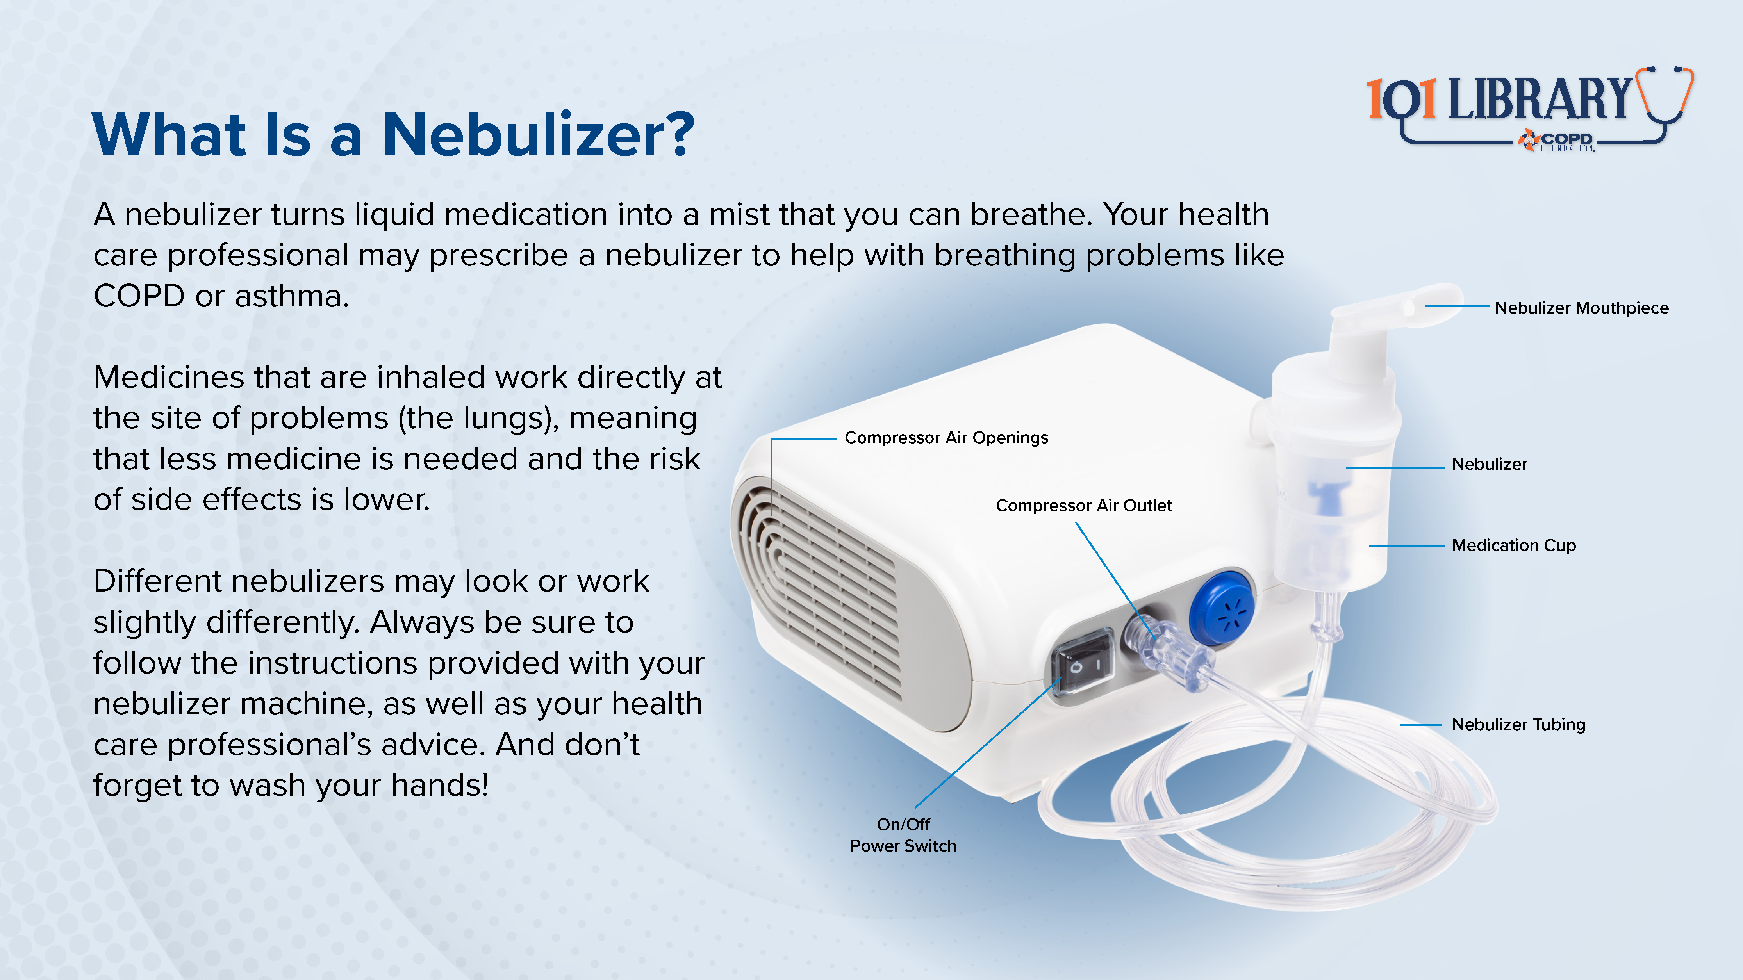

Slide 32
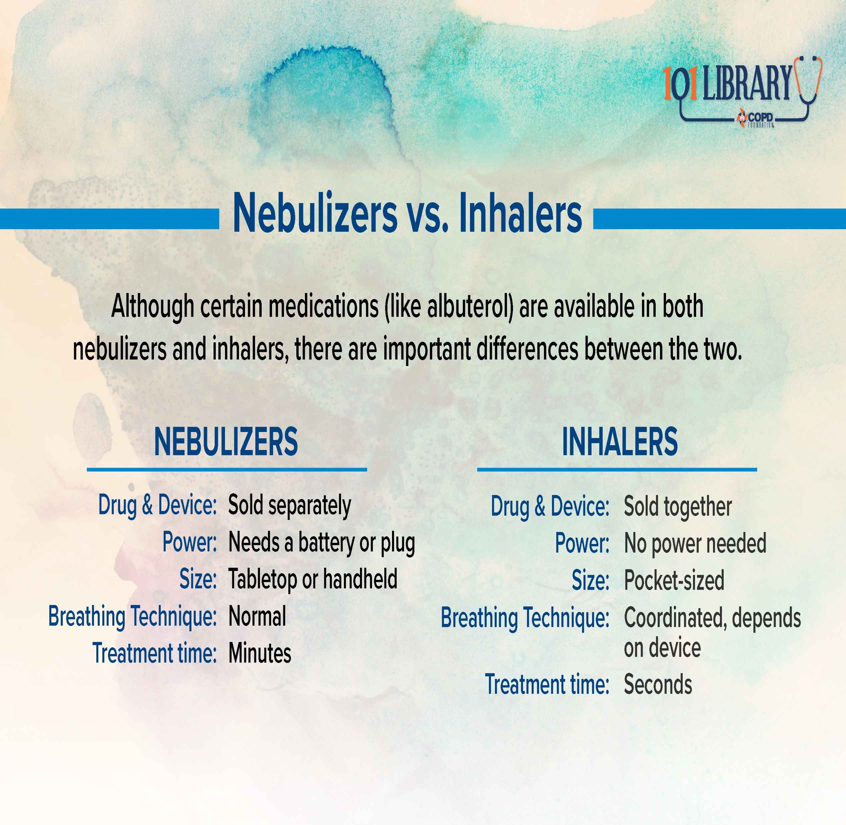

Slide 33
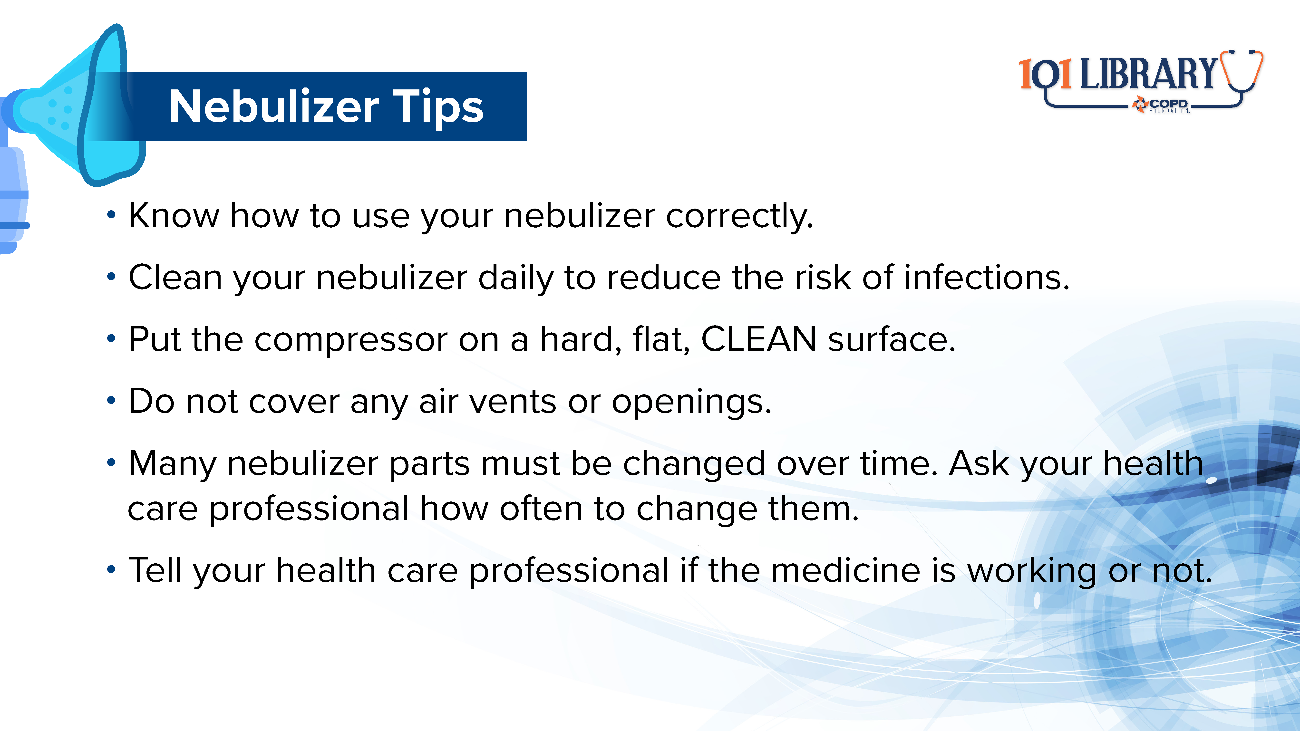

Slide 34
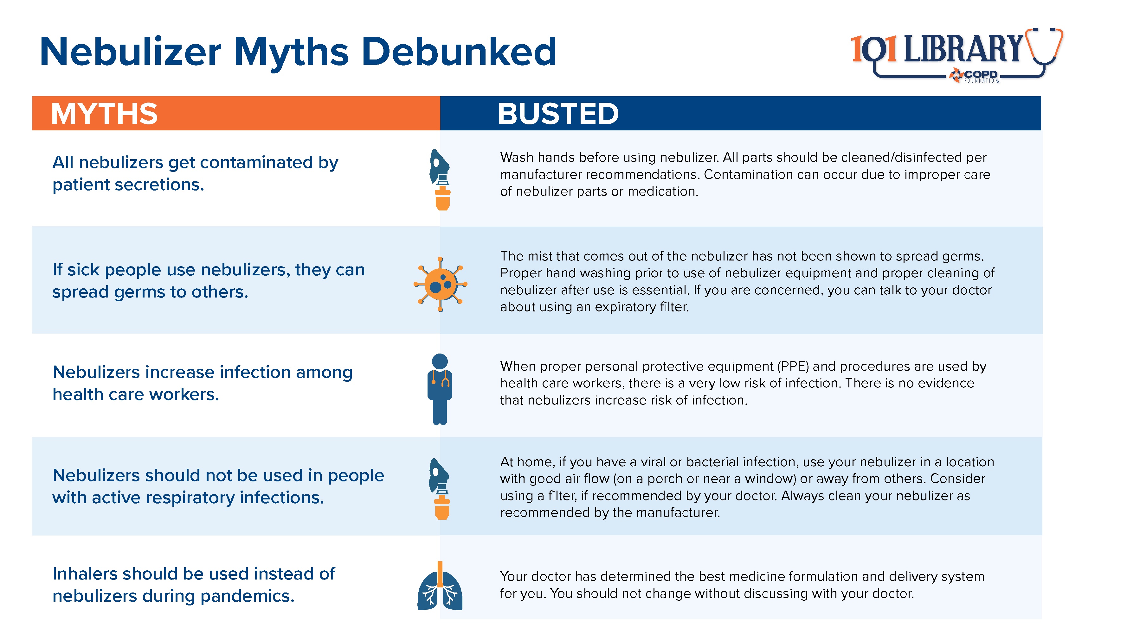

Slide 35
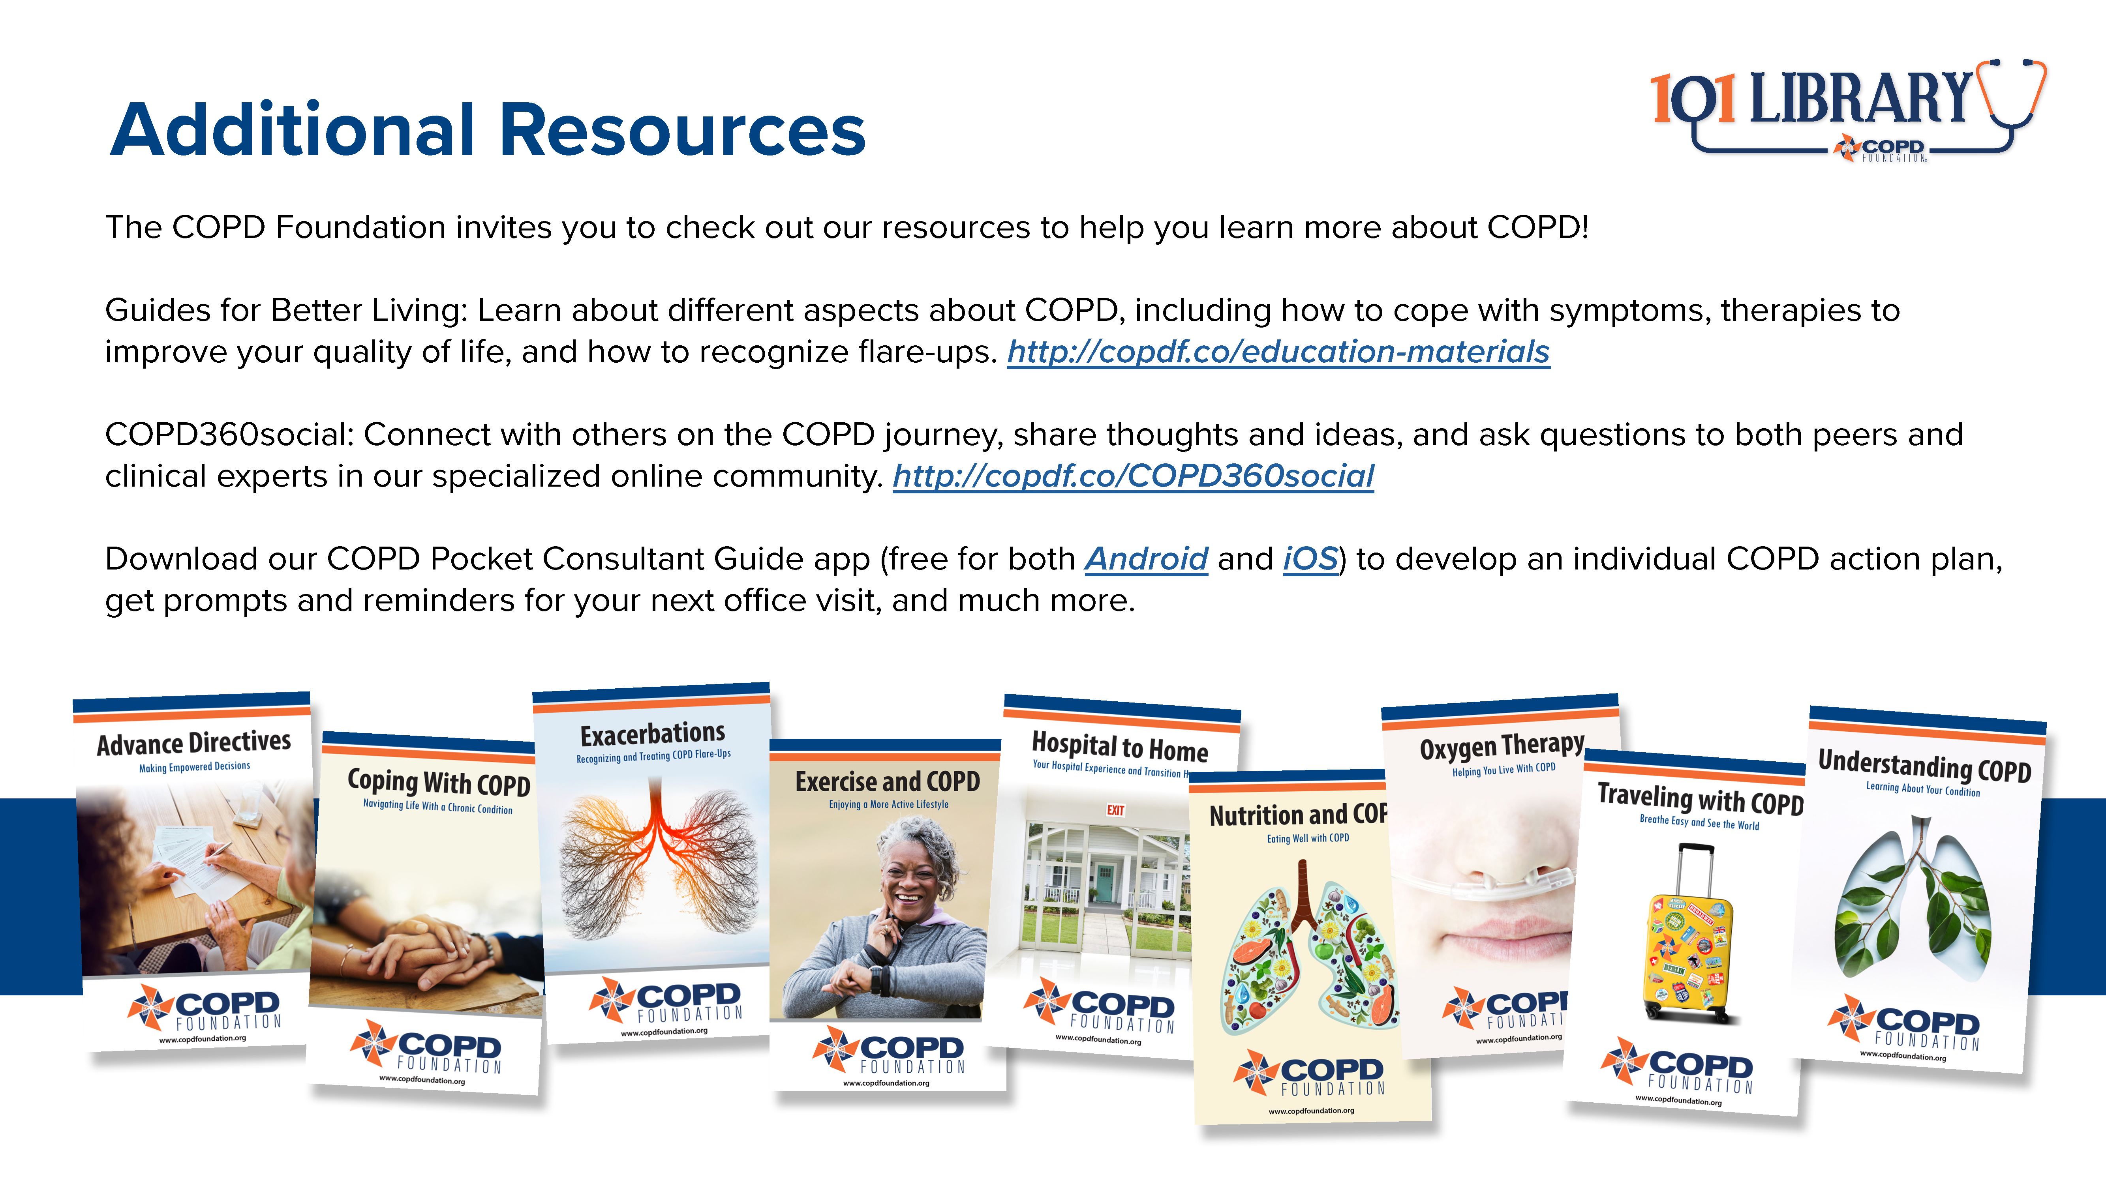

Slide 36

Notes:
Thank you to Viatris and Theravance Biopharma for supporting these educational materials.
For additional information or support, please contact the COPD Foundation at info@copdfoundation.org or 1-866-731-COPD (2673).

