Slide 1
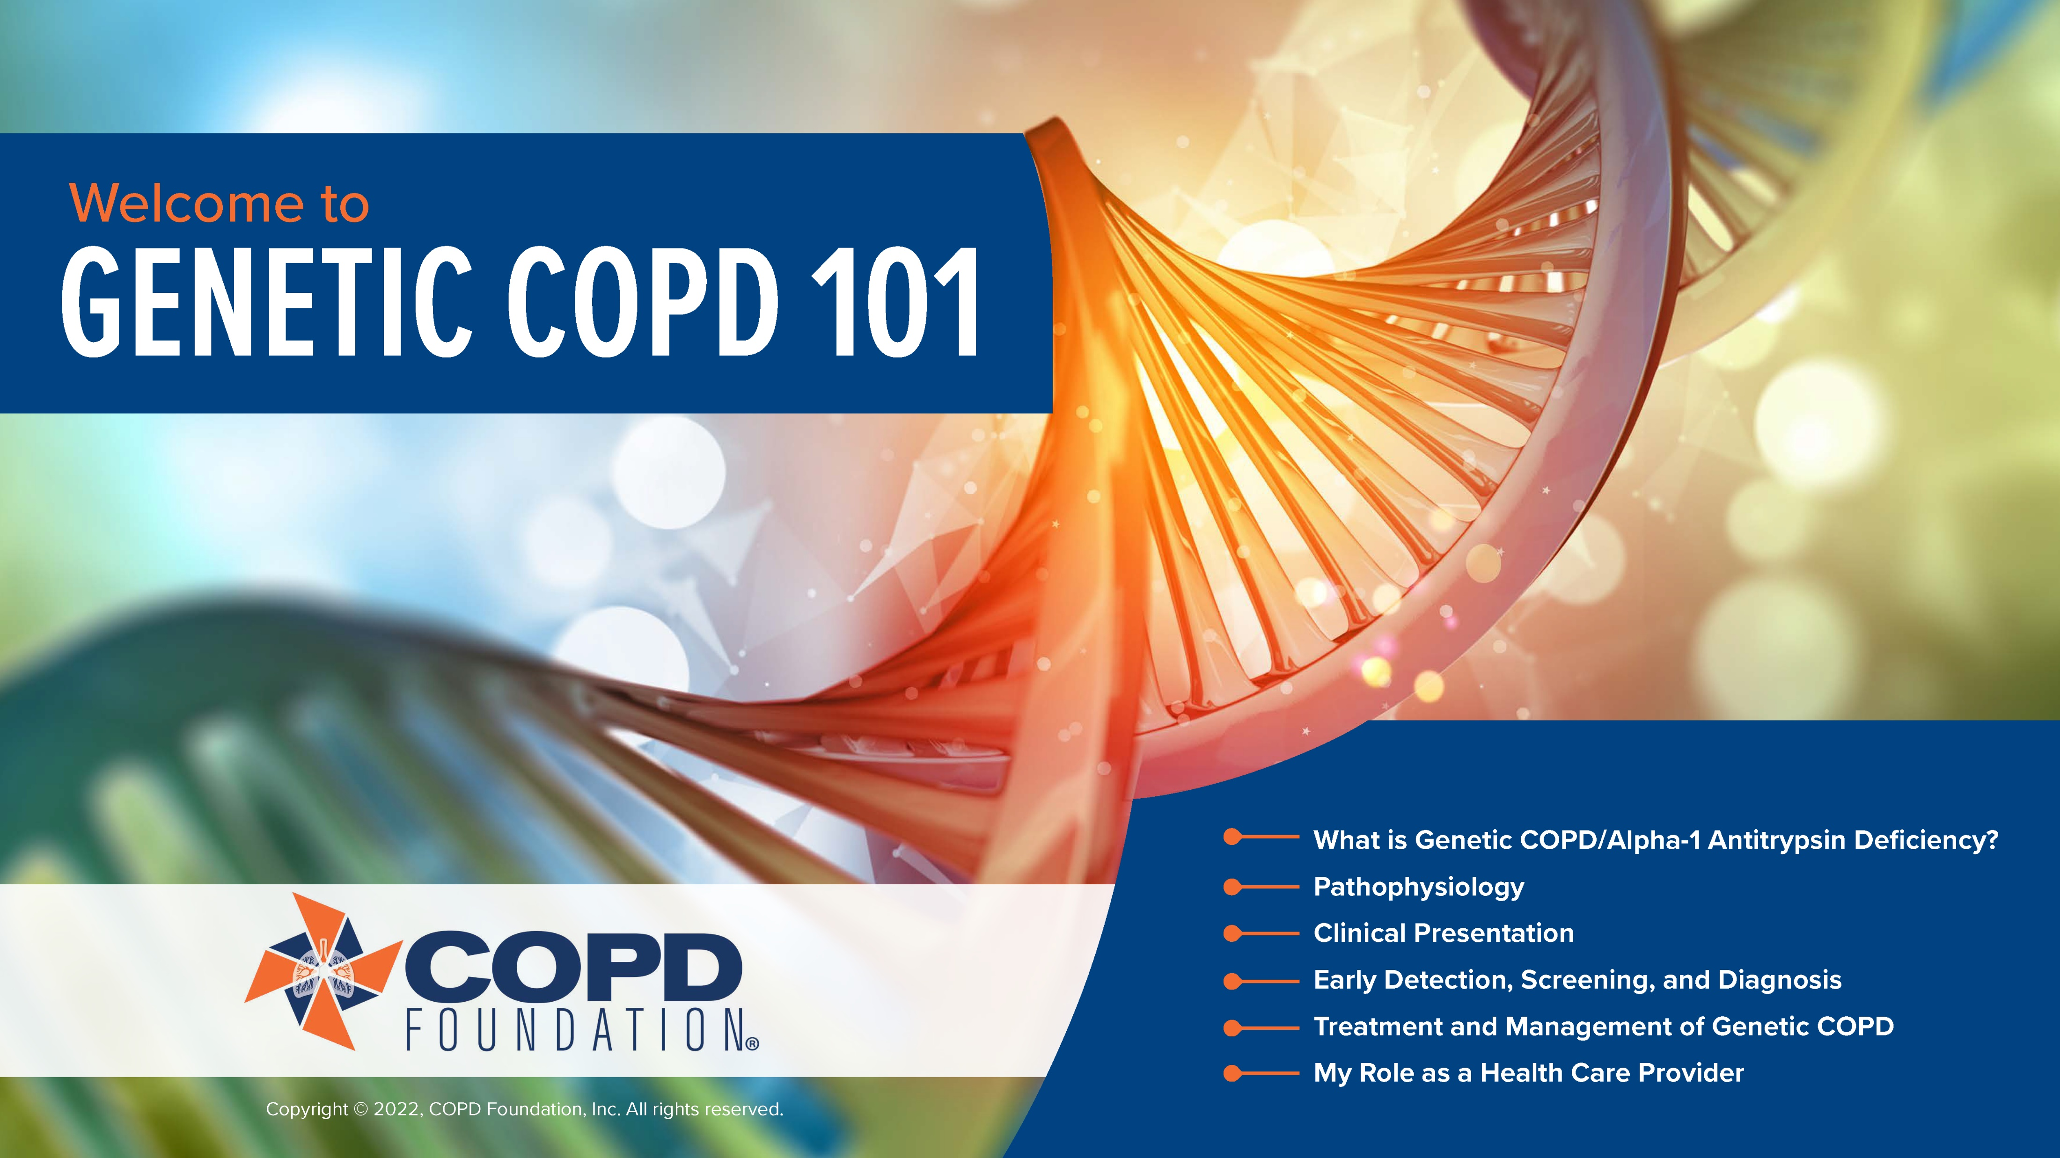
Notes:
Welcome! This presentation is intended to provide an overview of key points of genetic COPD, including pathophysiology, screening/testing, and management strategies. In addition, we have provided resources for supplemental learning as well as patient materials to facilitate communication and discussion (particularly among the newly-diagnosed).
We hope these materials are of benefit to you and your practice. Please contact us at info@copdfoundation.org with comments, questions, or concerns.
Copyright © 2022, COPD Foundation, Inc. All rights reserved.

Slide 2
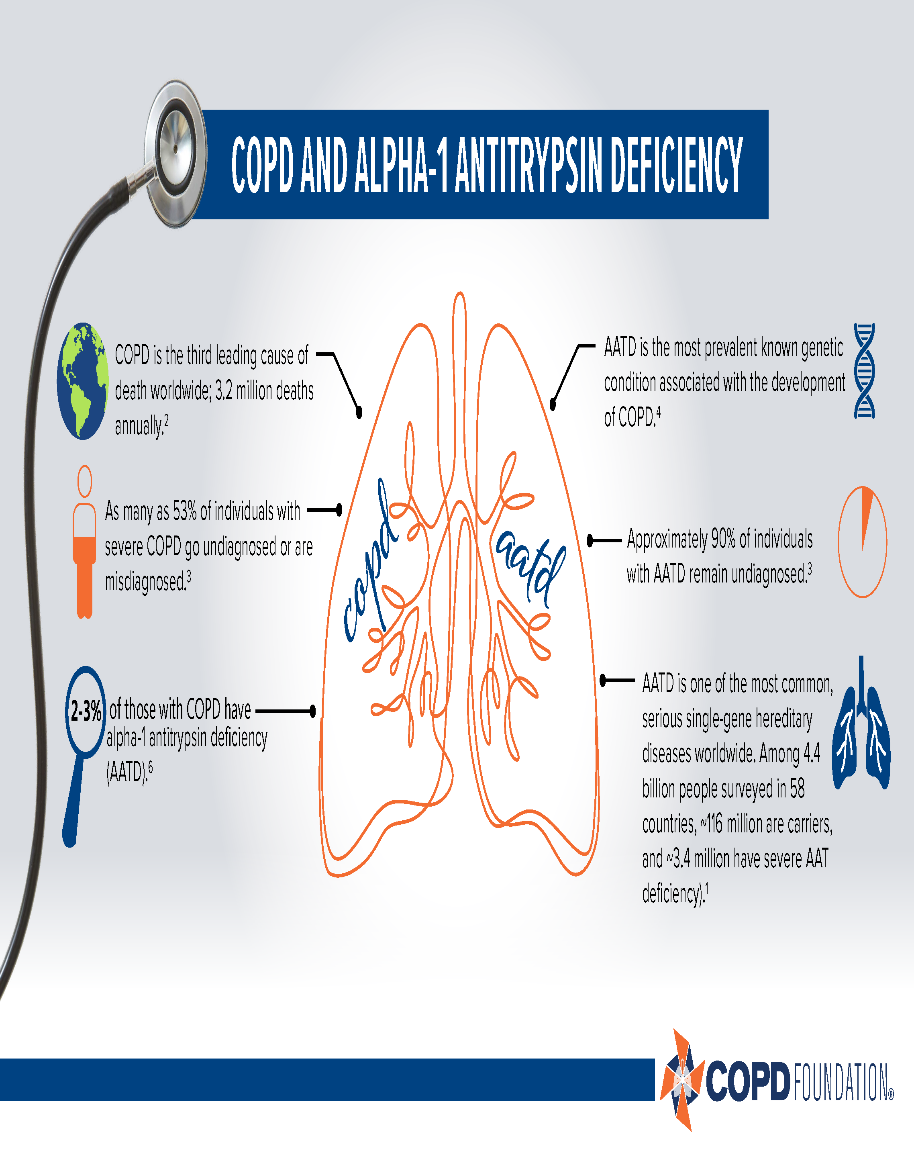

Slide 3


Slide 4
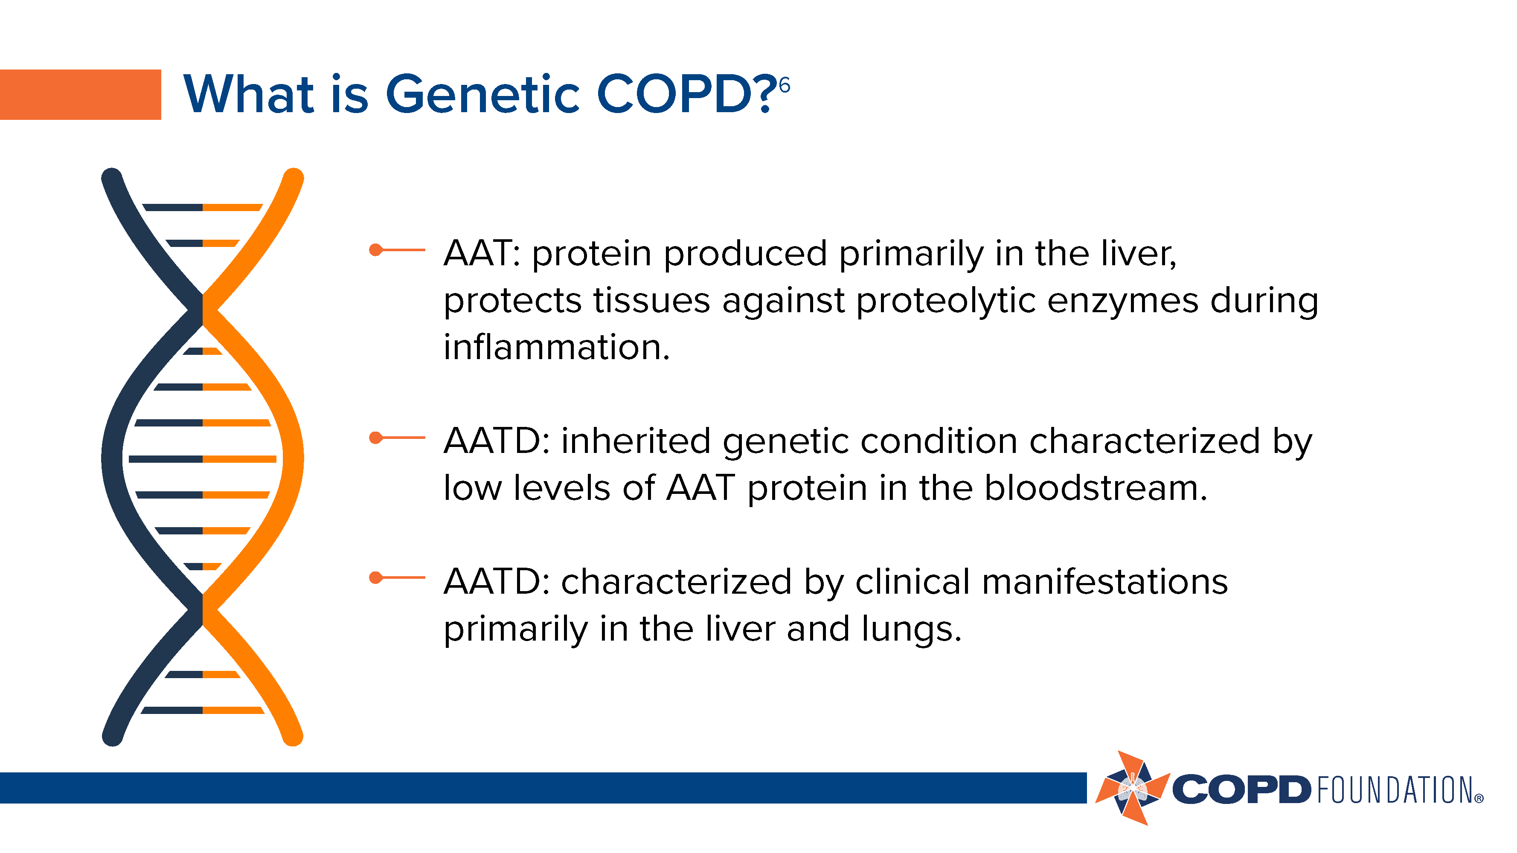

Slide 5


Slide 6
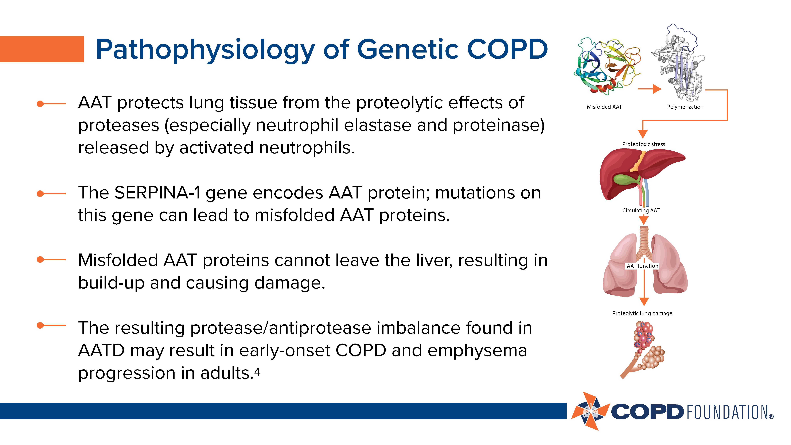

Slide 7
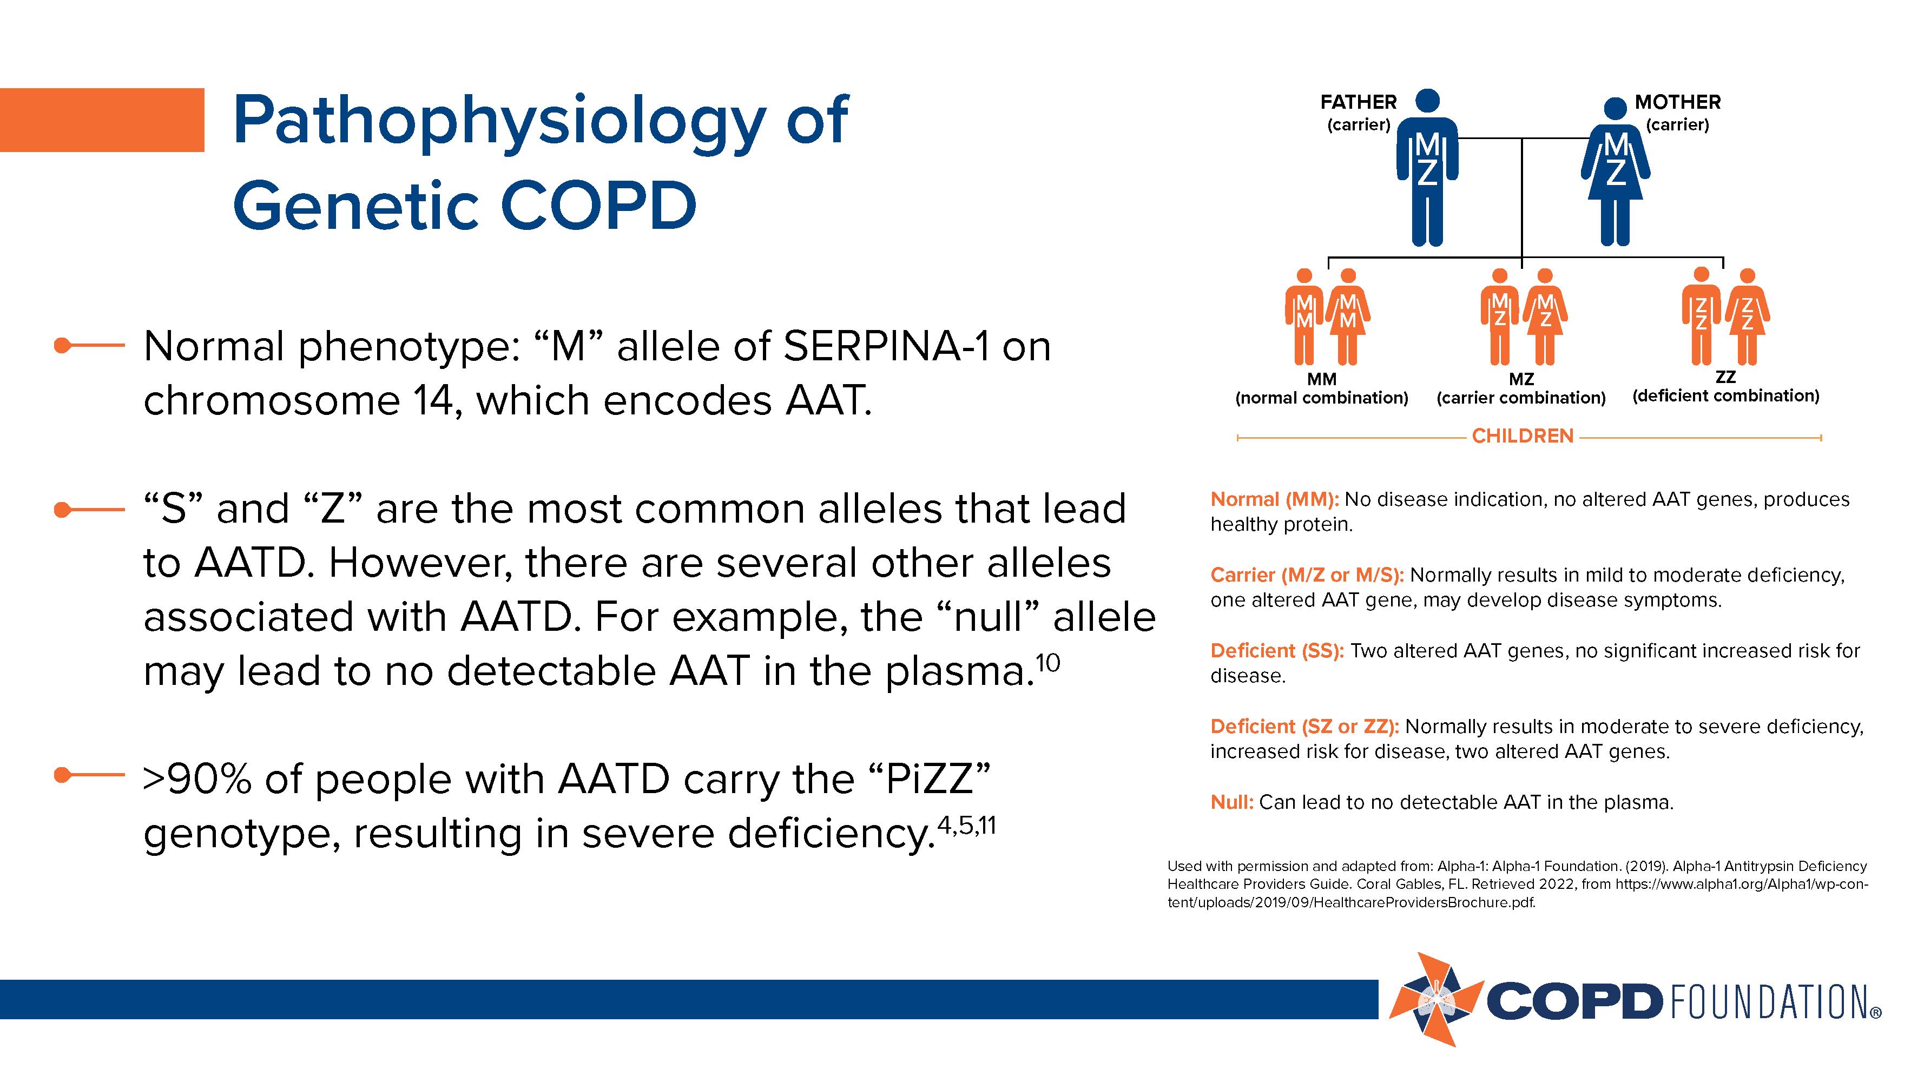

Slide 8


Slide 9
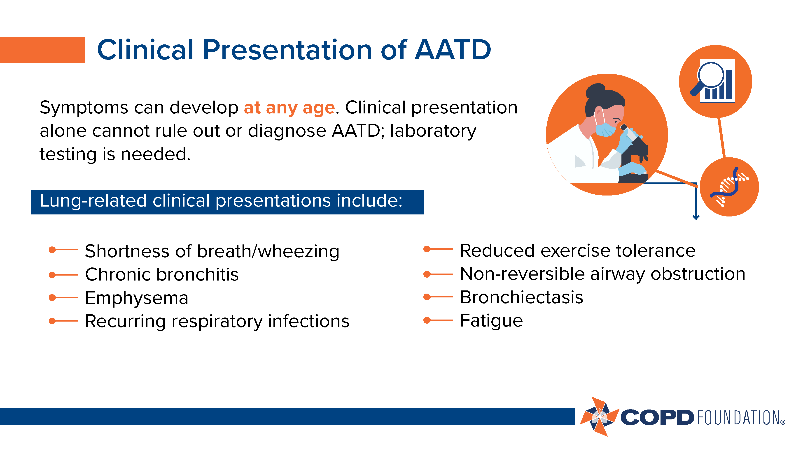

Slide 10
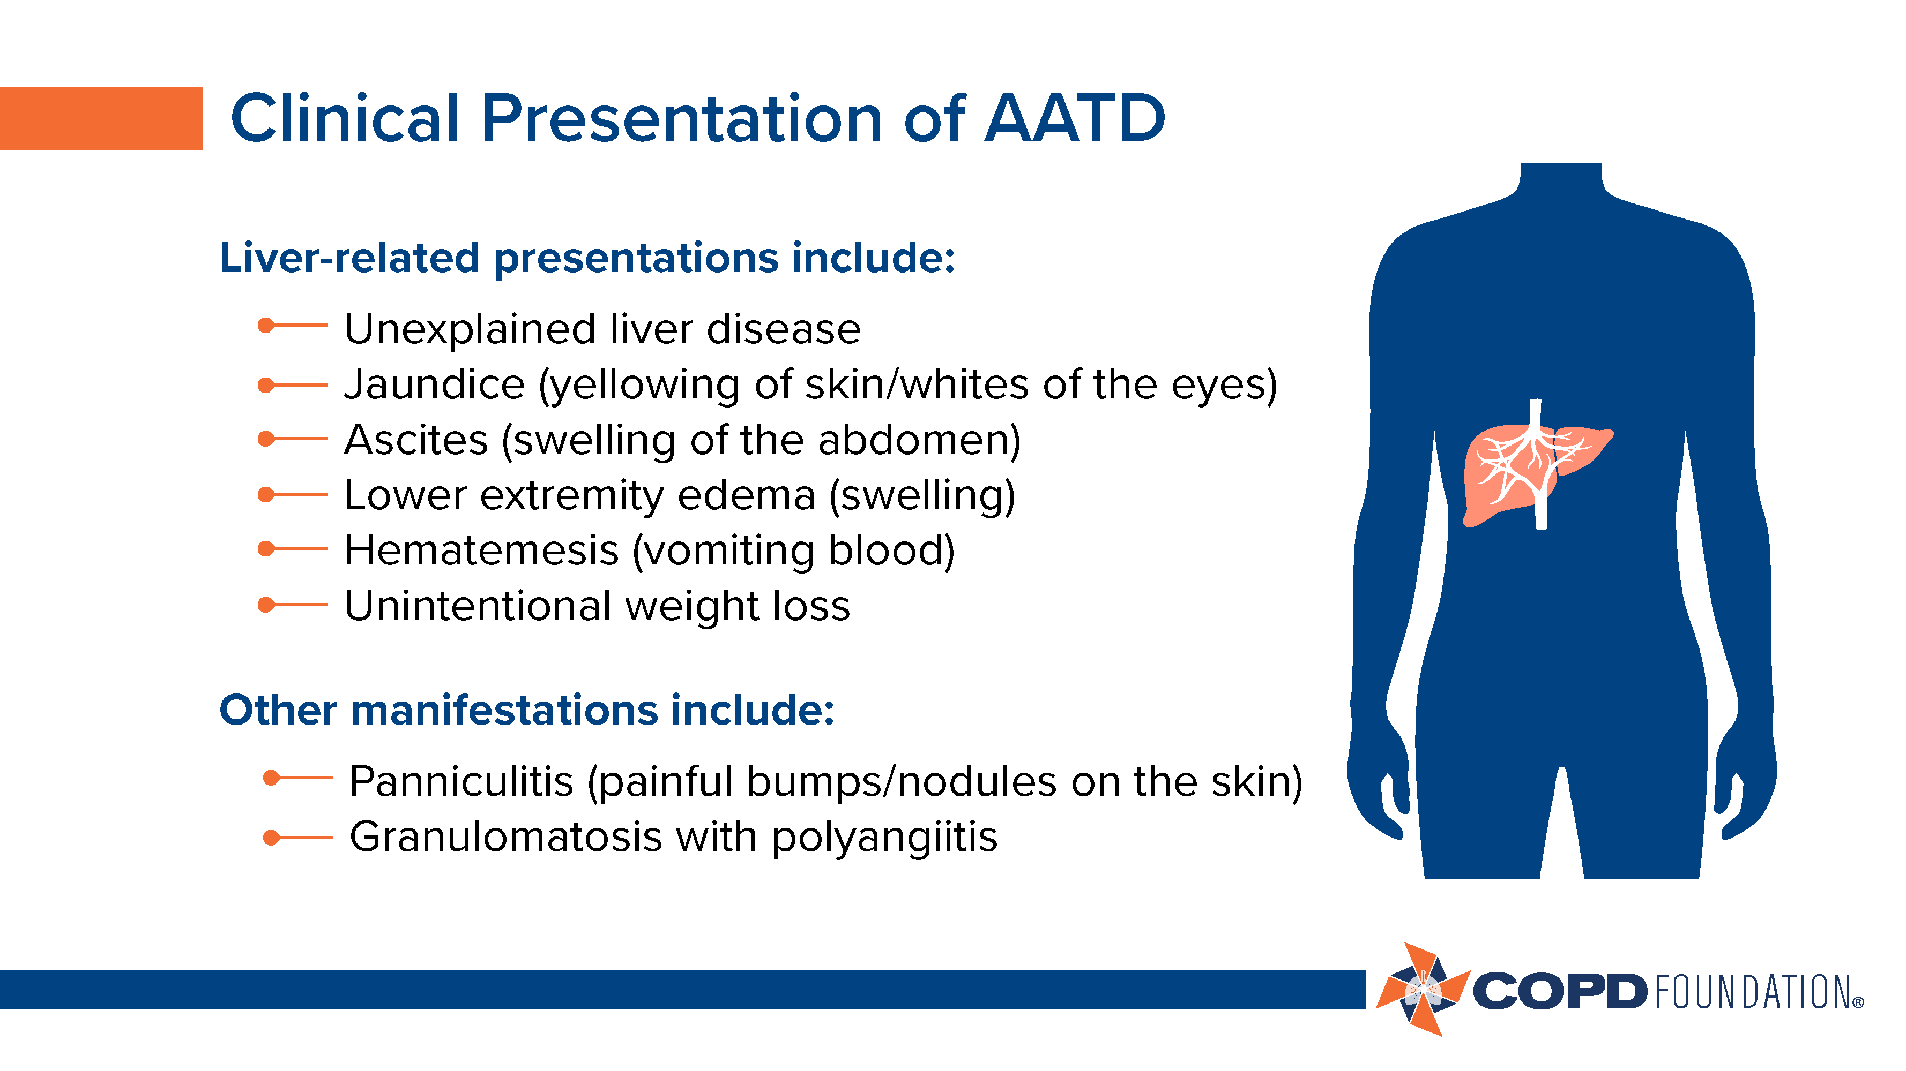

Slide 11


Slide 12
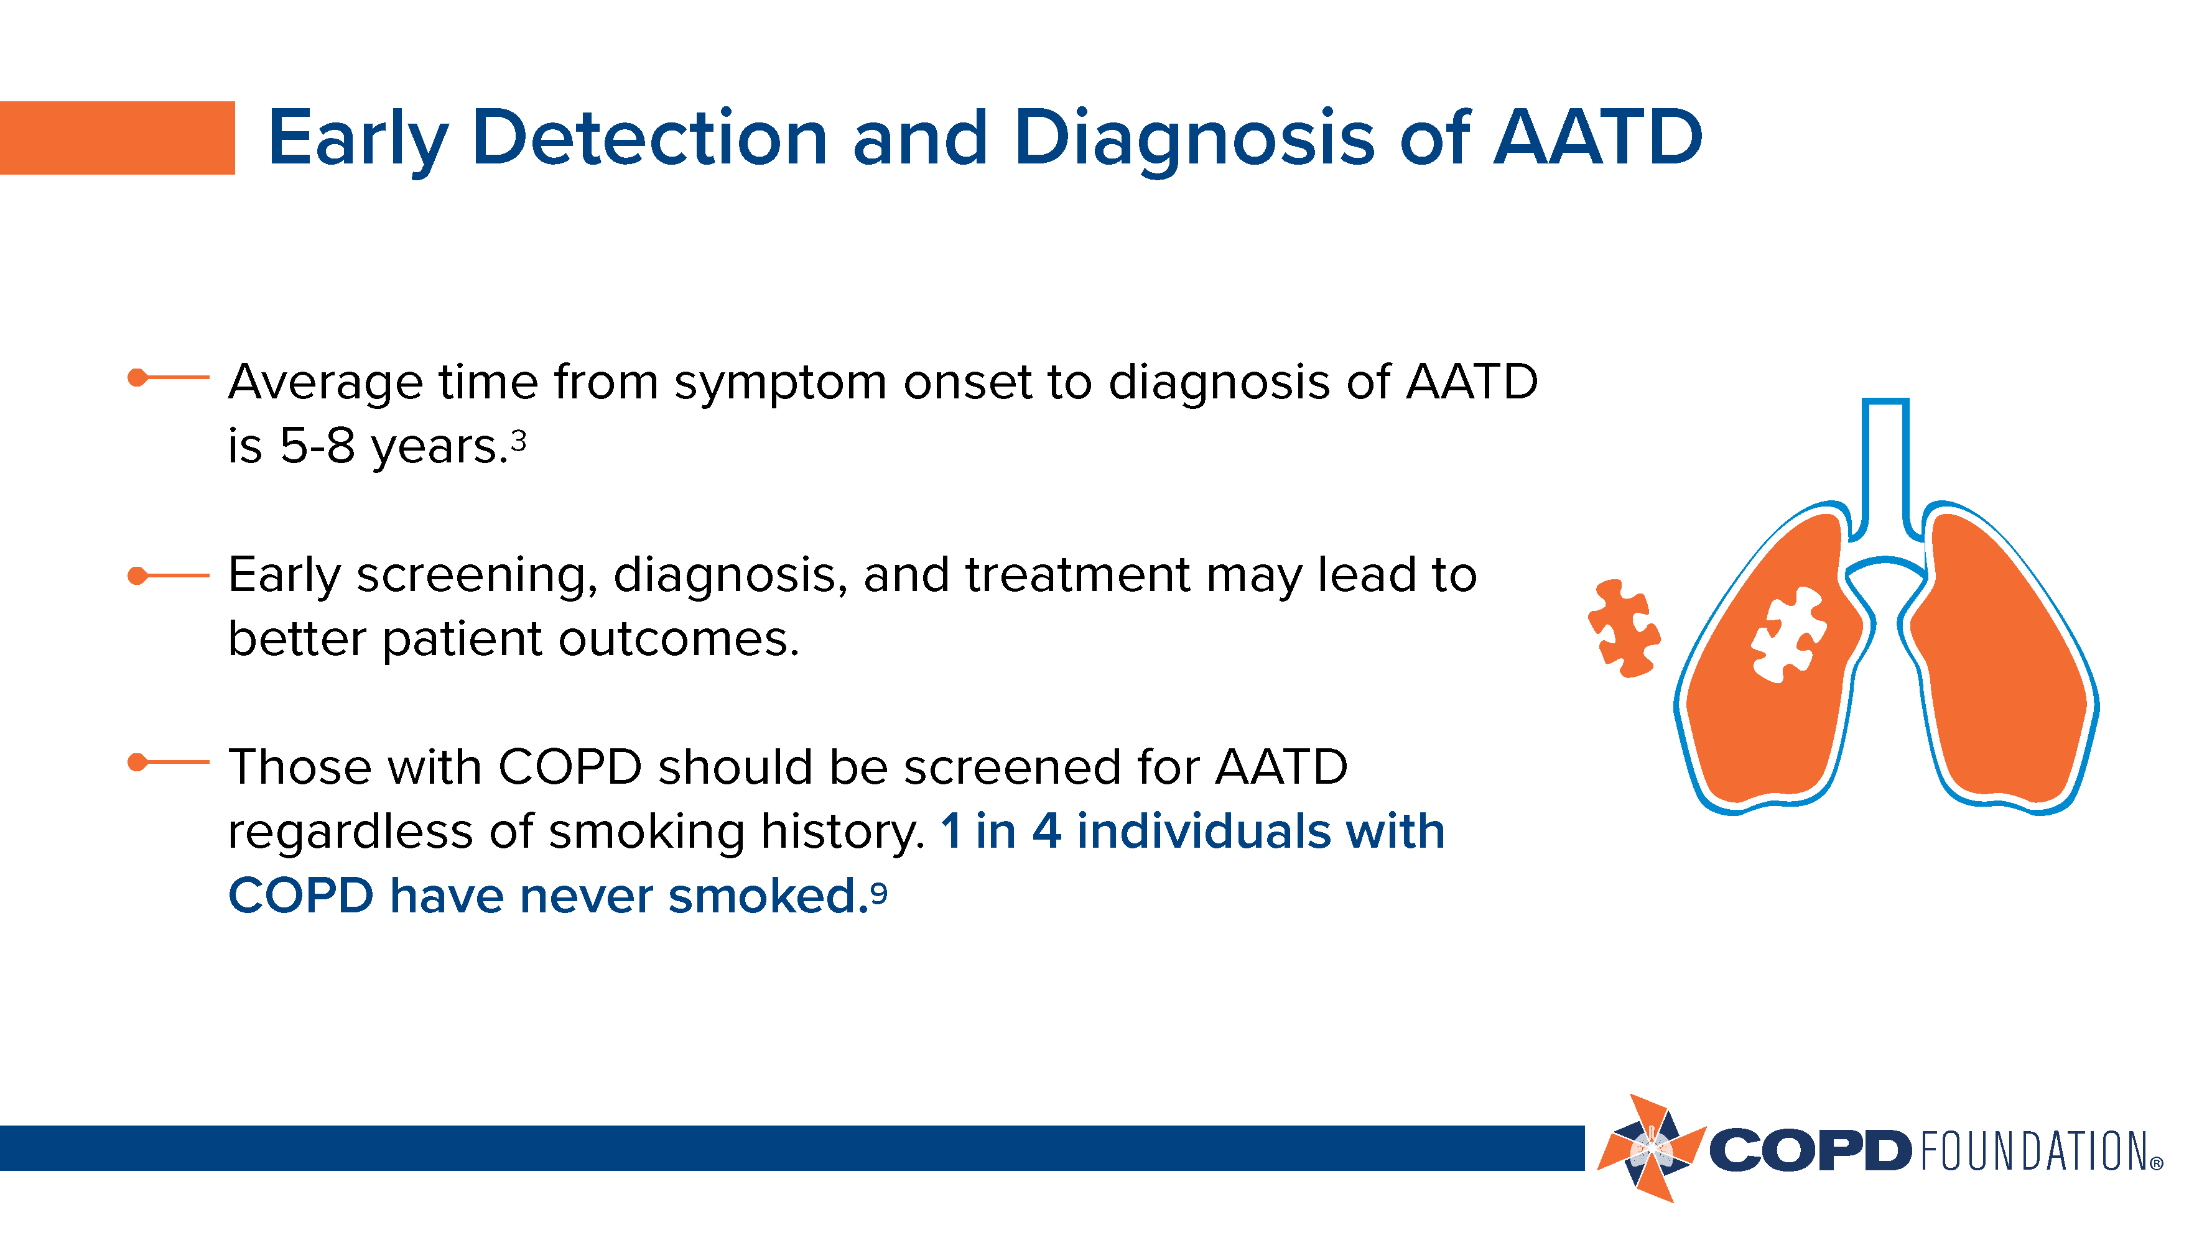

Slide 13
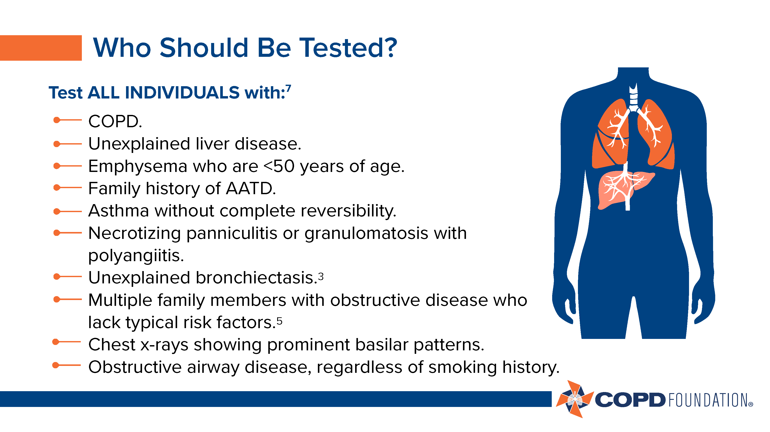

Slide 14
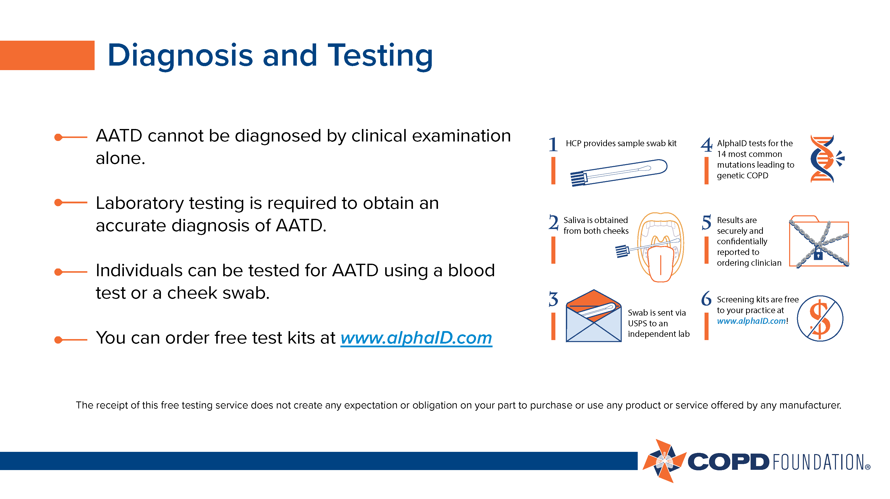

Slide 15


Slide 16
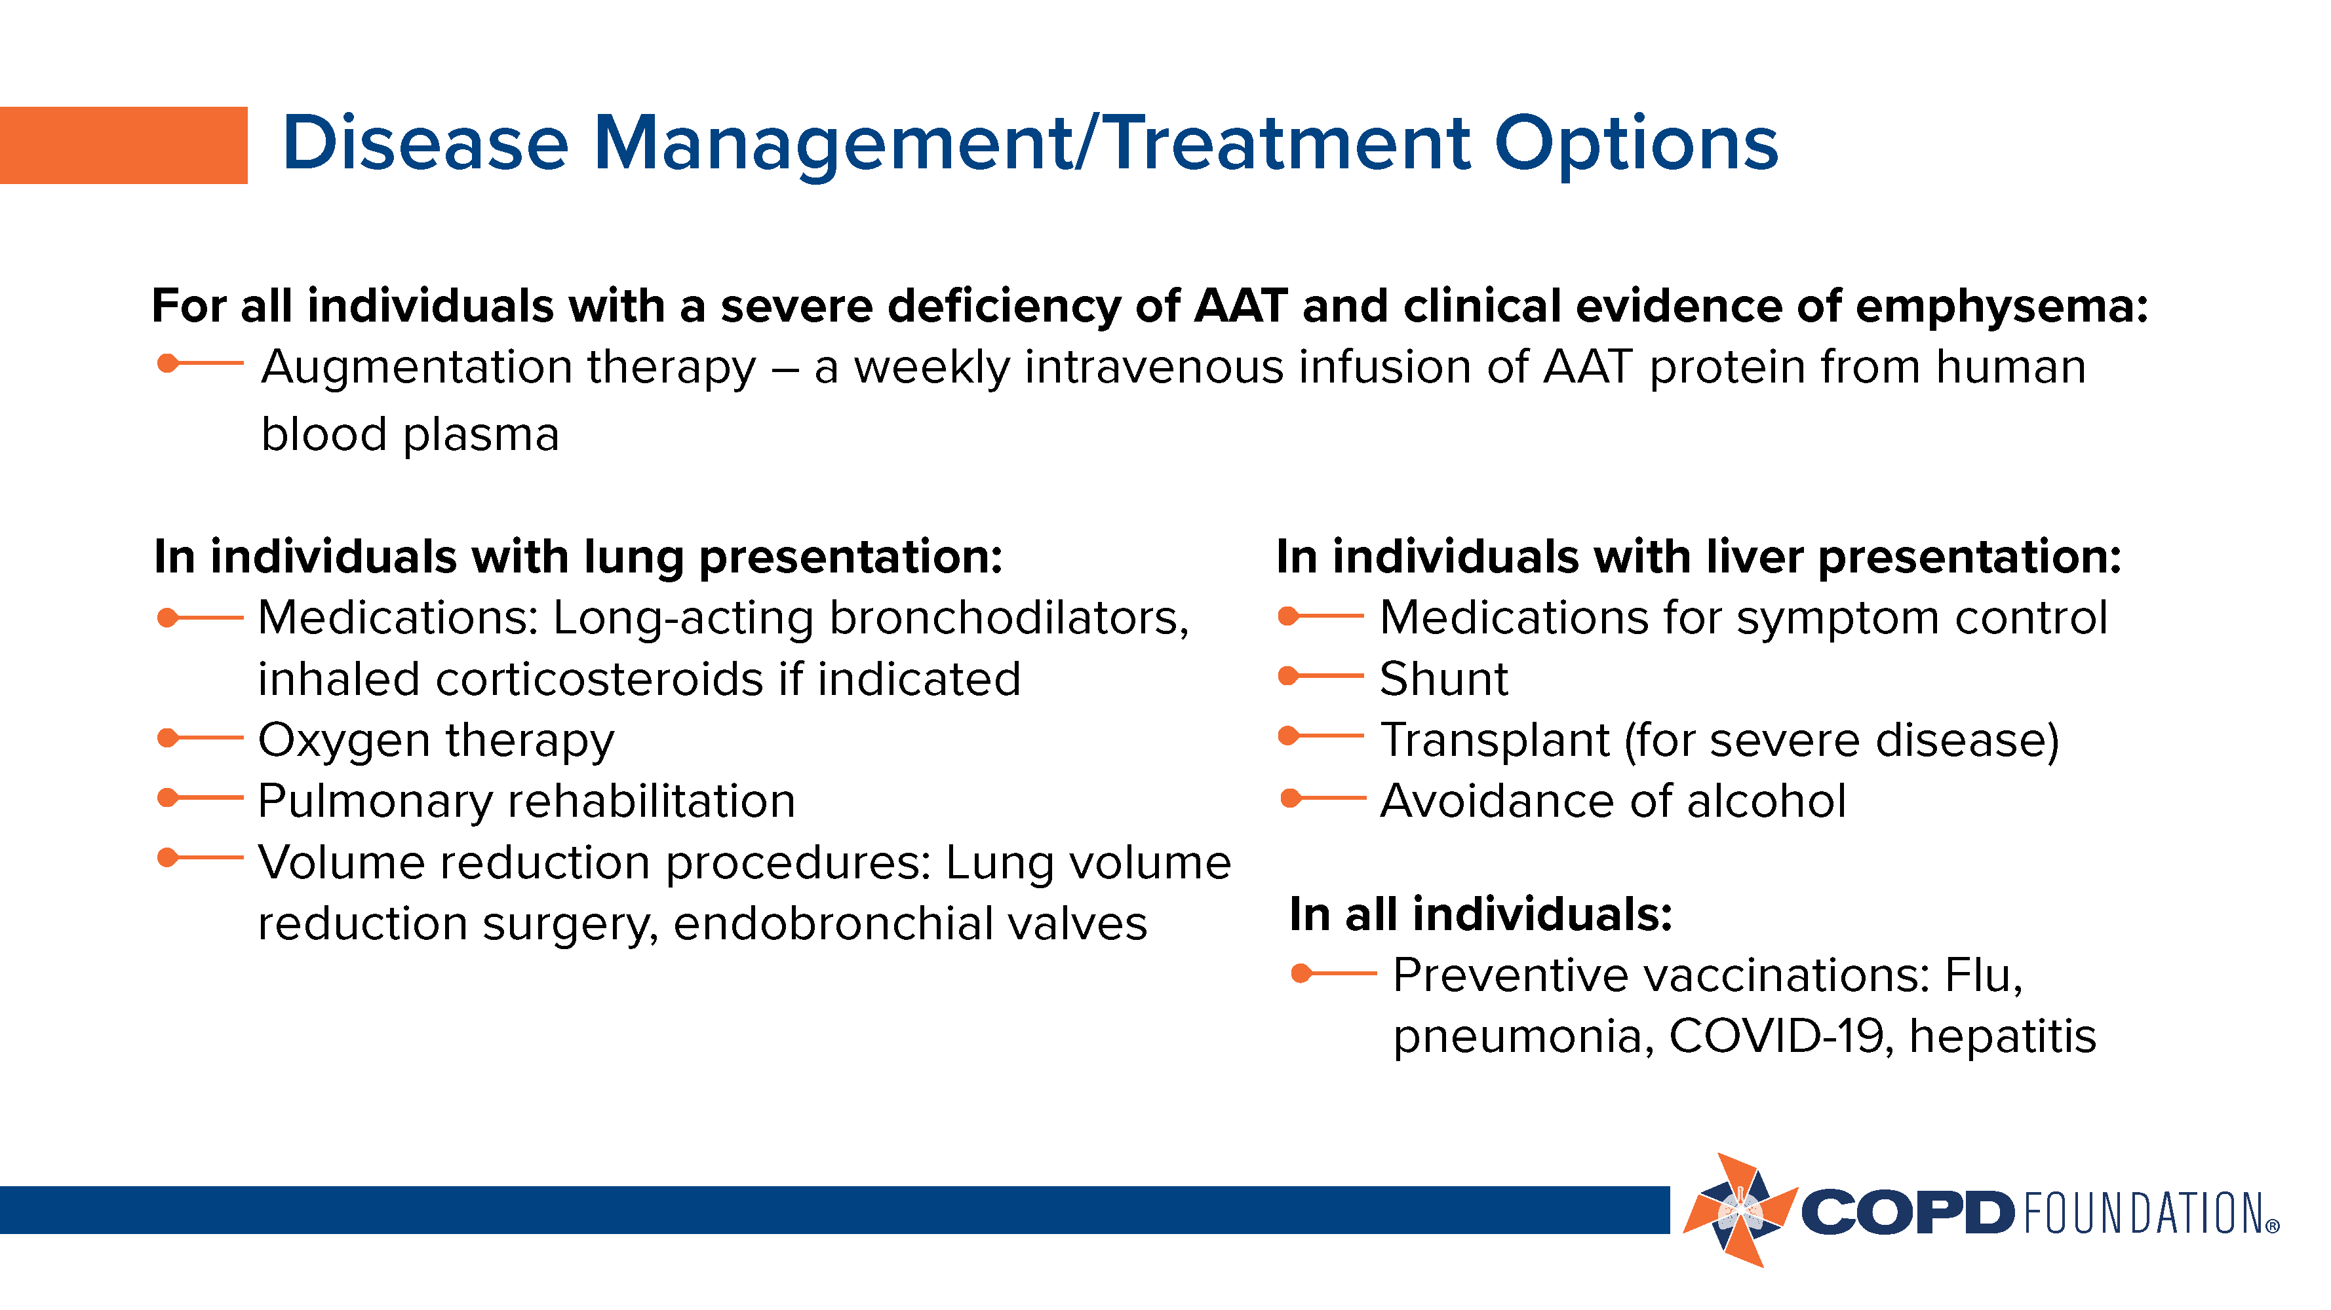

Slide 17


Slide 18
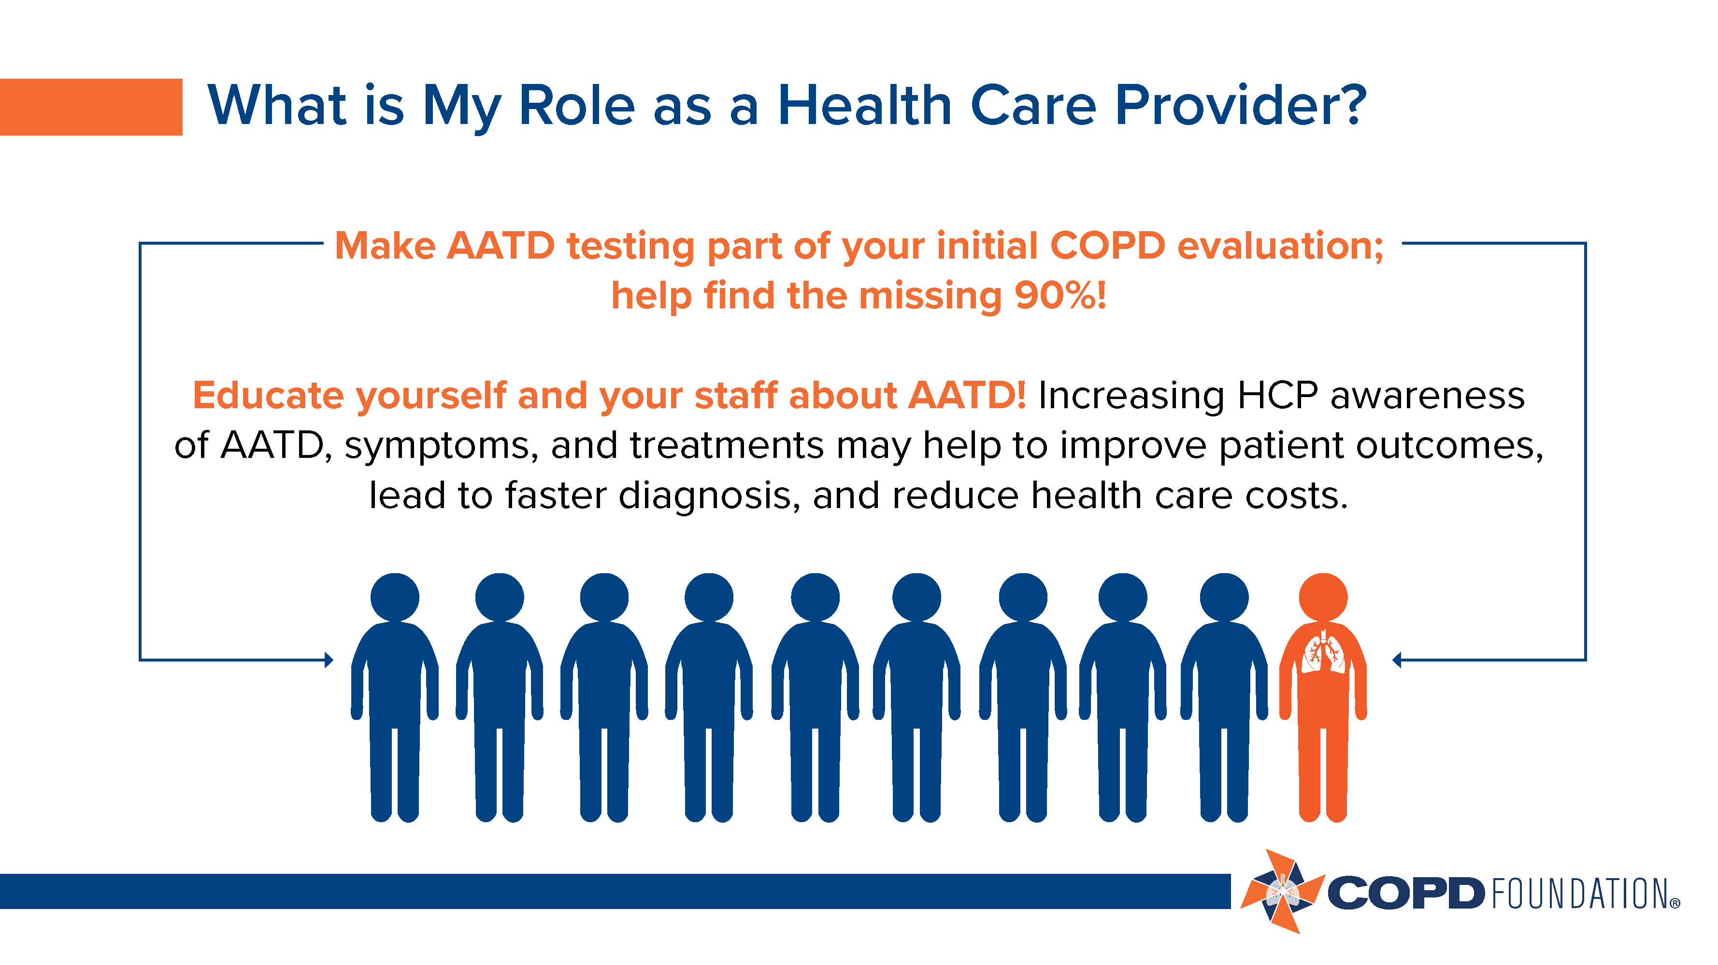

Slide 19
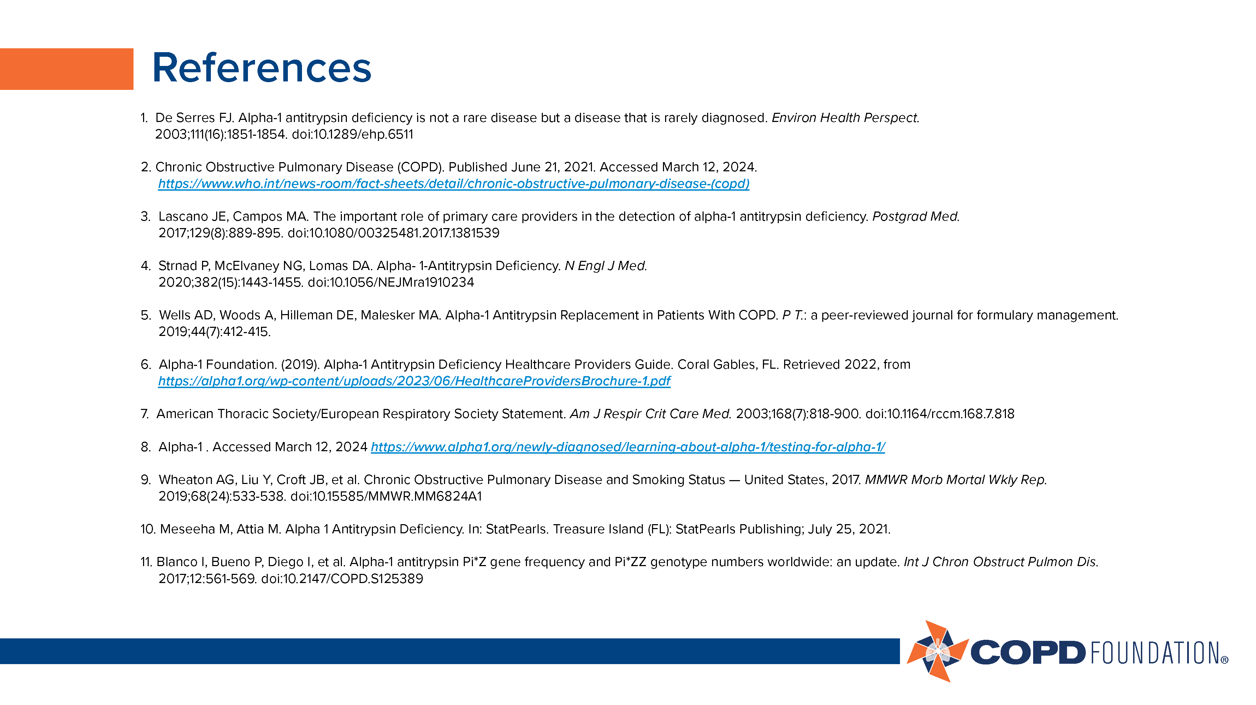

Slide 20


Slide 21
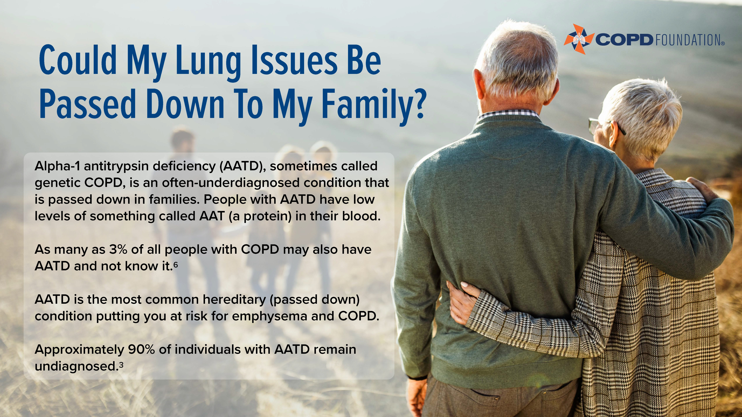

Slide 22


Slide 23
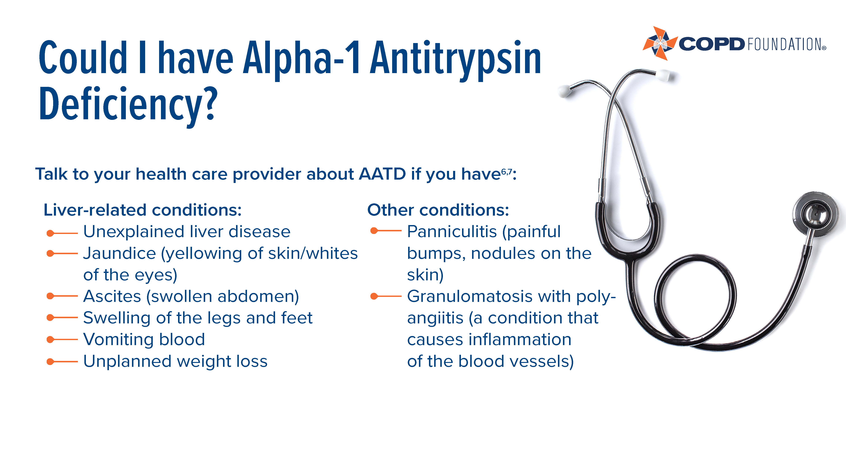

Slide 24
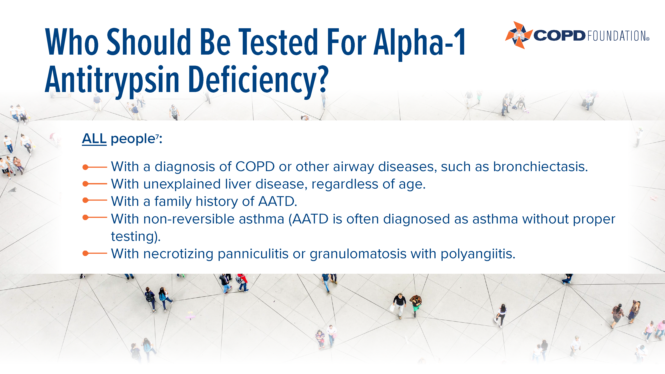

Slide 25
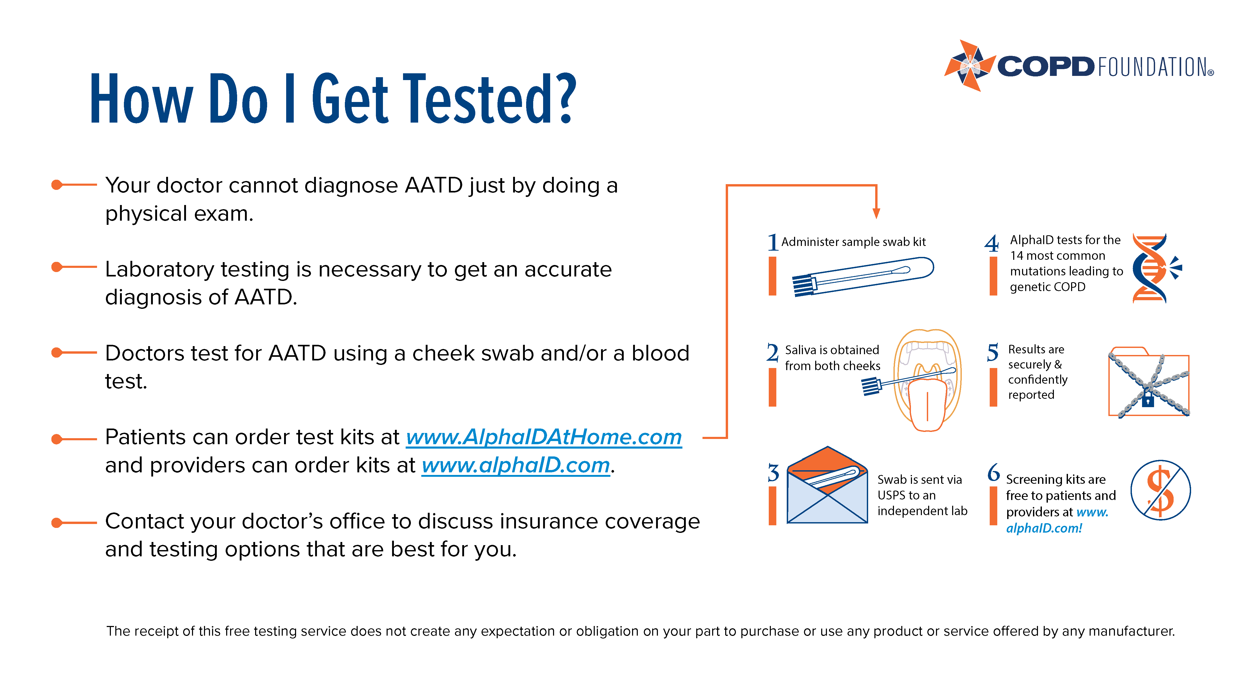

Slide 26


Slide 27


Slide 28
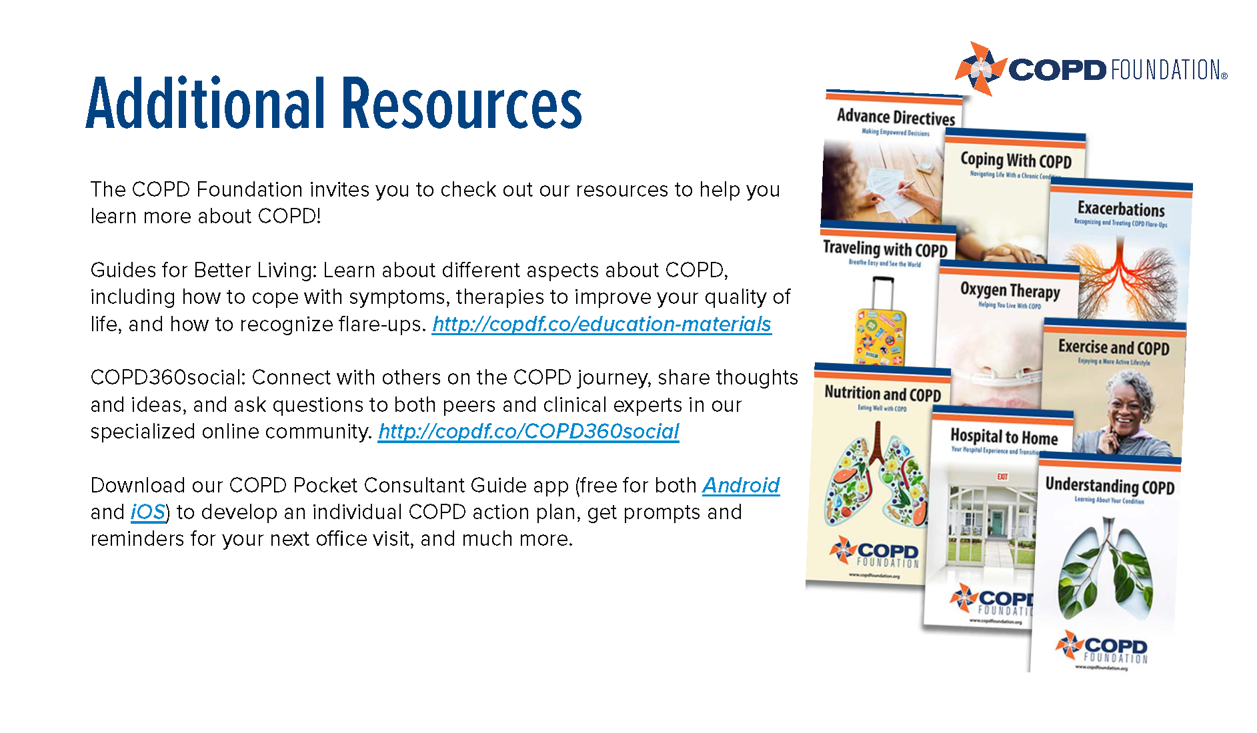

Slide 29

Notes:
Thank you to Grifols for supporting these educational materials.
For additional information or support, please contact the COPD Foundation at info@copdfoundation.org or 1-866-731-COPD (2673).

