Slide 1
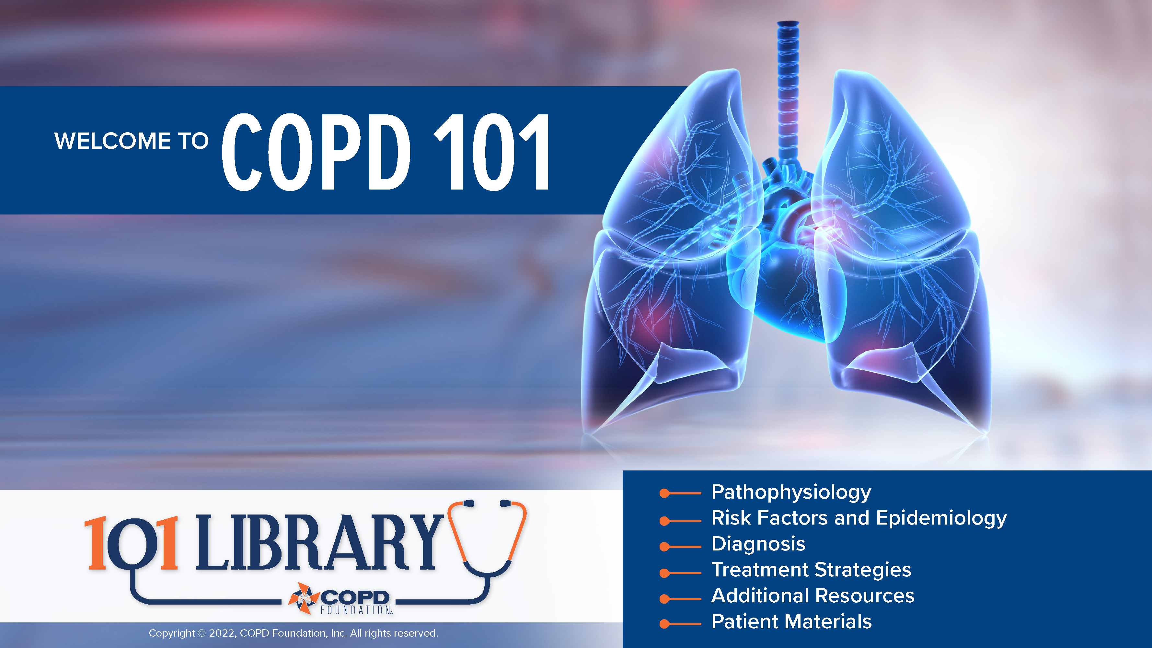
Notes:
Welcome! This presentation is intended to provide an overview of key points of chronic obstructive pulmonary disease (COPD) from a clinical standpoint. In addition, we have provided resources for supplemental learning as well as patient materials to facilitate communication and discussion (particularly among the newly-diagnosed).
We hope these materials are of benefit to you and your practice. Please contact us at info@copdfoundation.org with comments, concerns, or to request the PowerPoint version of this document.
Copyright © 2022, COPD Foundation, Inc. All rights reserved.

Slide 2
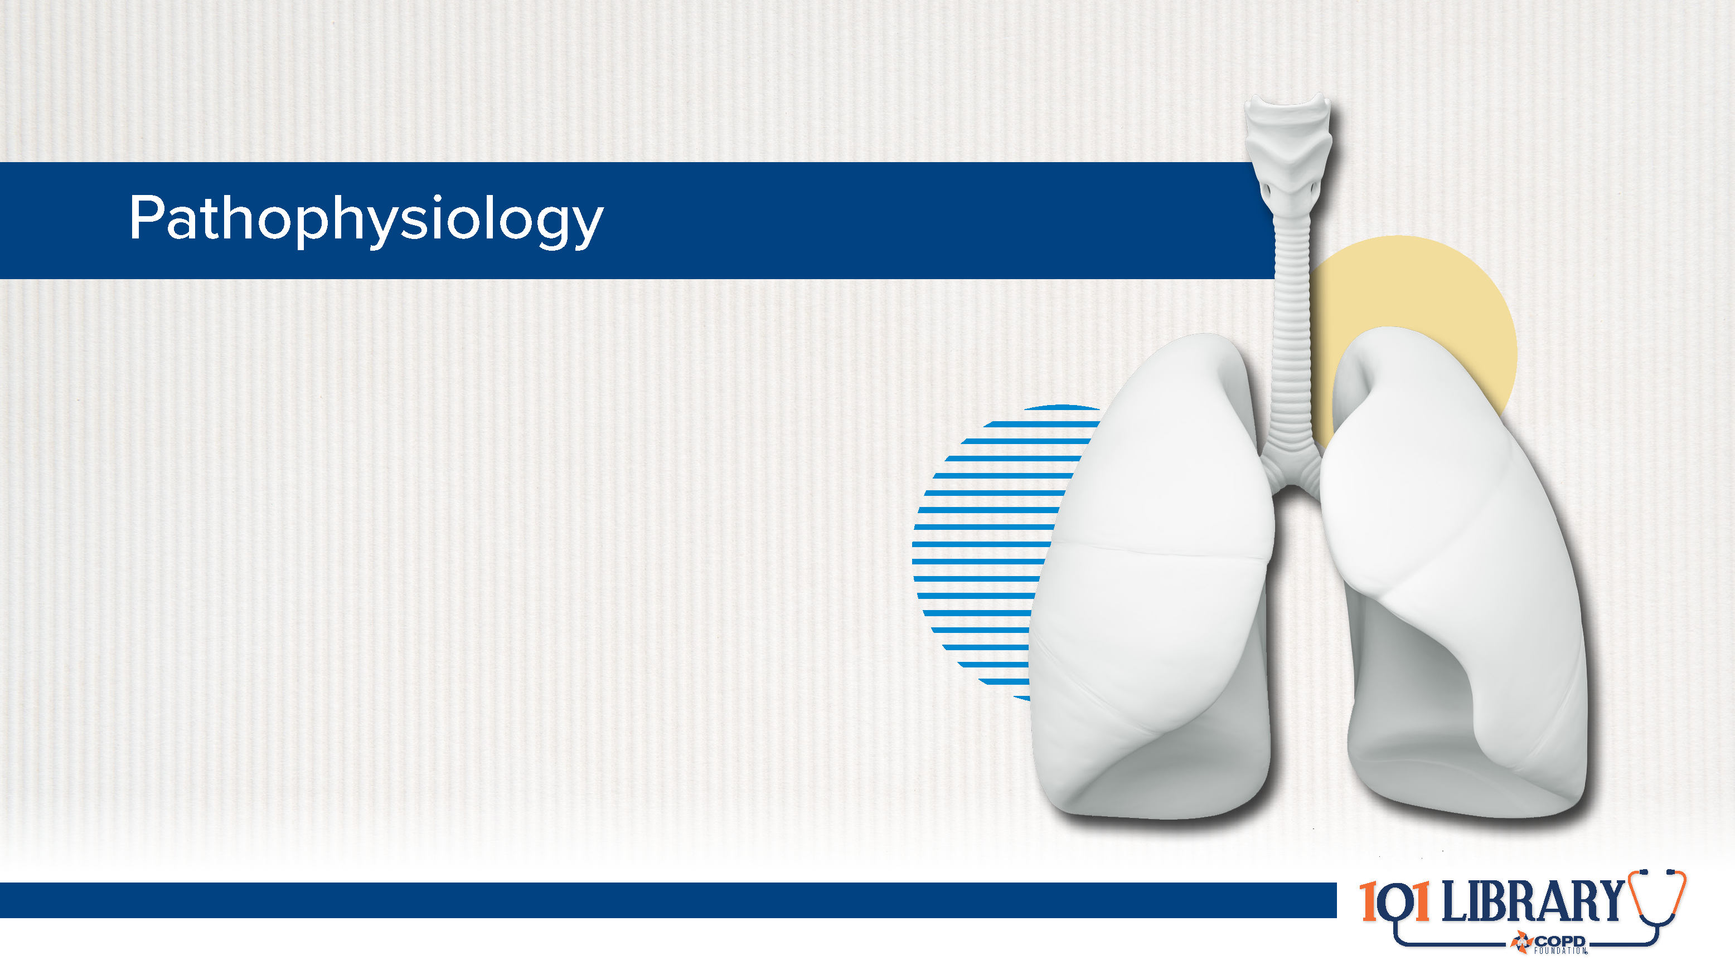

Slide 3
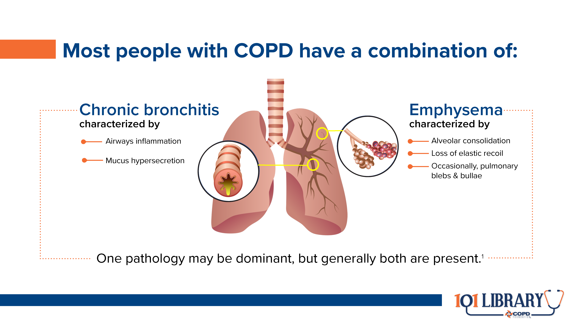
Notes:
Chronic bronchitis is often diagnosed as a chronic cough with mucus production lasting for at least three months, with multiple bouts over the course of at least two years. Emphysema can be detected using radiographic imaging. Initial symptoms (cough, shortness of breath, fatigue) may present as nonspecific regardless of pathology(ies).

Slide 4
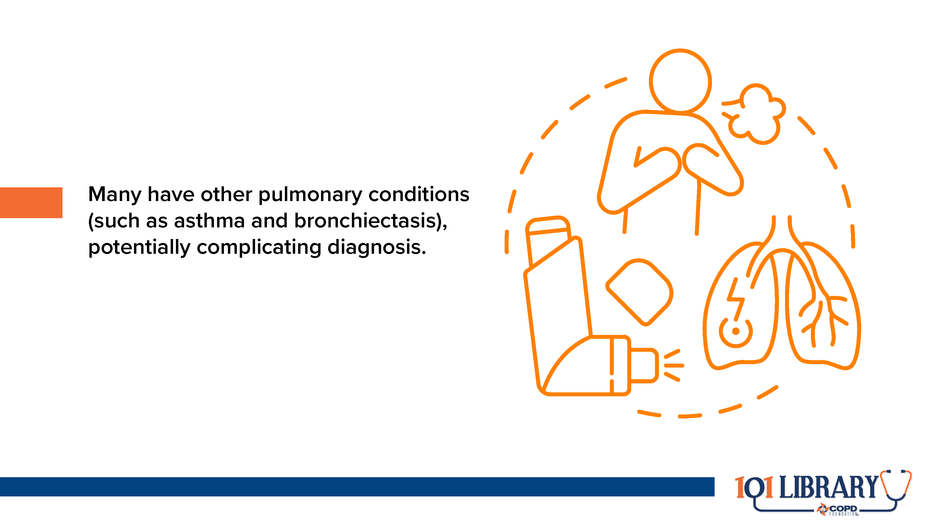
Notes:
The stereotype of people with COPD falling into specific categories like “pink puffers” or “blue bloaters” is now quite outmoded. Chronic bronchitis and emphysema can lead to each other (or develop simultaneously) and can also be worsened by the presence of asthma (especially if it is poorly controlled). Bronchiectasis, or a thickening of airway walls secondary to chronic infection, is also prevalent in the COPD population.

Slide 5
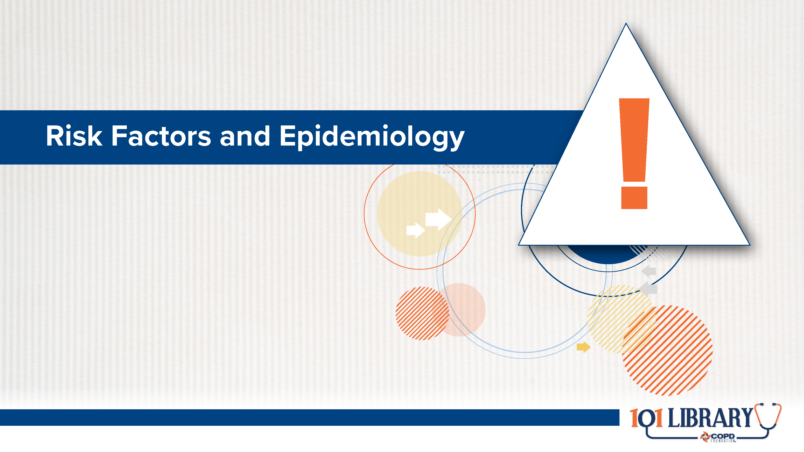

Slide 6
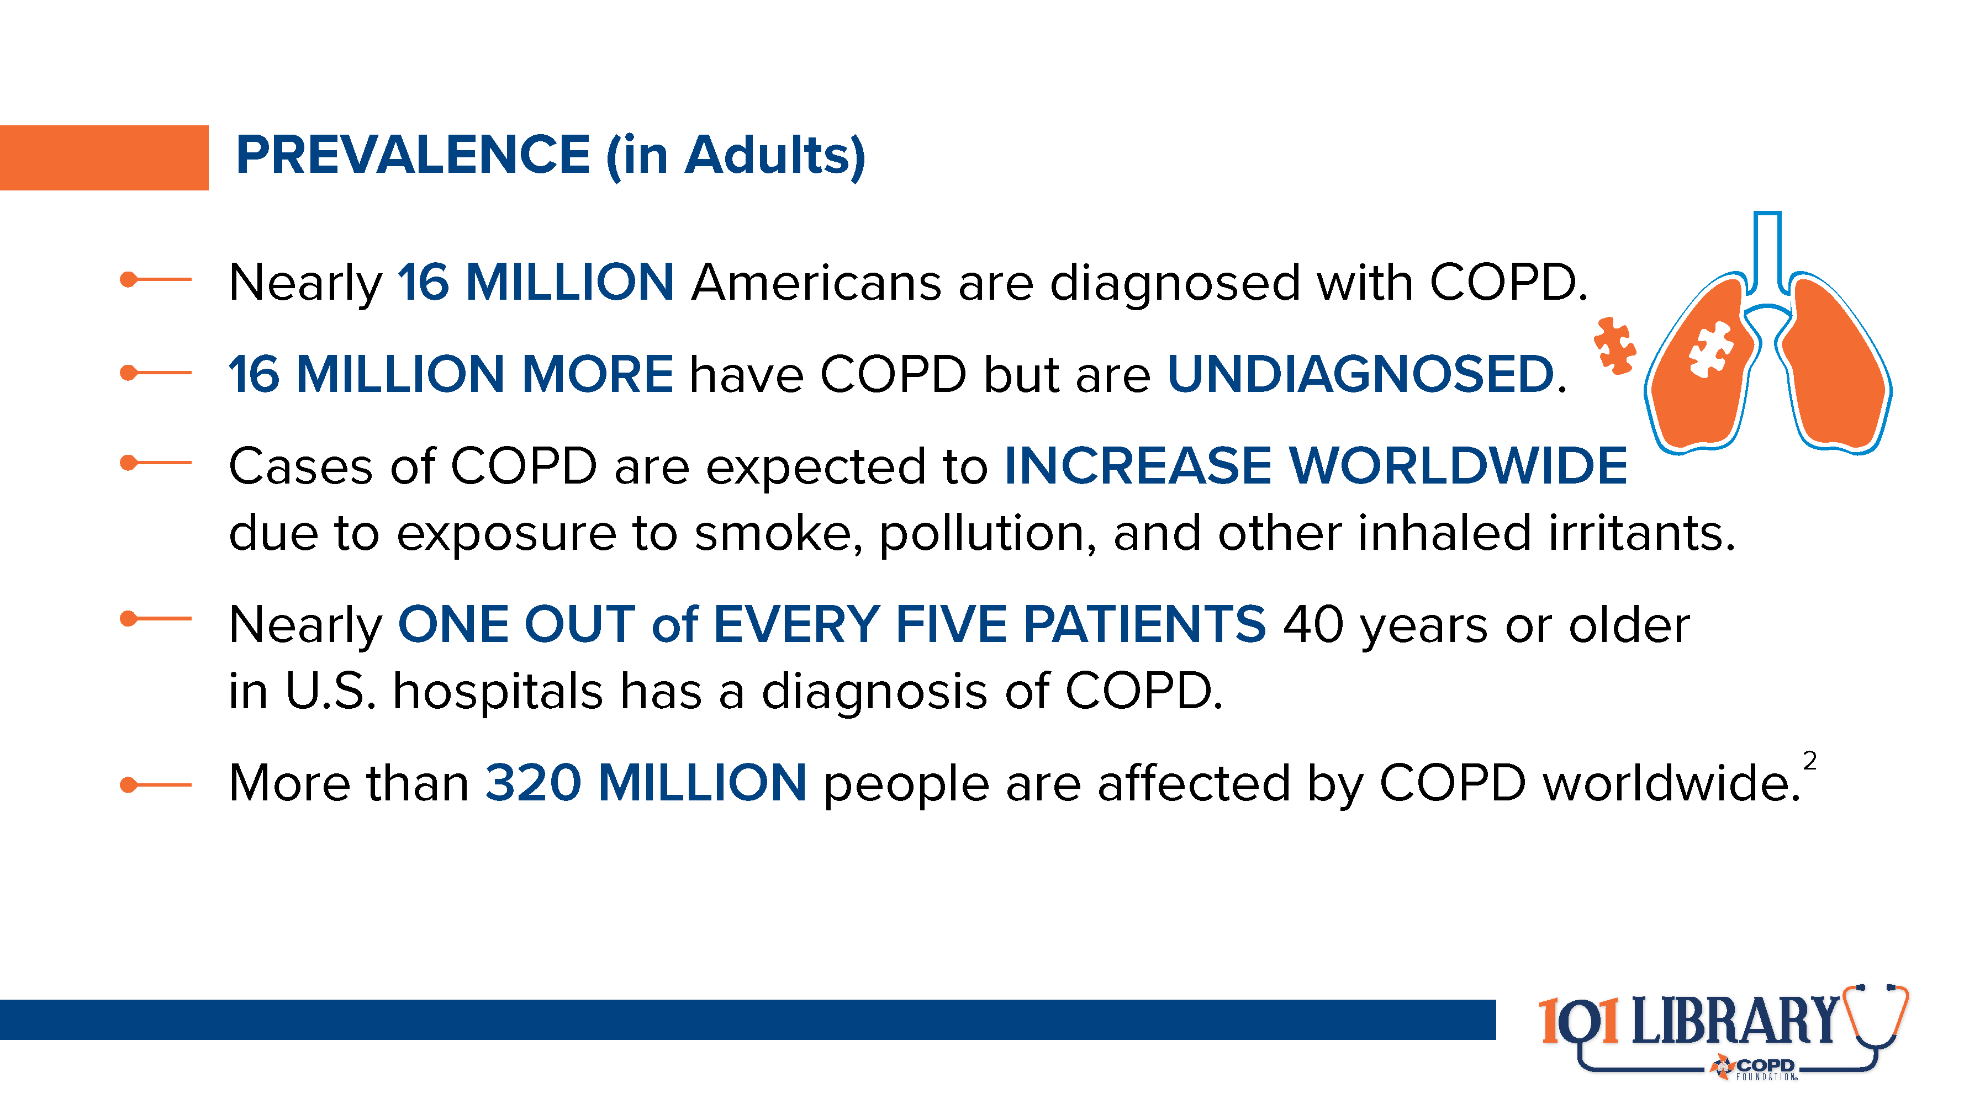
Notes:
The large population of people with undiagnosed COPD is often described as the “missing millions.” Improved screening and diagnostic procedures can help find these people and provide access to treatment options.

Slide 7
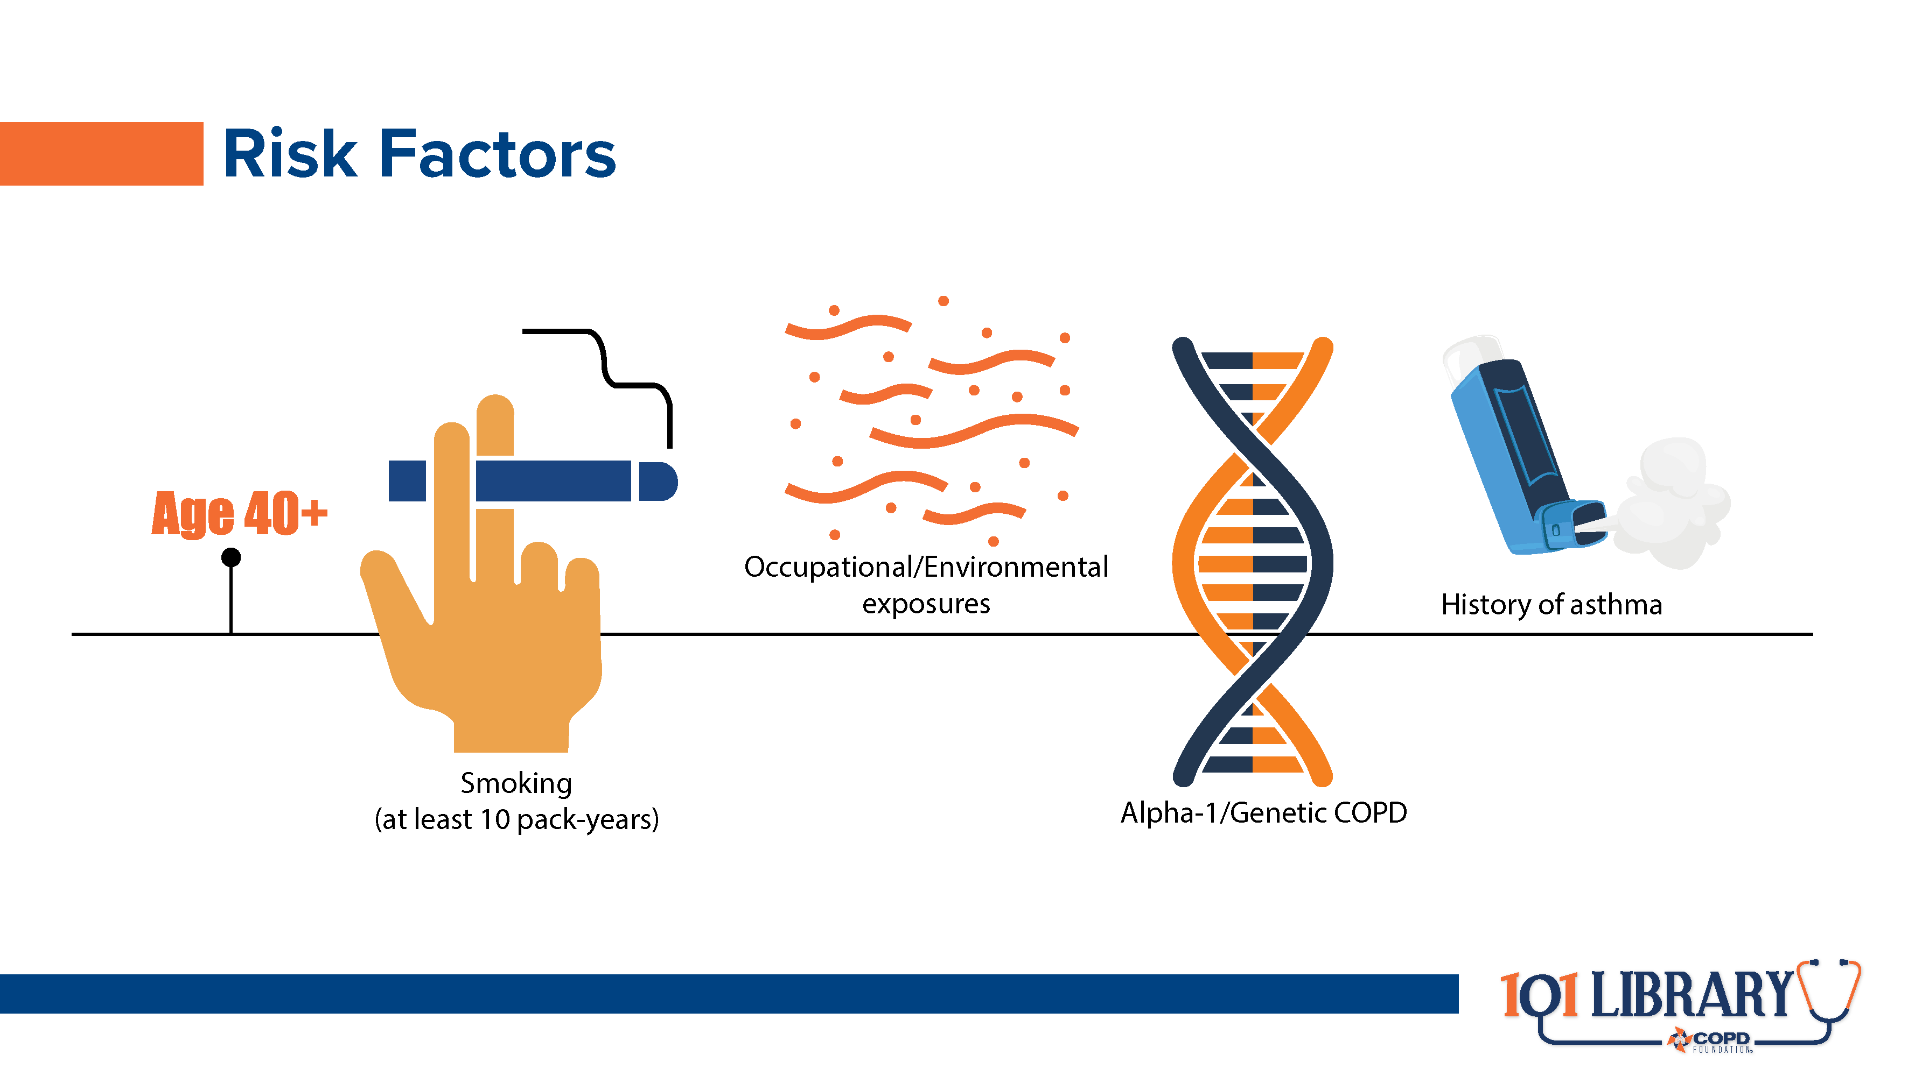
Notes:
Far from being only a “smoker’s disease,” roughly 20-25% of COPD cases occur in nonsmokers.³ Approximately 1-3% of COPD cases are caused by alpha-1 antitrypsin deficiency, which is genetically transmitted. For this reason, best practice standards indicate all people with evidence of chronic obstruction on spirometry should be screened for genetic COPD. This is a simple blood test or cheek swab that can be done in the office setting.

Slide 8
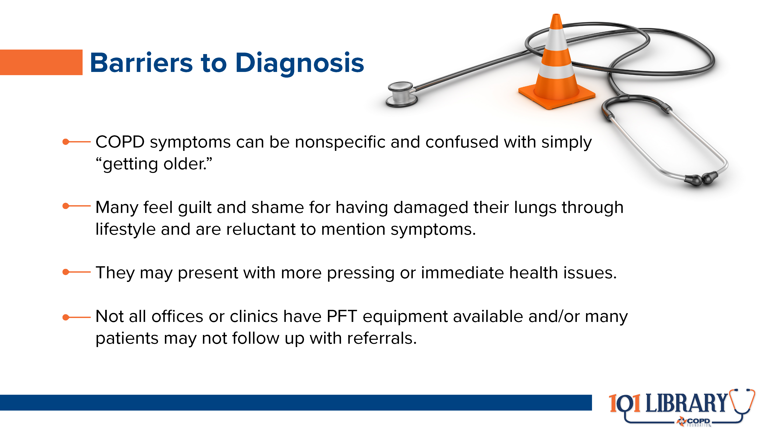
Notes:
Many barriers have been found to improving the diagnostic process.⁴ First and foremost, conversations with patients experiencing shortness of breath and/or chronic cough can tease out additional context and improve their comfort level. Pulmonary function testing, particularly high-quality spirometry, is also essential.

Slide 9
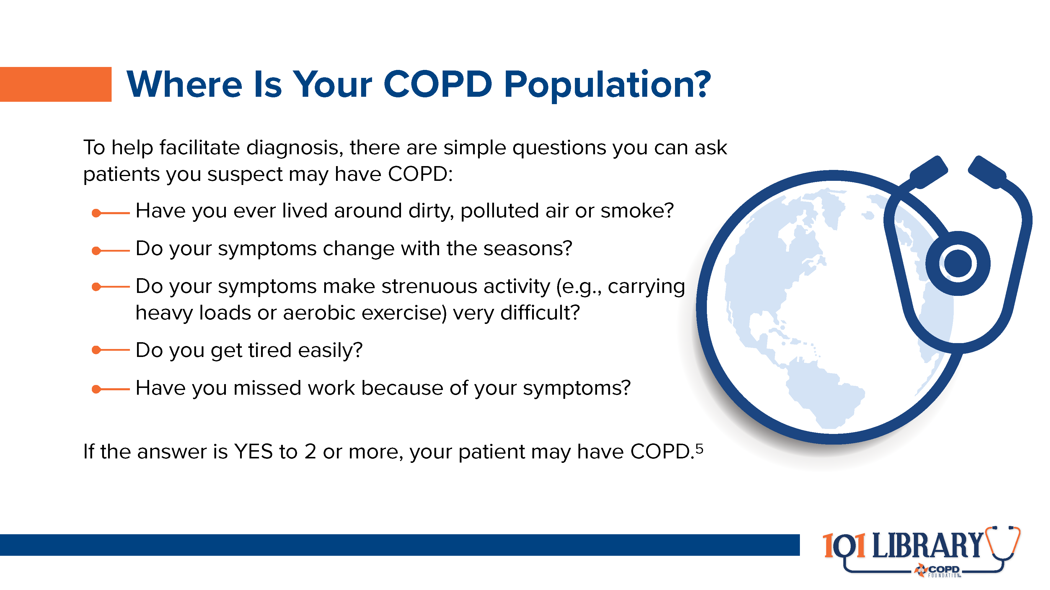

Slide 10


Slide 11
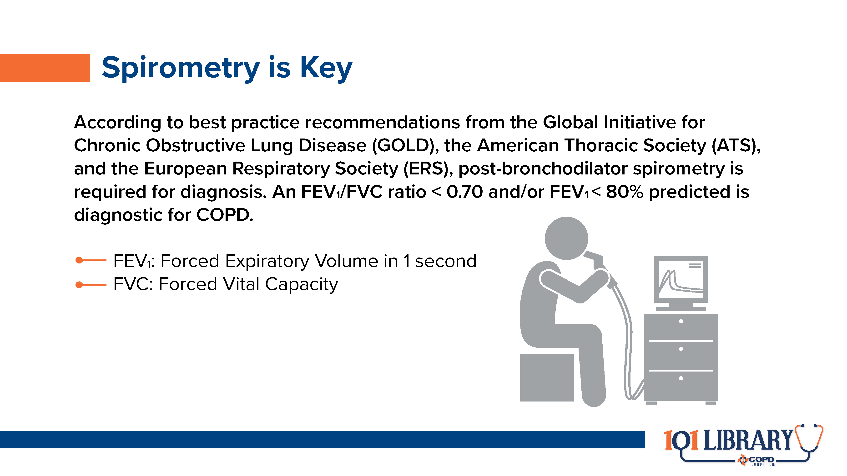
Notes:
It is important to note that optimal technique and maximal effort are all essential to gathering high-quality data through spirometry. Test subjects require active coaching for best results. Clinicians may want to consider a full pulmonary function test, including diffusion capacity (DLCO), for additional context.

Slide 12
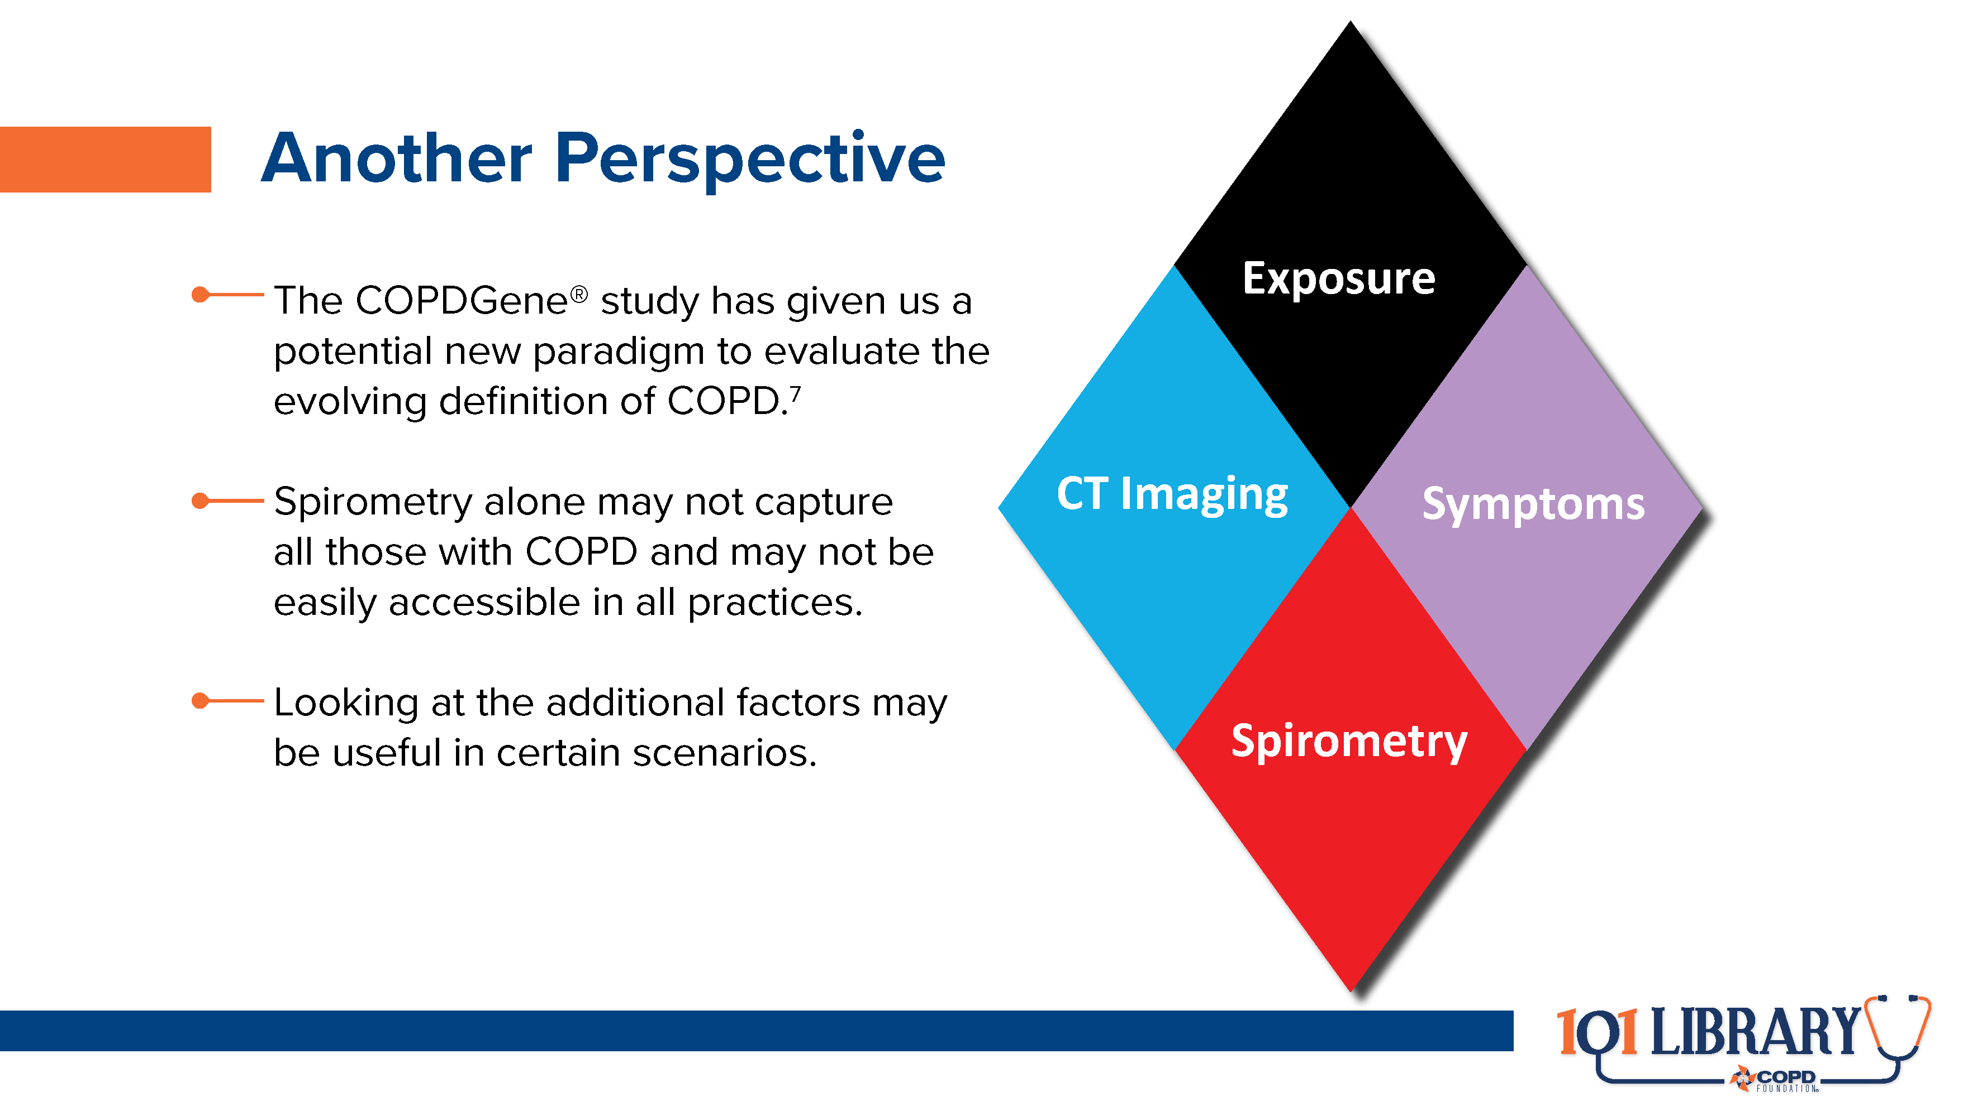
Notes:
The COPDGene study has given us a wealth of information and may represent a more comprehensive way to find and treat people with COPD and related symptoms than the traditional reliance on spirometry alone.⁷

Slide 13
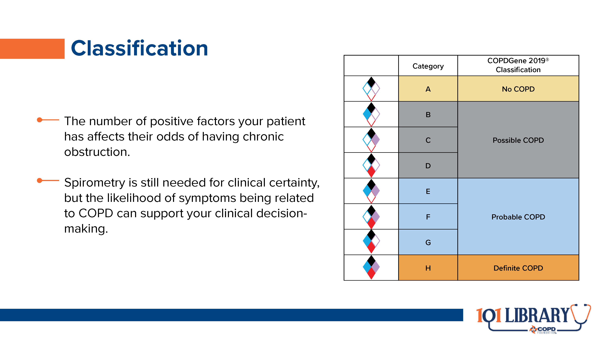

Slide 14
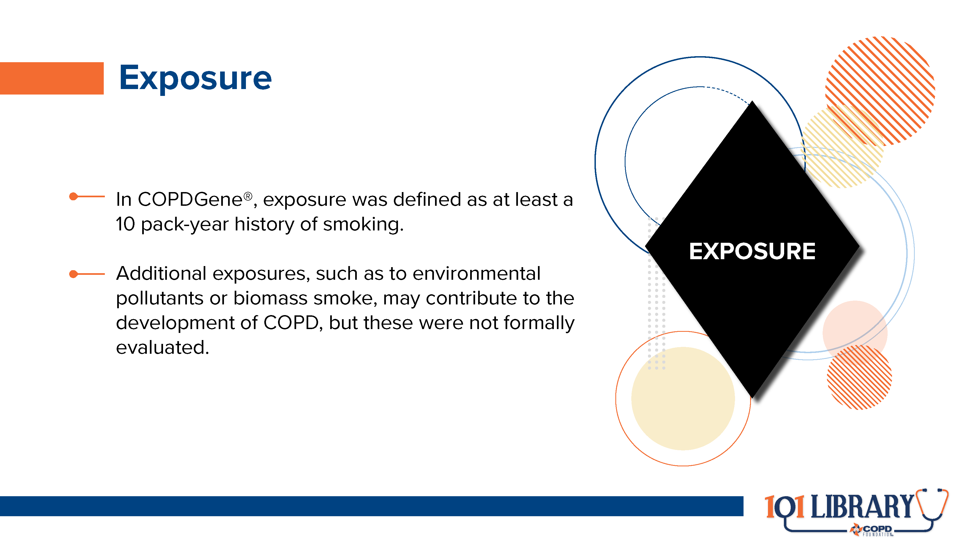

Slide 15
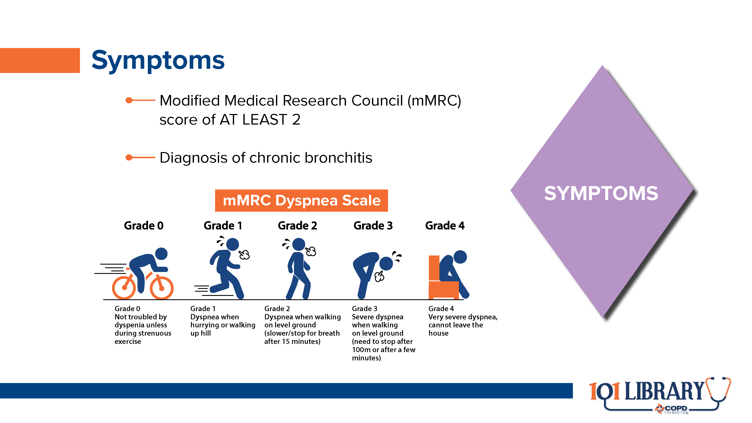

Slide 16
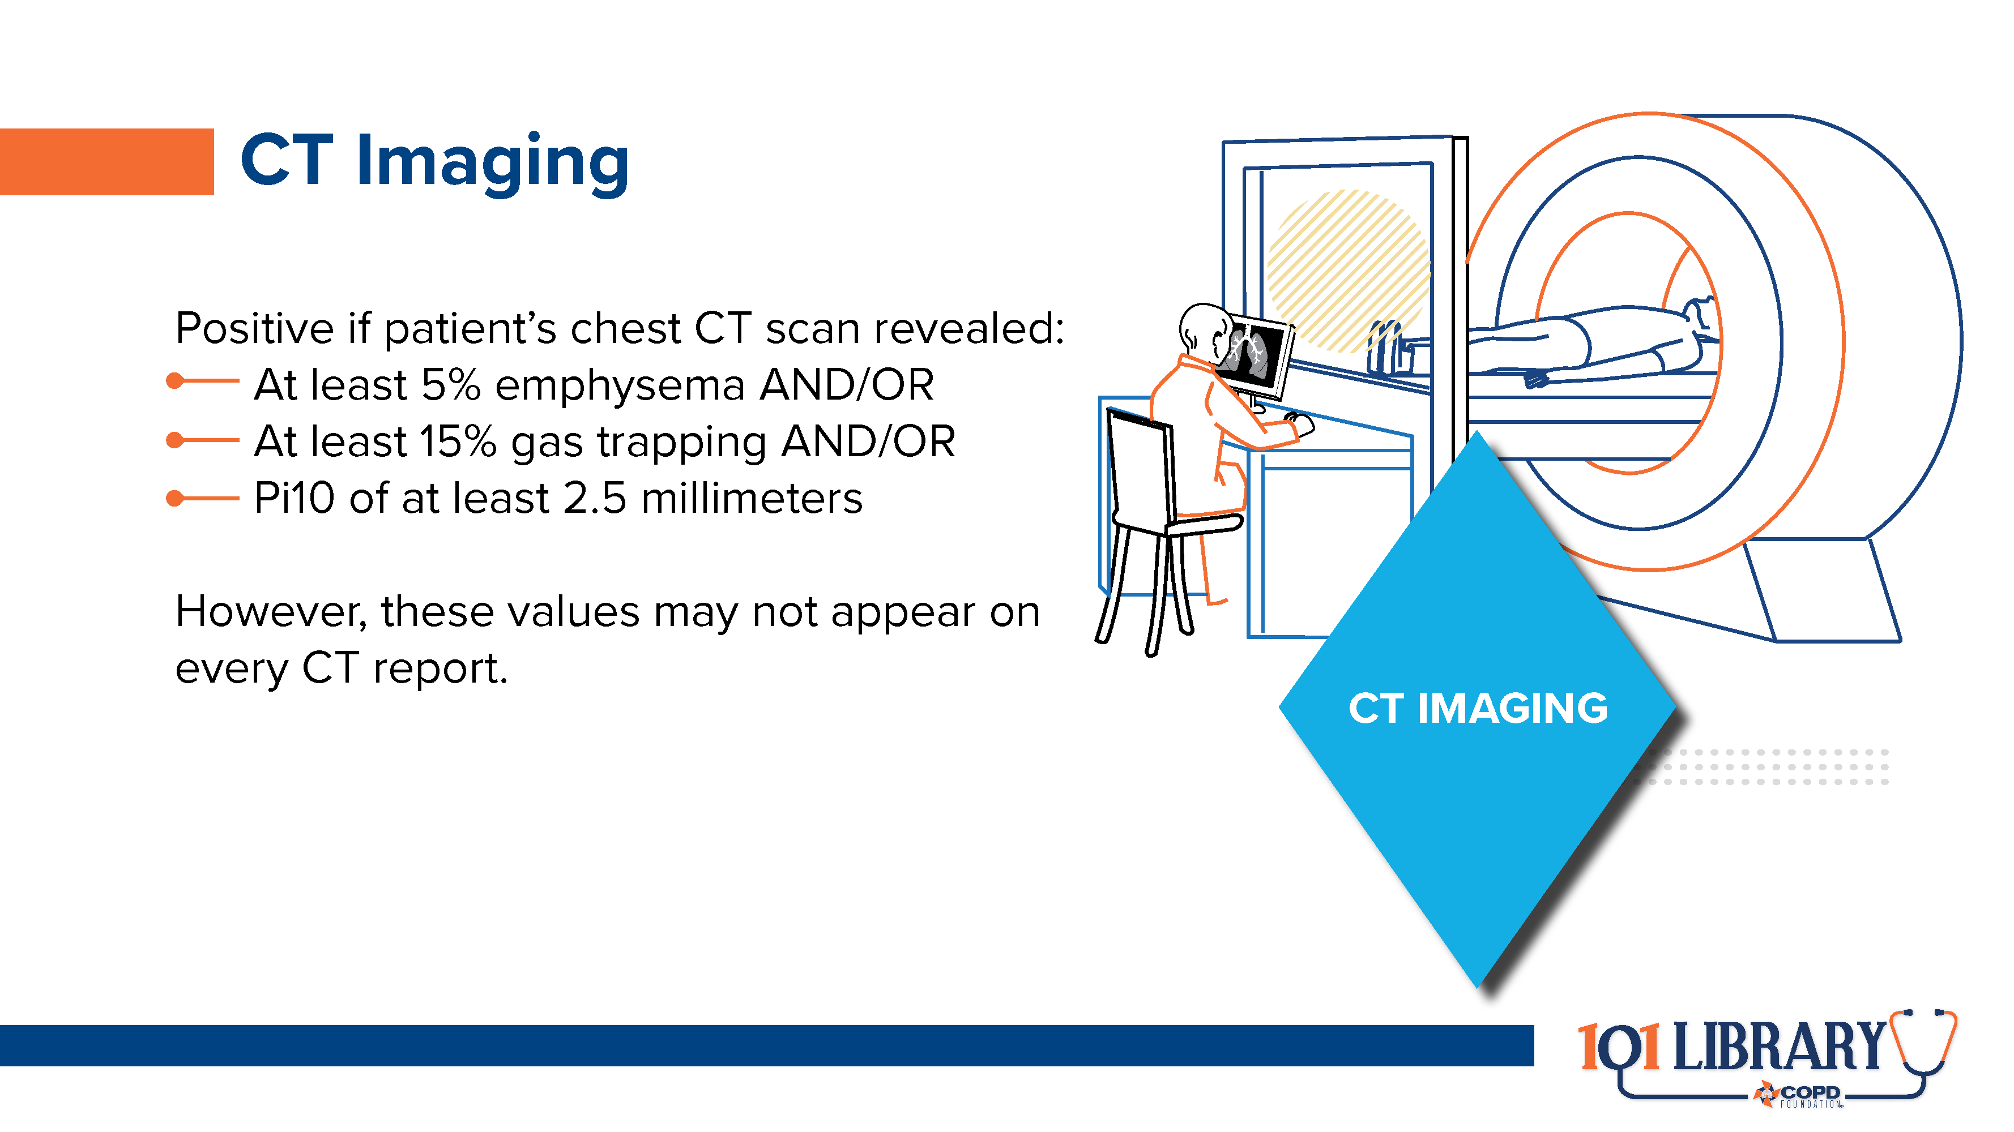
Notes:
Emphysema was defined as a low attenuation area of 950 Hounsfield units of inspiratory CT. Gas trapping was defined as a low attenuation area of 856 Hounsfield units on inspiratory CT. Pi10 was defined as the square root of airway wall area for a standardized airway of 10mm internal perimeter.

Slide 17
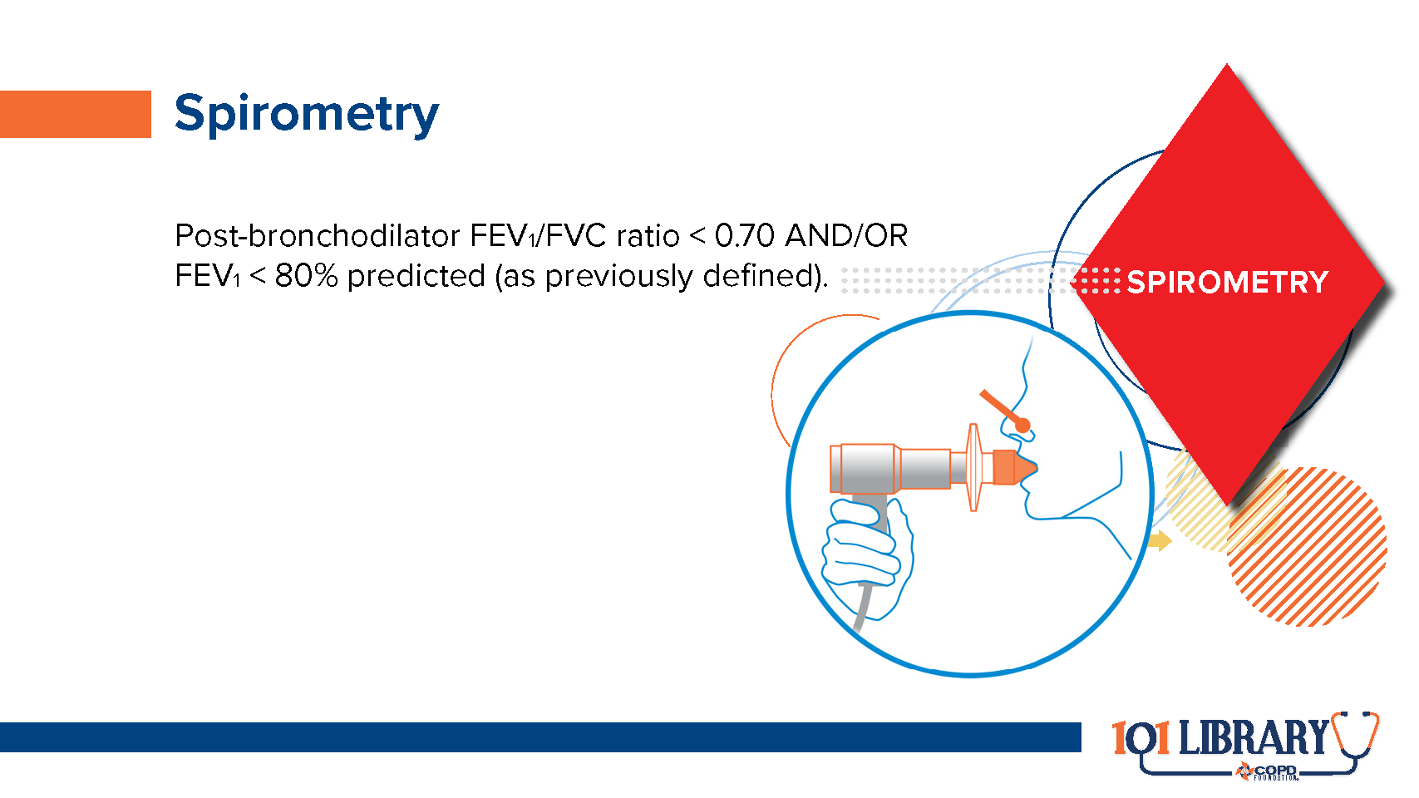

Slide 18


Slide 19
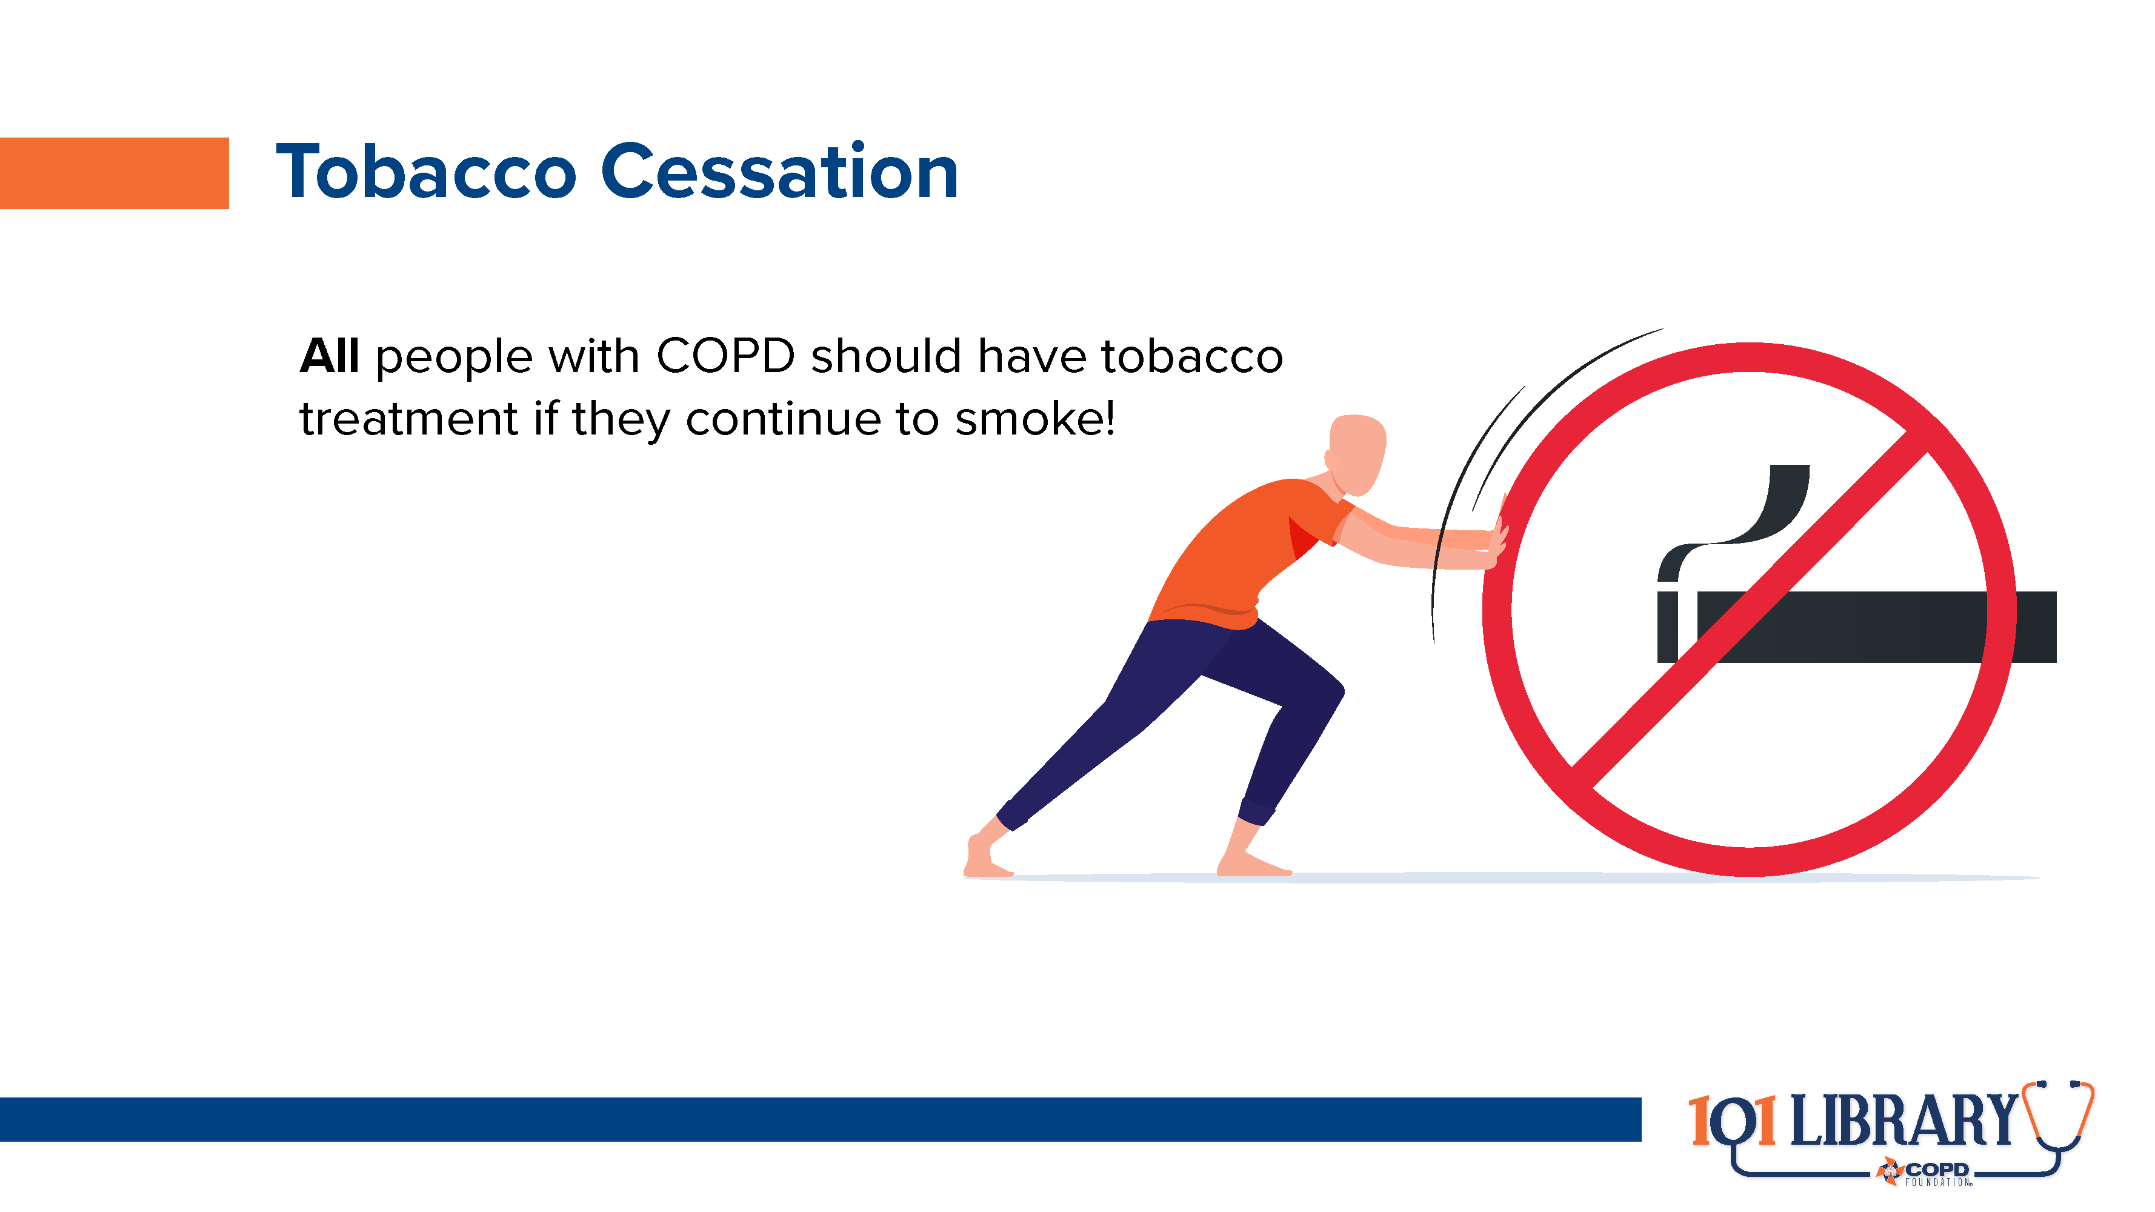
Notes:
Even if people are initially reluctant to discuss quitting or seem overwhelmed by the idea, the conversation is important. According to the CDC, even short discussions and advice have the potential to improve overall cessation rates. (https://www.cdc.gov/tobacco/data_statistics/fact_sheets/cessation/smoking-cessation-fast-facts/index.html)

Slide 20
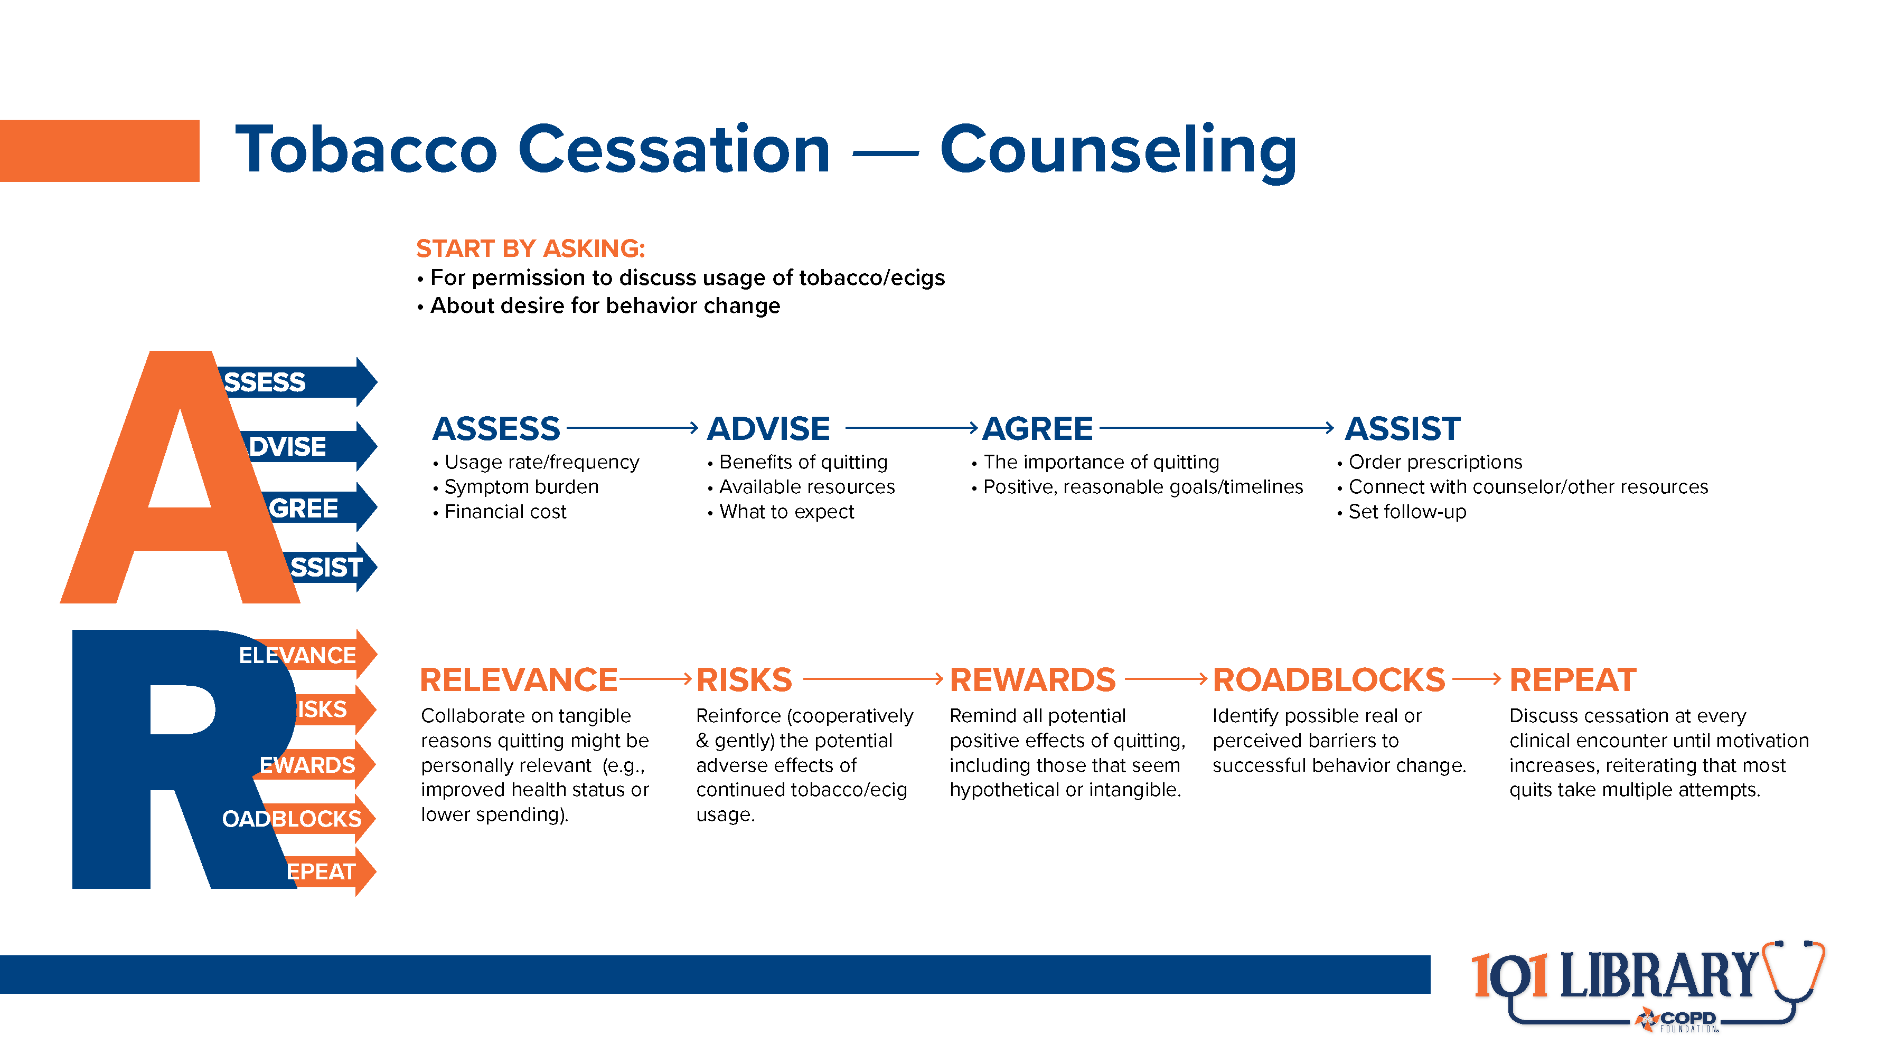
Notes:
Tobacco treatment counseling is highly individualized, but always starts with the “5As and 5Rs.^{8"} Techniques such as motivational interviewing, cognitive behavioral therapy, and shared decision making go hand-in-hand to help the process along. Additional local resources, like peer counseling and the 1-800-QUIT-NOW helpline, can also assist.

Slide 21
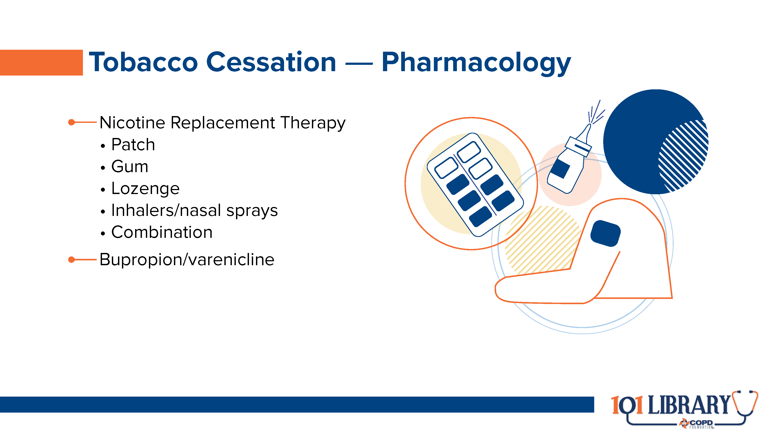
Notes:
In many cases, combinations of NRT types (along with bupropion or varenicline) may be indicated to more closely match the subject’s nicotine intake patterns and more effectively manage their levels.

Slide 22
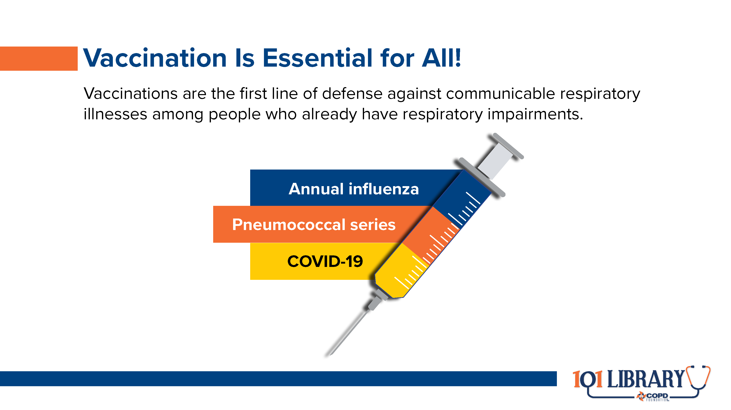
Notes:
Vaccines for respiratory conditions are critically important to help guard against infections that can lead to acute exacerbations of COPD and subsequent accelerated disease progression.

Slide 23
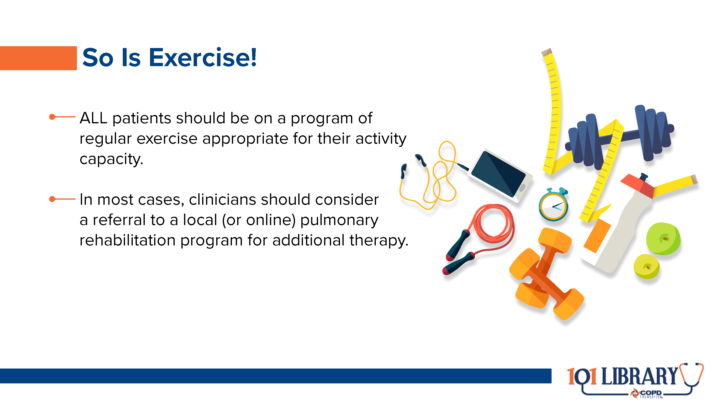
Notes:
Pulmonary rehabilitation is a program of monitored exercise and disease management education for people with chronic respiratory conditions like COPD.⁹ These programs are often overlooked but are invaluable for improving health care-related quality of life and managing symptom burden, which often leads to lower mortality.

Slide 24
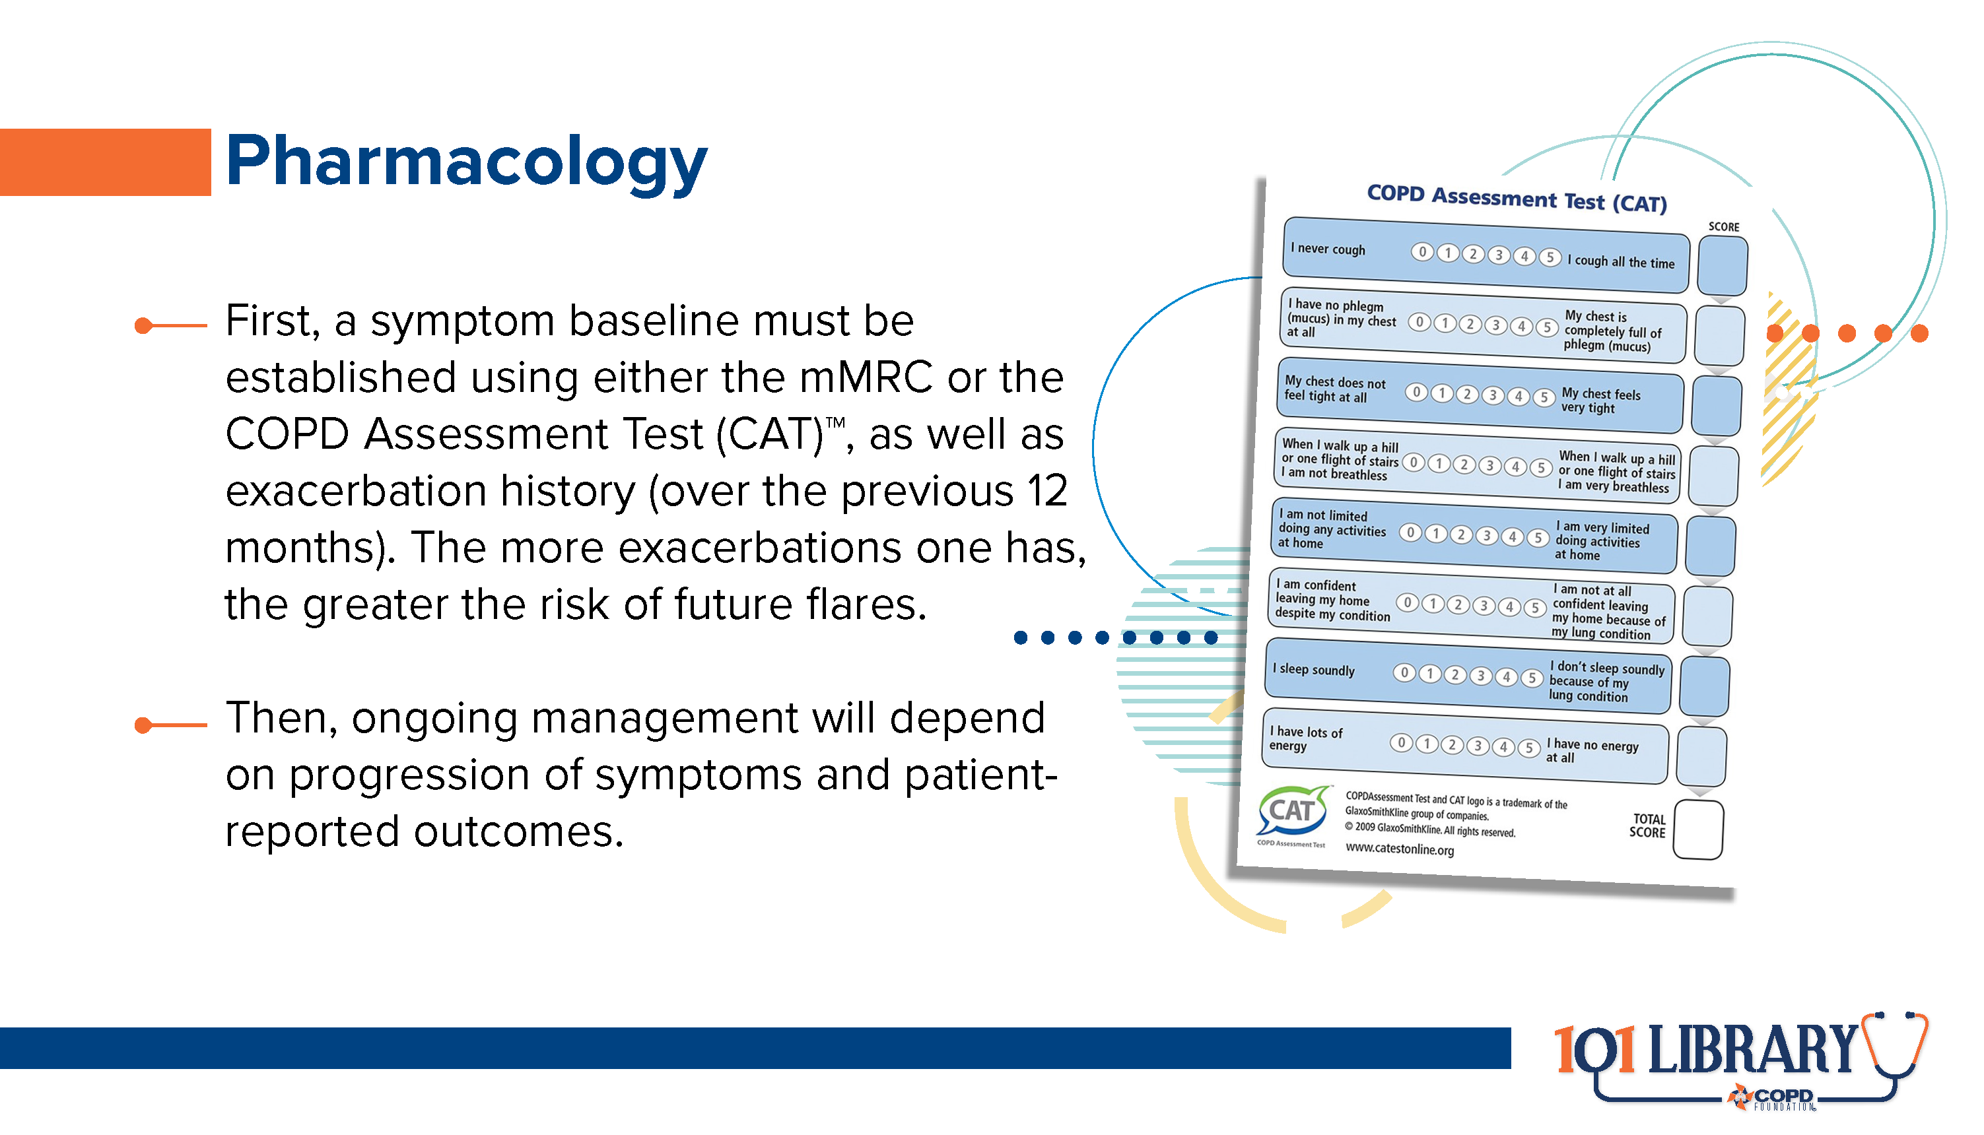

Slide 25
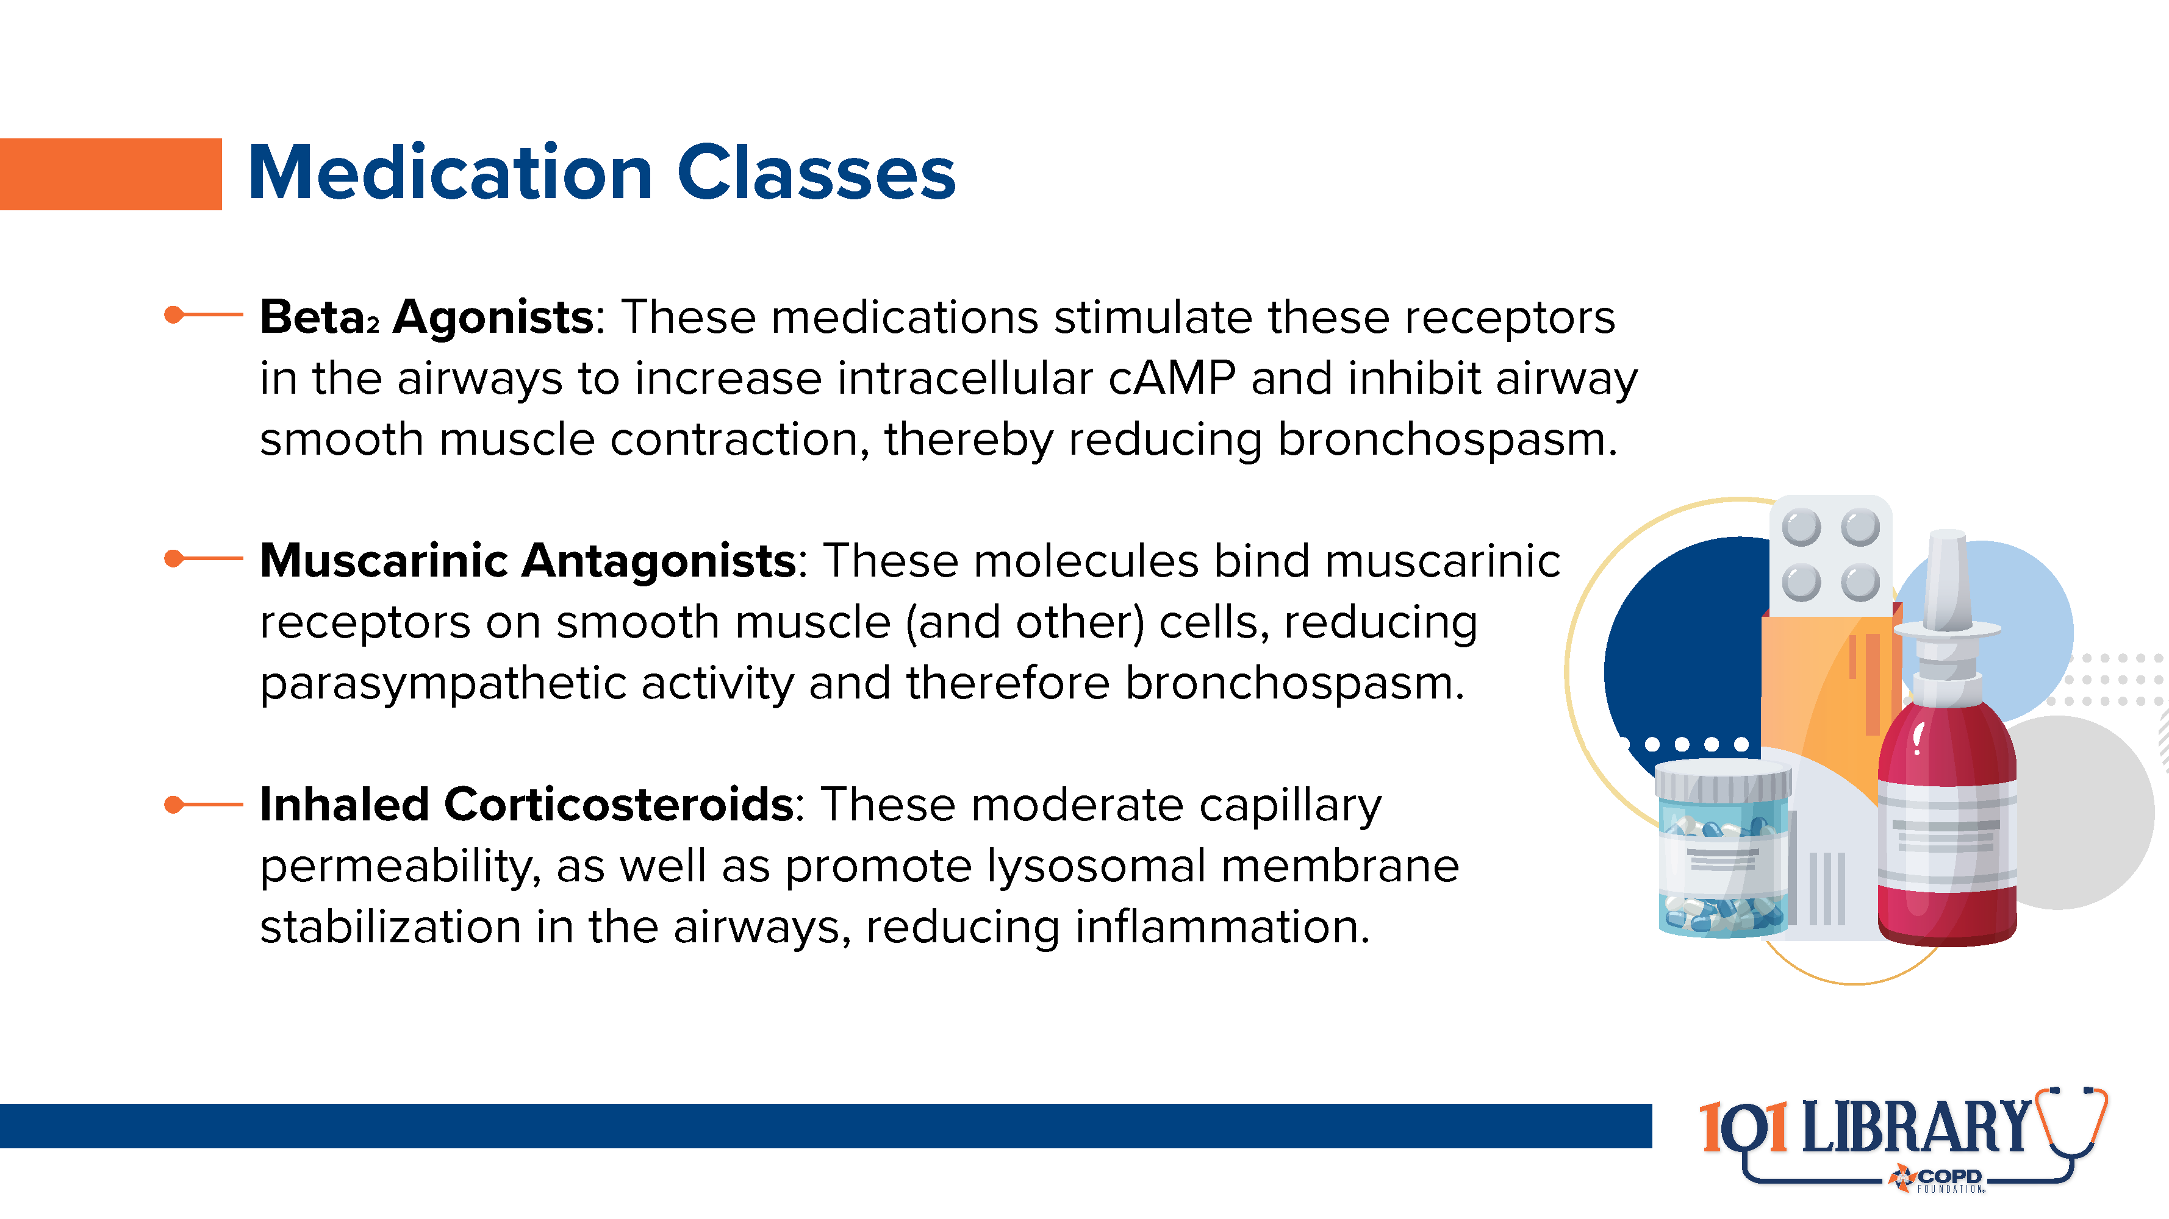

Slide 26
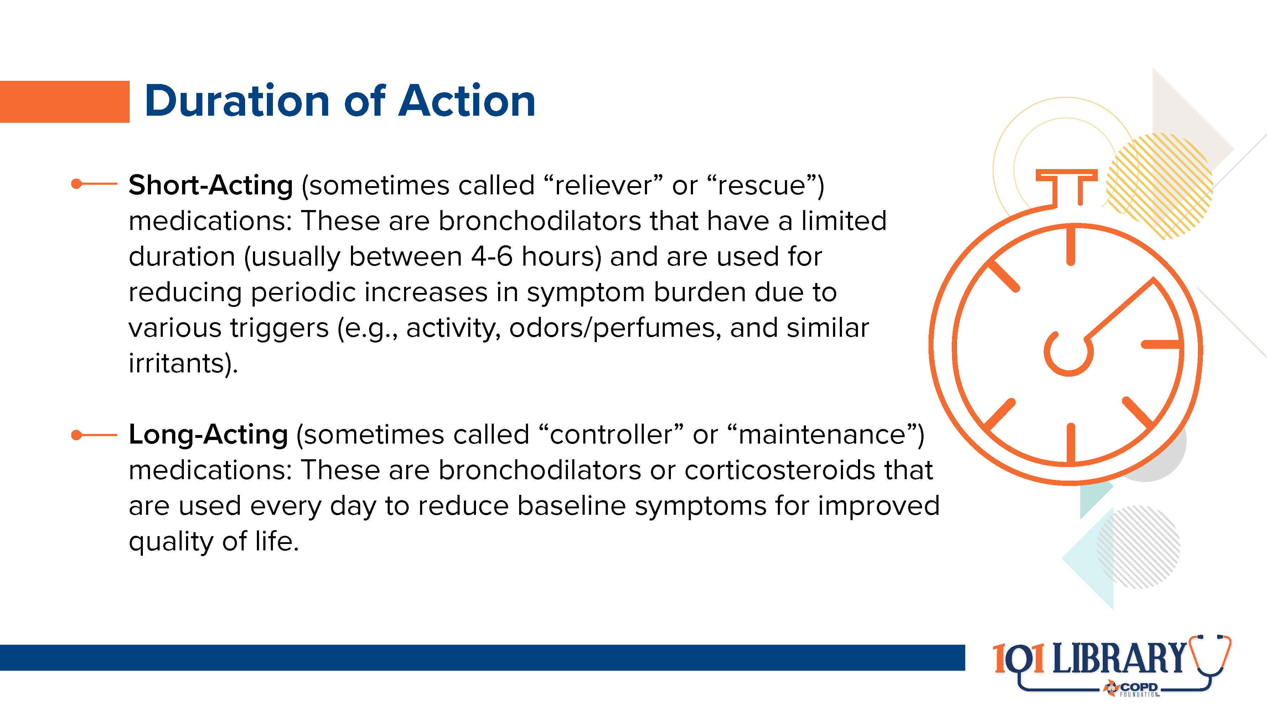
Notes:
Because of the myriad potential combination of regimens, it is critically important that patients be effectively taught both WHEN and HOW to use their inhaled medications. The use of the teach-back method, as well as ongoing technique assessment and providing resources like online videos (available from the COPD Foundation’s YouTube channel at https://www.youtube.com/c/CopdfoundationOrganization) are also essential.

Slide 27
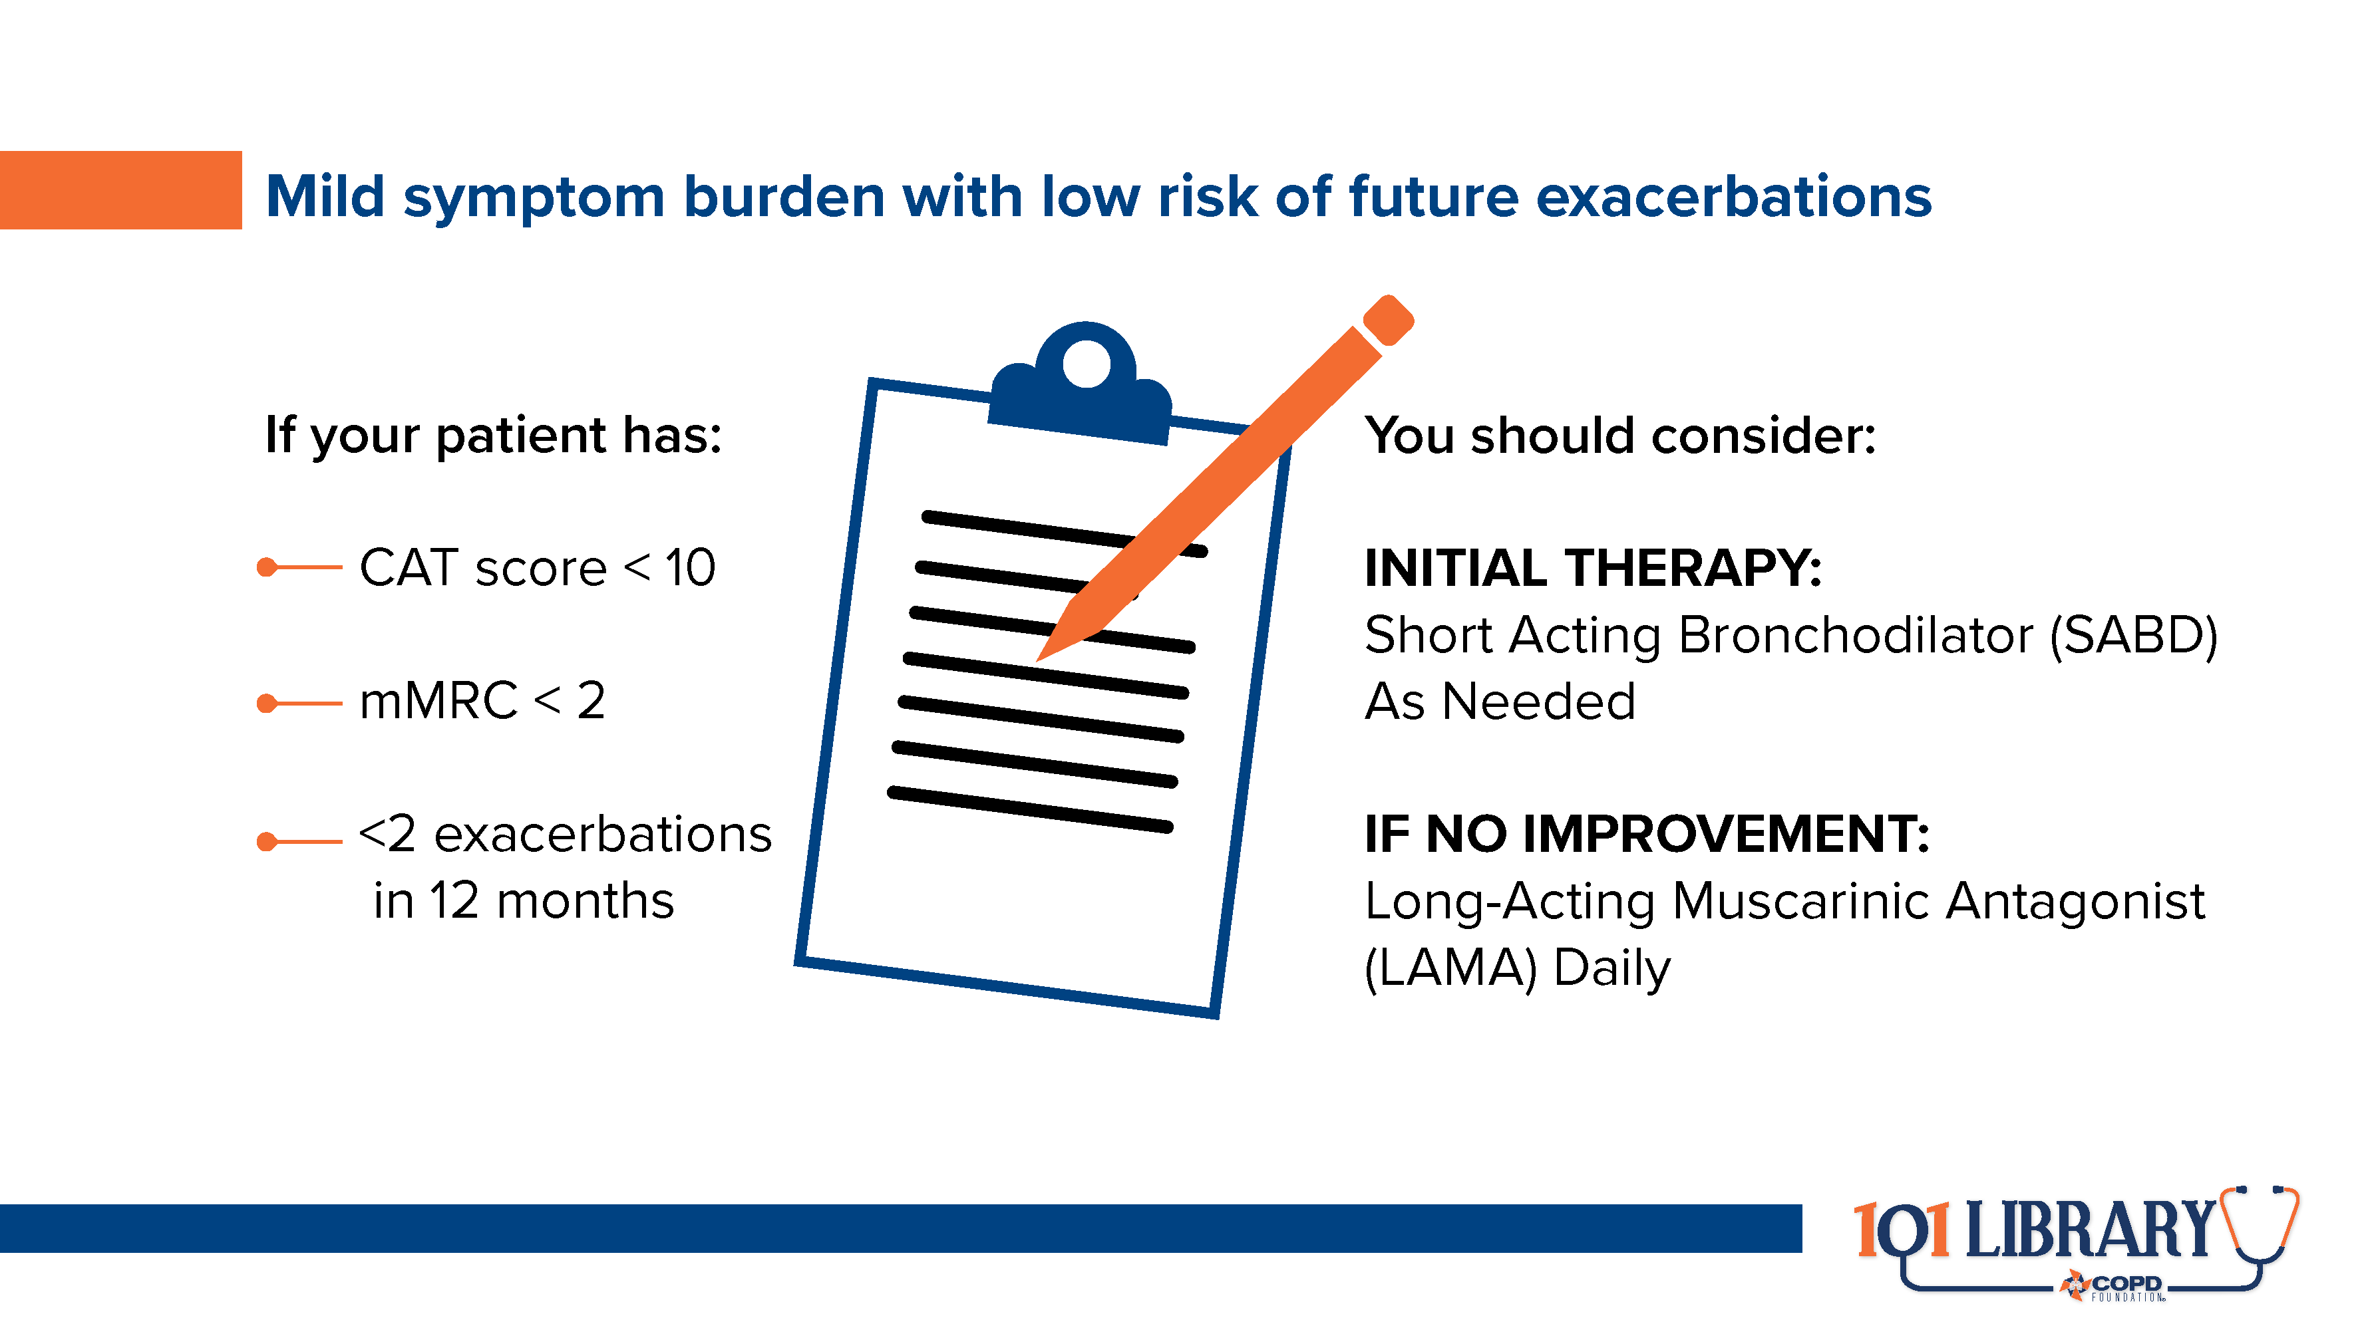

Slide 28
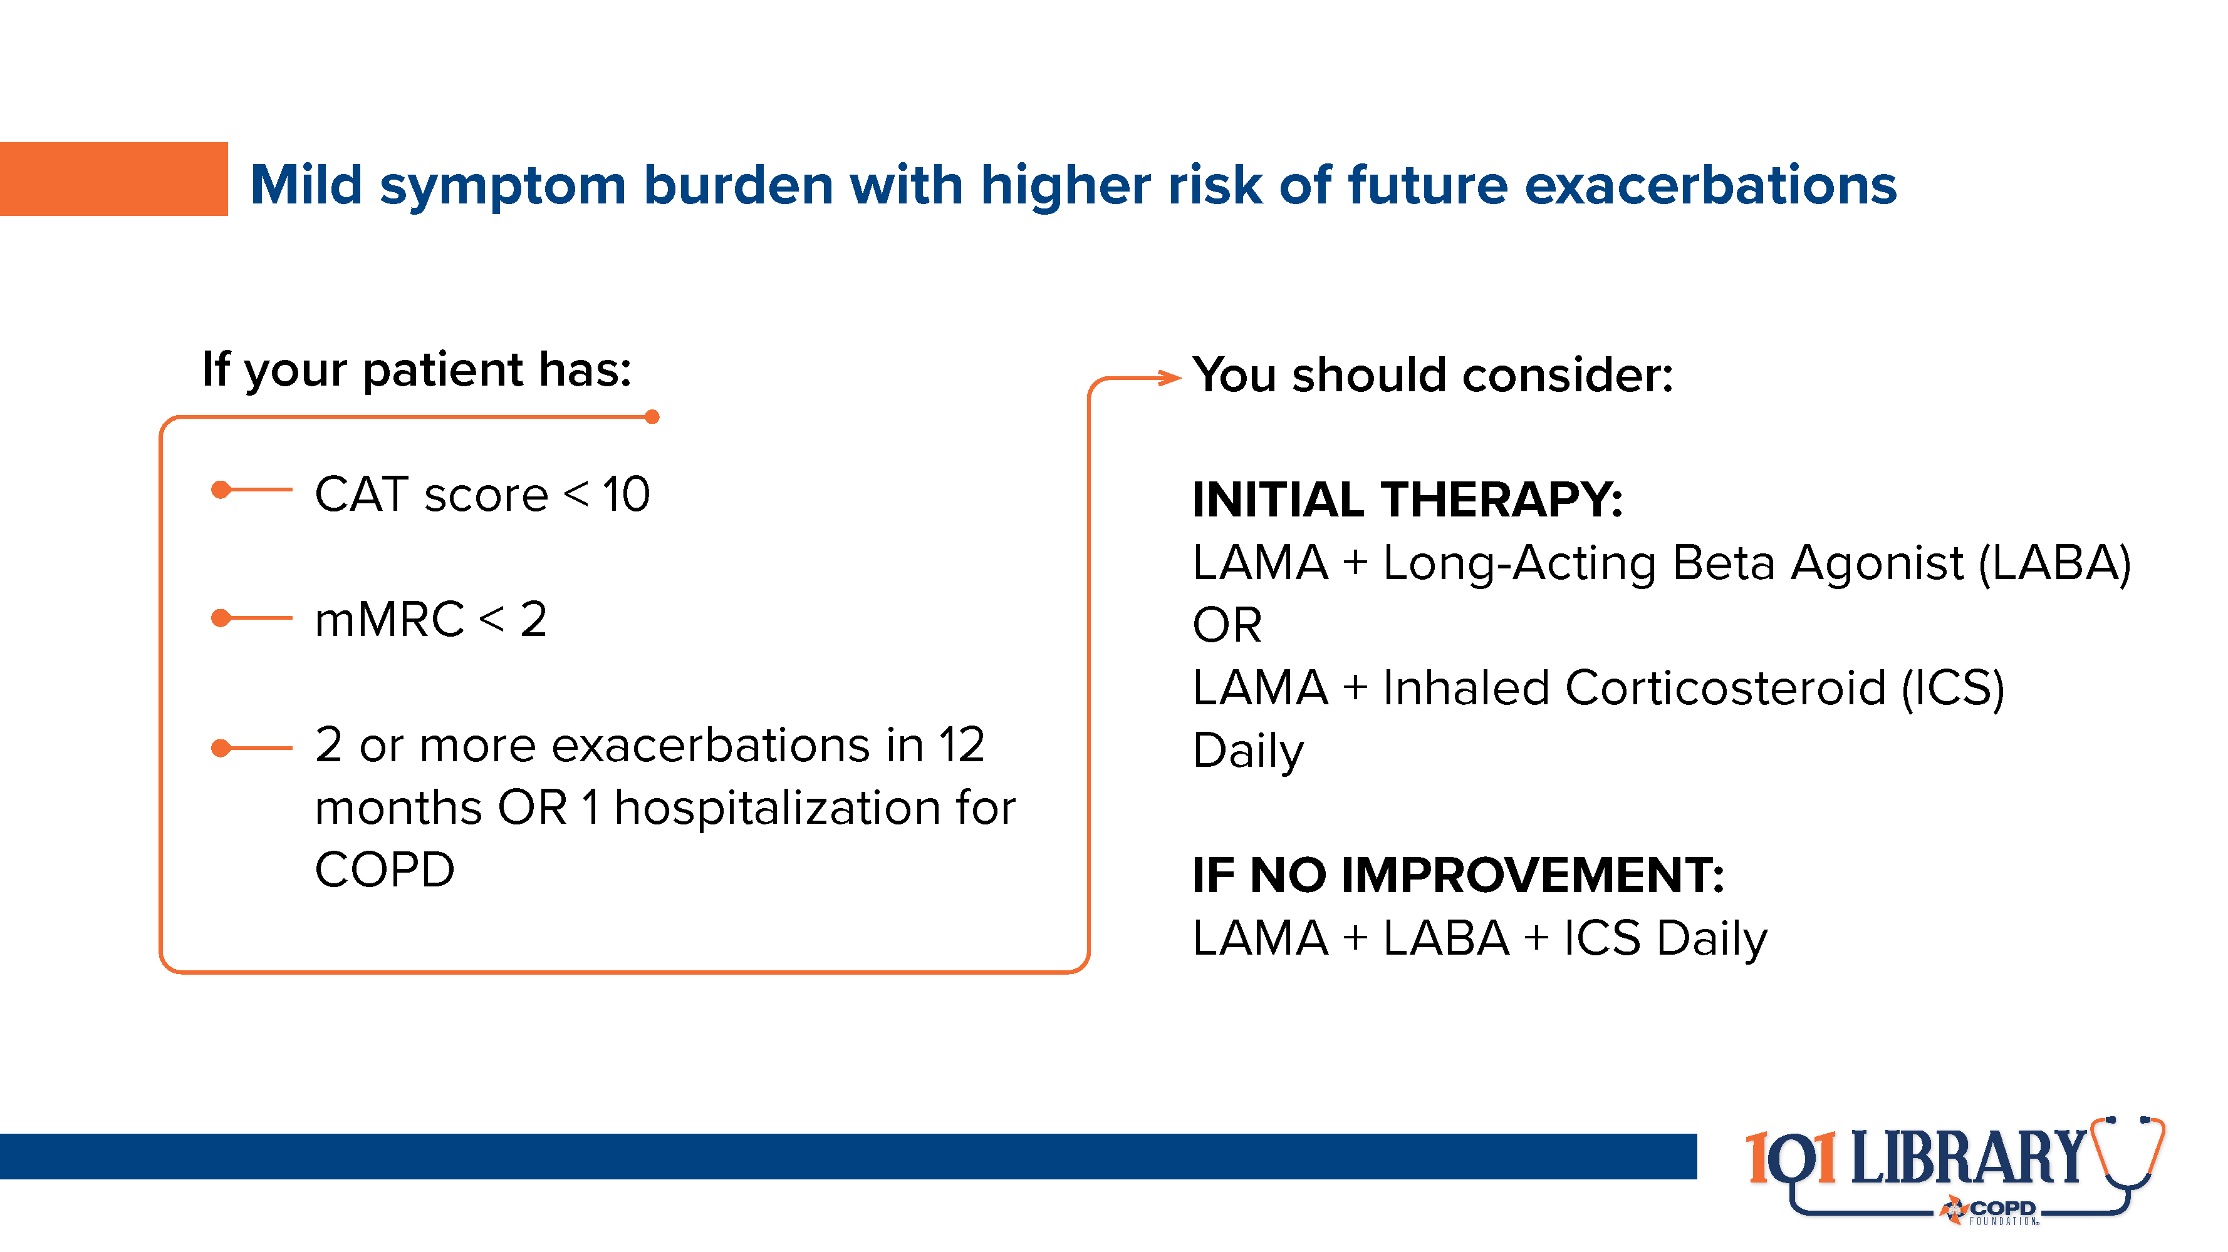

Slide 29
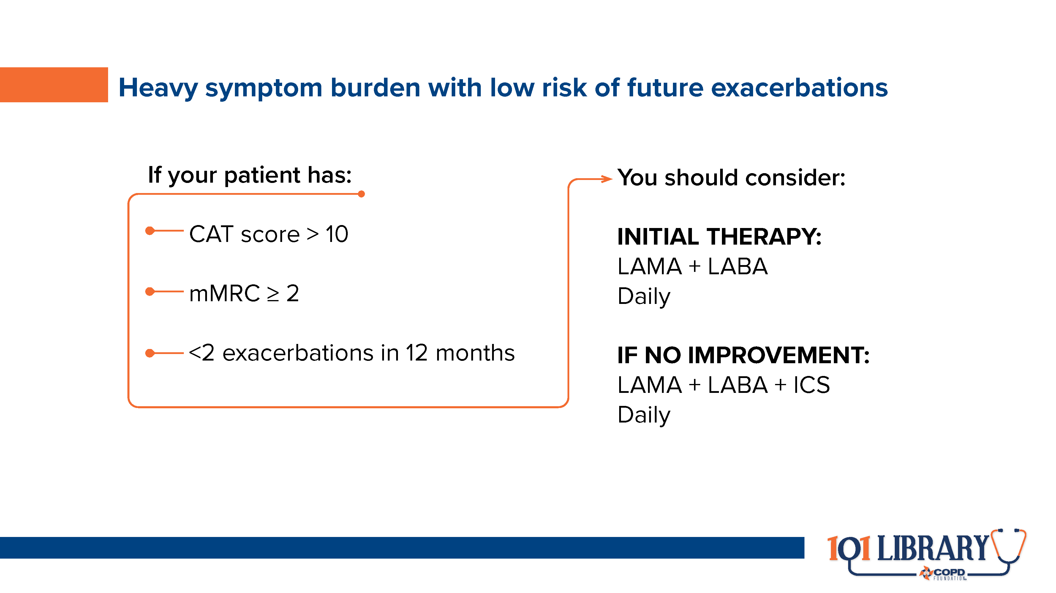

Slide 30
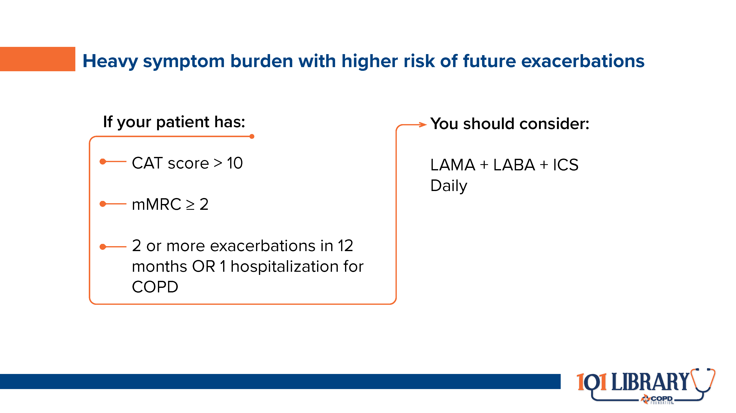

Slide 31
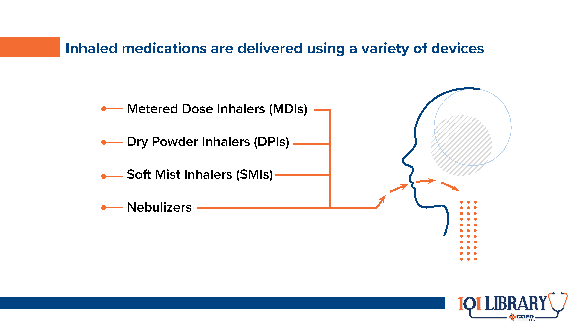
Notes:
Prescribers must consider several factors when choosing a medication and device combination¹⁰:
Can the person use this device?
WILL the person use this device?
Is this device affordable or on formulary (including assistance programs)?
Is the desired medication available in this device?

Slide 32
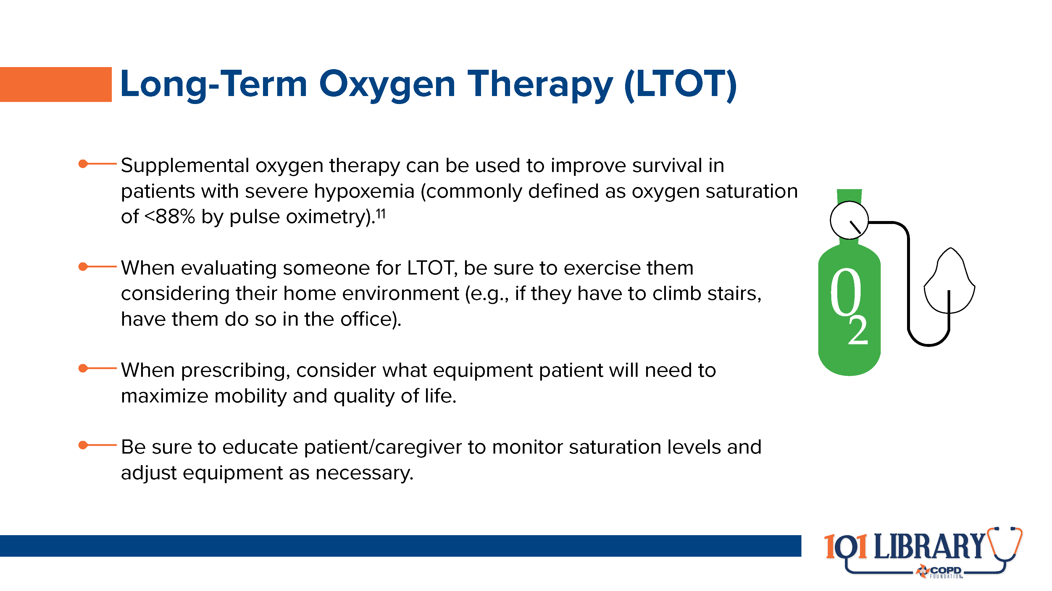
Notes:
Be sure to consider the both the patient’s physical environment and lived experience (e.g., activities of daily living or transportation needs) when evaluating and prescribing oxygen equipment.

Slide 33
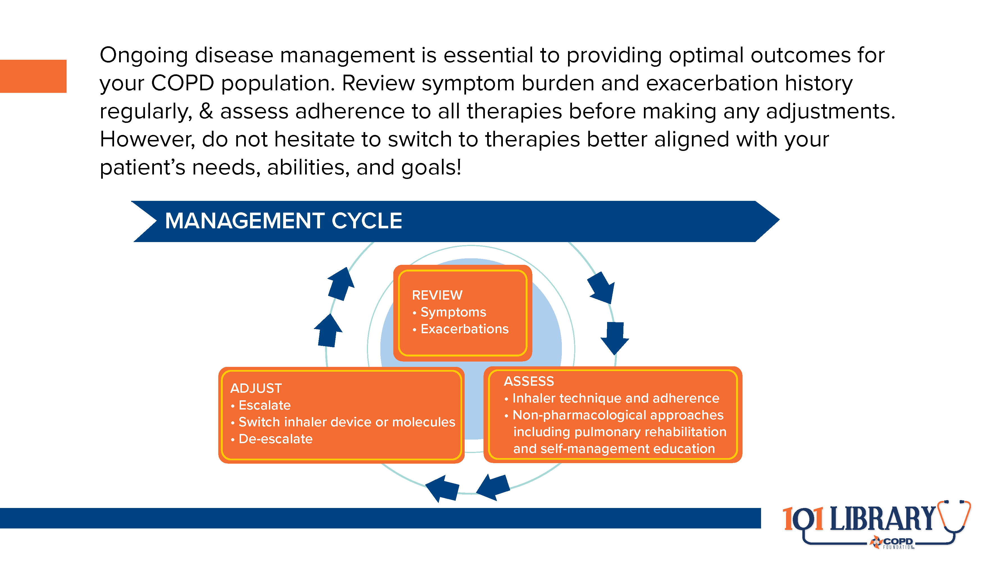

Slide 34
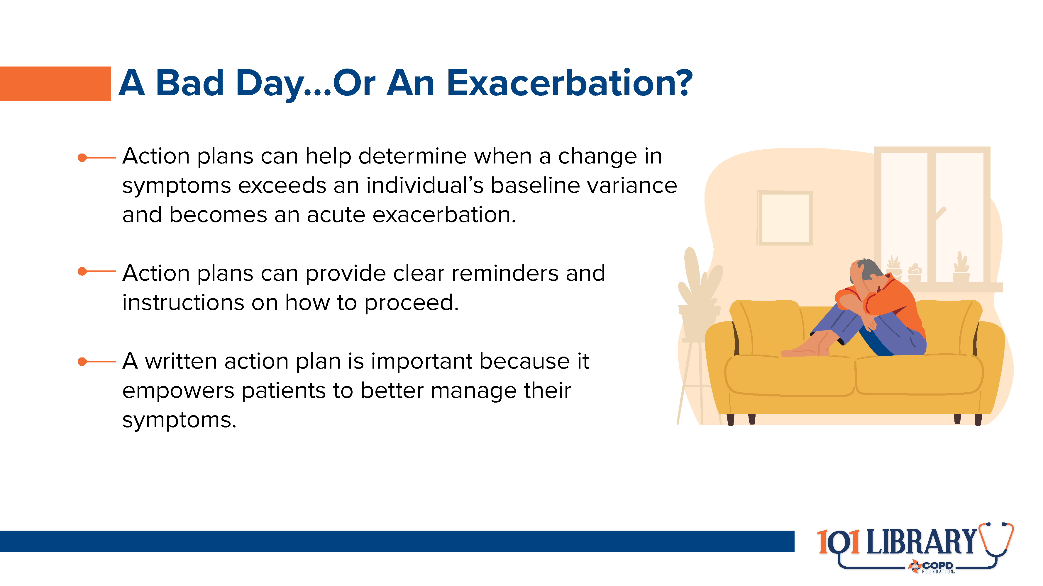
Notes:
Unfortunately, periodic symptom flares, known as exacerbations, are almost inevitable in COPD. Research suggests that approximately 44% of people diagnosed with COPD will have at least 1 exacerbation within two years of diagnosis, and 8.5% will have three or more during that time. The vast majority of acute exacerbations are caused by respiratory infections. (citation: Sethi S, Murphy TF. Evaluation for infection in exacerbations of chronic obstructive pulmonary disease. UpToDate. Published online 2021:1-11. Accessed January 28, 2022. https://www.uptodate.com/contents/evaluation-for-infection-in-exacerbations-of-chronic-obstructive-pulmonary-disease?search=Evaluation for infection in exacerbations of chronic obstructive pulmonary disease). Exacerbations are key drivers of healthcare utilization and disease progression, so it is imperative to prevent as many as possible, quickly detect those that do occur, and begin treatment as soon as possible. (citation: Dhamane AD, Moretz C, Zhou Y, et al. COPD exacerbation frequency and its association with health care resource utilization and costs. Int J COPD. 2015;10(1):2609-2618. doi:10.2147/COPD.S90148)
It’s important to remember that exacerbations tend to manifest differently in different people, and there is not a universal definition of what constitutes an exacerbation beyond “symptoms greater than baseline.” Just as with chronic management, exacerbation treatment must be individualized for each case.

Slide 35
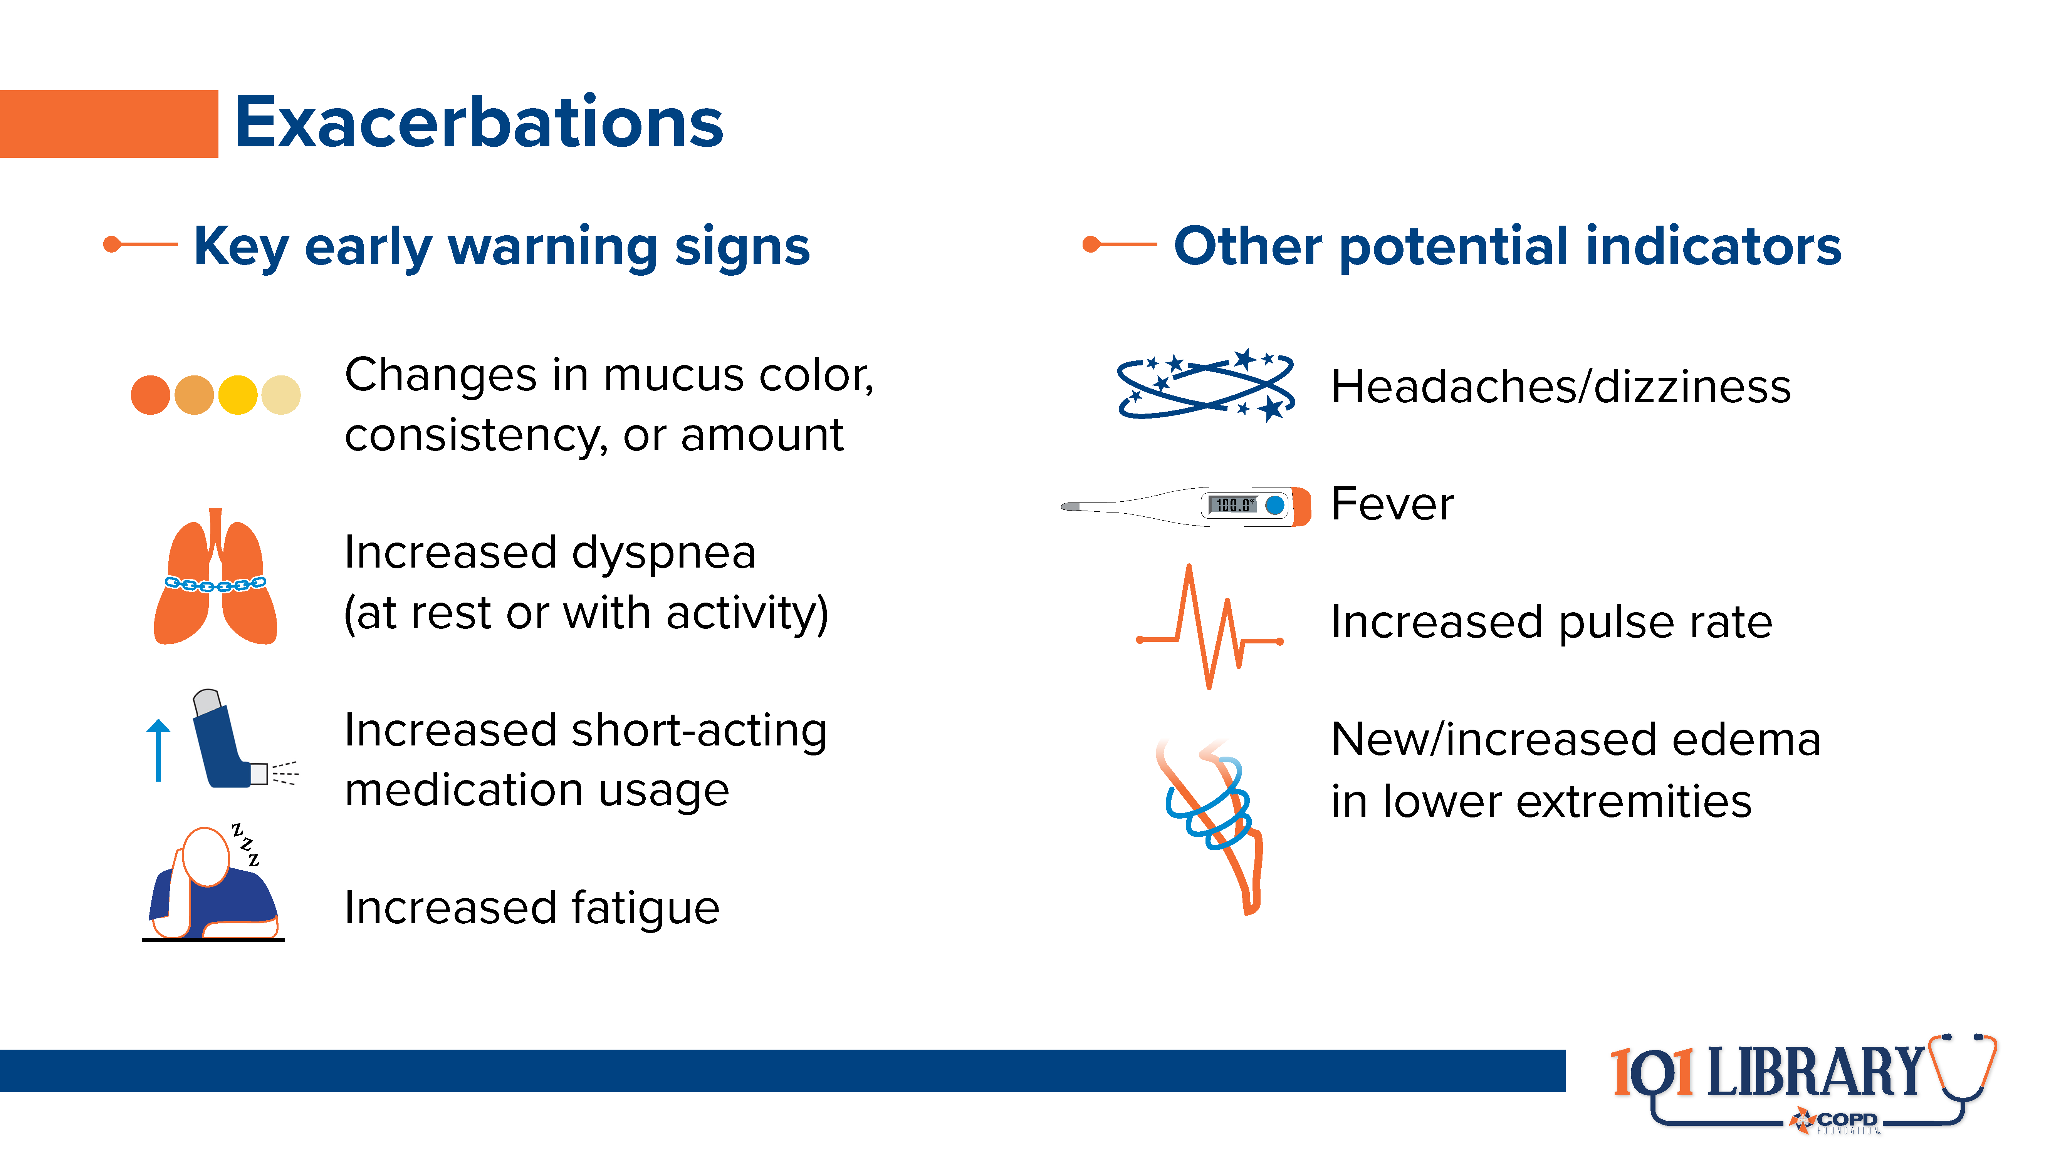
Notes:
In the absence of clear biomarkers to define an exacerbation, it comes down to experience and clinical judgment. People with COPD come to know their own variations and can have valuable insight into when things don’t “feel right.” In addition, working with them to create a written action plan (like the one available at https://www.copdfoundation.org/Downloads/MyCOPDActionPlan.pdf) can provide guidance to when enhanced treatments may be necessary. These action plans can also give patients and caregivers valuable instructions on when to contact their clinical team and/or emergency services for assistance.
Be sure to review any COPD action plan every six months to account for clinical progression or other changes in baseline health status.

Slide 36
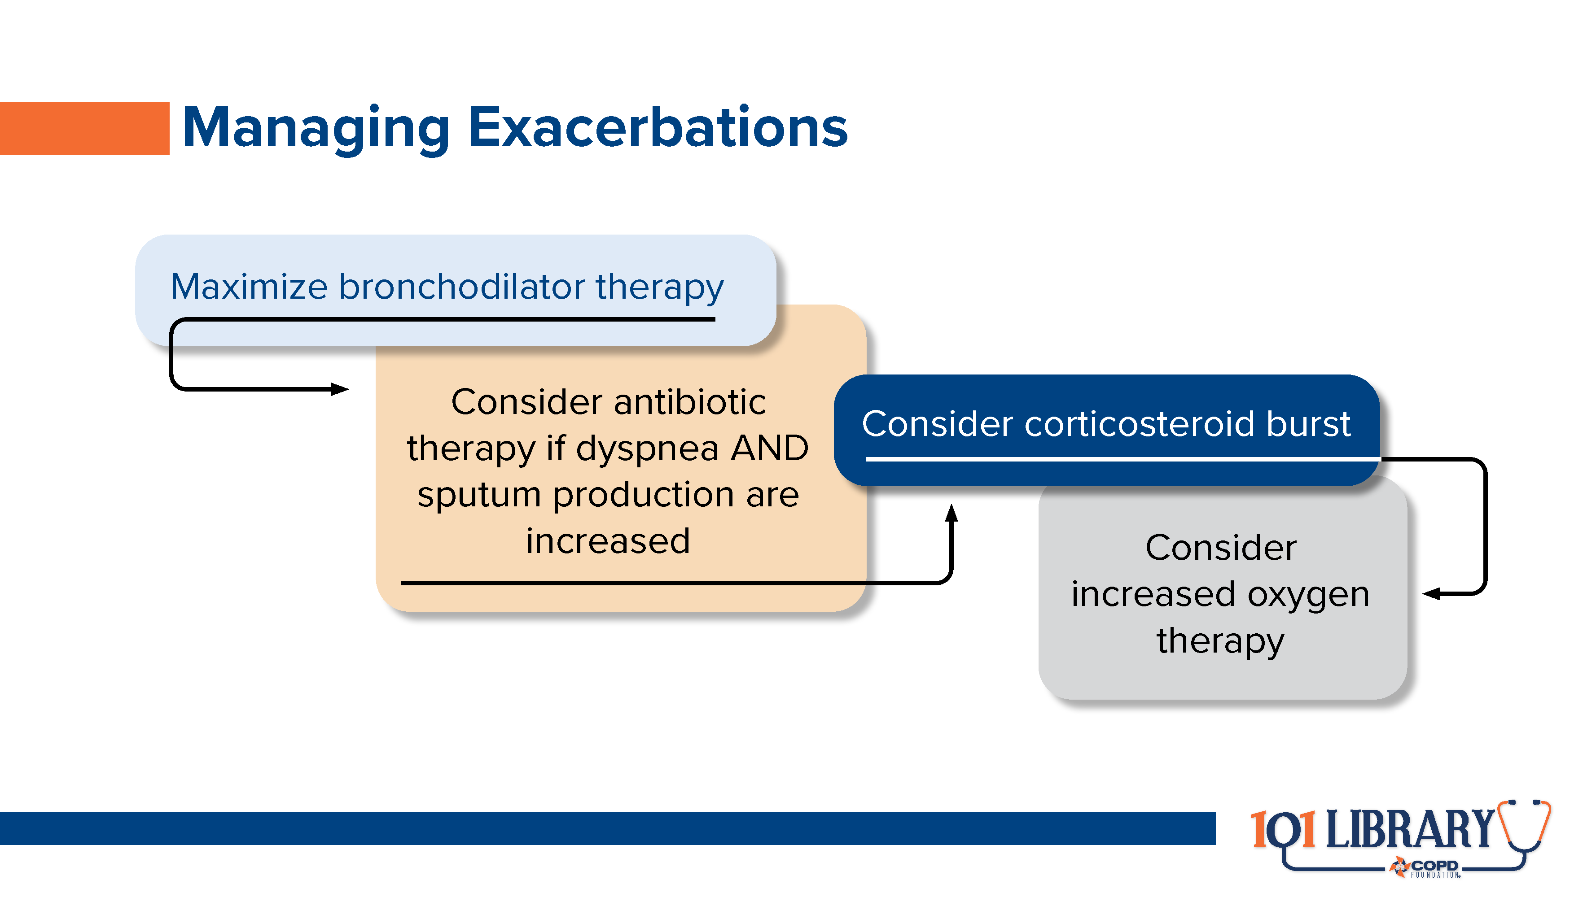
Notes:
Exact treatment will depend on how far above baseline the symptom burden becomes. For mild exacerbations, simply increasing the frequency of short-acting bronchodilators may be sufficient. Moderate exacerbations may require the addition of a course of antibiotics (often a macrolide, such as azithromycin) to counter an infection and/or a short steroid burst (commonly 40mg of prednisone daily for approximately 5 days). Research has indicated that steroid bursts are equally as effective as longer tapers, with the added benefit of reducing the risk of adverse effects. (citation: Walters JAE, Tan DJ, White CJ, Wood-Baker R. Different durations of corticosteroid therapy for exacerbations of chronic obstructive pulmonary disease. Cochrane Database Syst Rev. 2018;2018(3). doi:10.1002/14651858.CD006897.pub4)
In cases where the exacerbation is leading to hypoxia, supplemental oxygen therapy may be of benefit (especially in those who are already prescribed oxygen).

Slide 37
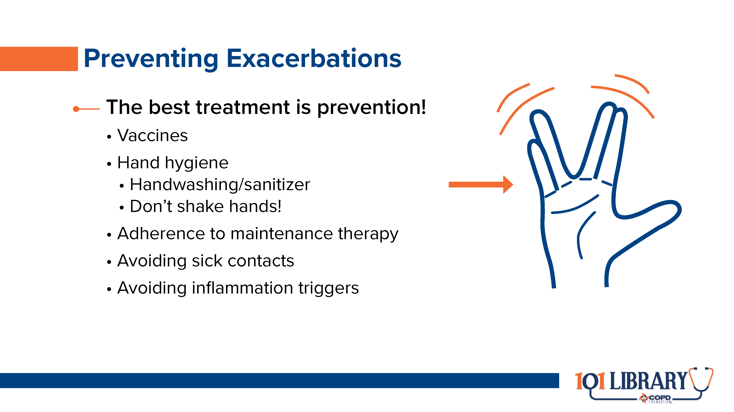
Notes:
As with much in healthcare, an ounce of prevention is worth a pound of cure. It is important to work with your people with COPD to ensure they have the best defense against acute exacerbations, including proper instruction on handwashing and general hygiene, adequate understanding of their therapy regimen, and an up-to-date vaccination history. Avoiding sick contacts and exposures to pollen, dusts, or other airway irritants is also helpful in prevention. (citation: Guide for Better Living: Exacerbations)

Slide 38
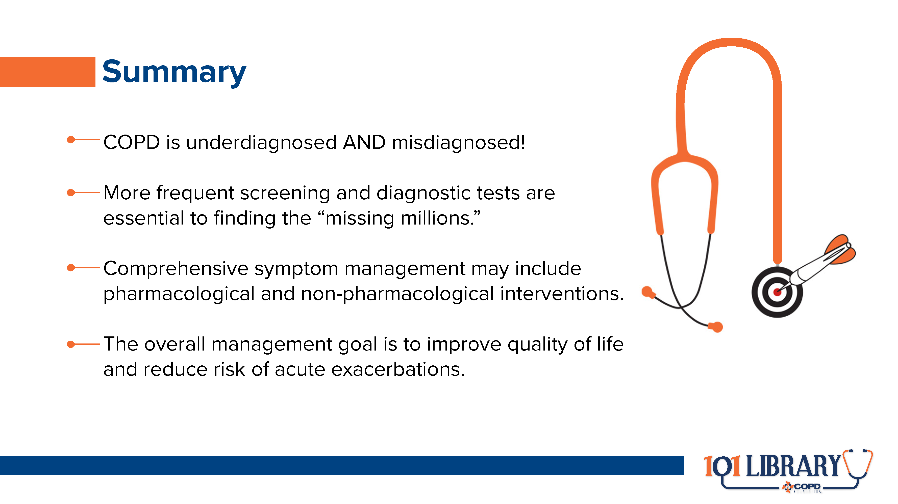

Slide 39


Slide 40
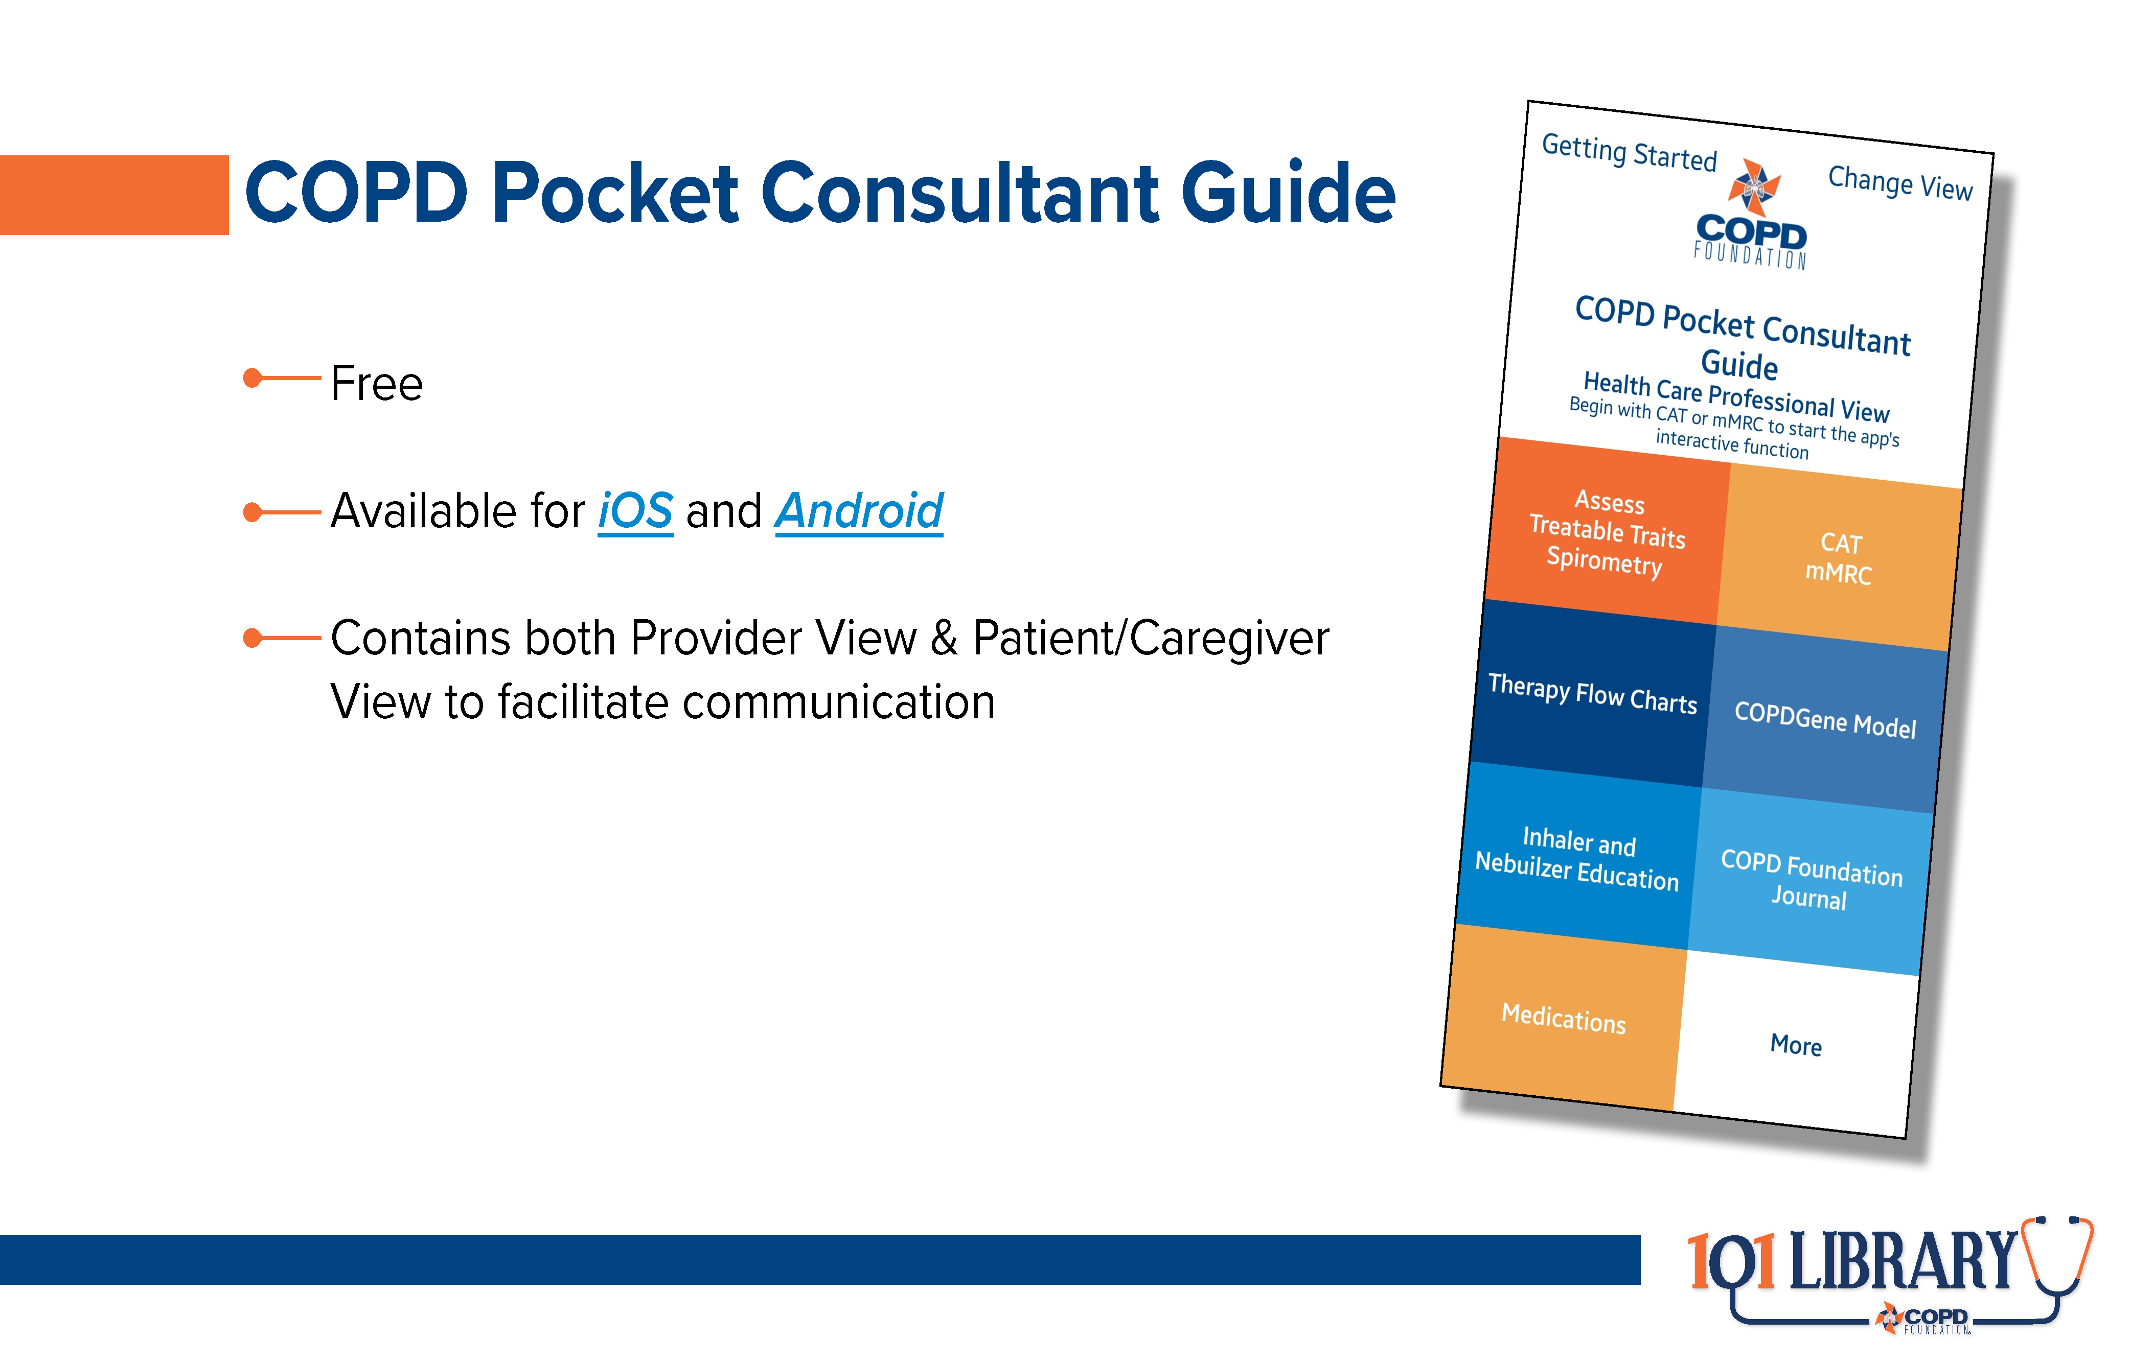

Slide 41
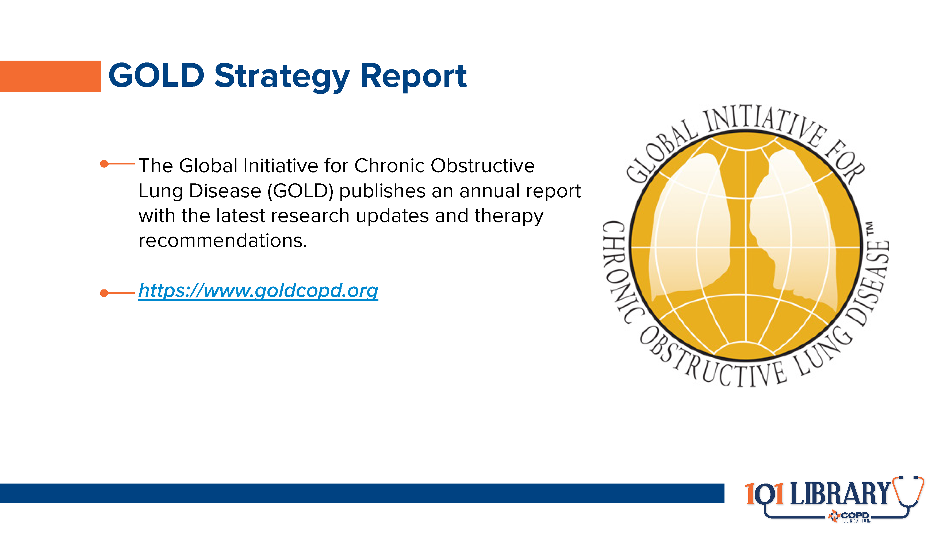

Slide 42
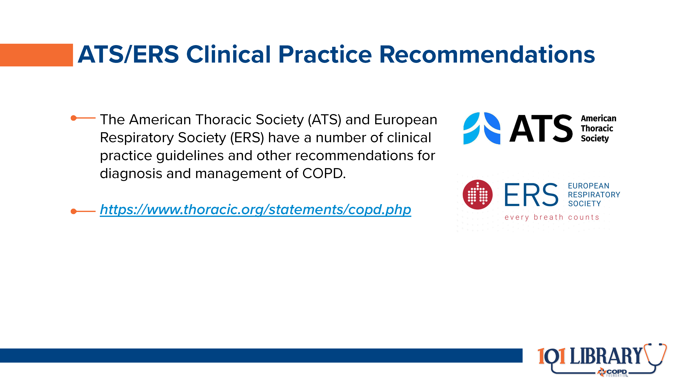

Slide 43
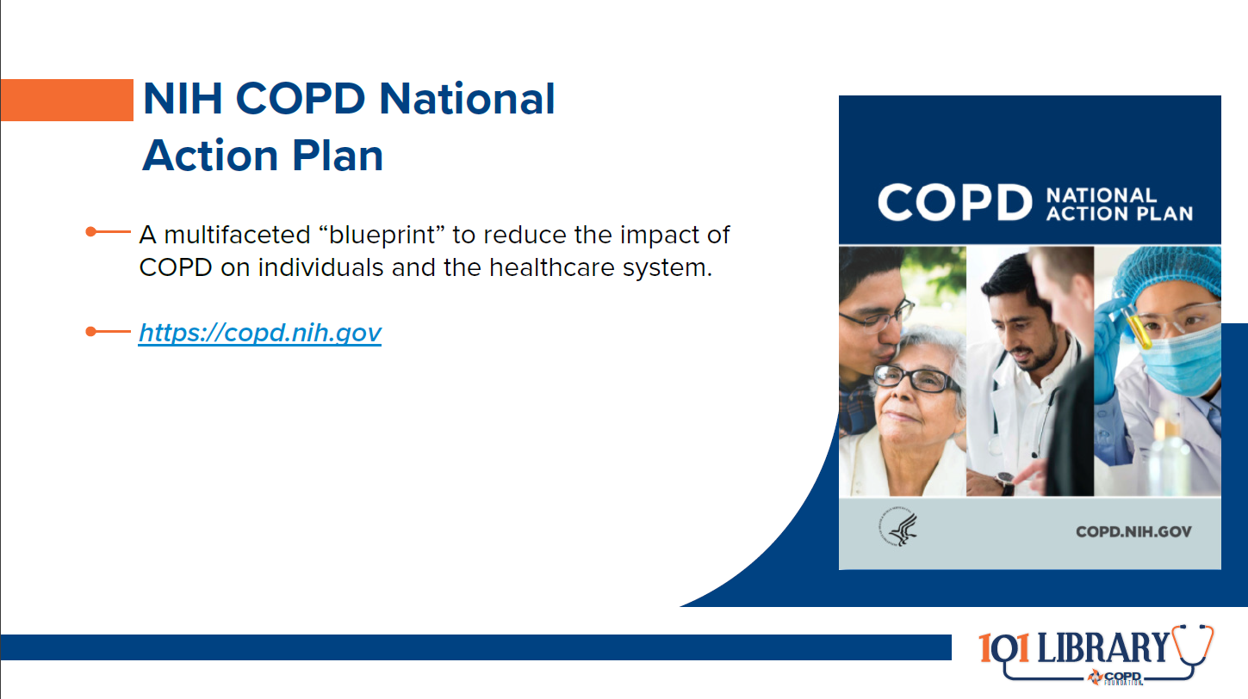

Slide 44
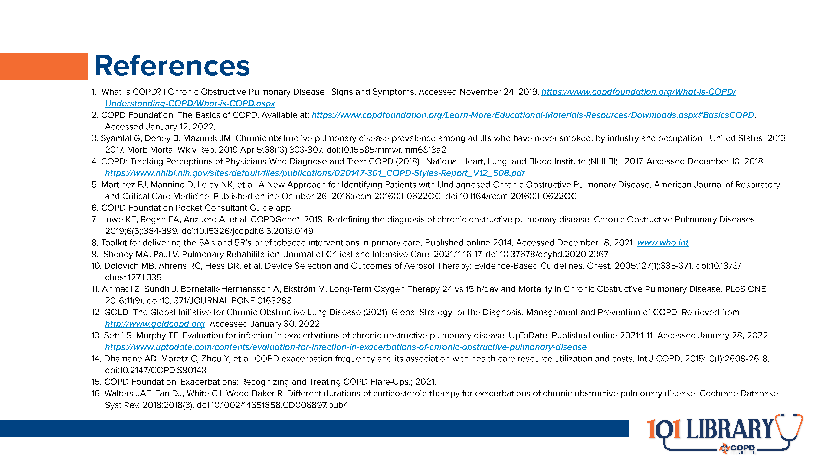

Slide 45


Slide 46
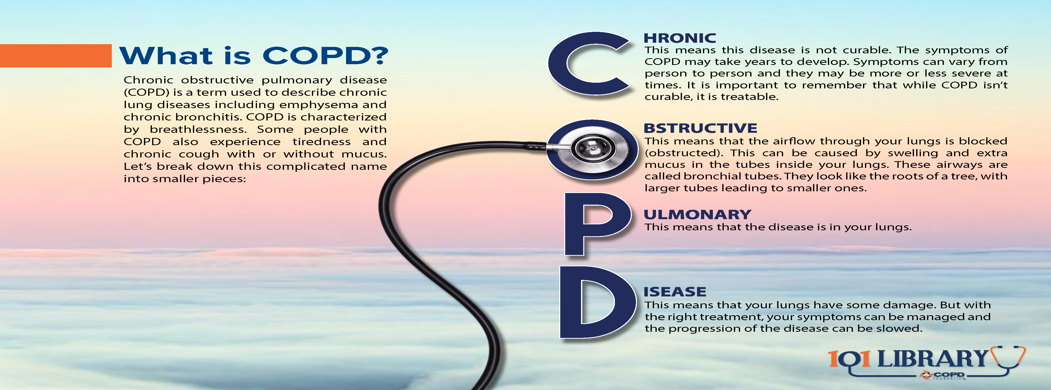

Slide 47
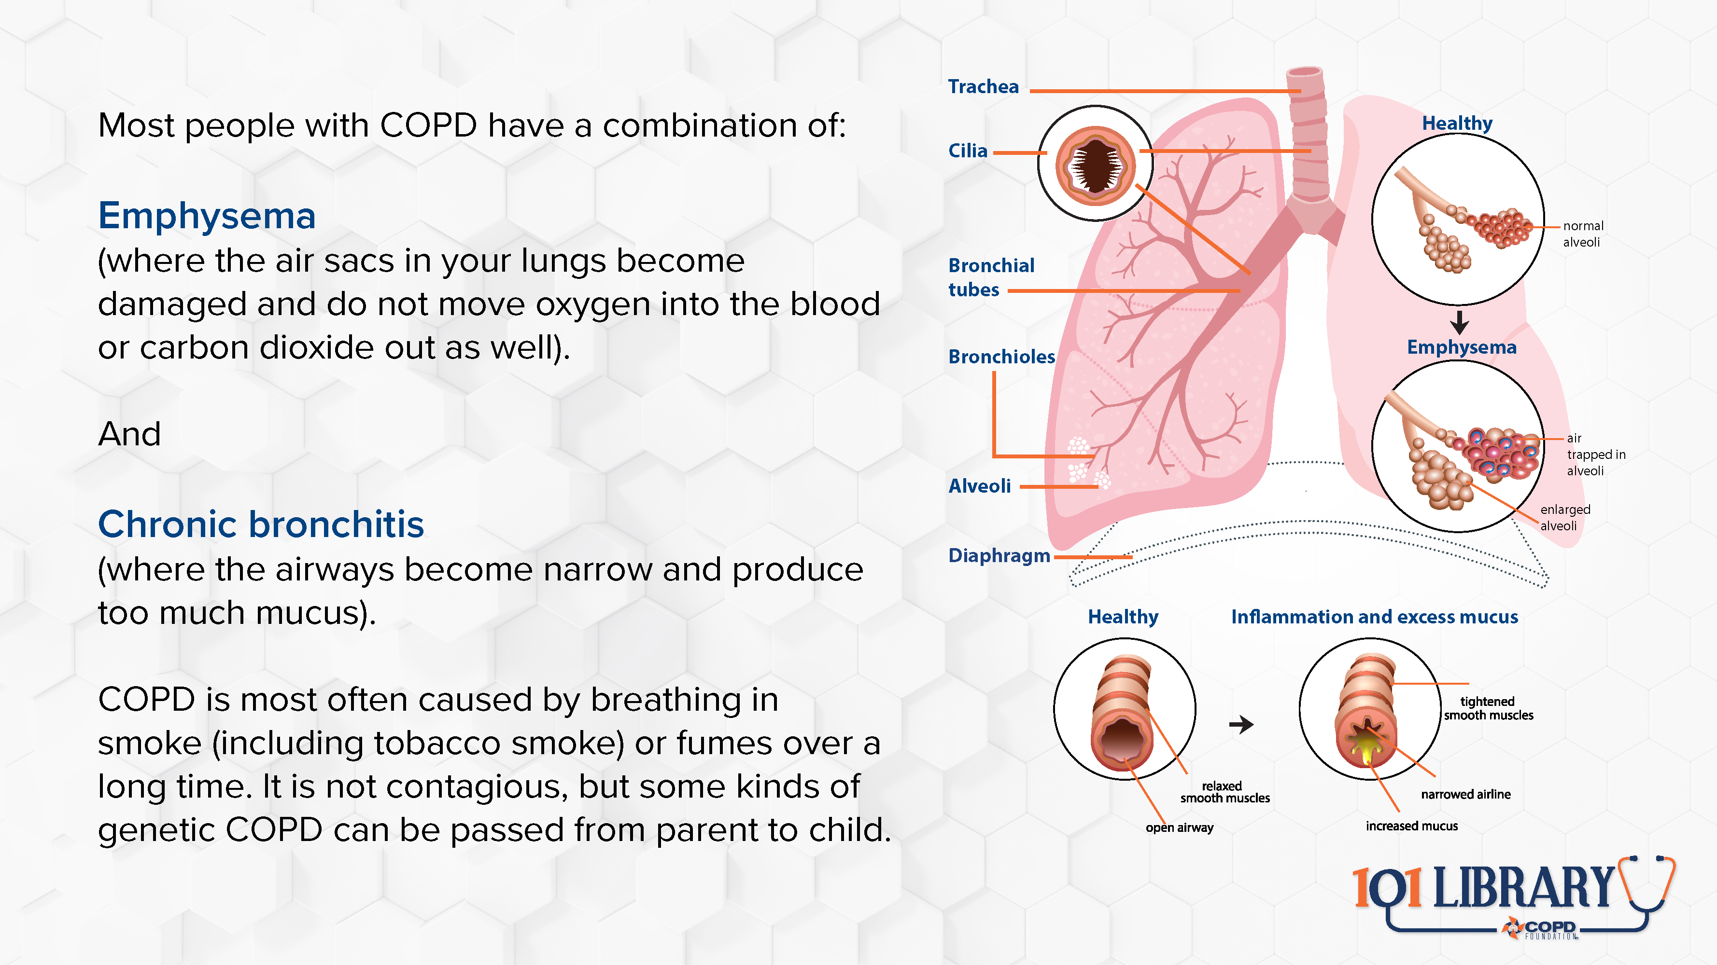

Slide 48
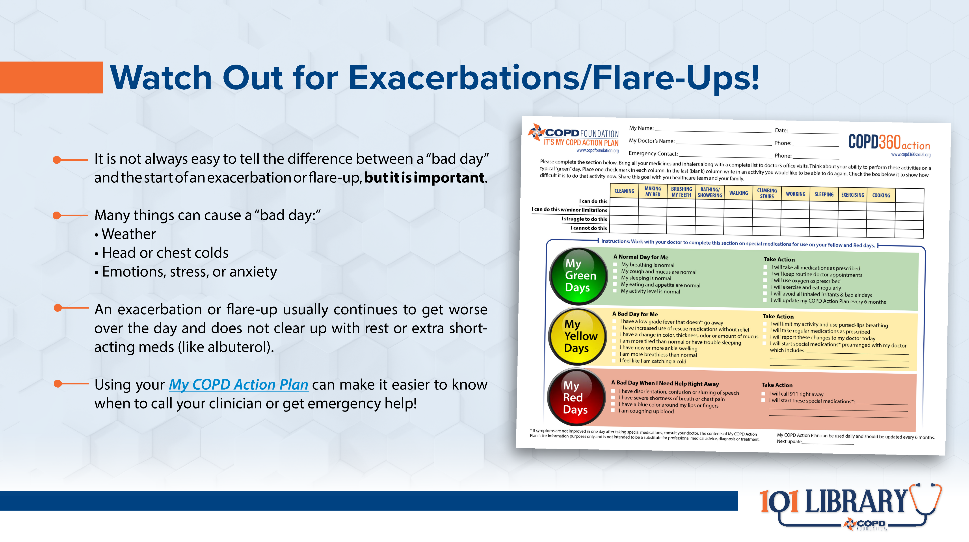

Slide 49
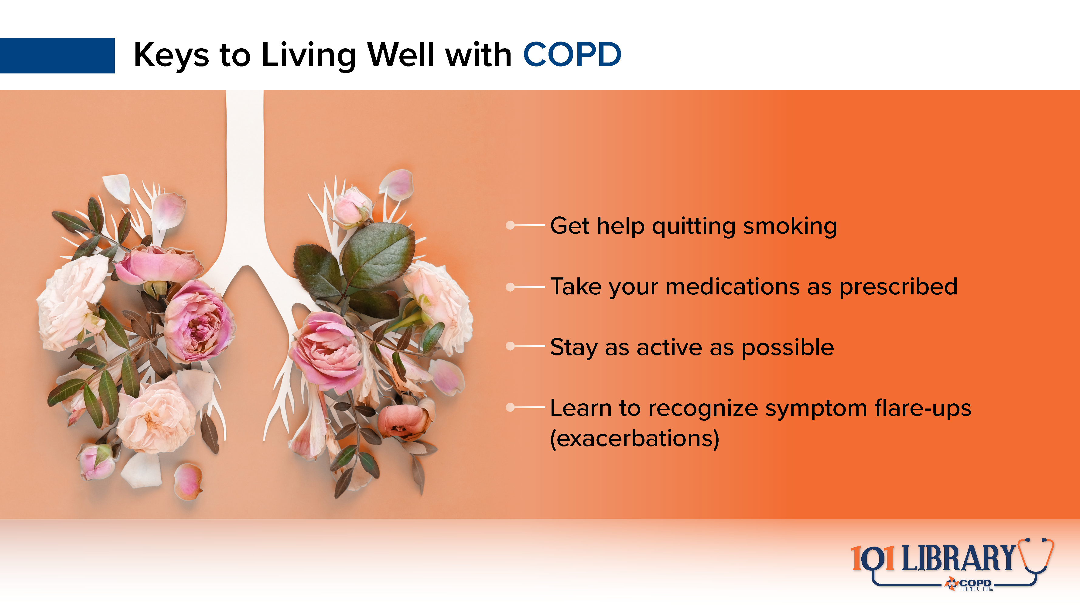

Slide 50
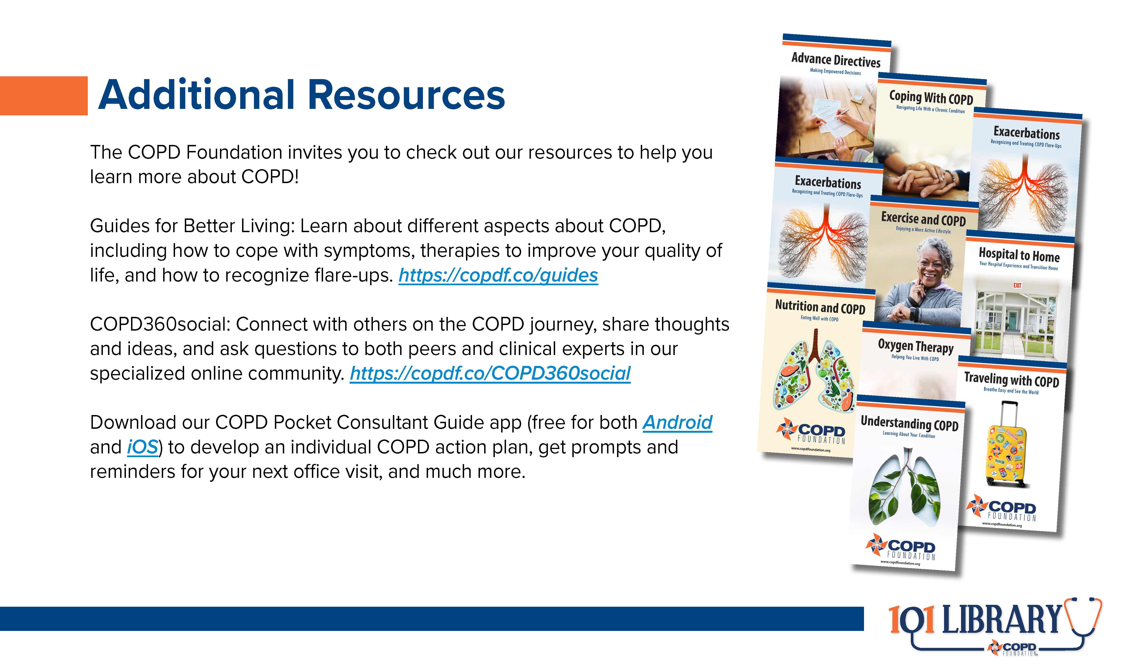

Slide 51

Notes:
Thank you to Viatris and Theravance Biopharma for supporting these educational materials.
For additional information or support, please contact the COPD Foundation at info@copdfoundation.org or 1-866-731-COPD (2673).

