Slide 1
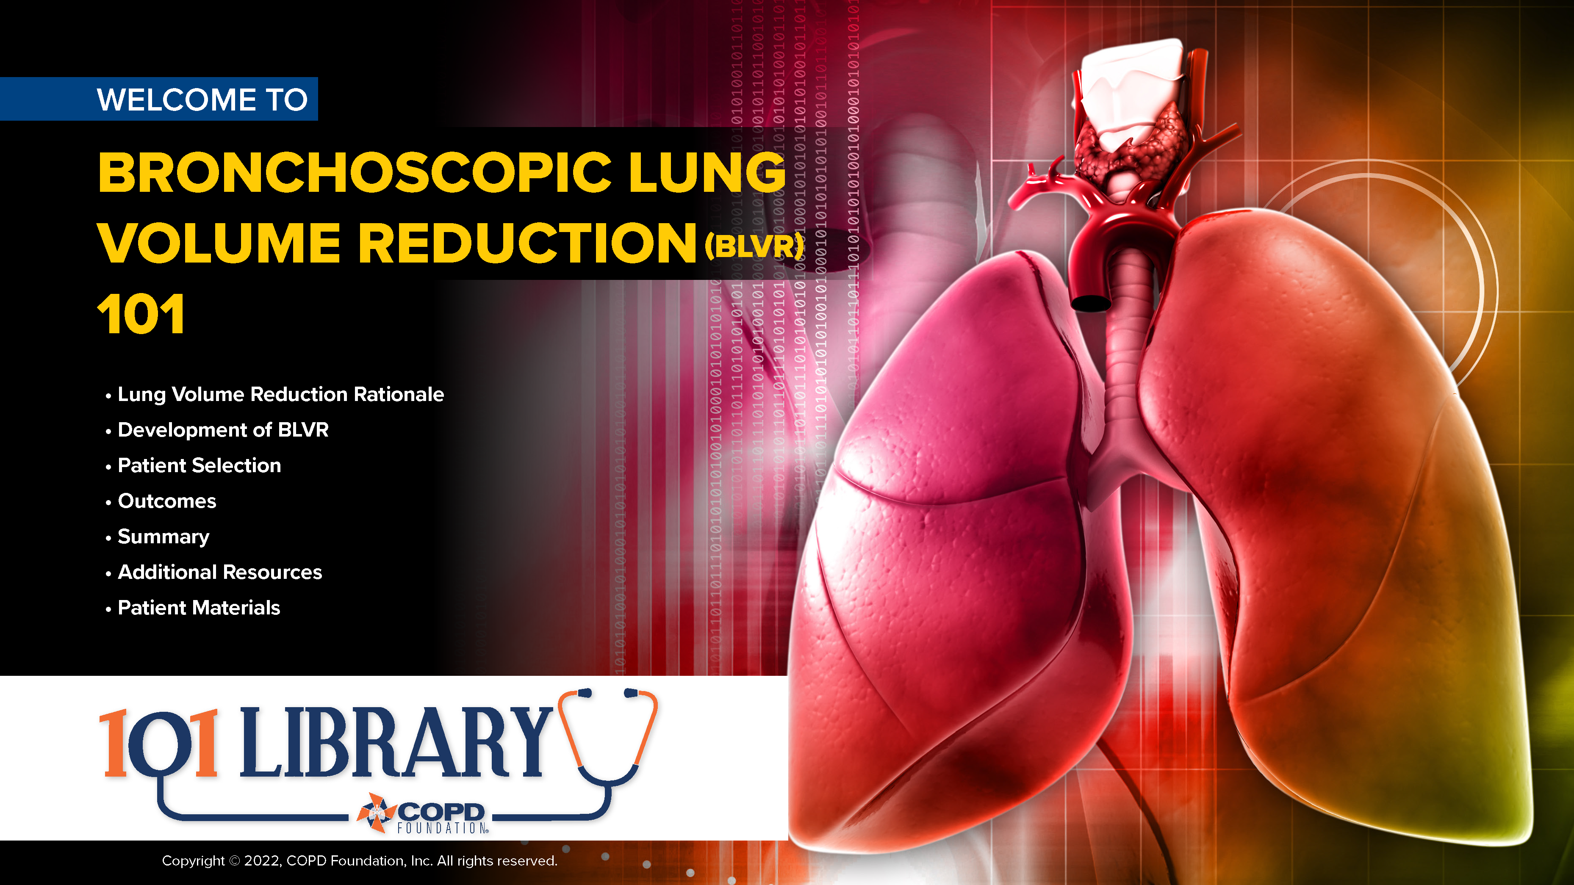
Notes:
Welcome! This presentation is intended to provide an overview of key points of the use of nebulized medications for COPD therapy. In addition, we have provided resources for supplemental learning as well as patient materials to facilitate communication and discussion (particularly among the newly diagnosed).
We hope these materials are of benefit to you and your practice. Please contact us at info@copdfoundation.org with comments, questions, or concerns.
Copyright © 2022, COPD Foundation, Inc. All rights reserved.

Slide 2
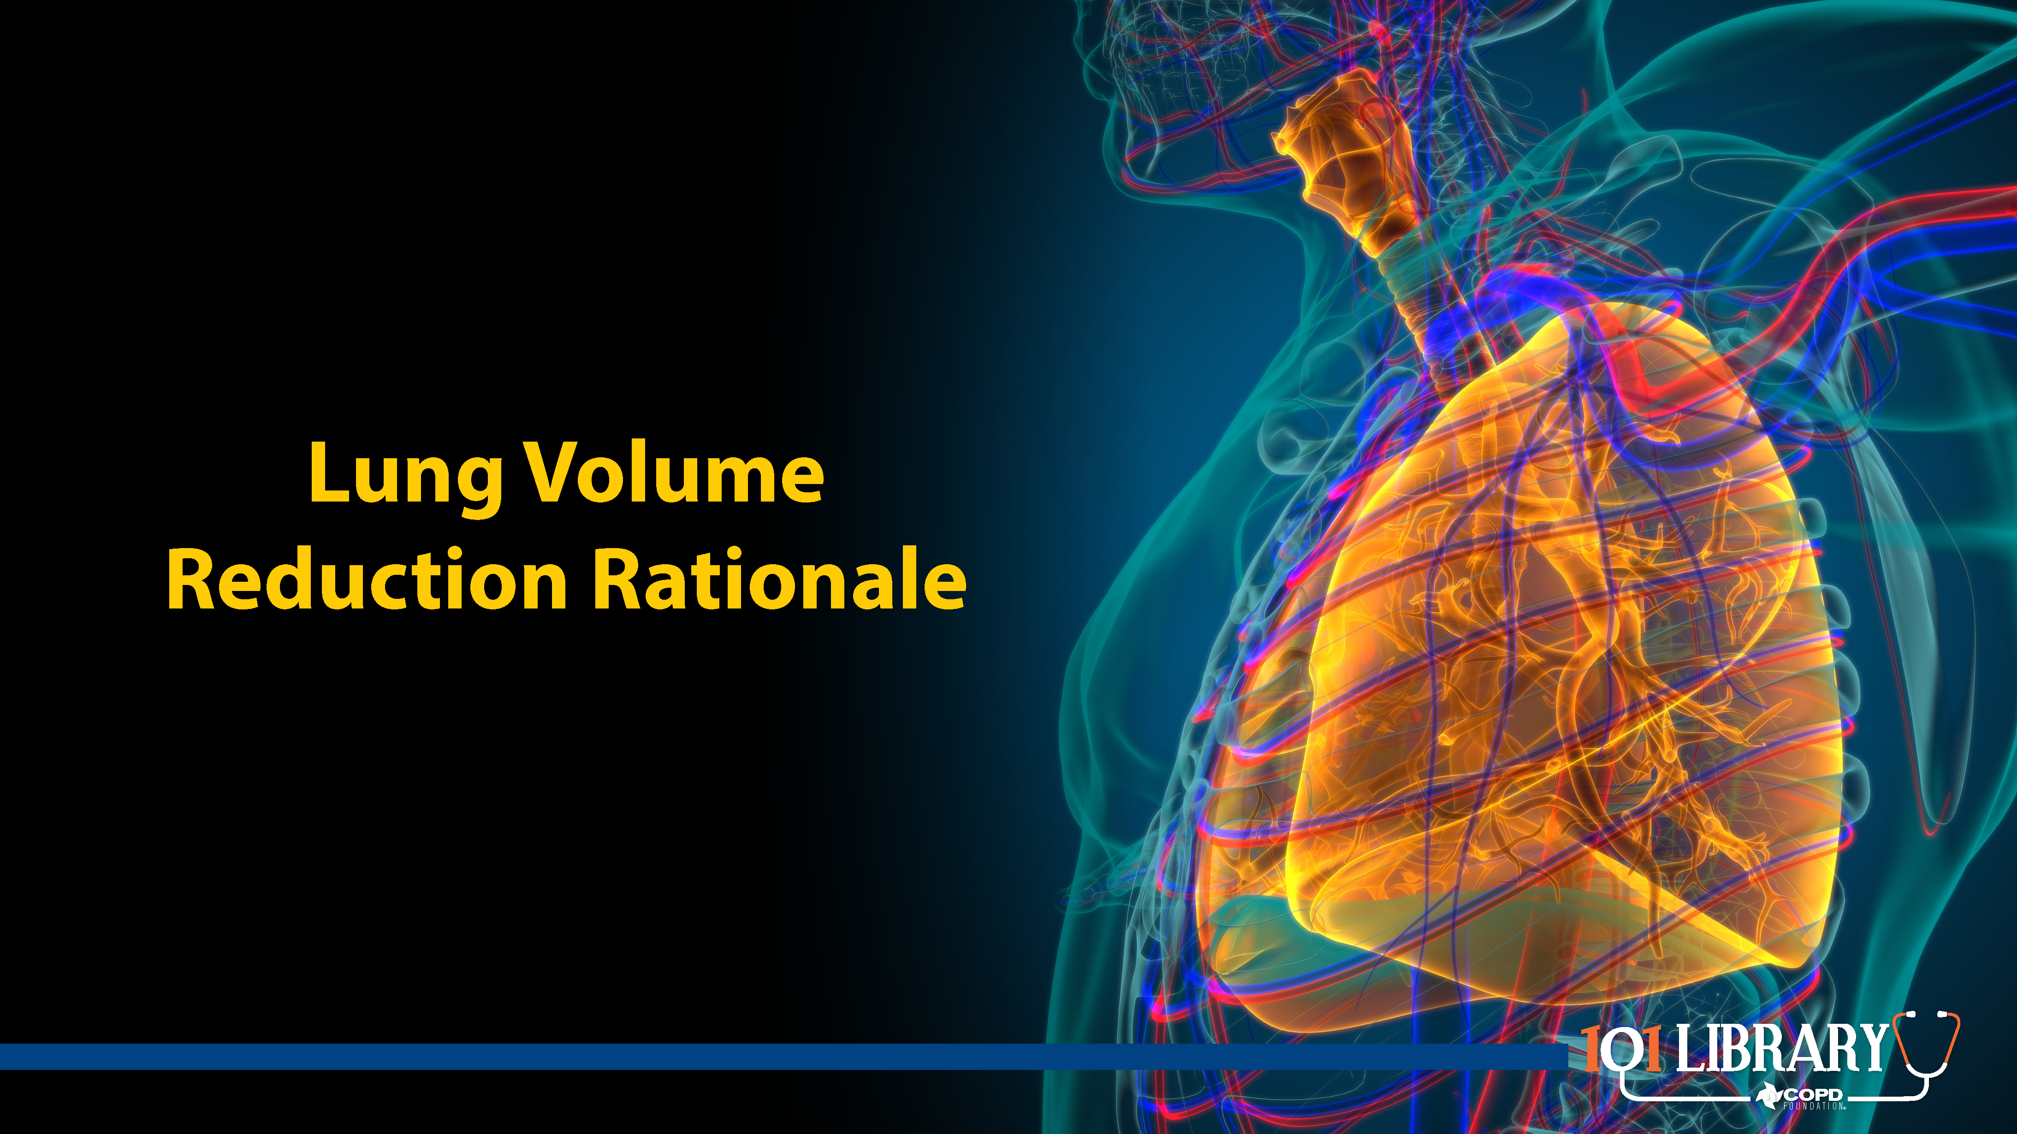

Slide 3
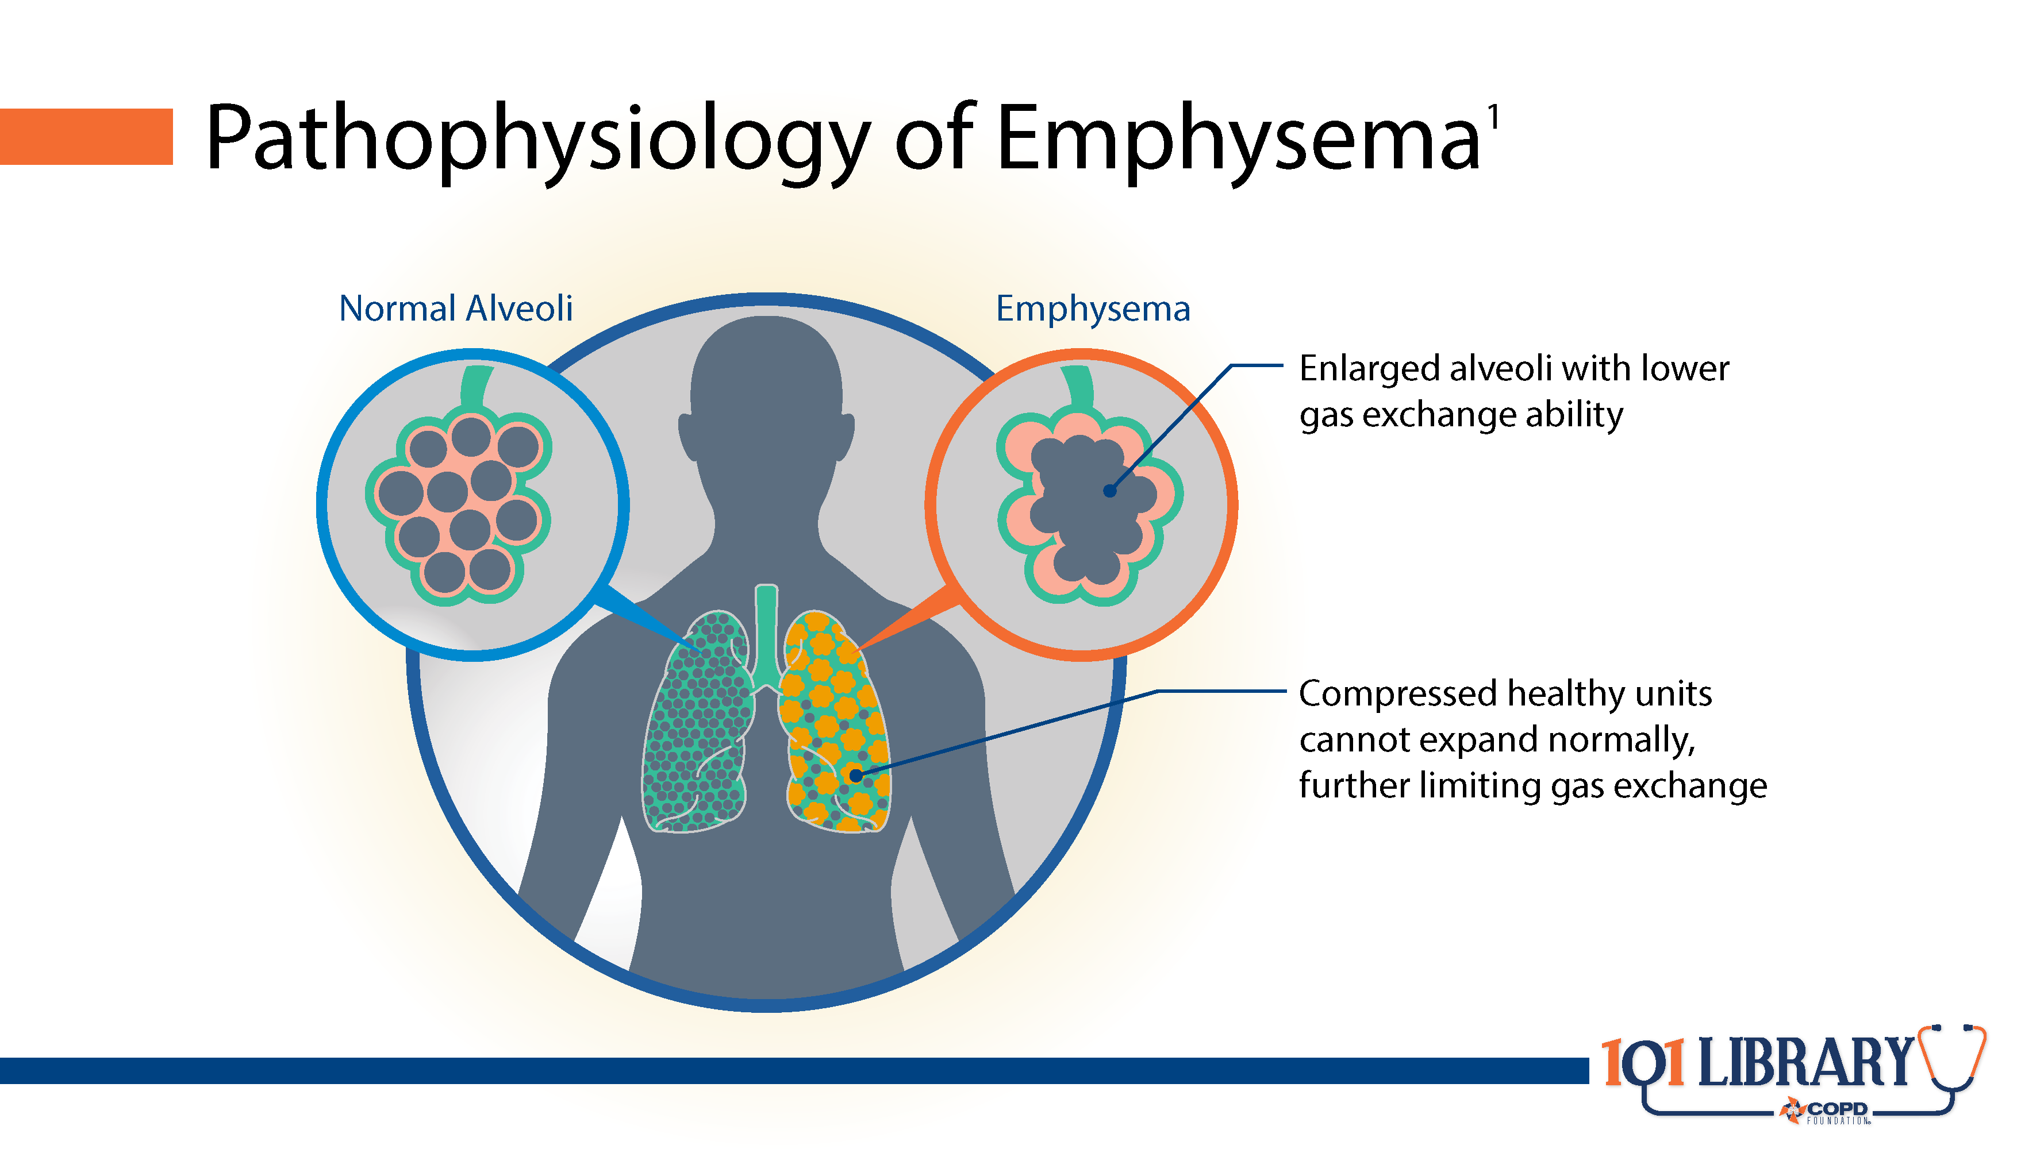
Notes:
Emphysema is characterized by the permanent hyperinflation of the alveoli. This hyperinflation is often accompanied by a breakdown of the septa between individual alveolar units, causing them to coalesce. The loss of alveolar surface area results in lower gas exchange, leading to the shortness of breath that is a hallmark symptom of COPD. Alveoli can also become so distended that they restrict the inflation of healthy alveoli, further impairing gas exchange.

Slide 4
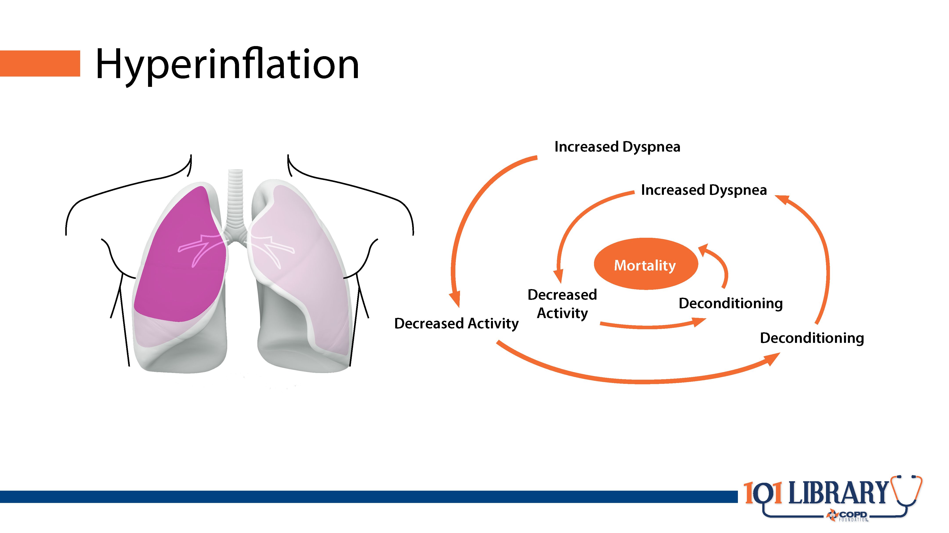
Notes:
Hyperinflation thus leads to a vicious cycle of dyspnea on exertion leading to worsening activity tolerance and deconditioning.

Slide 5
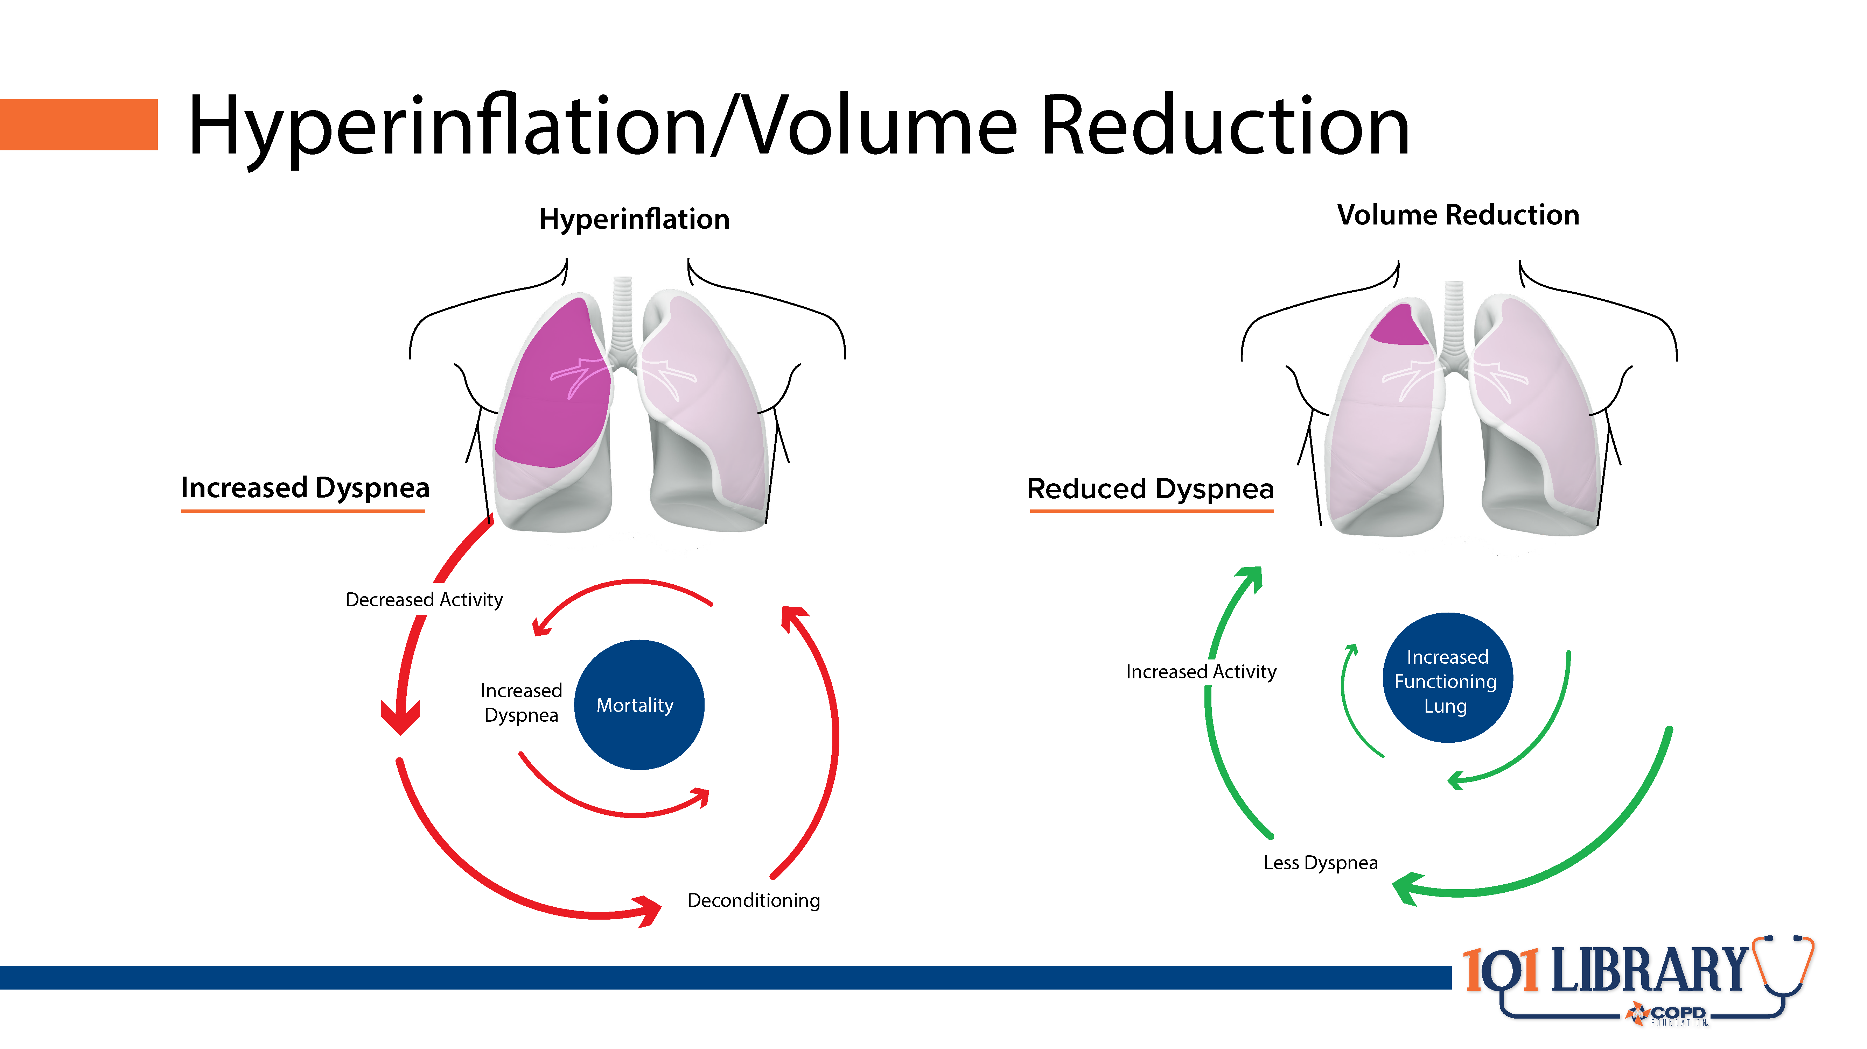
Notes:
The reduced physiological dead space and thoracic geometry improvements lead to more optimal lung expansion, thereby reversing the deconditioning spiral.

Slide 6
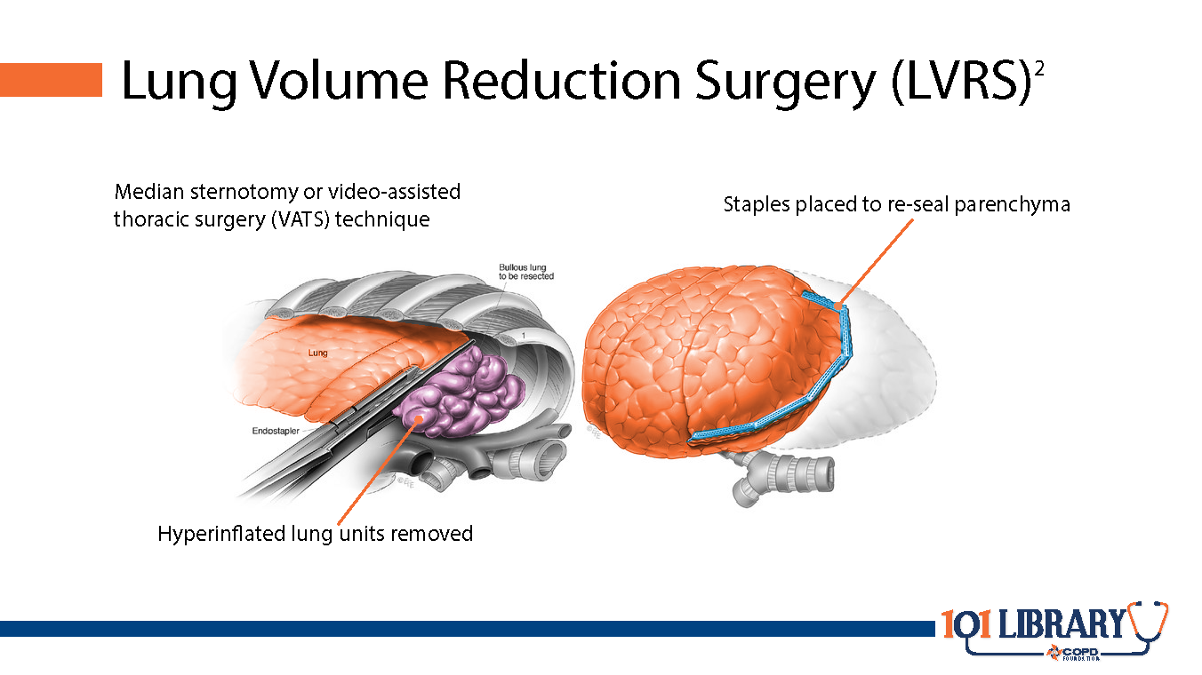
Notes:
First described in the 1960s and coming to prominence in the 1990s, surgical lung volume reduction aims to improve respiratory dynamics through the removal of diseased, expanded tissue. This can decrease residual volume (RV) and allow the remaining lung tissue to expand more normally. In most cases, 20-30% of each lung is removed, focusing on the most damaged segments.

Slide 7
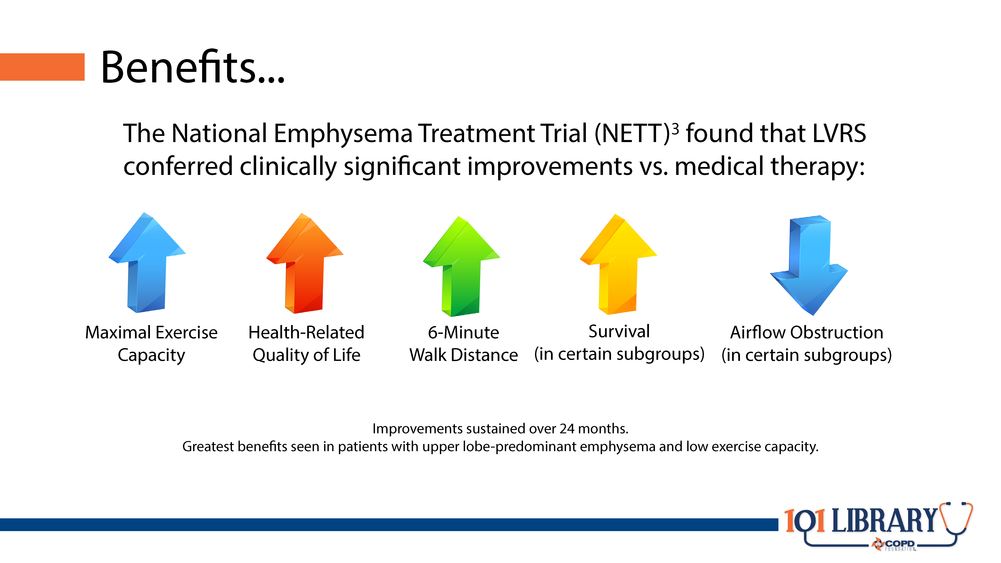
Notes:
The NETT study found that LVRS had a positive impact on both objective and patient-reported outcomes. Overall, patients who underwent the procedure saw an improvement in exercise tolerance (defined by an improvement of 10 watts or more of maximal workload from baseline) and an improvement in symptom burden as measured by the St. George’s Respiratory Questionnaire (SGRQ). Importantly, the improvement in SGRQ score was defined as at least 8 points, double the generally accepted minimal clinically important difference. This allows a more accurate risk/benefit analysis considering the magnitude of the intervention. In patients with mostly upper-lobe emphysema and low baseline exercise tolerance, improvements were also seen in mortality risk.

Slide 8
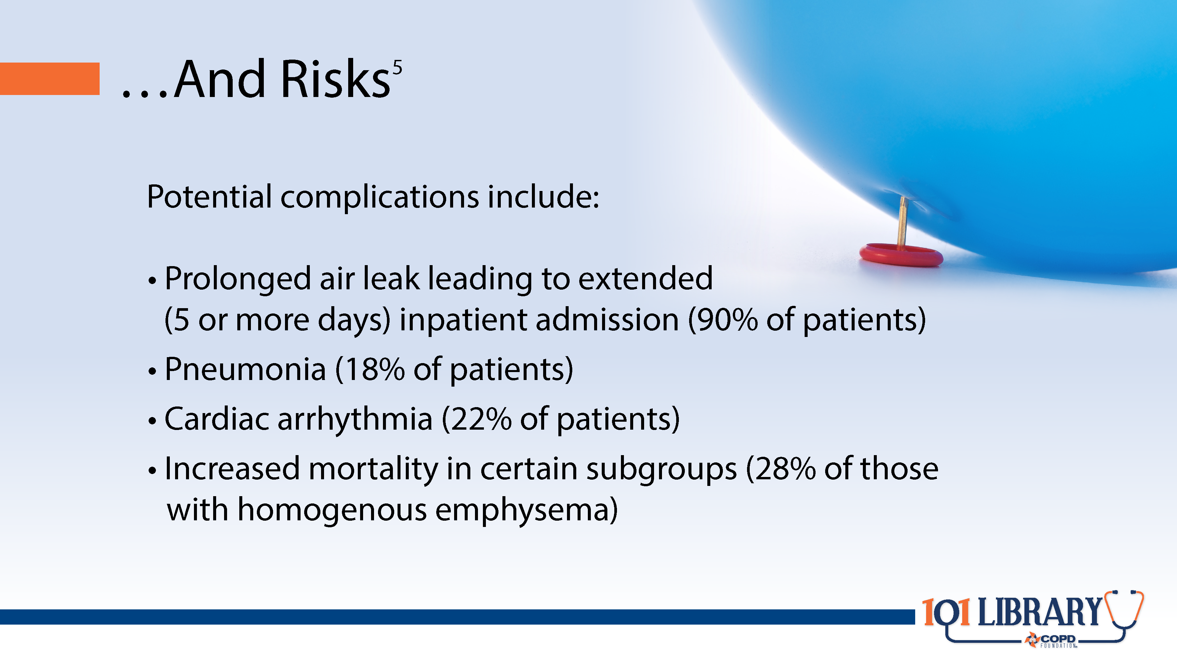
Notes:
As with any invasive surgery, there are a variety of risks to consider. This makes patient selection, preparation, and clinical experience very important. While less comprehensive than lung transplantation, LVRS is still a major procedure, and many patients may not be willing to undergo the surgery given uncertain outcomes. This led to a consensus that the procedure, while potentially effective, was underutilized.

Slide 9
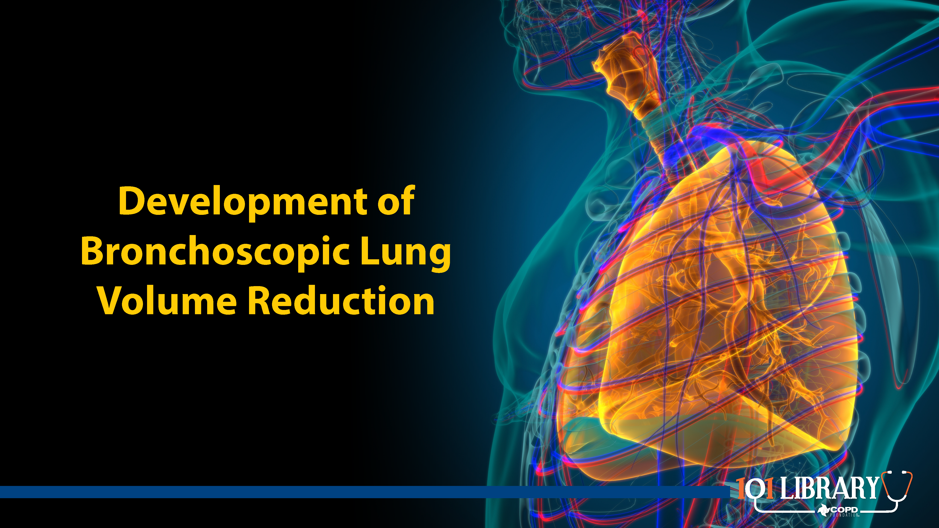

Slide 10
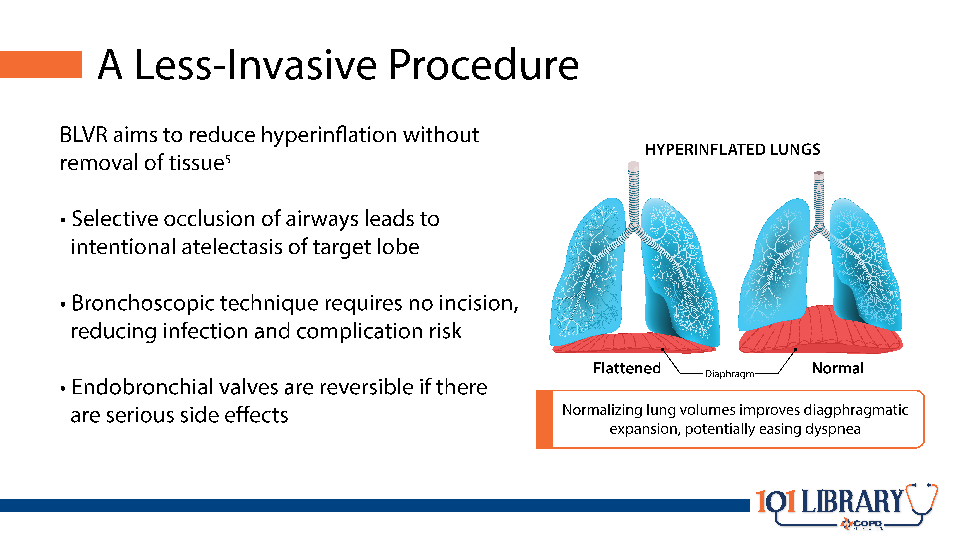
Notes:
Bronchoscopic lung volume reduction (BLVR) aims to achieve similar results as surgical approaches while reducing risks. By occluding airways leading to the most distended alveoli, these procedures cause absorption atelectasis in selected areas of the lung, allowing healthier lung units to re-expand. As with surgical volume reduction, this facilitates a return to improved pulmonary function, activity tolerance, and subjective dyspnea.

Slide 11
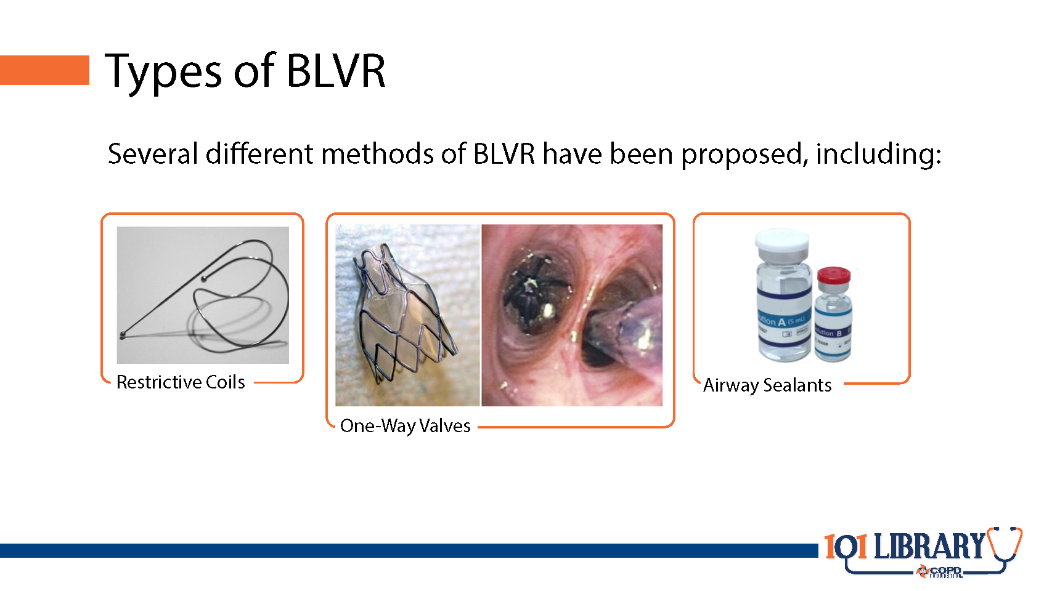
Notes:
Some of the first procedures were performed with silicone balloons similar to those used to block blood vessels. Subsequent trials used biocompatible sponges confined within a stainless steel cage^{.6} Various other methods and adjuncts have also been trialed, all with the aim of allowing hyperexpanded units to deflate, freeing up space in the thoracic cage.

Slide 12
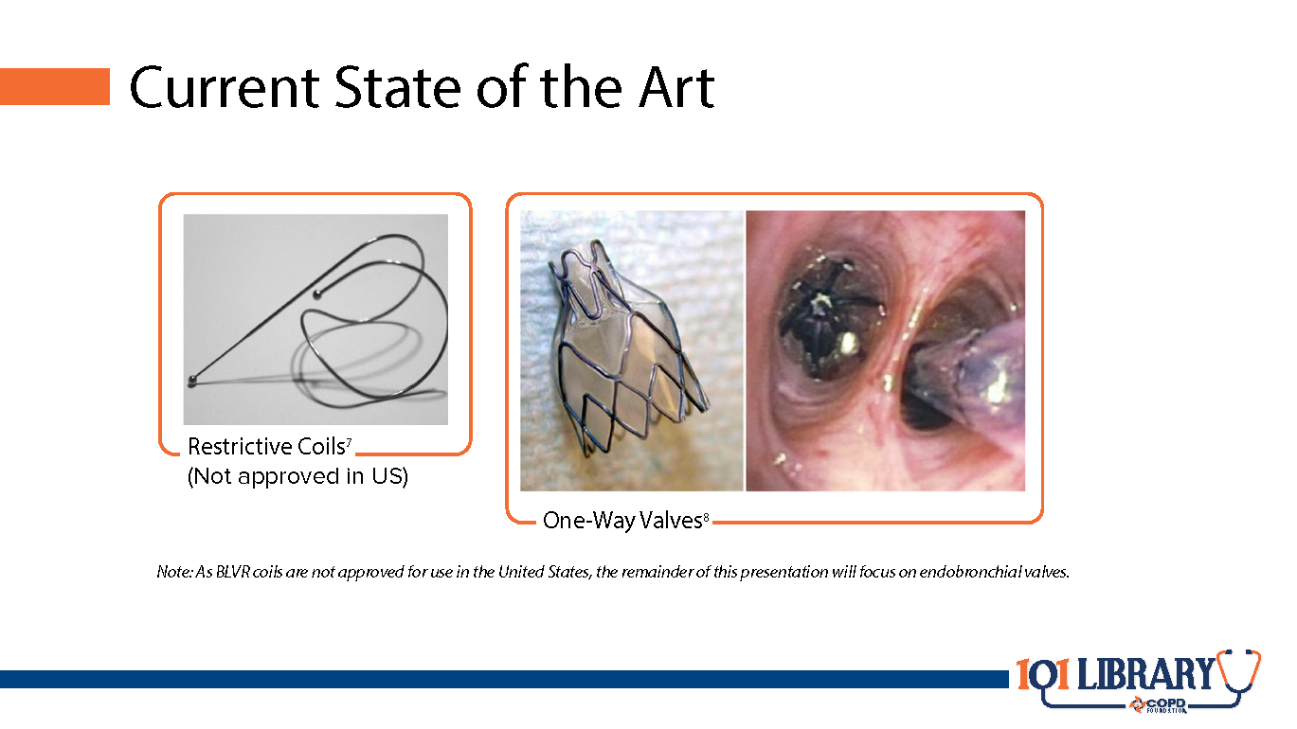
Notes:
Two techniques have so far proven to be the most effective. Restrictive coils made of nitinol (an alloy composed of nickel and titanium) physically prevent lung units from re-expanding. Nitinol is a superelastic alloy, allowing the coil to be flattened for placement; release of tension causes the coil to return to its original shape, confining alveoli to a smaller volume. Endobronchial valves occlude airways with a one-way valve, allowing air to escape during exhalation while preventing reinflation.

Slide 13
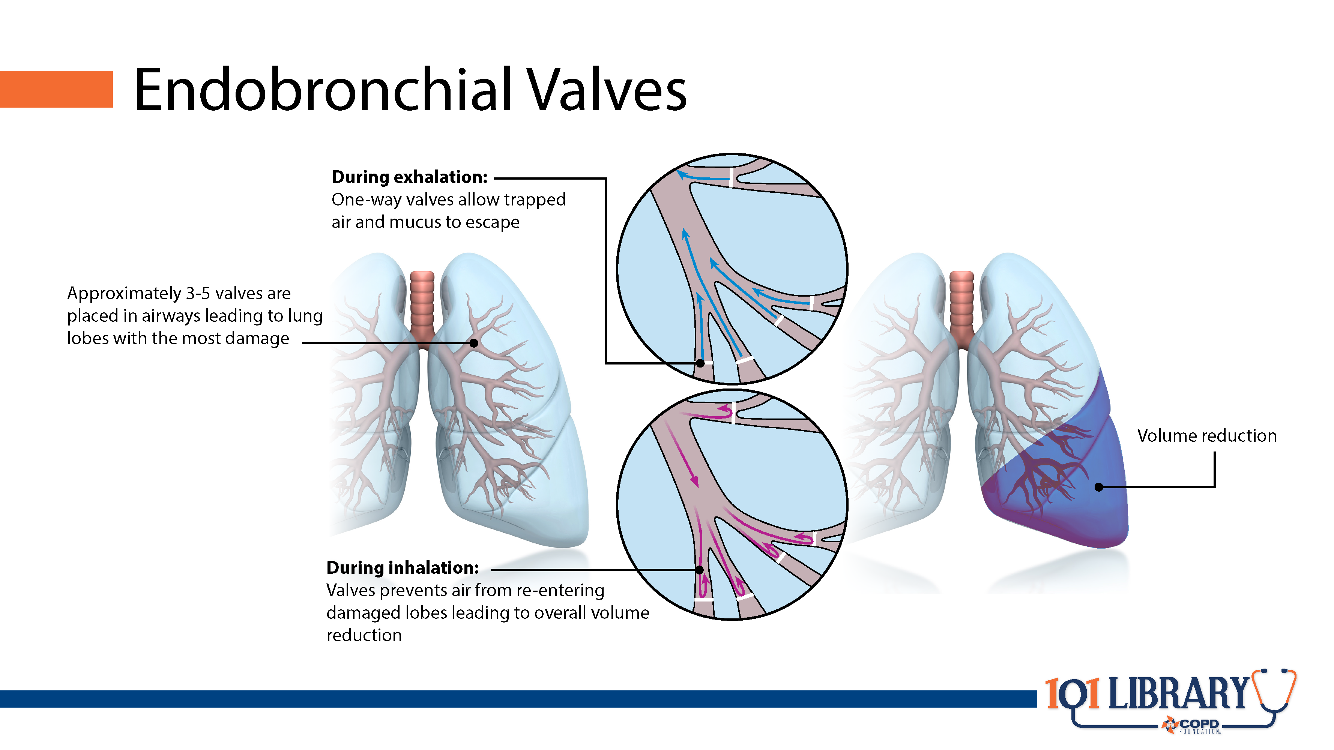

Slide 14


Slide 15
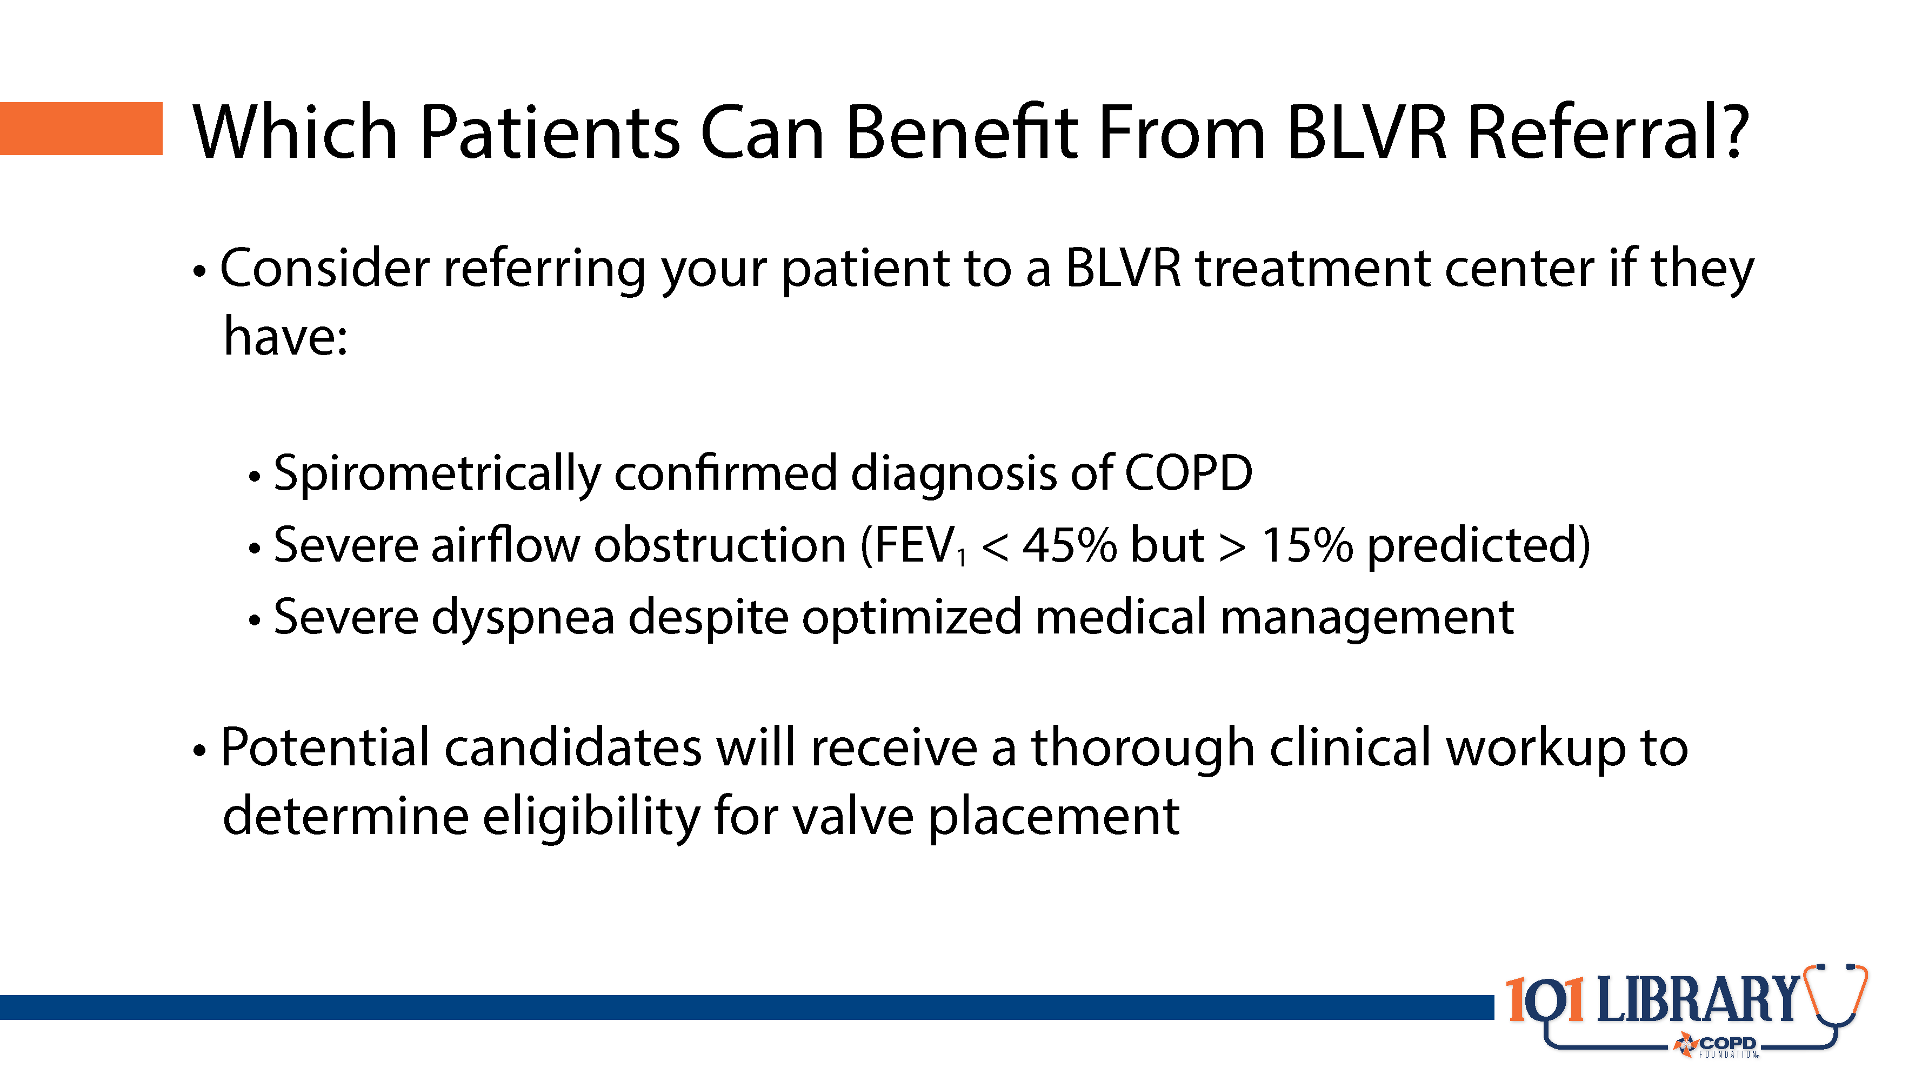
Notes:
A BLVR treatment center is the ideal setting to identify the best candidates for BLVR success. However, primary care providers should refer potential candidates if they have significant airflow obstruction (confirmed by spirometry) and ongoing dyspnea despite optimized medication management.

Slide 16
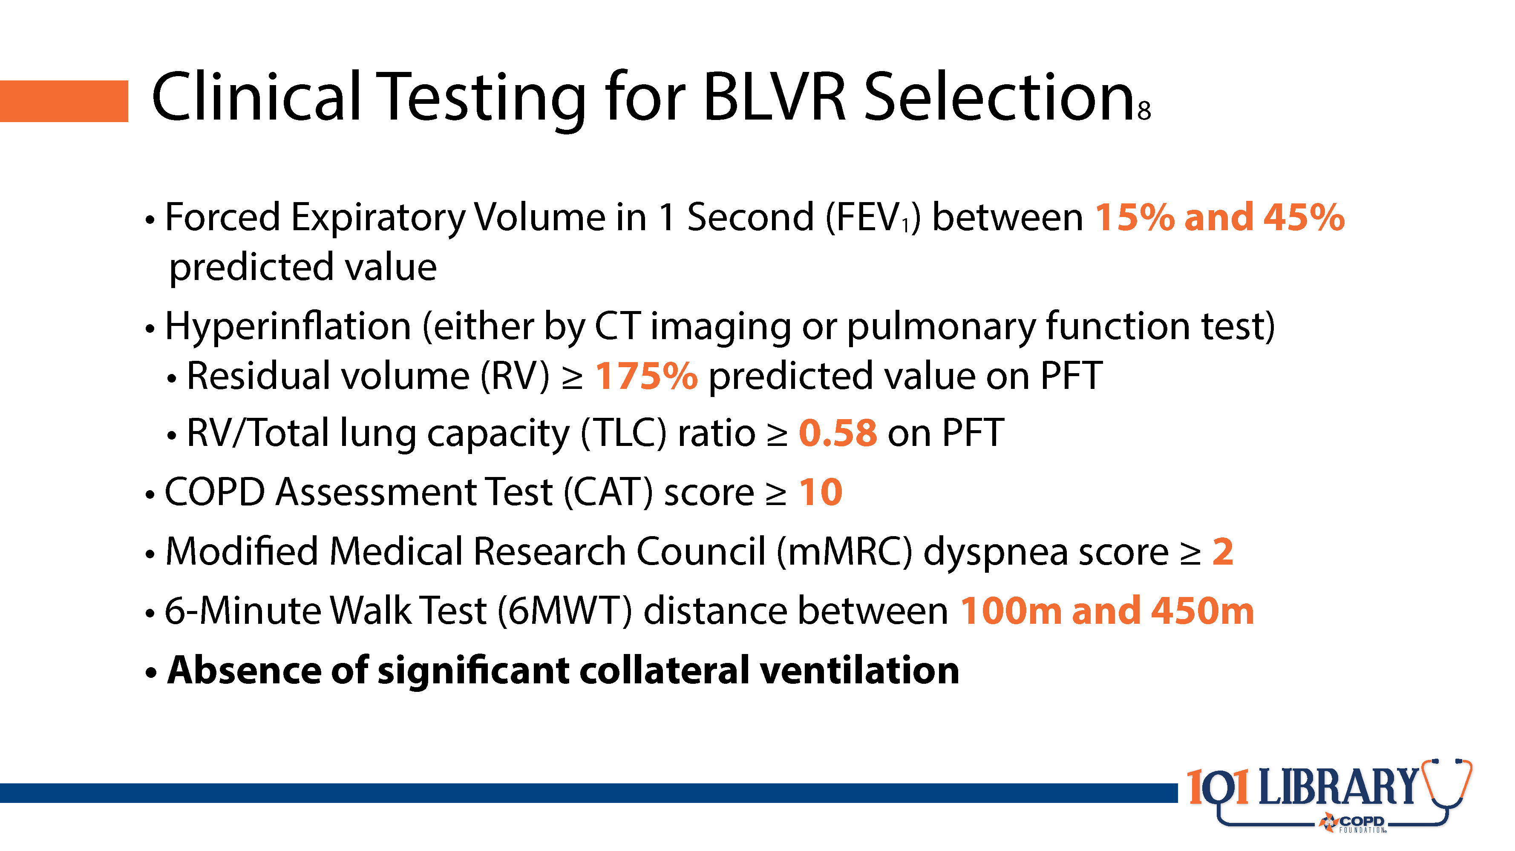
Notes:
Research continues to refine ideal patient selection for BLVR. However, studies have identified those patients who are most likely to benefit while experiencing the lowest risk. Essentially, these are people who have clinically diagnosed COPD with hyperinflation that significantly limits their activity and quality of life. The criteria listed here are generally accepted recommendations; acceptable outcomes have been achieved with cases outside of these parameters.

Slide 17
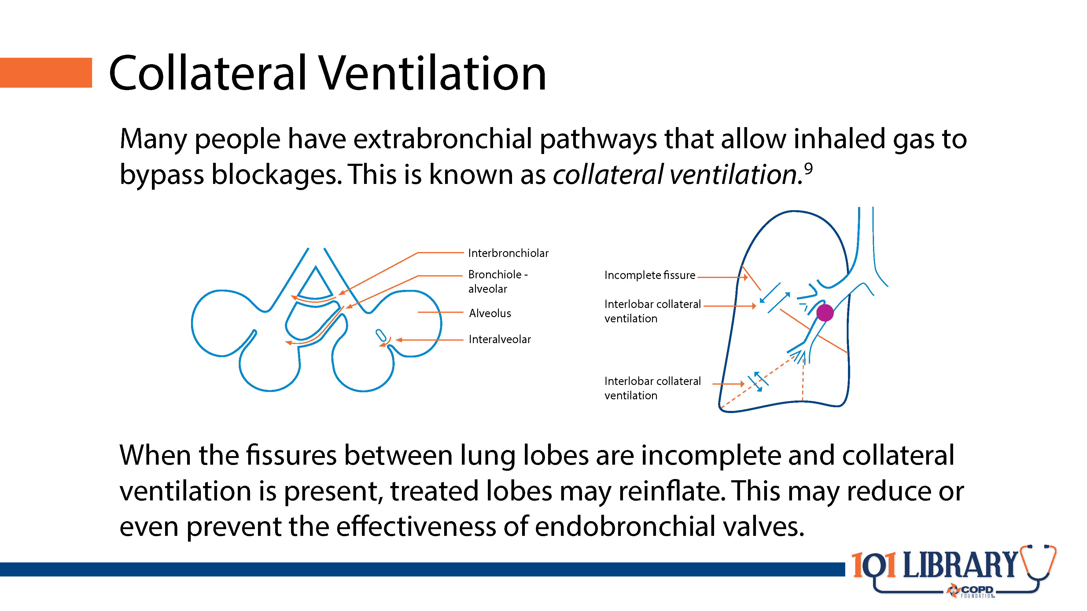
Notes:
The presence of collateral ventilation, while often considered a physiological boon, can be detrimental in this case. If patients have too many alternative pathways for airflow, the target lobes will be able to eventually reinflate to their distended state, rendering any benefit from BLVR temporary and potentially leading to dissatisfaction with their care. Thus, evaluation for collateral ventilation should be considered a key component to patient selection.

Slide 18
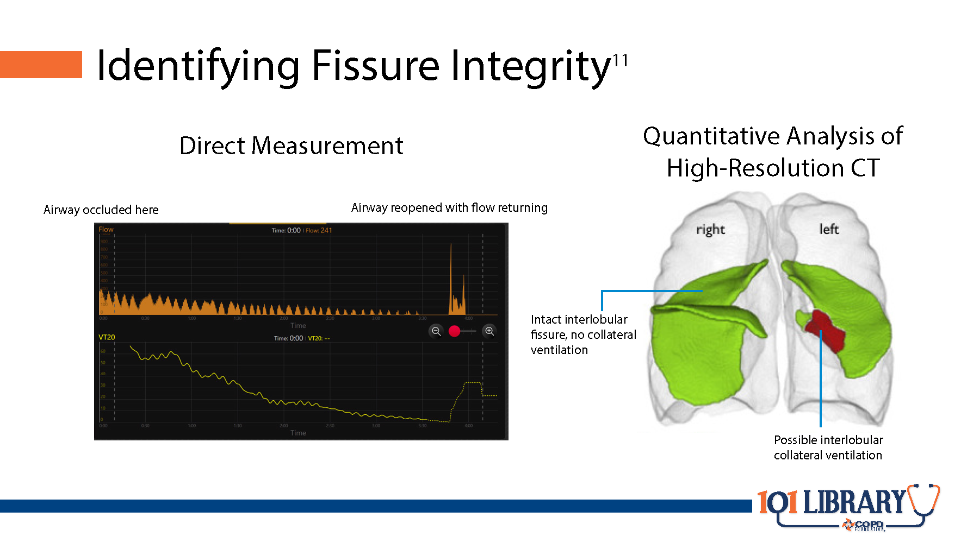
Notes:
Depending on the type of valve placed, the strategy for assessing collateral ventilation may differ. In many patients, a high-resolution CT scan with quantitative analysis may sufficiently detect a complete fissure, indicating the lack of collateral ventilation. In others, collateral ventilation may be directly measured using a specialized bronchoscopic system.

Slide 19
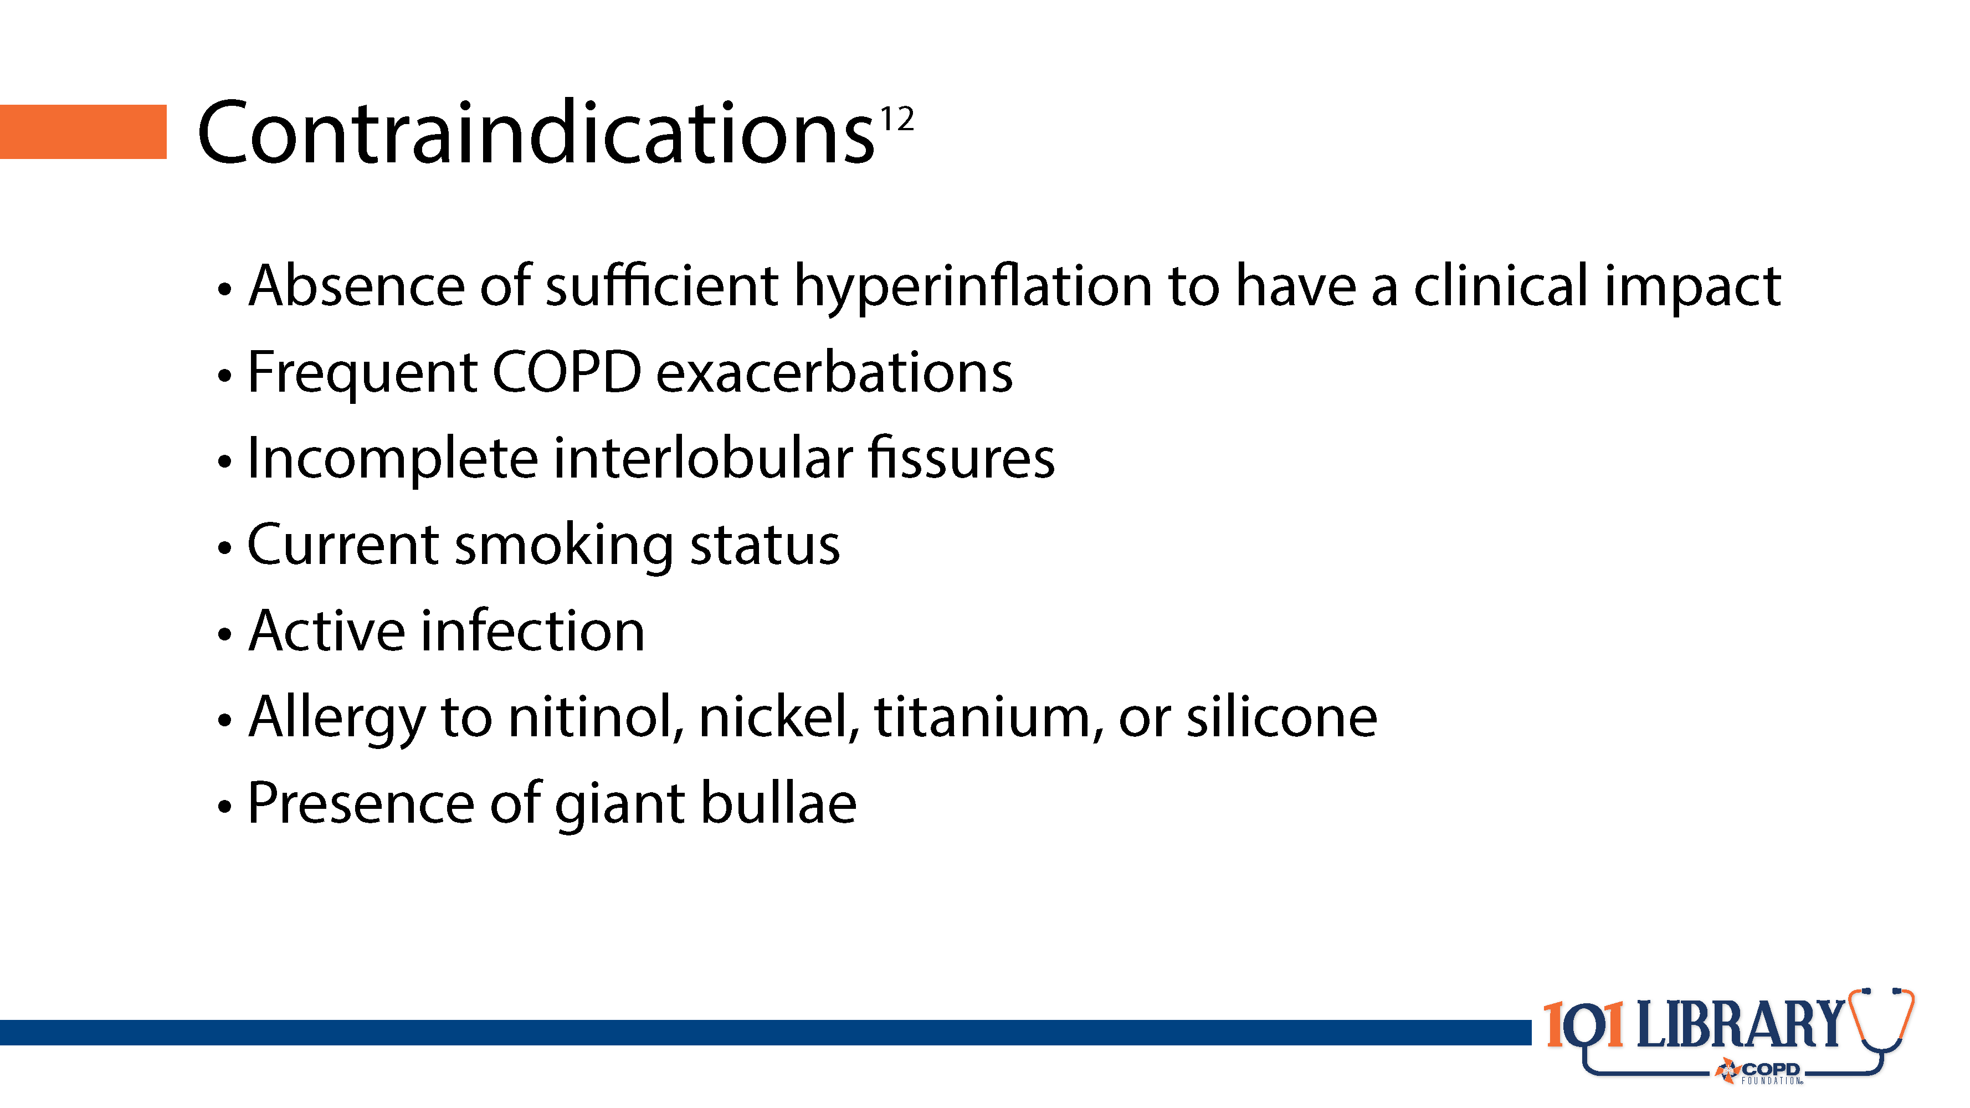

Slide 20
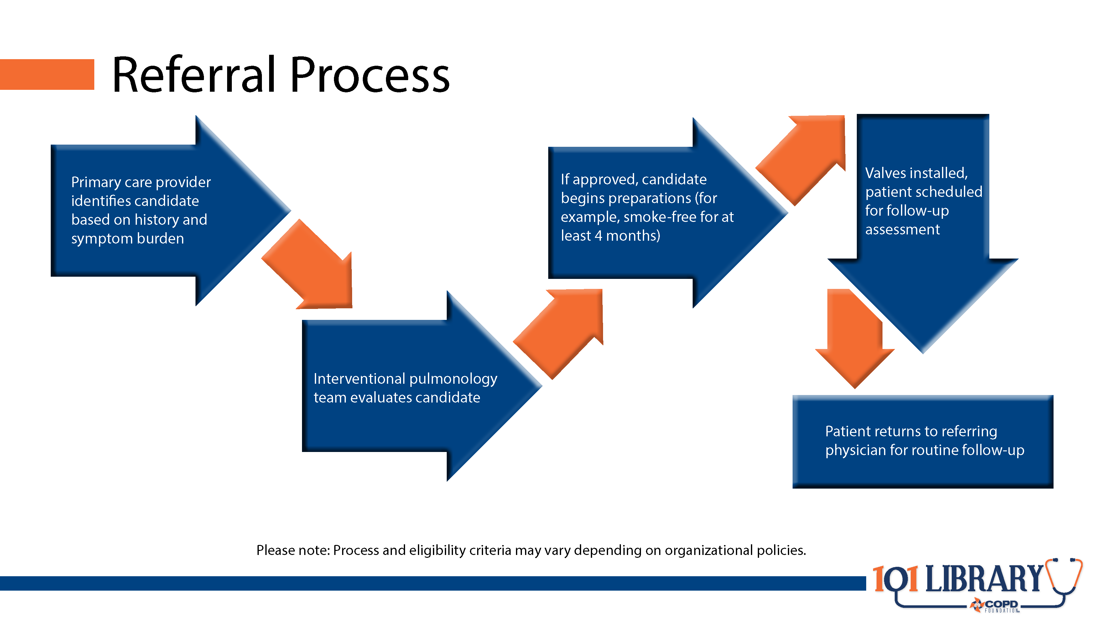

Slide 21


Slide 22
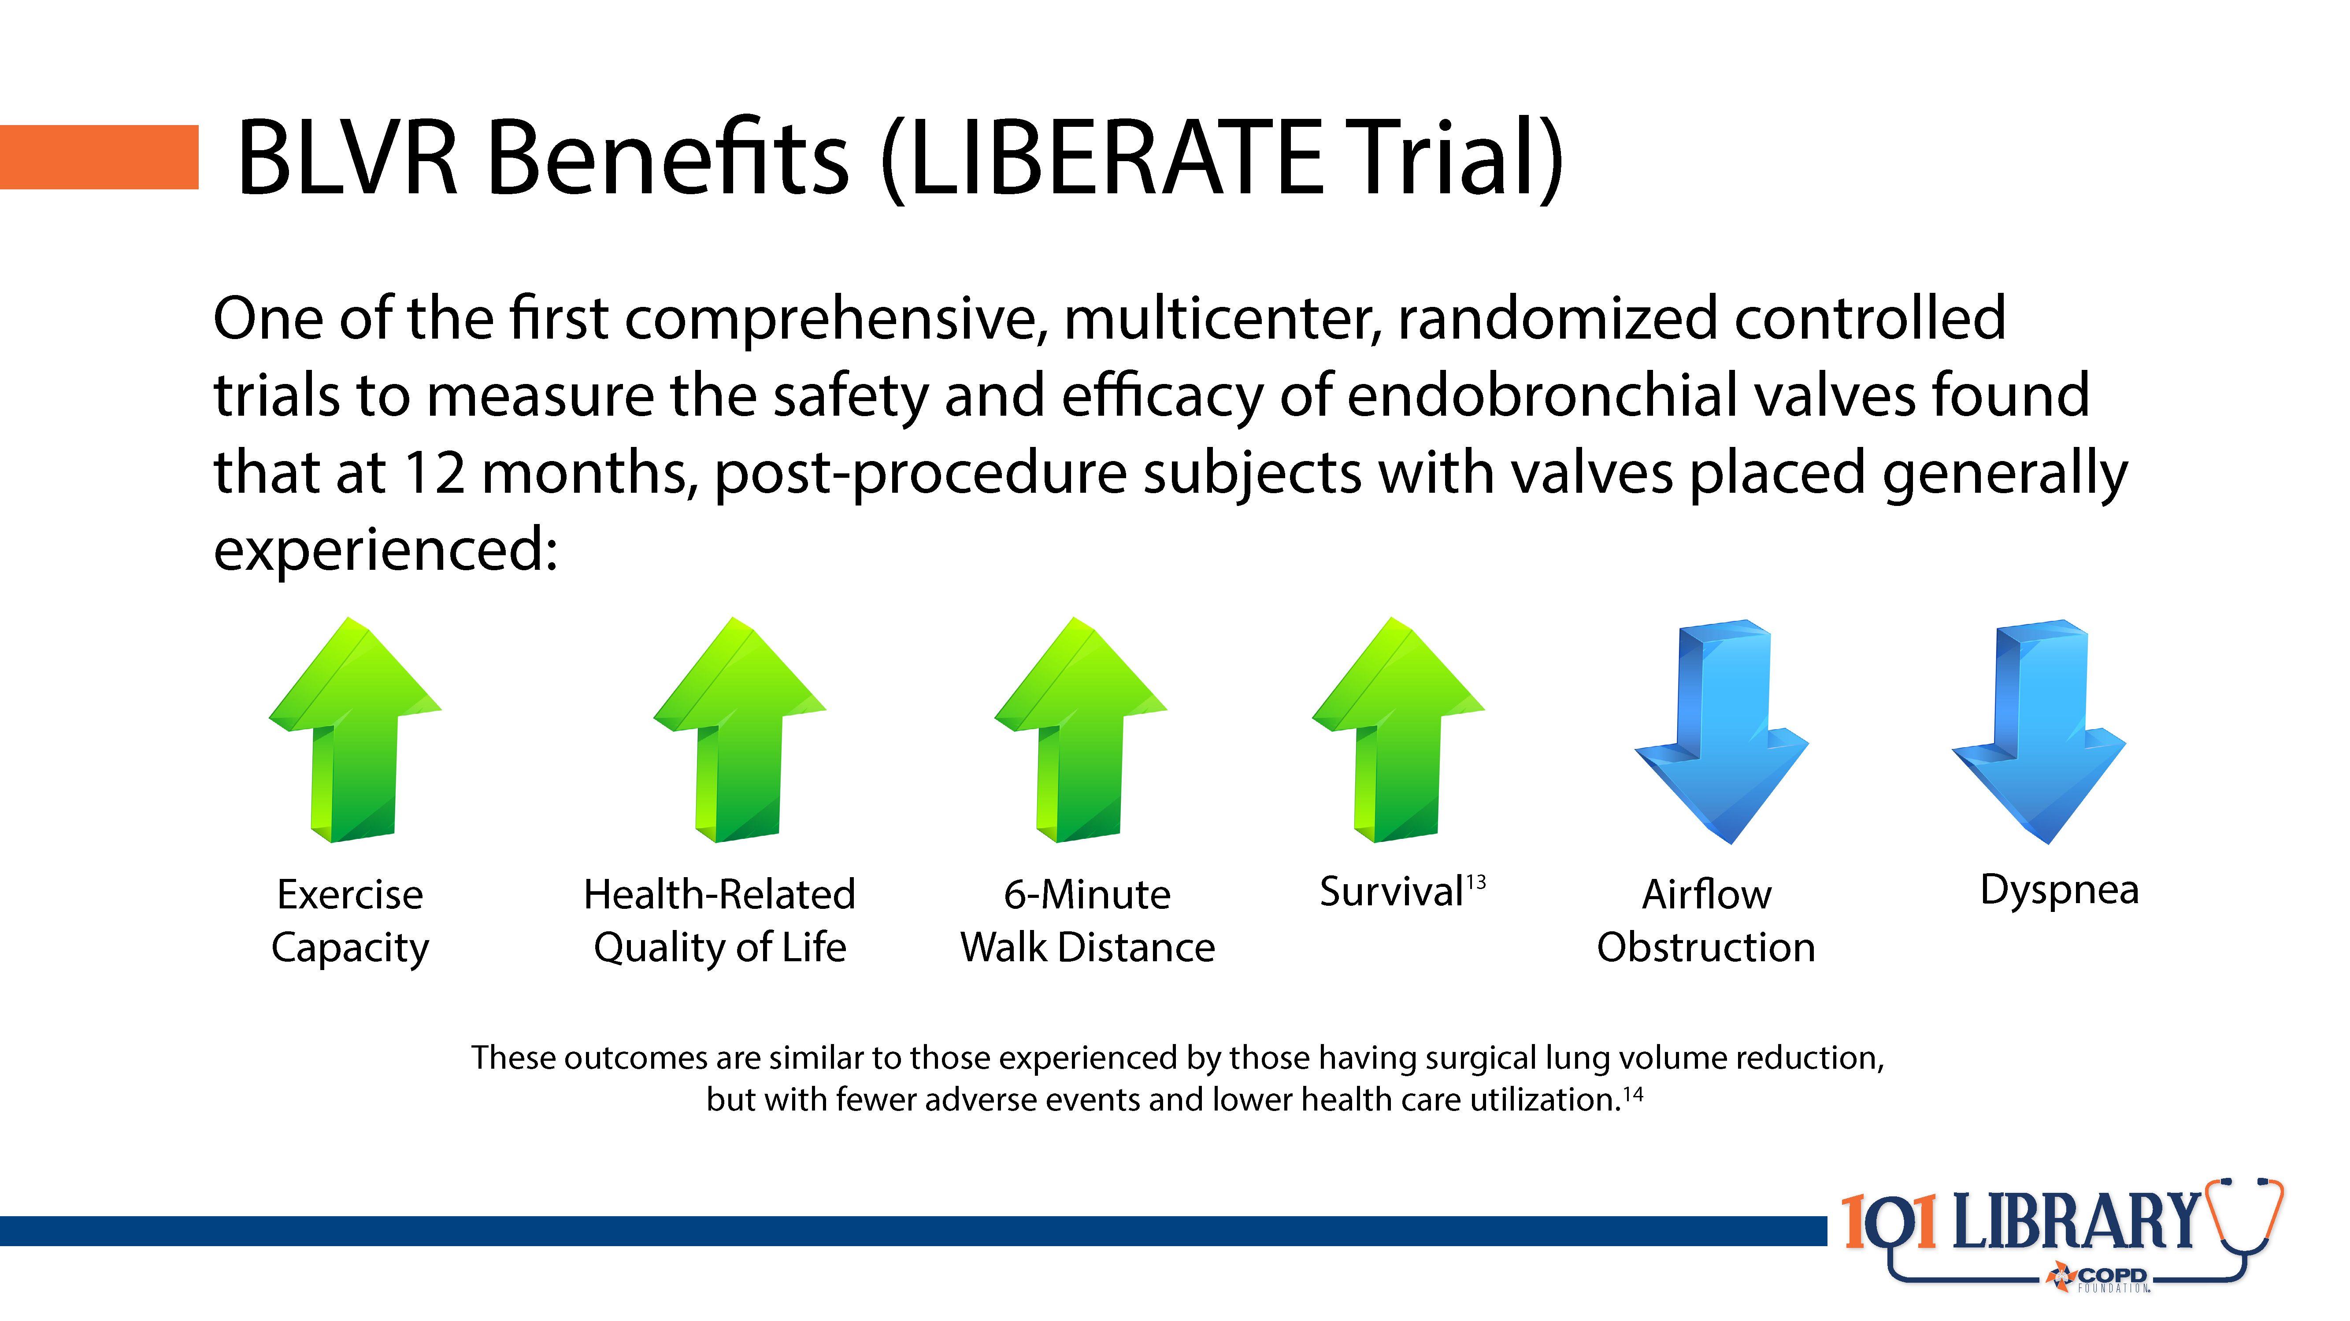

Slide 23
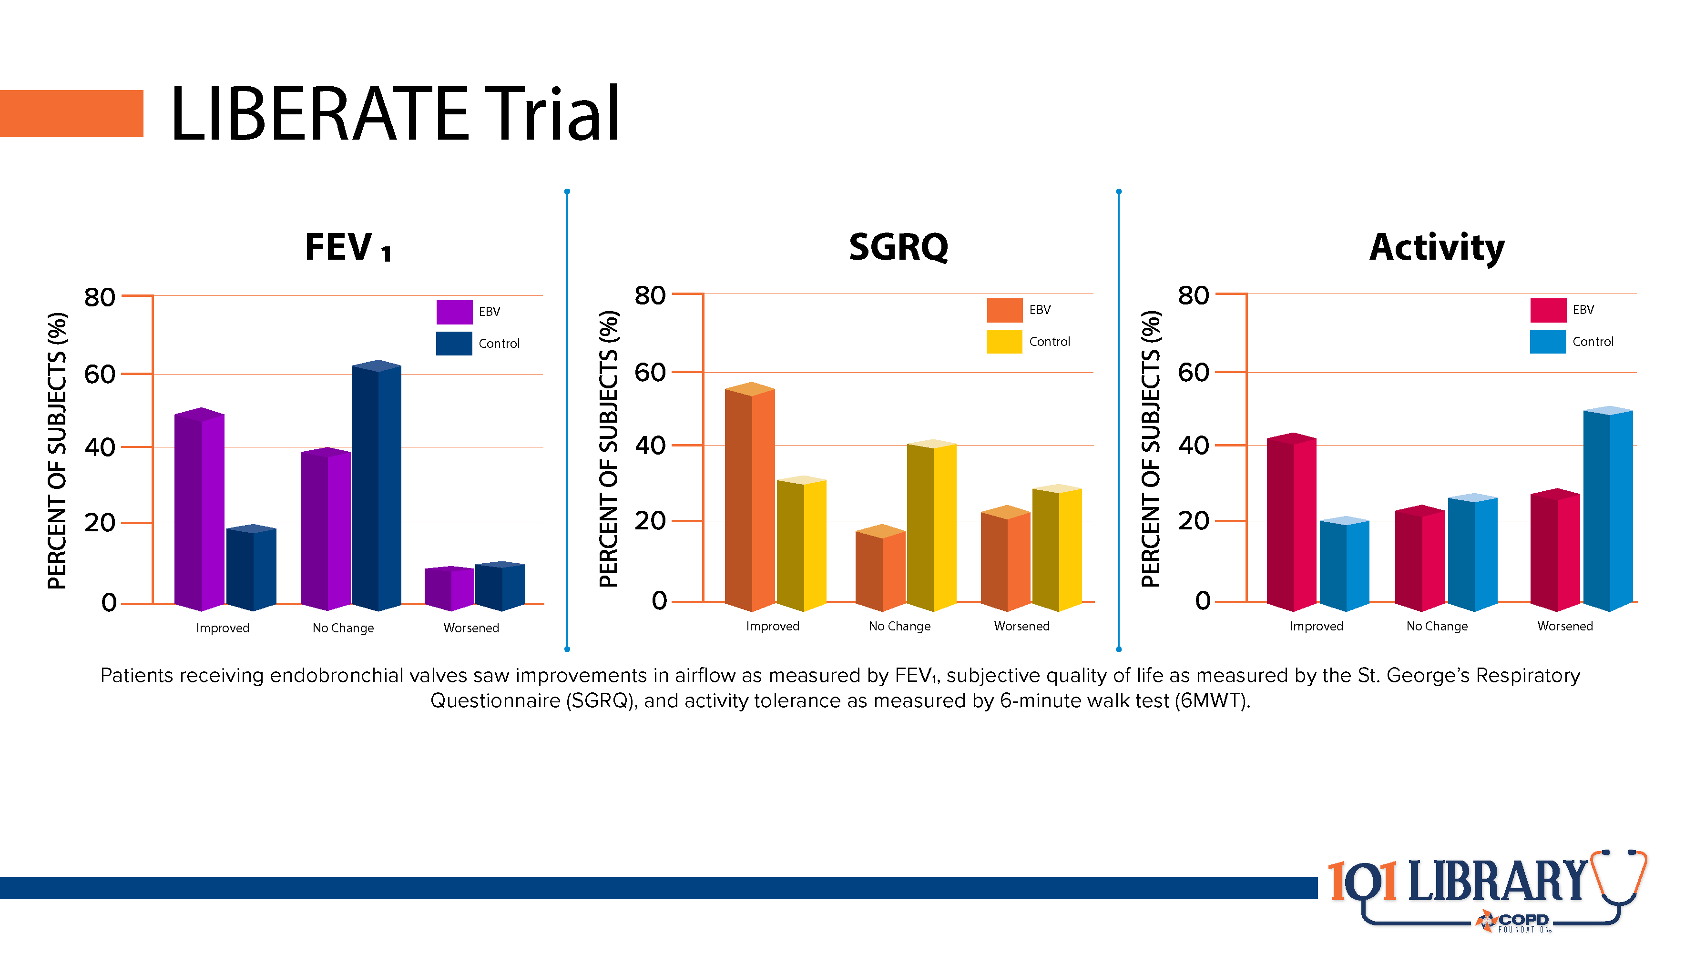

Slide 24
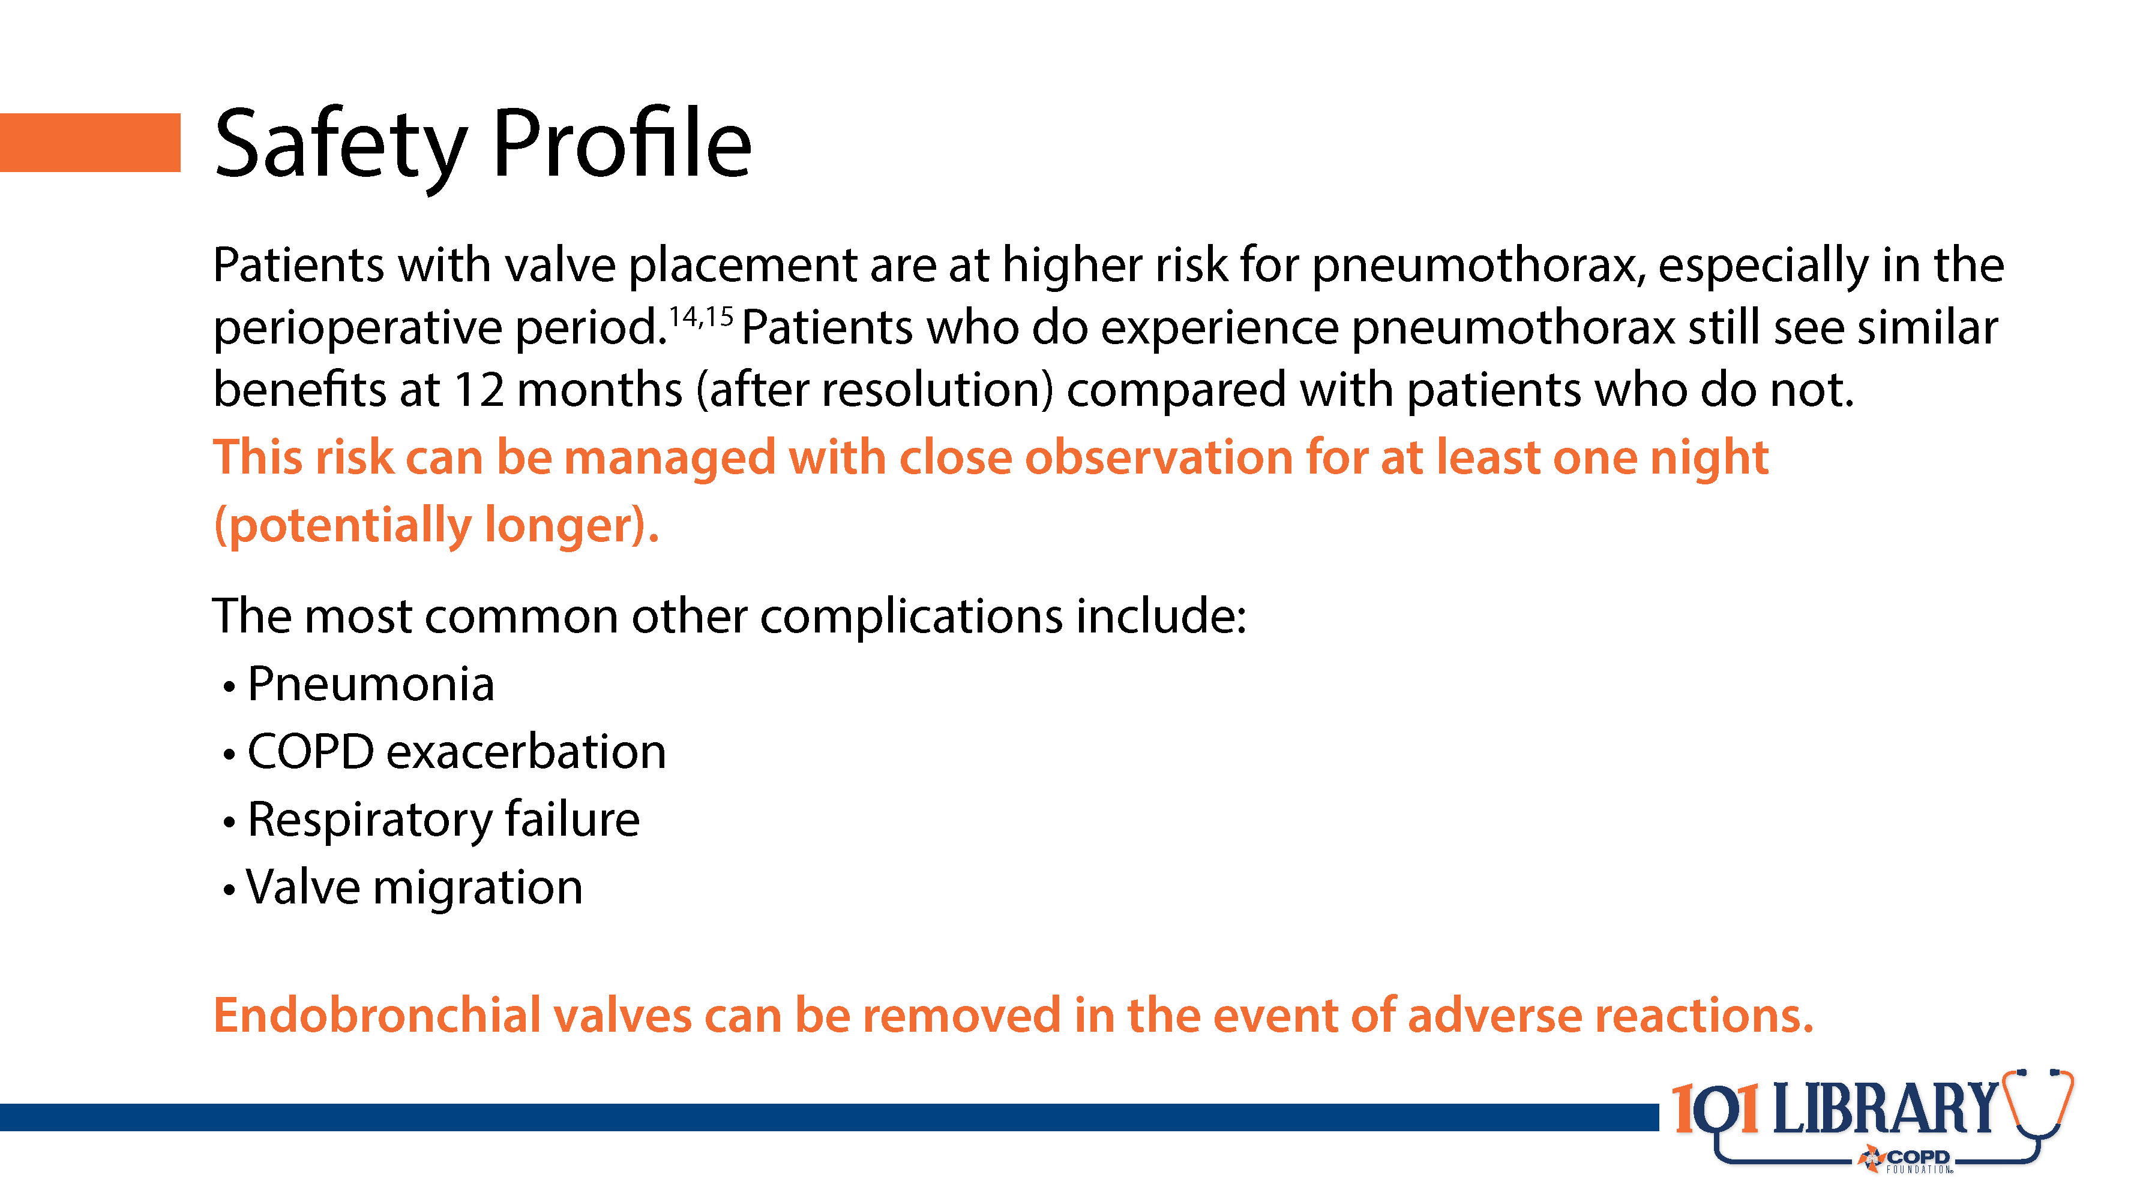
Notes:
With the exception of pneumothorax, adverse effects to endobronchial valve placement appear to be relatively rare. This makes valve placement a safe alternative to surgical lung volume reduction in appropriate patients. In addition, it is important to remember that should the unpredictable worst case happen, the valves can be removed bronchoscopically as well.

Slide 25
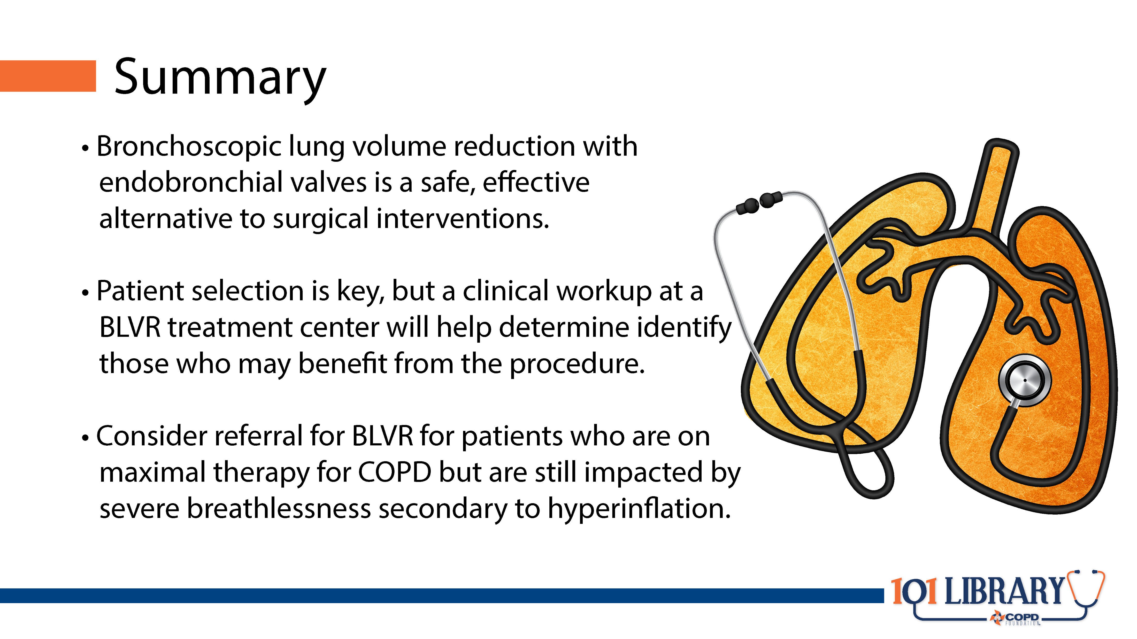

Slide 26


Slide 27
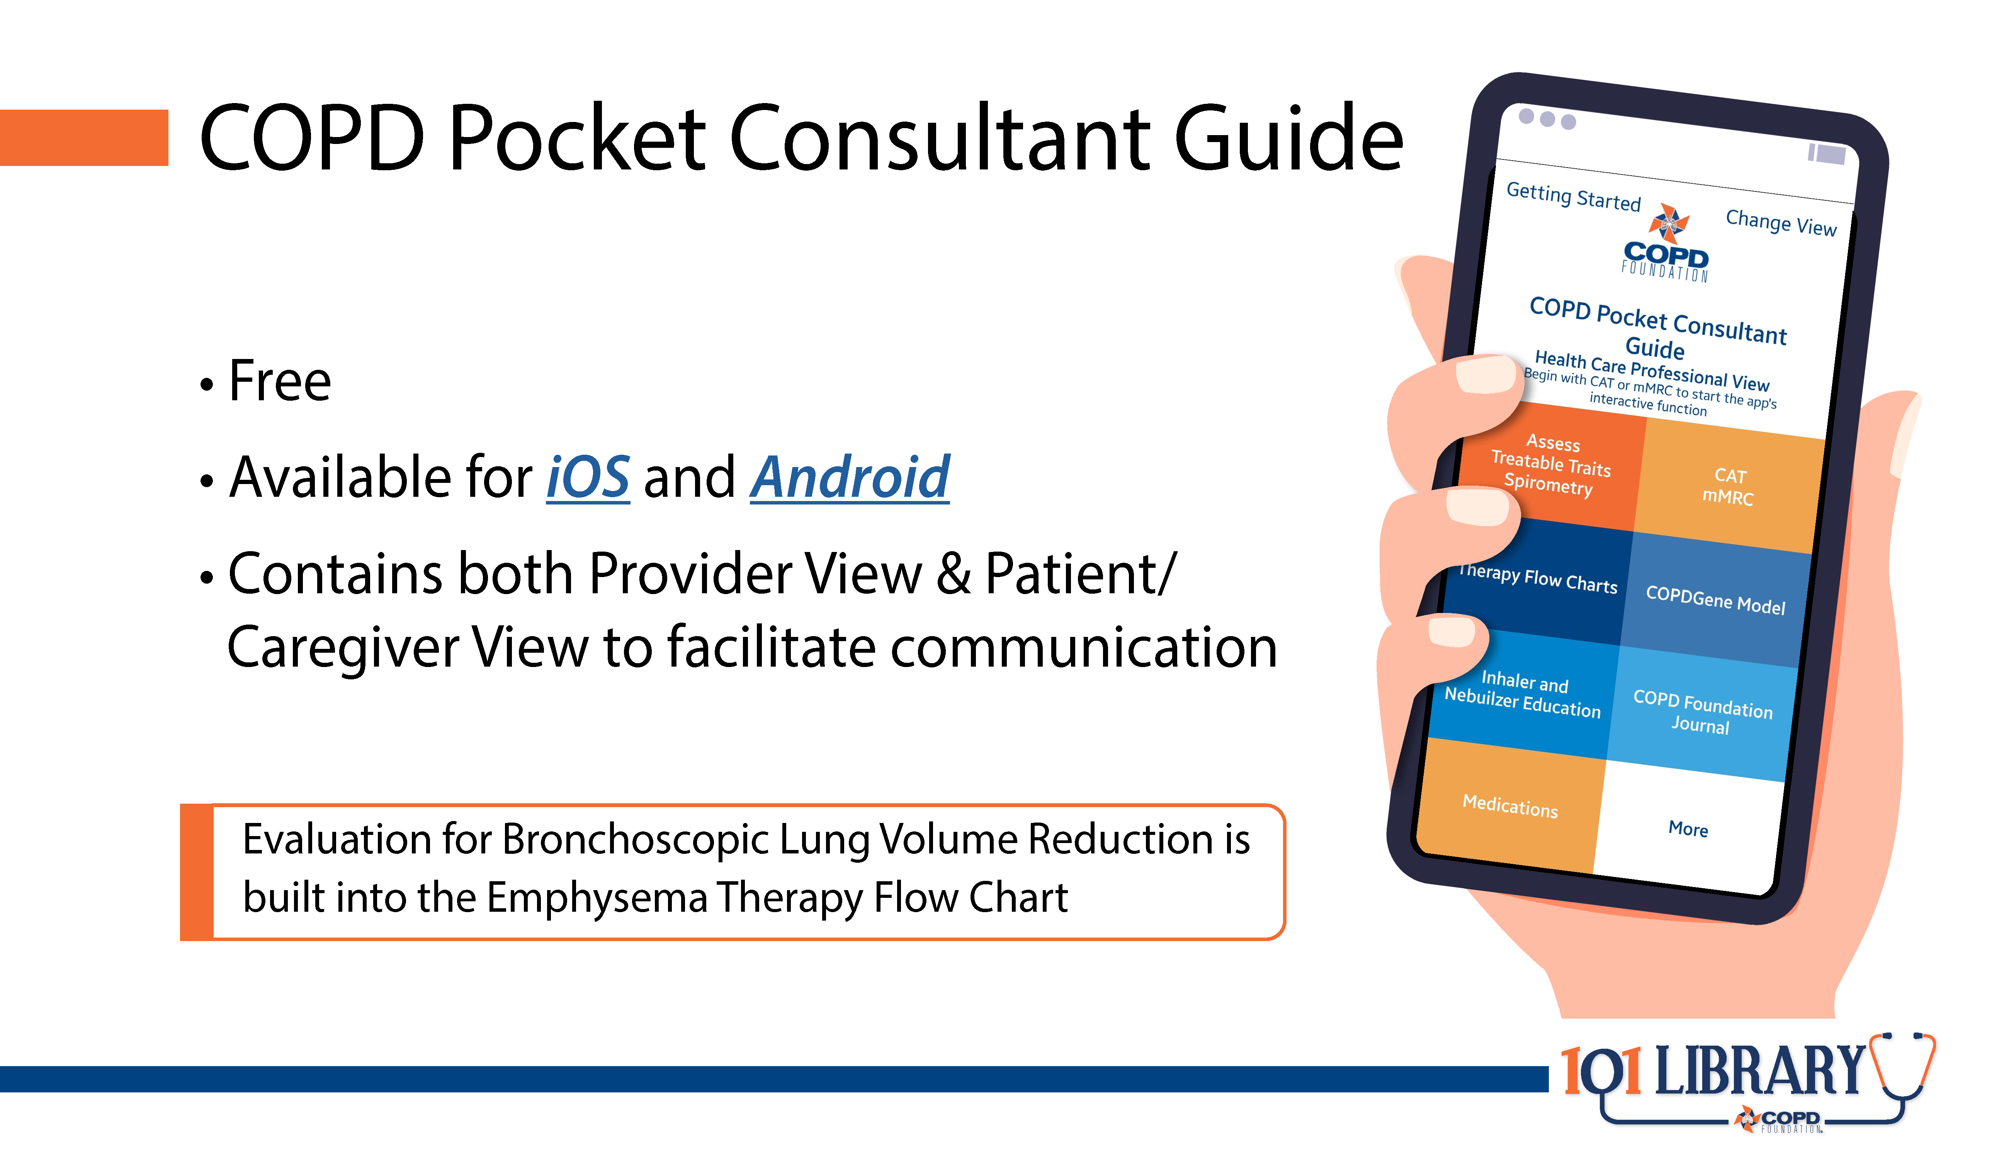

Slide 28
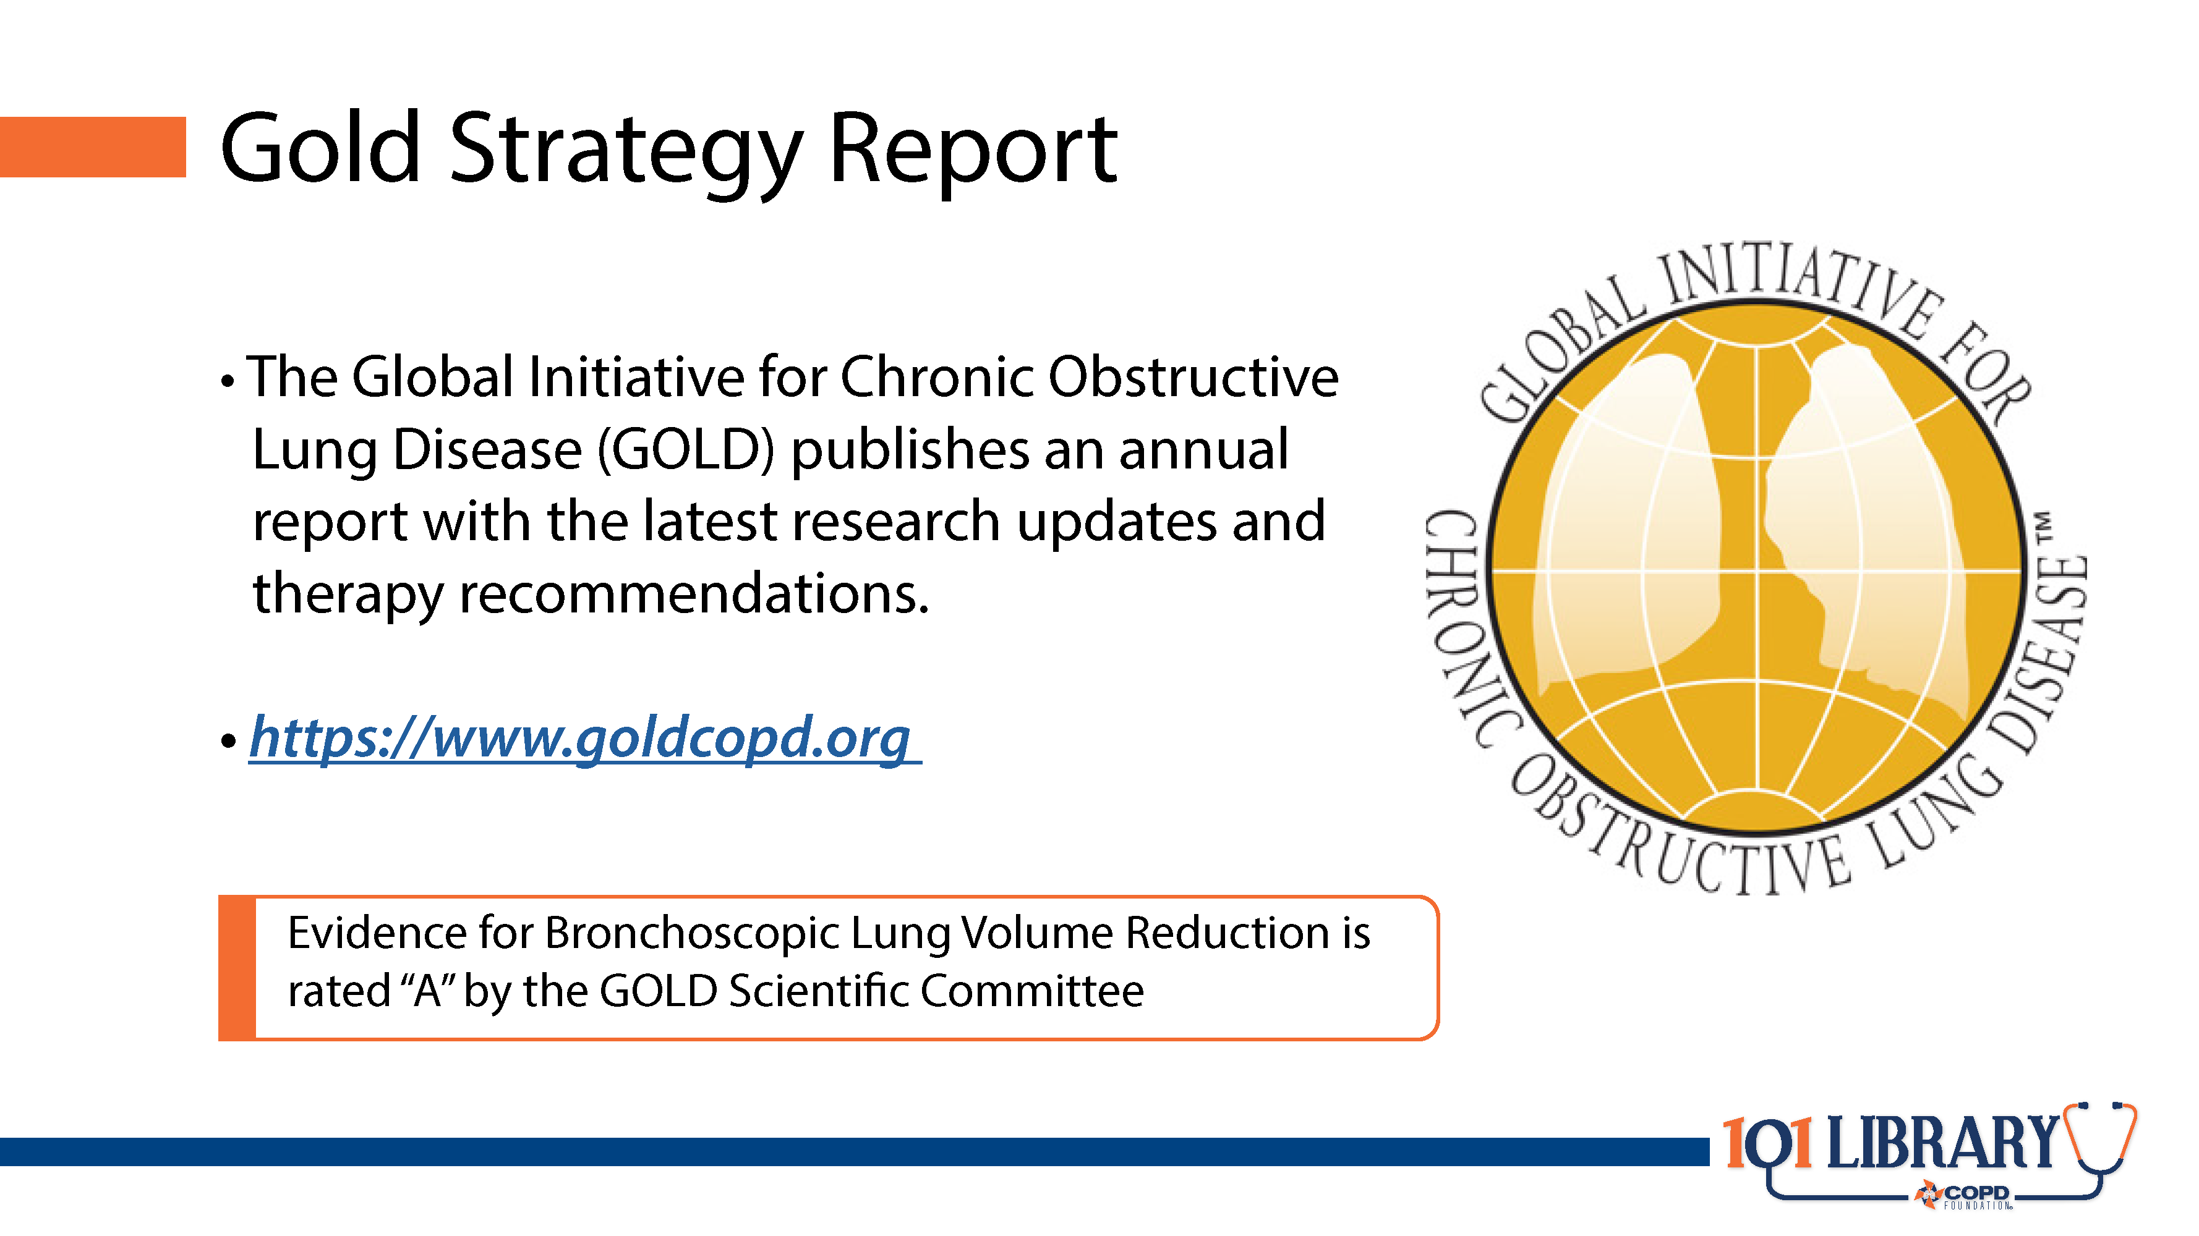

Slide 29
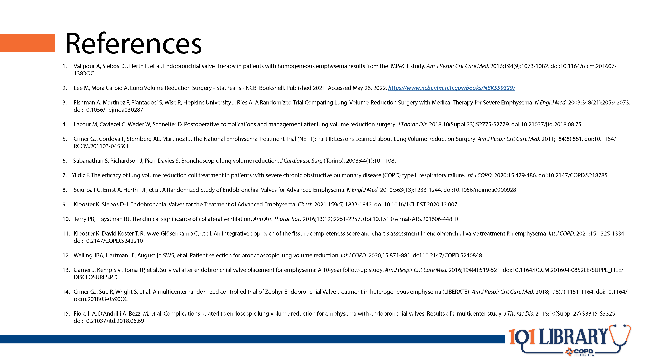

Slide 30


Slide 31
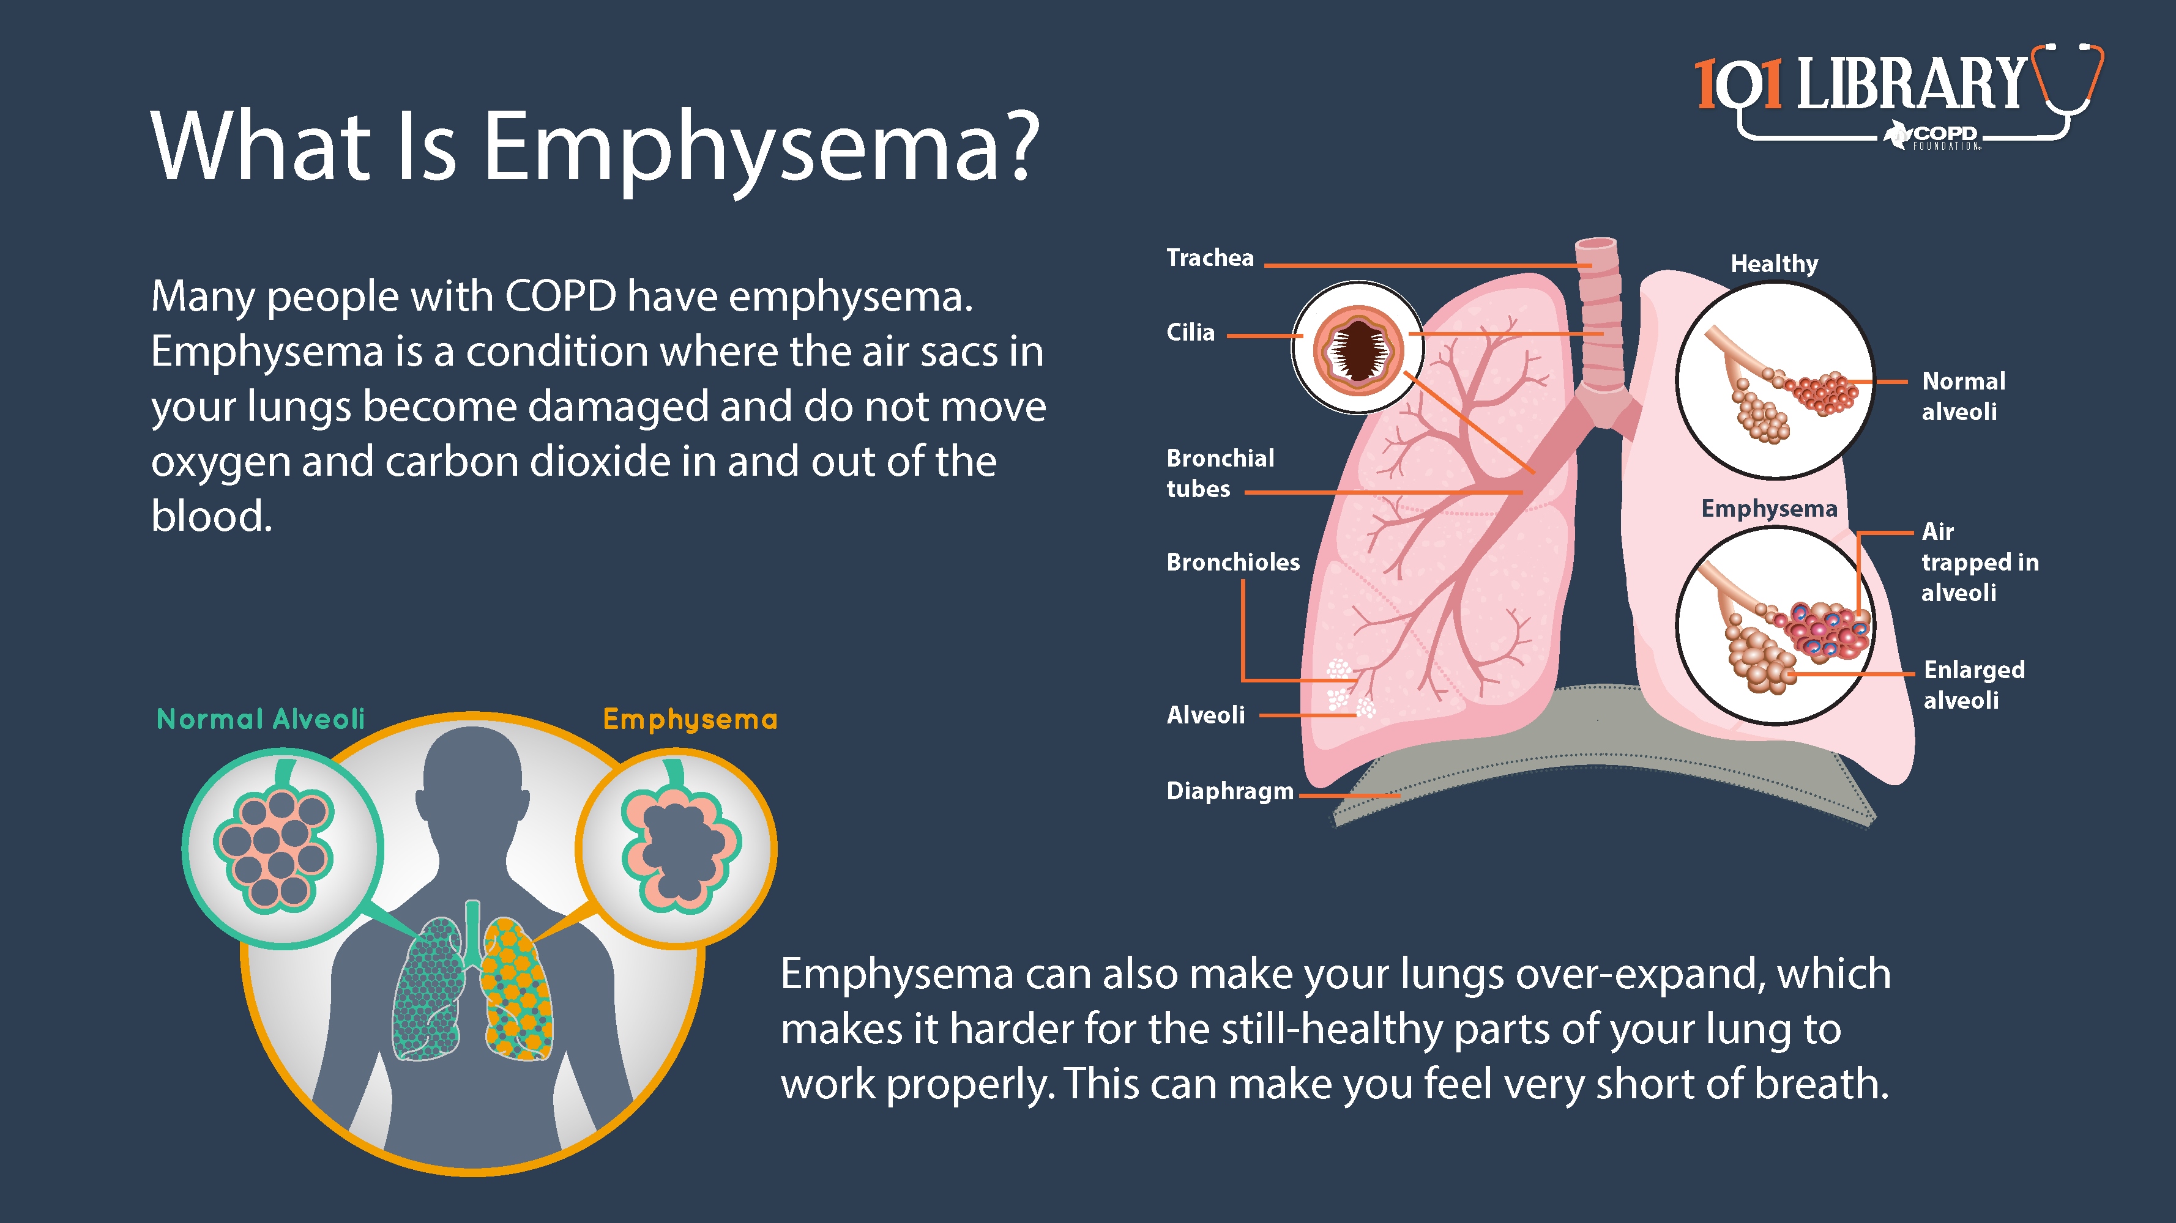

Slide 32
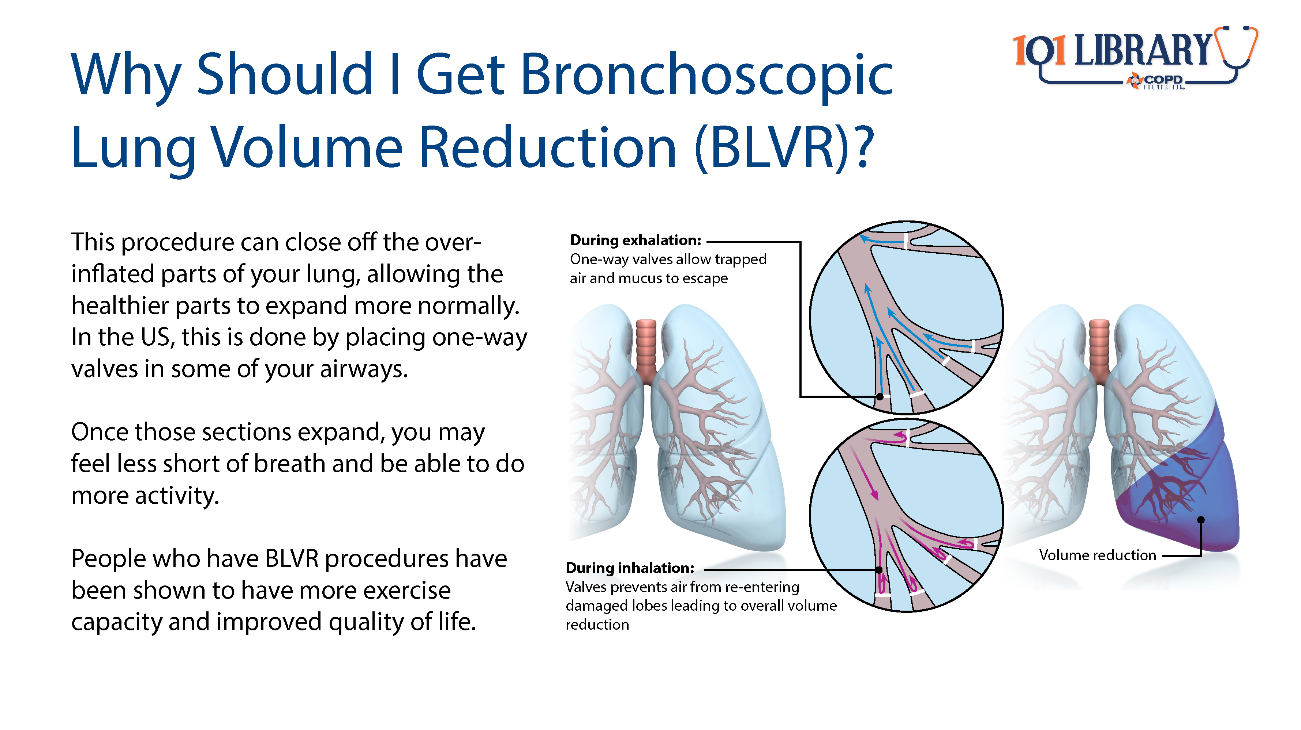

Slide 33
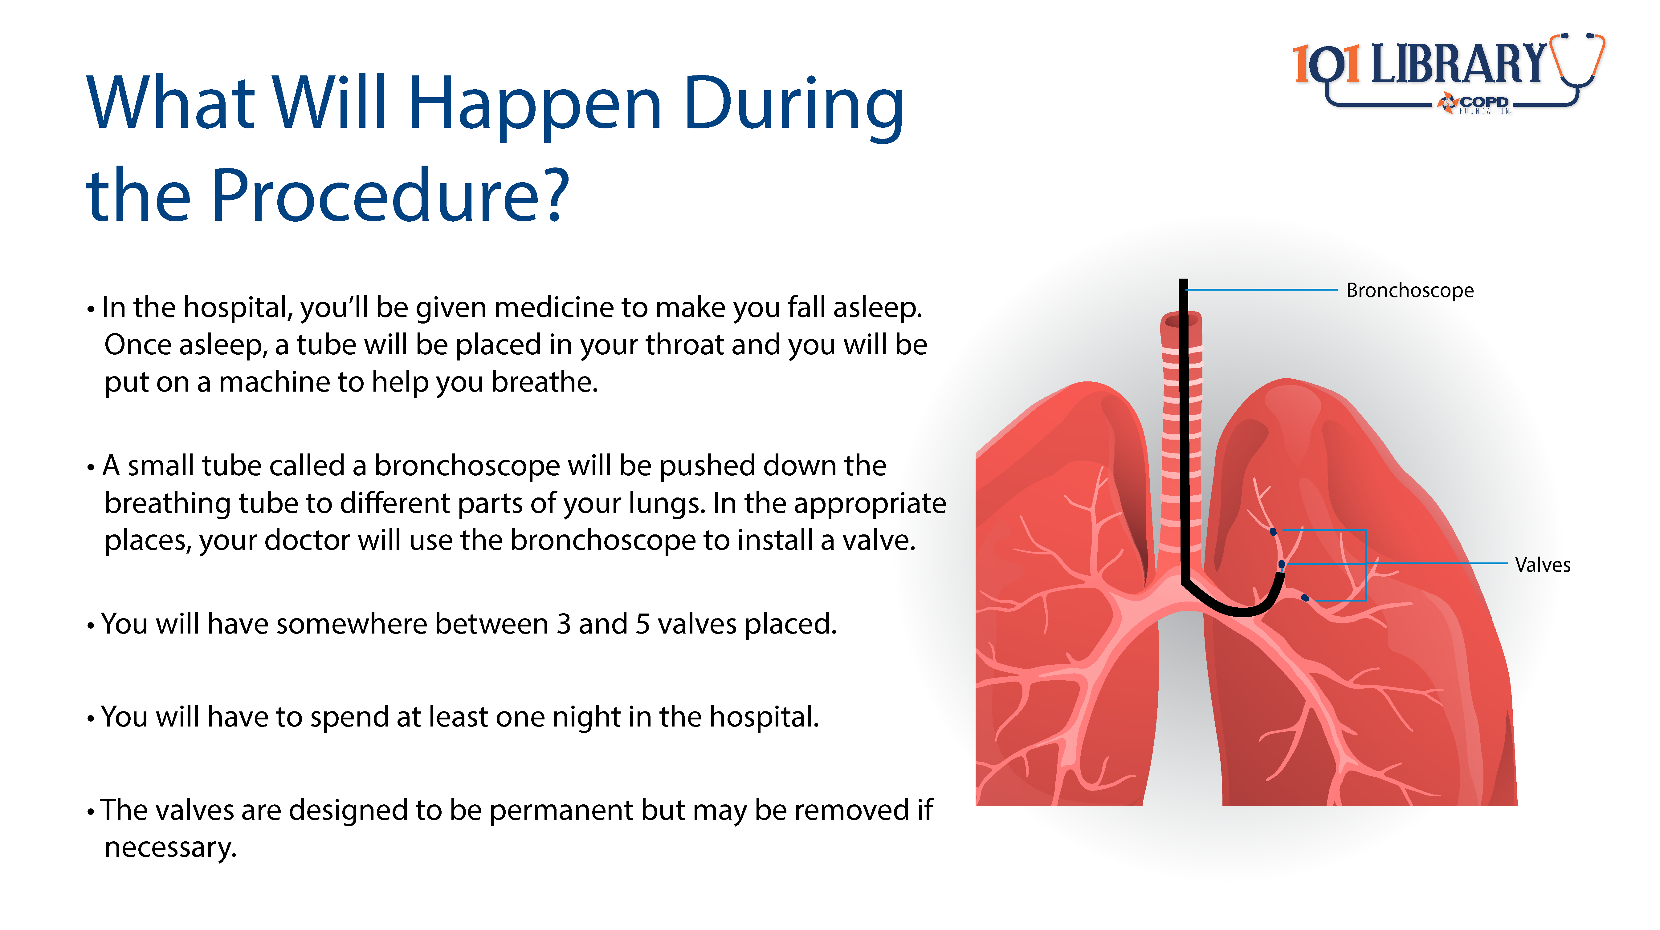

Slide 34


Slide 35
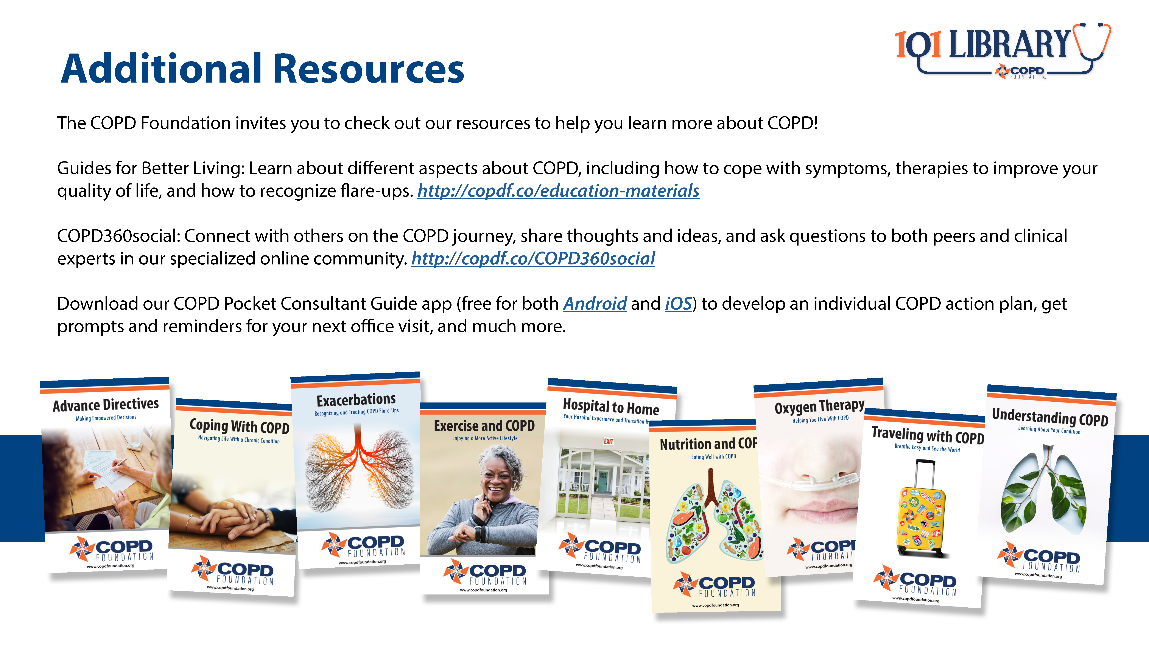

Slide 36

Notes:
This presentation was supported by Pulmonx.
For additional information or support, please contact the COPD Foundation at info@copdfoundation.org or 1-866-731-COPD (2673).

